Slide 1

Pressbooks Training Webinar series
Intermediate 4
Embedding and adding multimedia:
beyond the basics
Unless otherwise noted, this work is released under a CC BY. 4.0 International license. Feel free to use, modify, or distribute any or all of this presentation with attribution.
Notes:
Last updated: January 23, 2018, LA

Slide 2
Curriculum
Media overview
Adding images (video #8)
How to embed or link to videos (video #14)
How to embed or link to audio clips
Accessibility for media
Notes:
Here are our topics for today.

Slide 3
Pressbooks Video Tutorials
Found on YouTube
Throughout the Pressbooks Guide
(https://opentextbc.ca/pressbooks/)
See email sent to you containing information
about this webinar for links
Notes:
After this webinar, feel free to view videos #8 (how to add images) and #14 (embedding a video), and our other Pressbooks videos found on YouTube. These videos are also embedded throughout BCcampus Open Education’s Pressbooks Guide. See the emails you have received, regarding this webinar, for links to the Pressbooks Guide and videos on YouTube.

Slide 4
Lesson 1
Media Overview
Notes:
Let’s begin by defining media and looking at the Media Library in Pressbooks. The information for this lesson is taken, in part, from the Pressbooks Userguide (https://guide.pressbooks.com/) by Pressbooks.com, and used under a CC BY license.

Slide 5
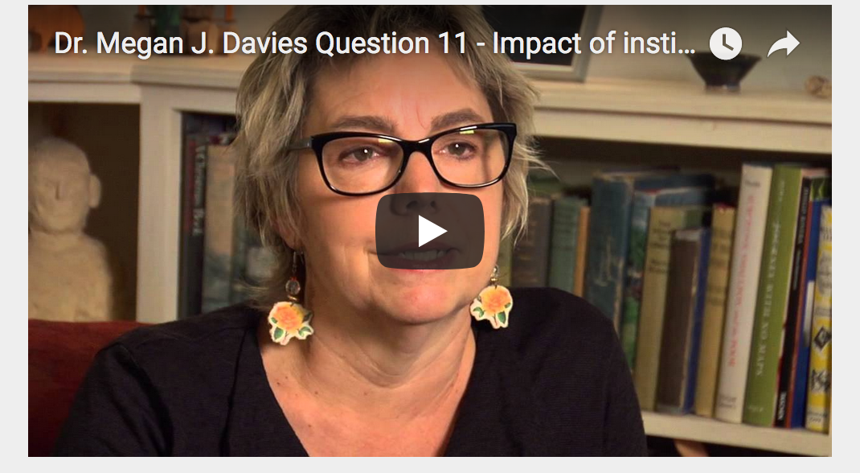
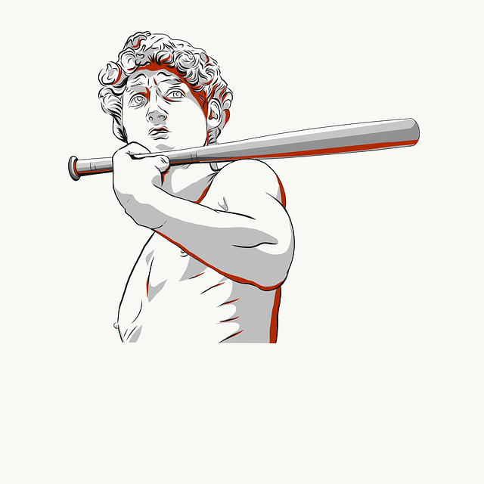
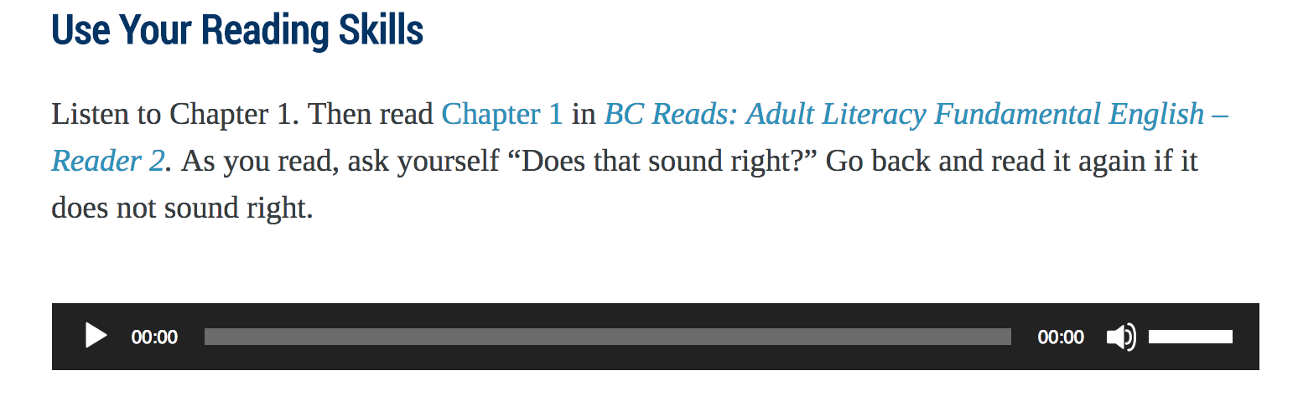
What are media?
video
image
audio
Notes:
Pressbooks allows you to add interactive elements to your book, which are collectively referred to as “media.” Pressbooks enables you to include three types of media in your book: images, video, and audio. All media file uploads permitted in the BCcampus OpenEd Pressbooks instance can be fairly large (48 MB); however, we recommend keeping them to 2 MB or less because large files delay the rendering of the book’s online version and slow down uploading of its PDF and other file types.

Slide 6
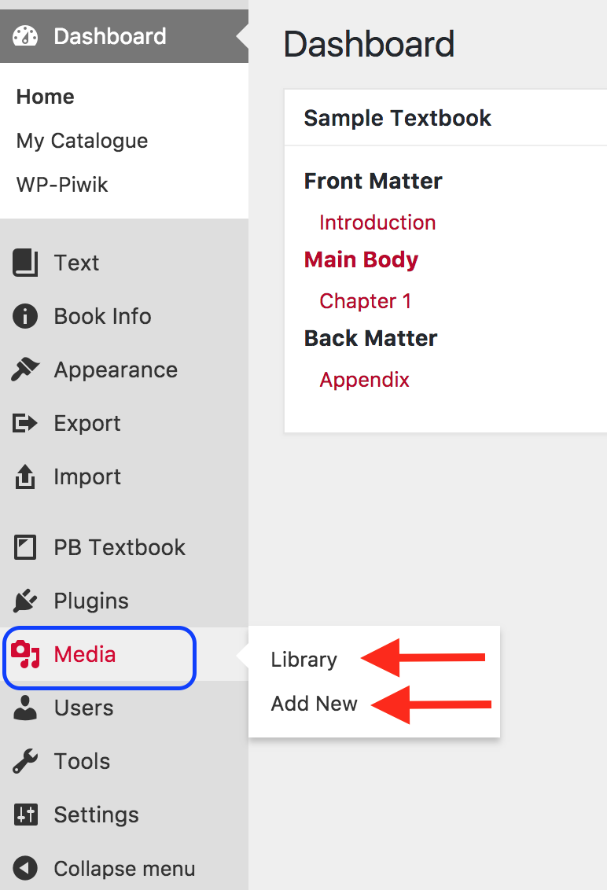
Media Library
Notes:
Most of media that will be added to your book will first be added to the Media Library. This library is accessed through the Dashboard of your textbook by hovering over the “Media” link which then displays the “Library” and option to “Add New” media.

Slide 7
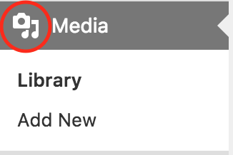
Notes:
Notice that the icon to the left of the “Media” label is a camera on top of music notes. This is a reminder that the Media Library is the place to upload images and audio files, but not typically video files. This will be explained later in the webinar.

Slide 8
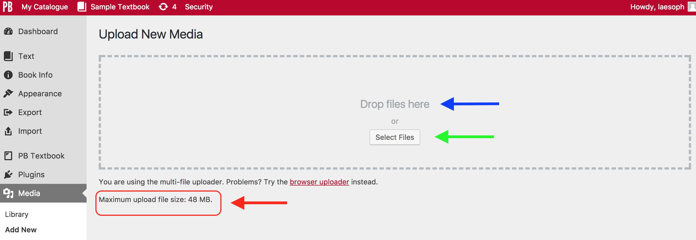
Media uploads and file size
Notes:
Here is the “Upload New Media” page. Take note of these items.
From this view, files can be added by either:
Dragging and dropping them into the “Drop files here” box (blue arrow) OR
With the “Select Files” button
The maximum file size is noted at the bottom. This is good information to have in the event you have problems uploading a file. The “Maximum upload file size” for this account is 48 MB.
Also take note that if you wish an image to display within your textbook, be sure it is added as a JPG, PNG or GIF file. A PDF file will not display as an image. However, you can link to it from the textbook body. (More on this later.)

Slide 9
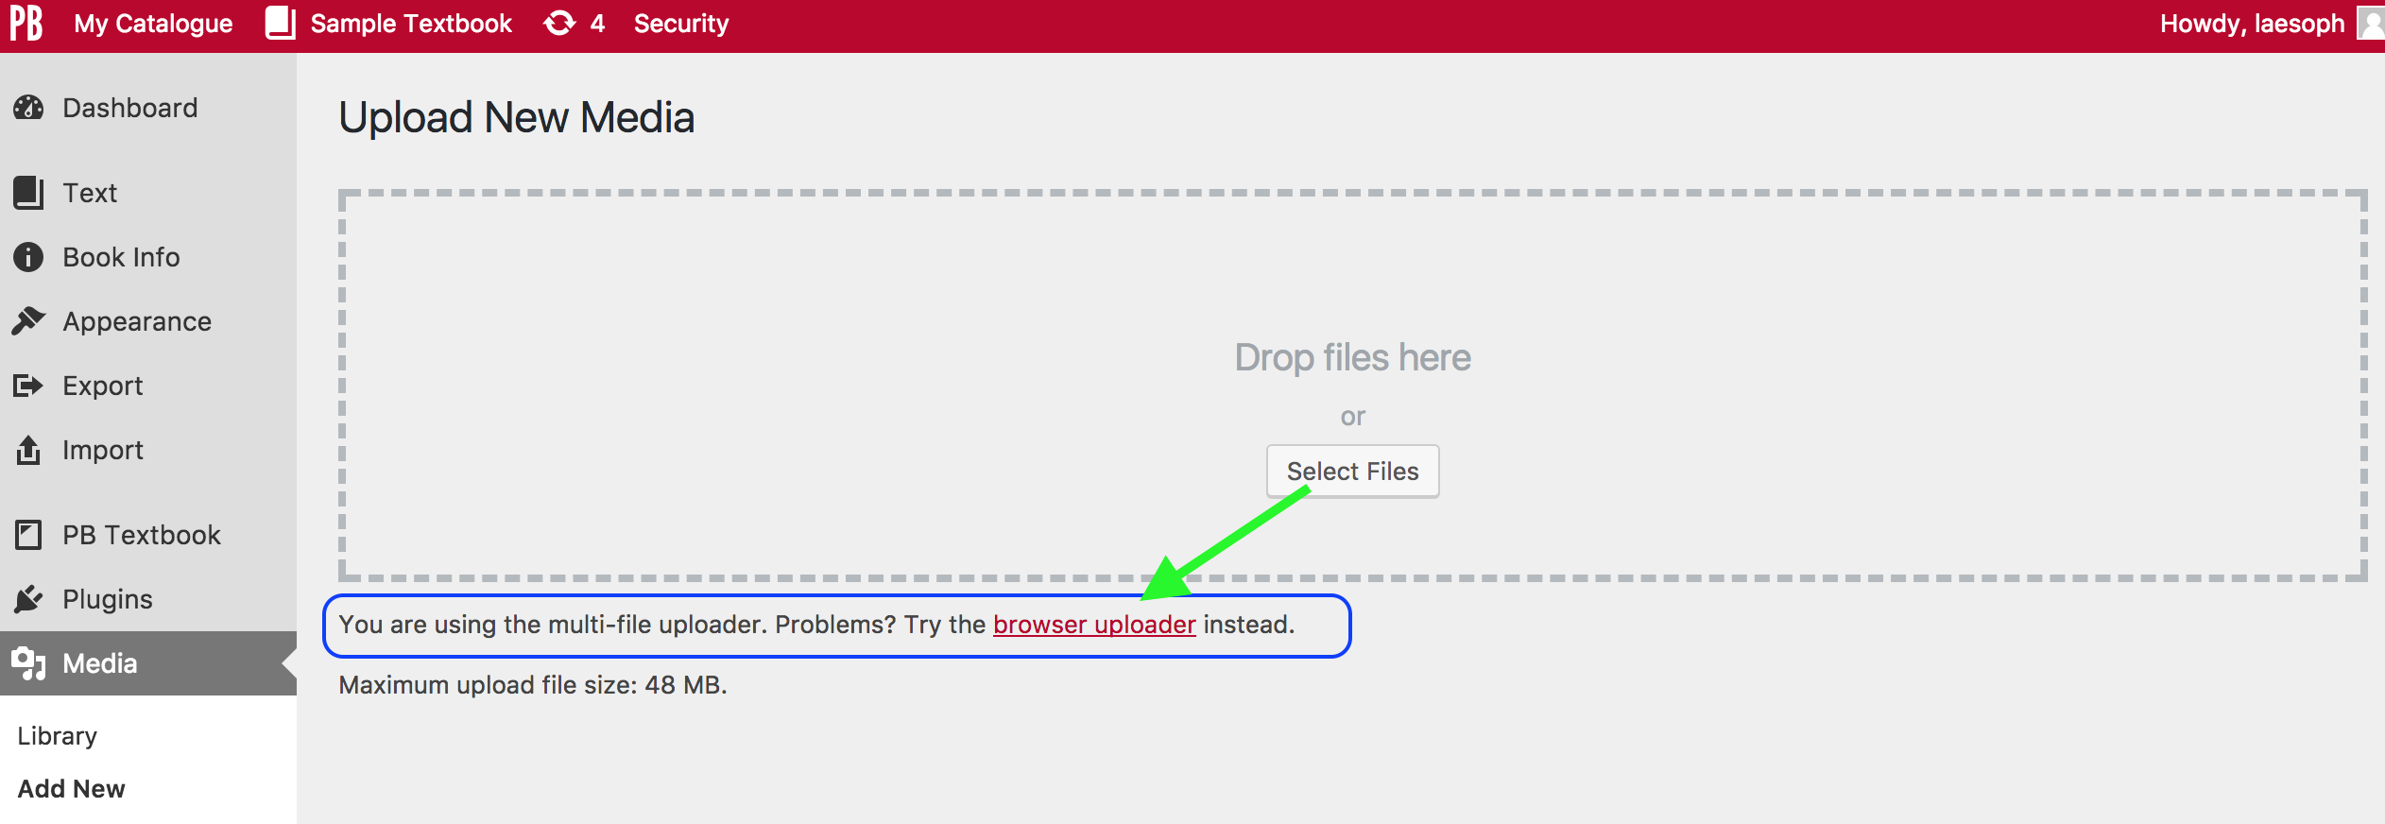
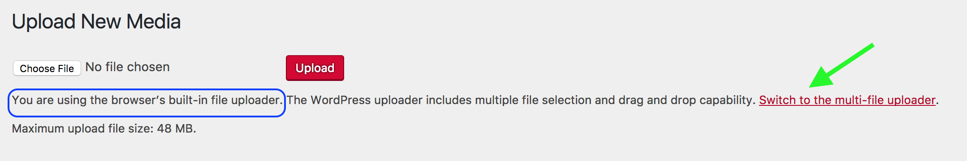
Multi-file uploader vs. browser uploader
multi-file uploader
browser/single file uploader
Notes:
Notice that you have the choice to upload several files at one time with the “multi-file uploader” OR if that doesn’t work, you can switch to the “browser uploader”. The browser uploader only allows a single file to be selected and uploaded at a time.

Slide 10
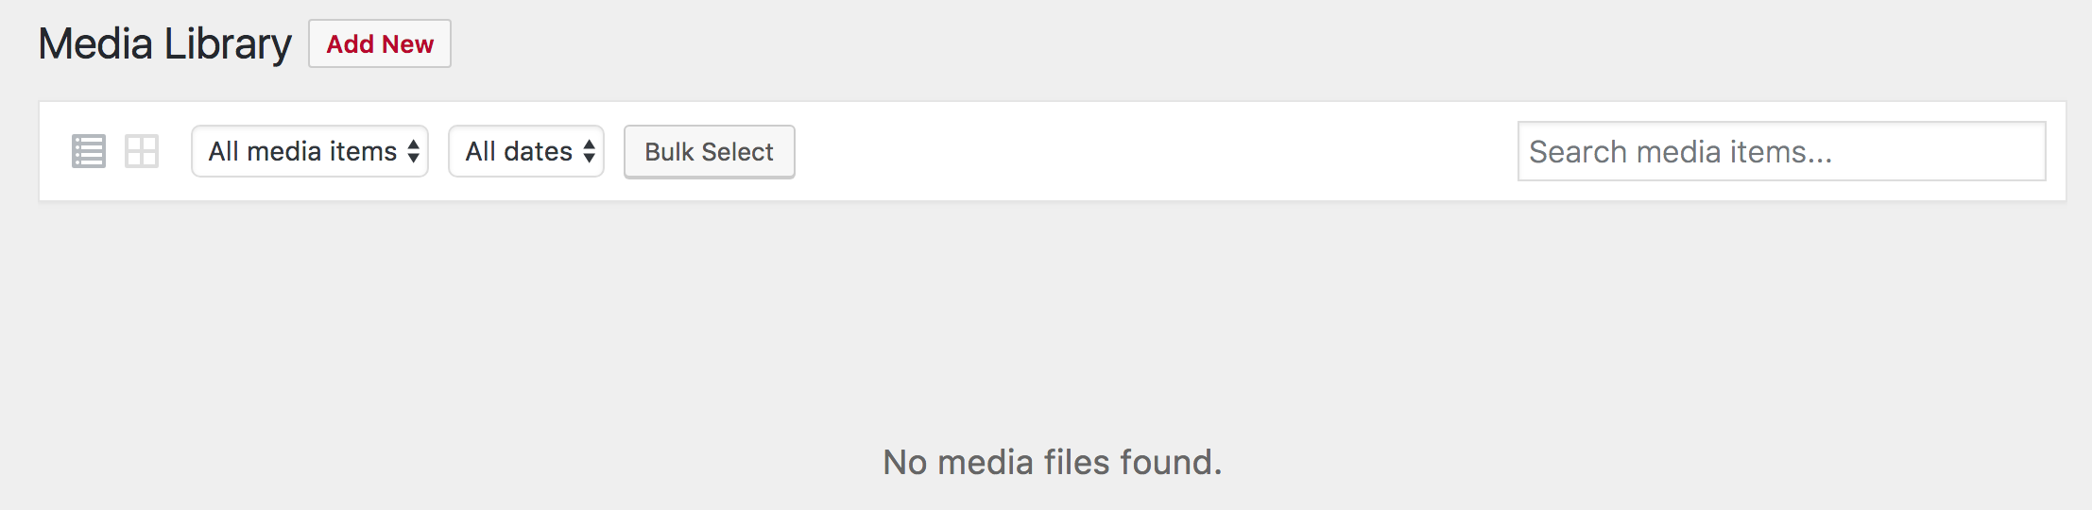
Media Library
Notes:
Before you begin adding images and other media to the Media Library, this is what you’ll see….
NEXT SLIDE

Slide 11
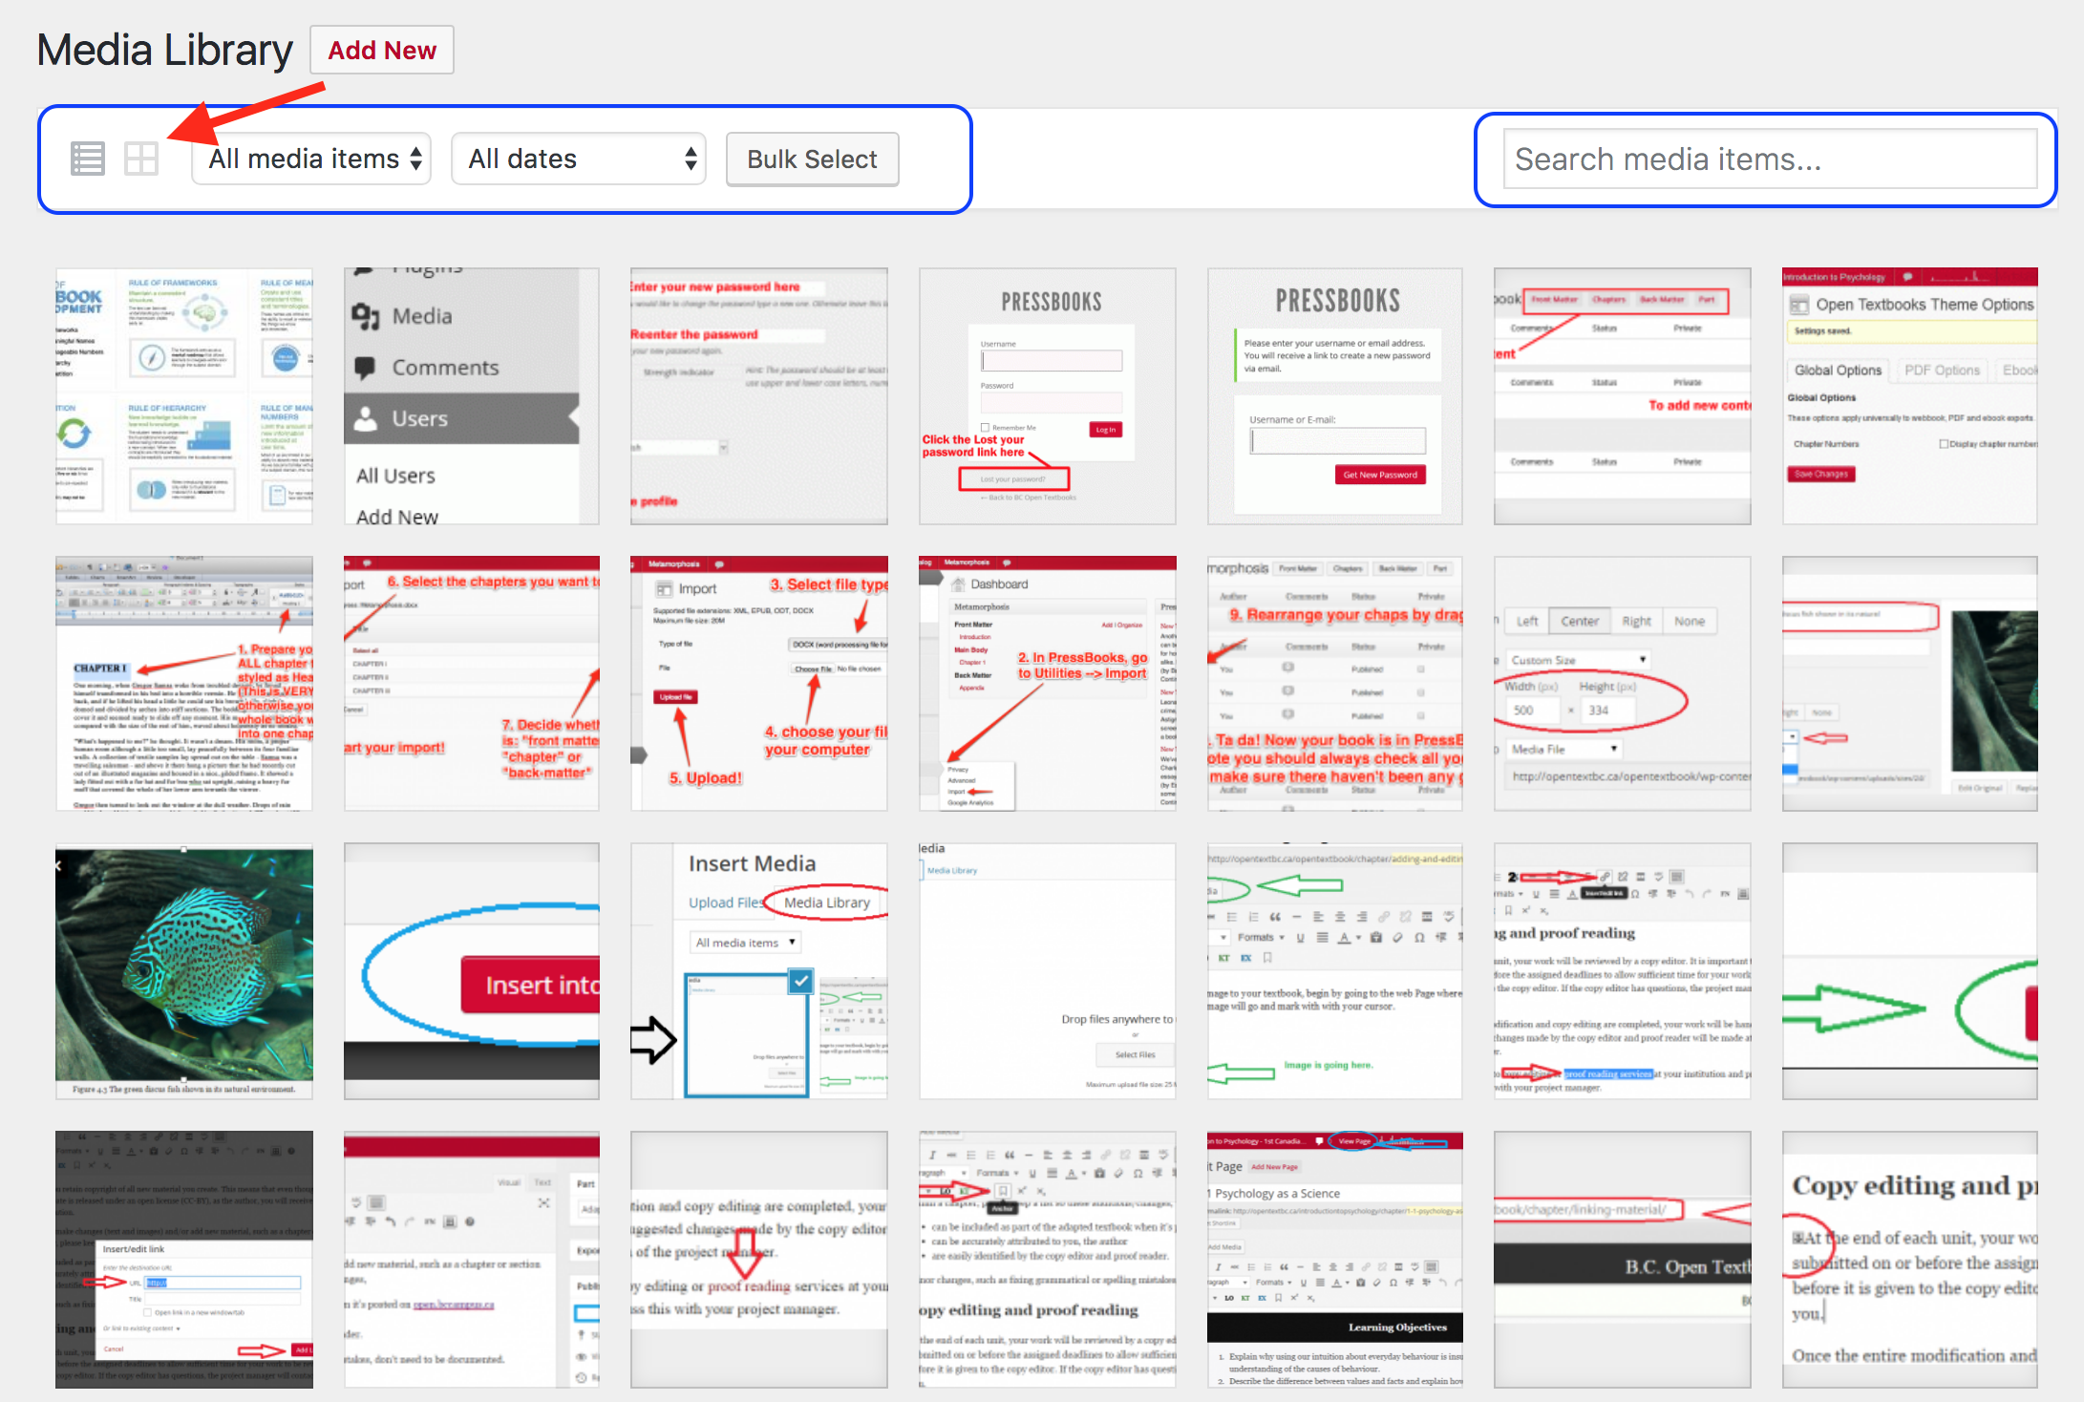
Notes:
Once you begin to populate the library, you can start using the various settings circled in blue to view and search for specific items. For example, this is the “grid” view. It is the default view, but can also be selected using the “grid” icon by the red arrow.

Slide 12
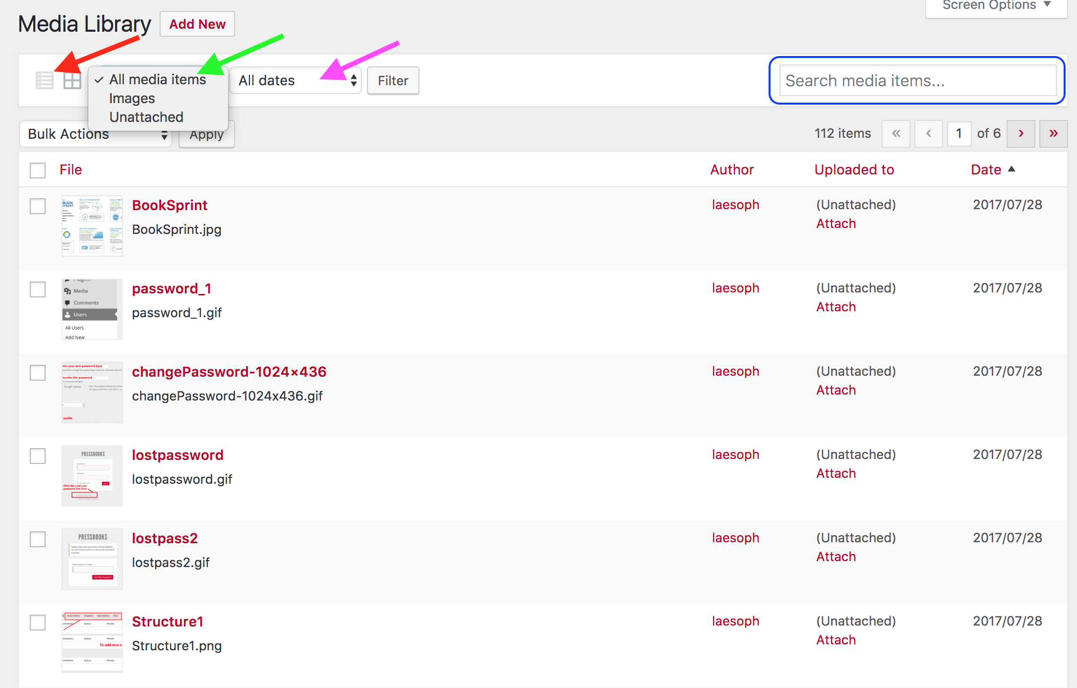
Notes:
This is the “list” view. You can select this using the “list” icon by the red arrow.
The green arrow points to the dropdown list that allows you to reveal:
“All media items”. You can also search for specific media items in the Search field to the far right (circled in blue).
“Images” only OR
All “unattached” media. Attached media are those for which a link is used, within the textbook’s body, and to a targeted medium within the library. An example will be provided later.
The “All dates” dropdown menu provides a list of dates, by month and year, of periods during which media has been added to this library. This view will allow you to look back at the times when media is added. This can be helpful when you want to update outdated items.
These options are also available in the “grid” view.

Slide 13
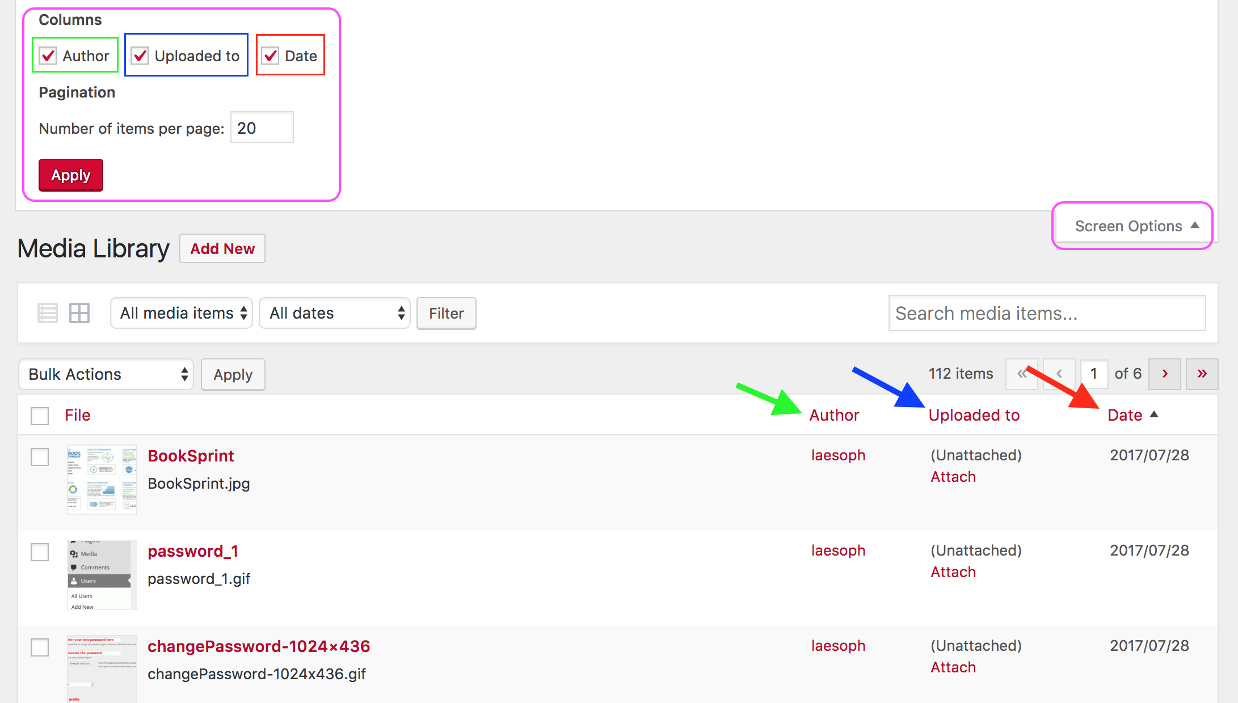
Notes:
For more information and to reorganize the media in your book’s library, open up “Screen Options” (circled in pink on the upper right side). This will reveal:
Columns that you’d like to see by:
“Author” (this is another name for the “Users” who has access to this book)
“Uploaded to”, which indicates whether or not the item has been attached or embedded within the textbook’s body
“Date” when the item was added to the library.
Pagination and the “Number of items per page” that are displayed when viewing the Media Library when using the “list” view.
Notice too that you can re-sort each column (Author by the green arrow; Uploaded to by the blue arrow; Date by the red arrow) by clicking on the column name.

Slide 14
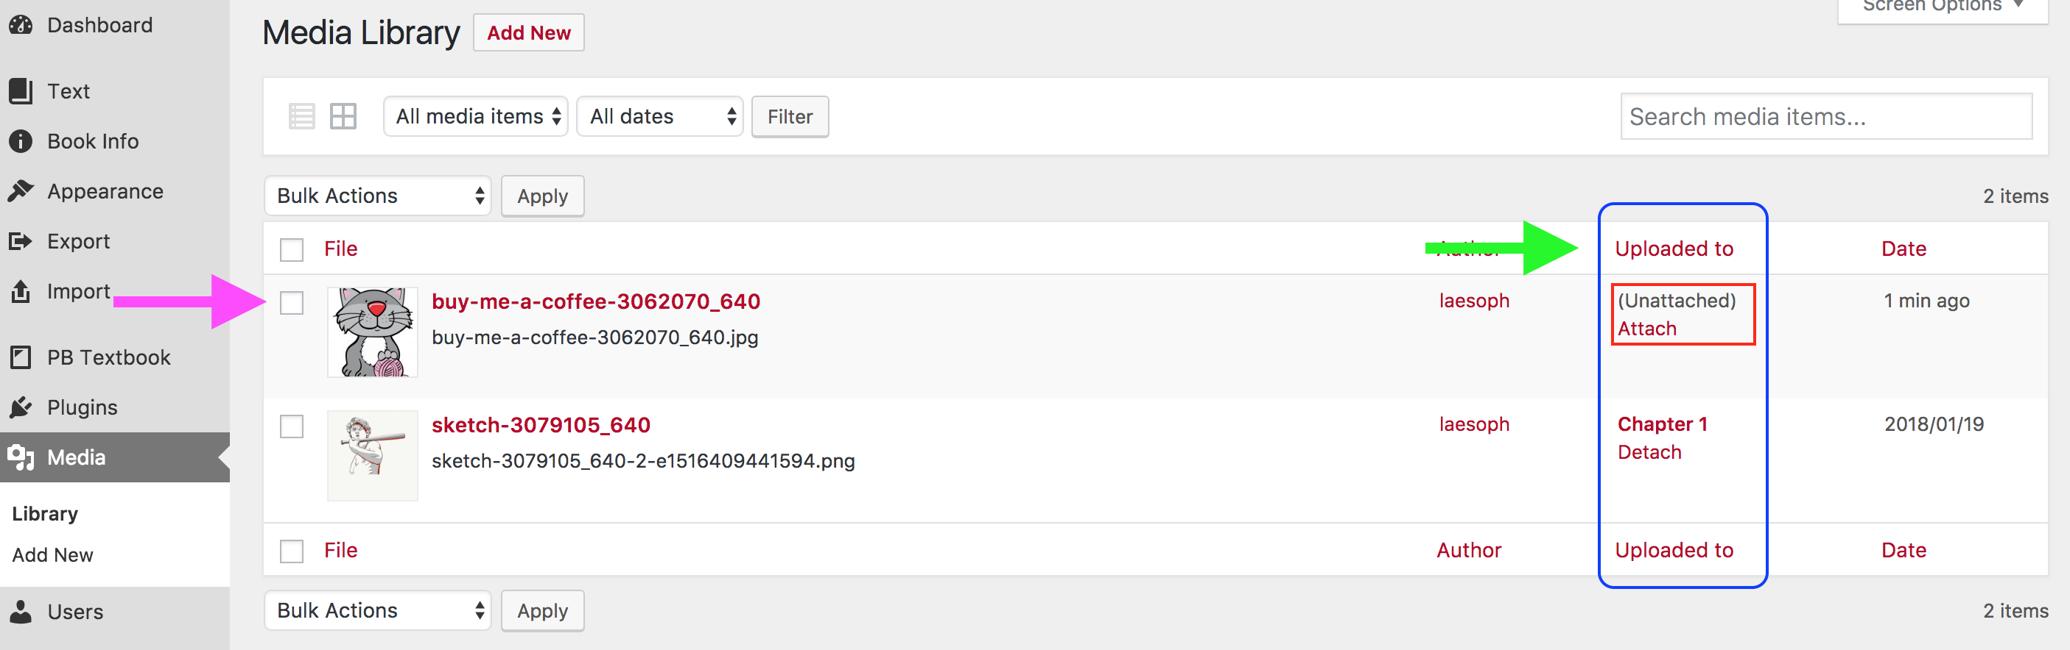
Attach, detach, remove media
Notes:
Interesting features are those that allow you to attach or detach an image (in the column by the green arrow) and remove an image (by the pink arrow).
NEXT SLIDE

Slide 15
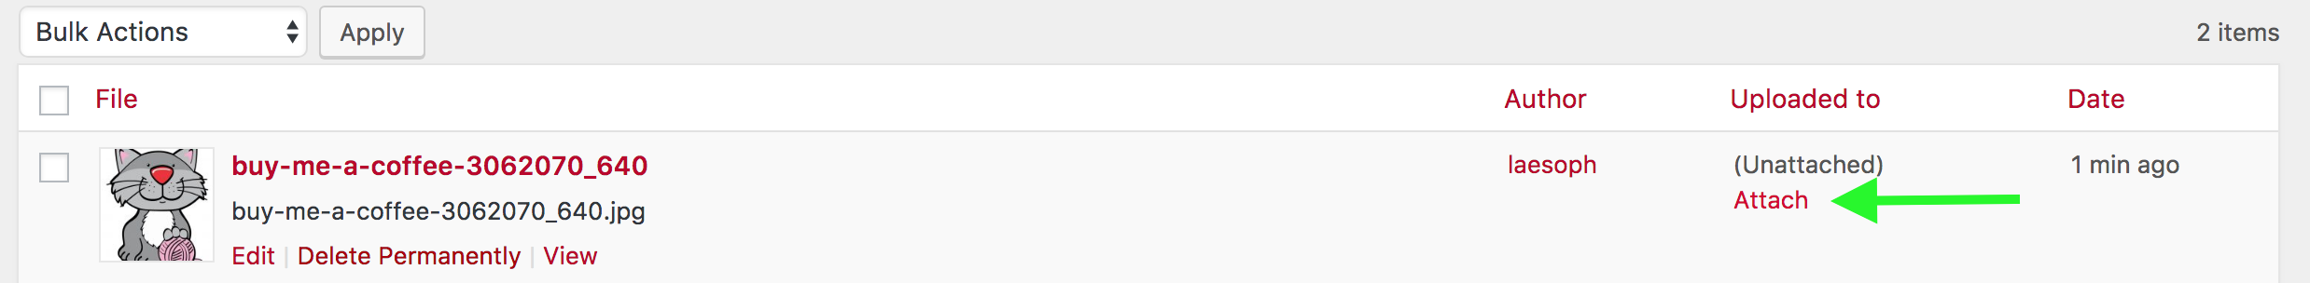
“Detach” function
“Attach” function
Notes:
When a “Detach” link is listed by an image (see blue arrow) this indicates that the image is, in fact, attached to a webpage within the textbook. The “Detach” link is the feature that presumably allows you to detach the image from that page (but does not remove it from the Media Library).
Similarly, the “Attach” link by an image (see green arrow) indicates that an image is not attached, or is in fact detached, to a webpage in the textbook. The “Attach” link is the means by which you should be able to attach this image to a specific webpage or chapter in your book.
Unfortunately, we have found that the “Attach” and “Detach” functions do not work as designed. We are investigating this problem.

Slide 16
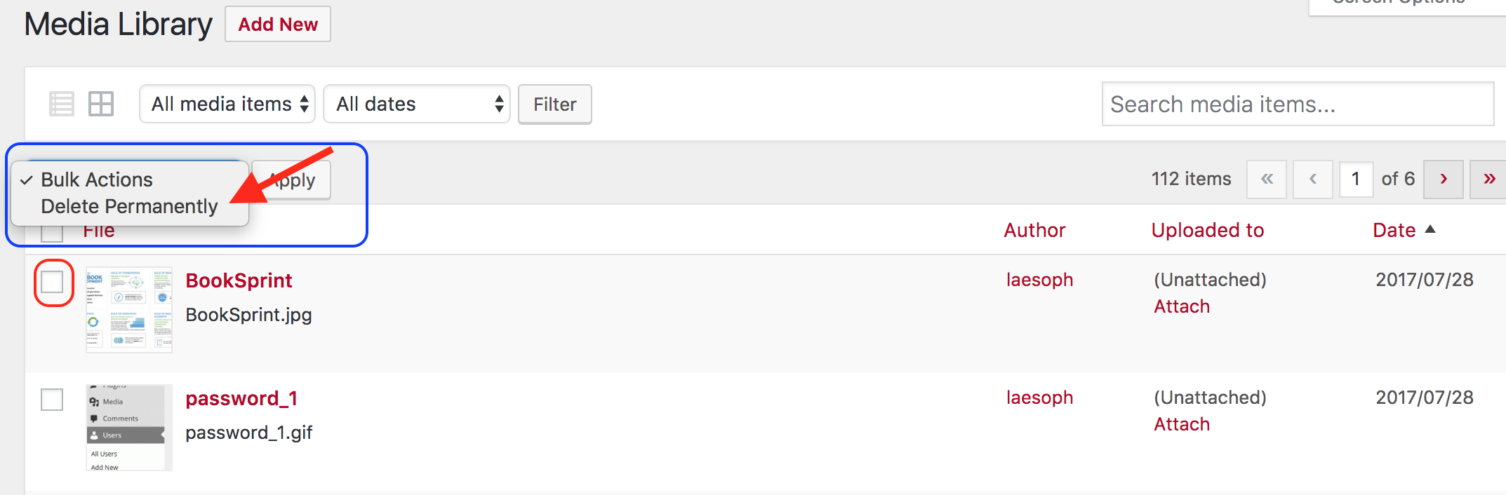
“Delete permanently” function
Notes:
The delete function does work well.
If you reveal the “Bulk Actions” dropdown list, the “Delete Permanently” option appears. This is useful when you want to remove several media items at the same time. To do this,
Choose “Delete Permanently”
Mark the checkbox by each item to delete
Click on the ”Apply” button

Slide 17
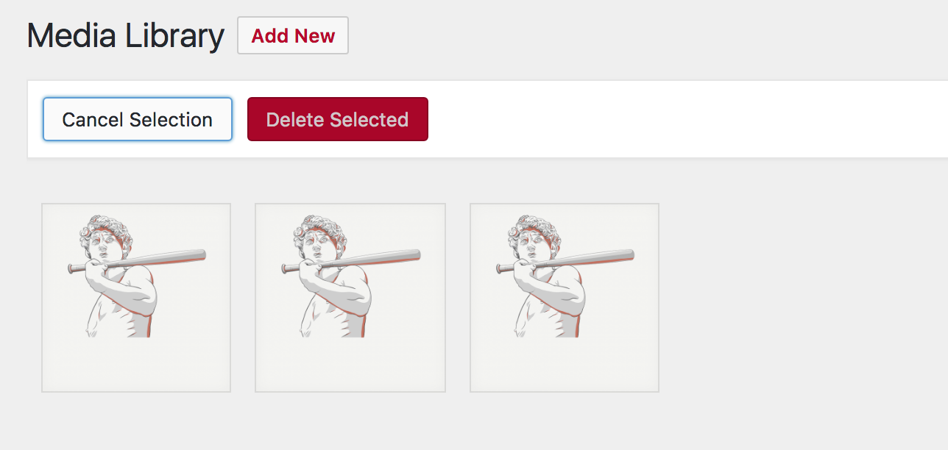
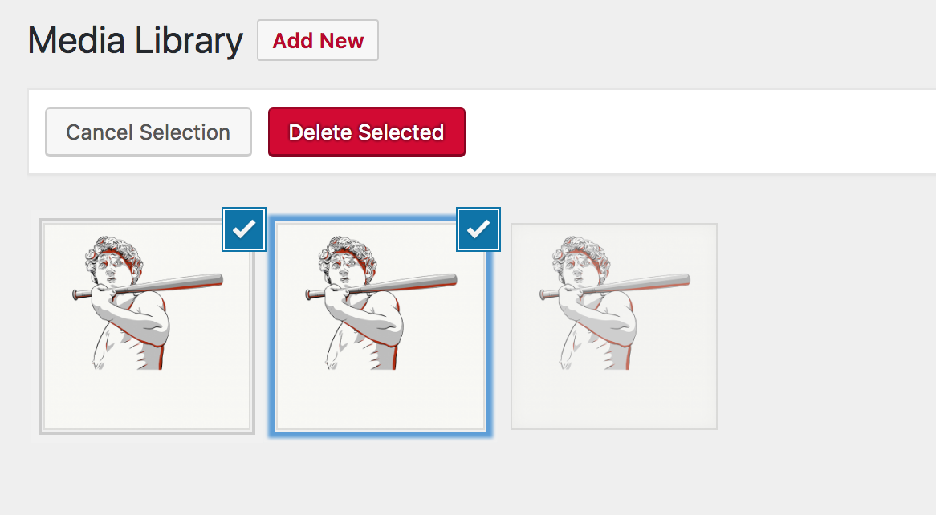
Notes:
This is what it looks like from the “grid” view.

Slide 18
Lesson 2
Everything you need to know when
Adding Images

Slide 19
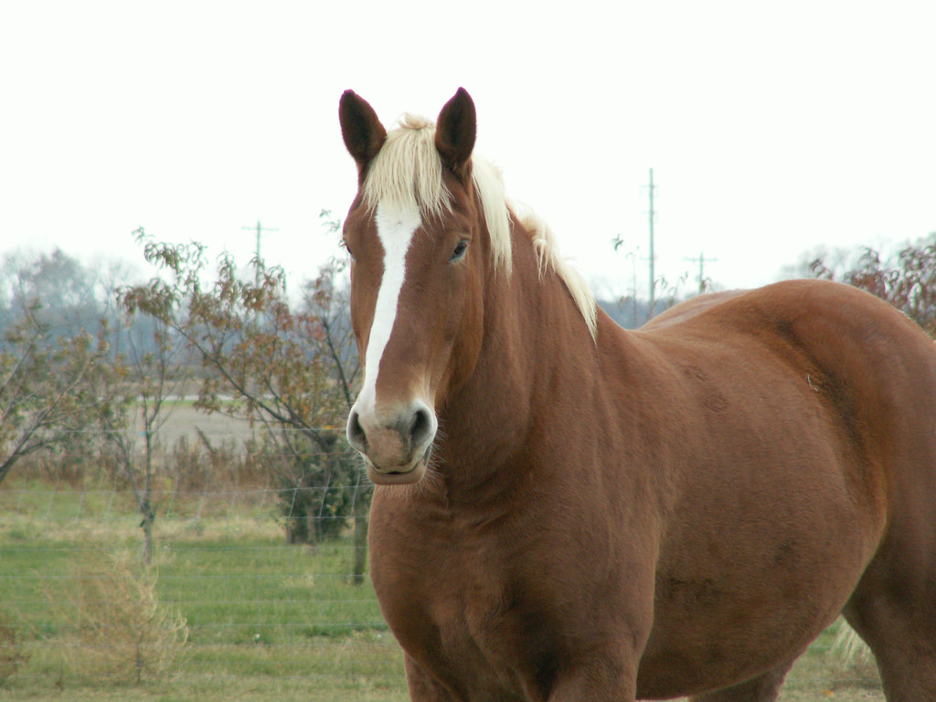


What is an image?
clip art
photo
Horse by Cindy Funk is used under a CC BY 2.0 license.
vector graphic
illustration
Notes:
We define an image as any non-text, static resource such as a photo, illustration, clip art, icon, vector graphic, or symbol.

Slide 20
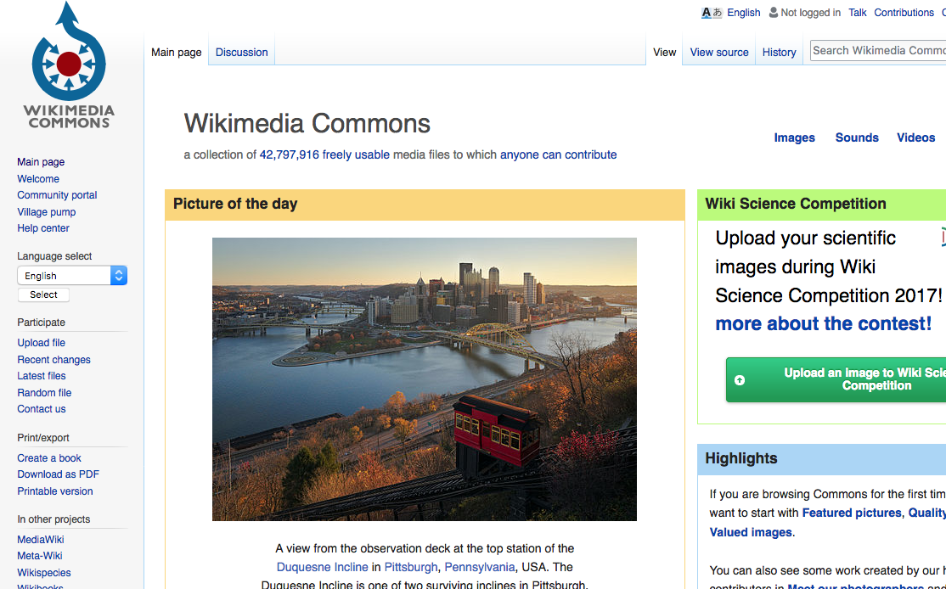
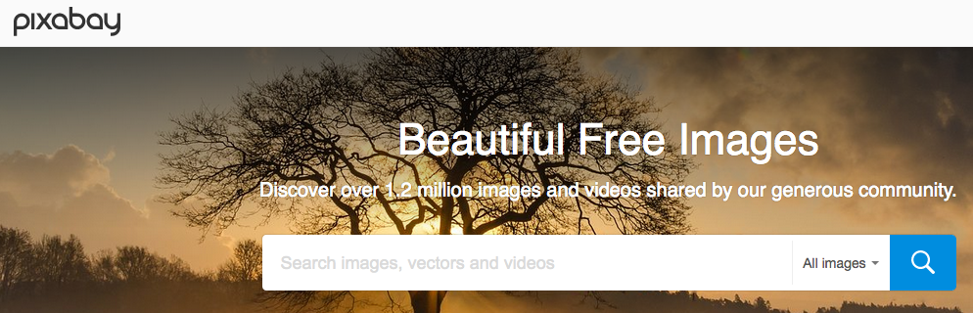
Where do images come from?
commons.wikimedia.org
pixabay.com
Notes:
Typically, open textbook authors rely on repositories like Wikimedia Commons and Pixabay for images covered by an open copyright license or in the public domain.
Wikimedia contains media available in the public domain and are available under a variety of open copyright licenses.
Pixabay contains copyright free images and videos. All contents are released under Creative Commons CC0 and are in the public domain.

Slide 21
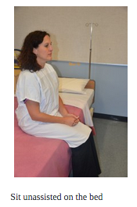
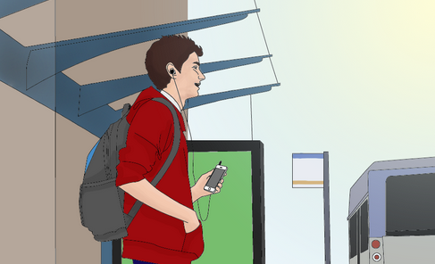
Original creations
2. Original illustration from the
B.C. Open Textbook Accessibility Toolkit
1. Original photo from
Clinical Procedures for Safer Patient Care
Notes:
You can also choose to create or hire someone else to create original resources, as long as the creator understands that the item will be released under an open copyright (Creative Commons) license. These might be photos, illustrations, or other images or objects. Here are a couple of examples:
All photos used in the Clinical Procedures for Safer Patient Care textbook were taken by the authors.
Many of the illustrations in the B.C. Open Textbook Accessibility Toolkit were original drawings created by a contracted illustrator.

Slide 22
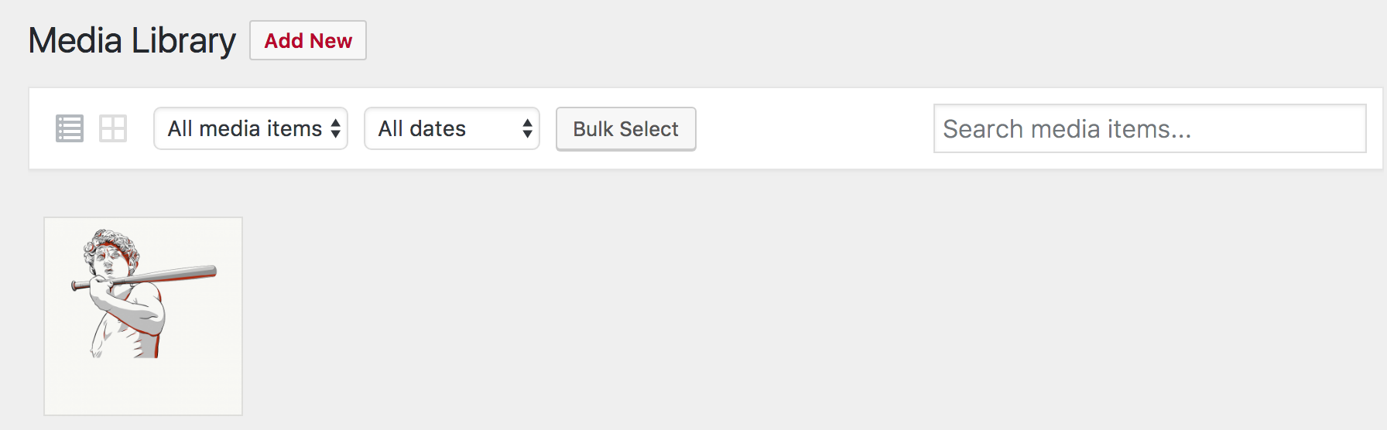
Add an image directly to the library
Select method to add image
Image in the Media Library
Notes:
To add an image to the Media Library, select the method you’d like to use.
You can drag files from your computer onto this screen.
Or, click on “Select Files” to browse for the correct media files on your computer. Click on the file names and the files will upload.

Slide 23
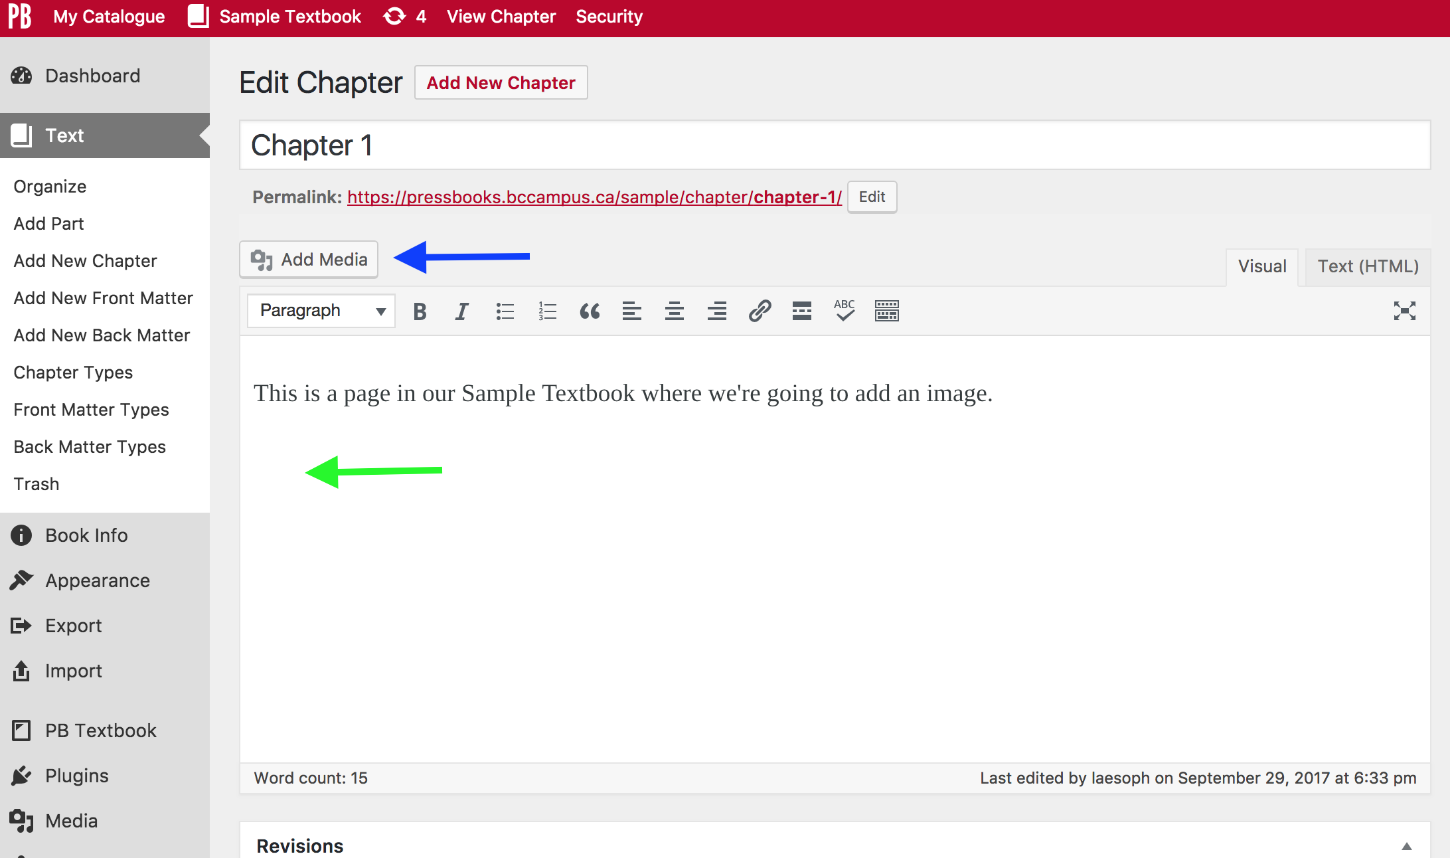
Add image to the book from library
Notes:
Next, go to the chapter or part where the image will be placed in the textbook (green arrow). Begin by clicking on the “Add Media” button by the blue arrow…
NEXT SLIDE

Slide 24
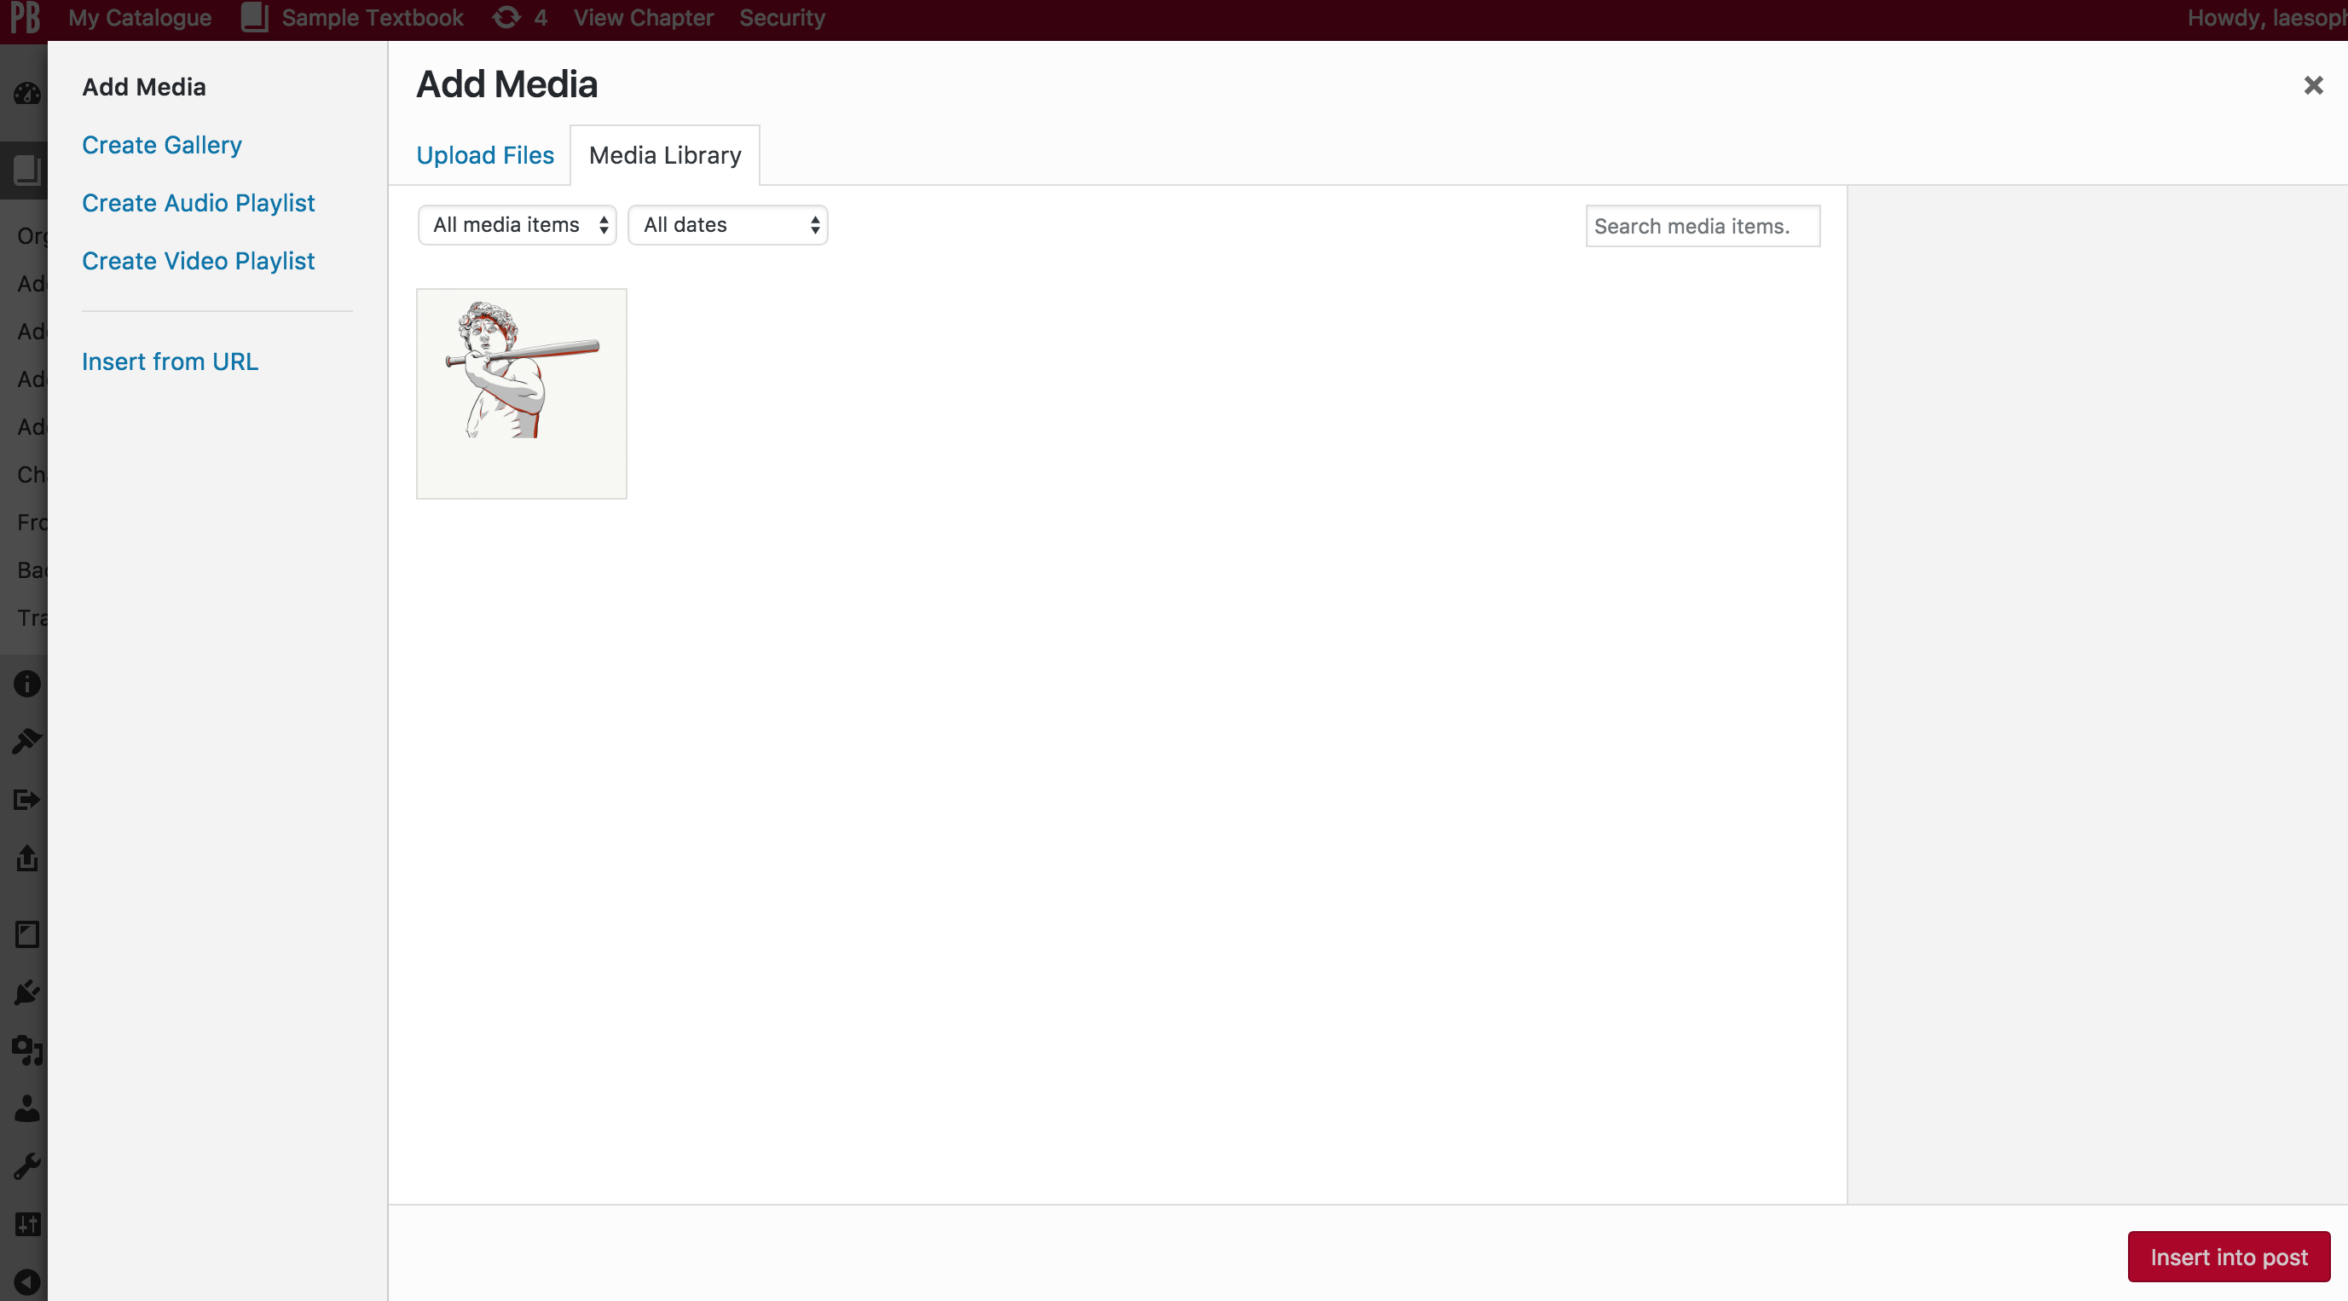
Notes:
…and you’ll be redirected to the Media Library…
NEXT SLIDE

Slide 25
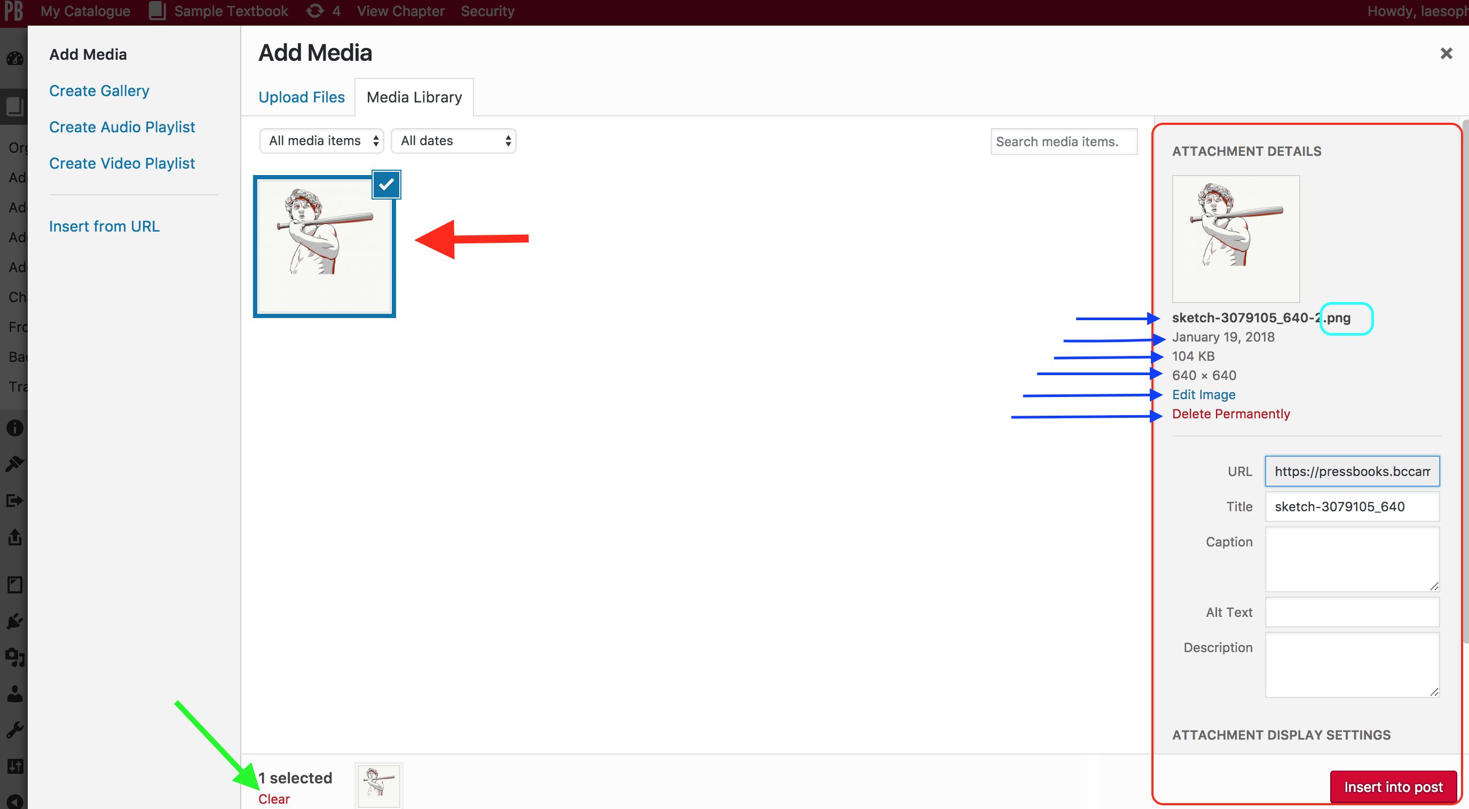
Notes:
….where you can select the image to insert into your book.
Notice that by selecting the image, the “Attachment Details” panel pops up (circled in red, on the right).
This panel provides details about your image such as,
The file name; notice that this is a PNG file
The date the image was added to the Media Library
The file size (104 KB)
The image dimensions
Functions include:
An ”Edit Image” link
A “Delete Permanently” link – a warning message will appear asking if you’re sure.
A “Clear” link (by the green arrow) will unselect the image for posting.

Slide 26
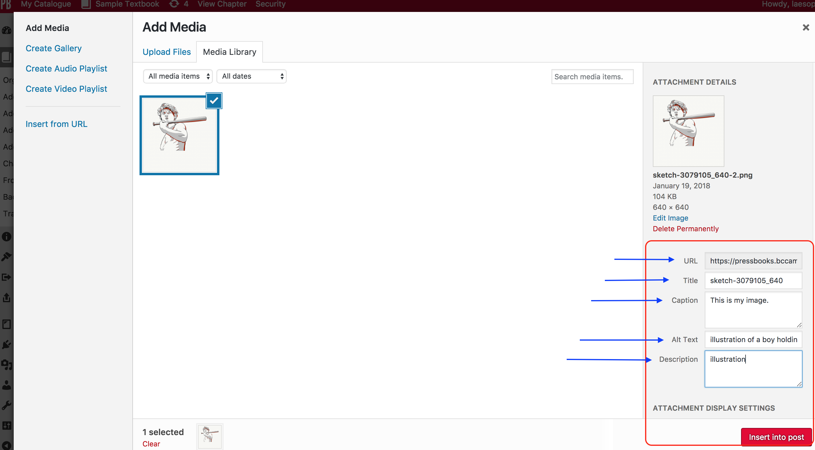
Notes:
You can also choose to make additions and changes to the image before posting through the “Attachment Display Settings” (circled in red, in the right, lower corner).
Here you’ll see:
The URL for the image in your book; don’t touch this.
The Title: here Pressbooks has used the file name, minus the file extension, as the name. This you can change.
The Caption: this will appear under the image once it’s posted in the book.
Alt Text: a description of the image can be added for accessibility. (This will be discussed in more detail later on.)
Description: authors often use this field to record information about the image that they want to refer to later such as the license type or URL to its source.
NOTE: It’s difficult to access this field once an image is posted because tt is not viewable via the Edit icon from the post. Instead, you need to locate and view the image from the Media Library.

Slide 27
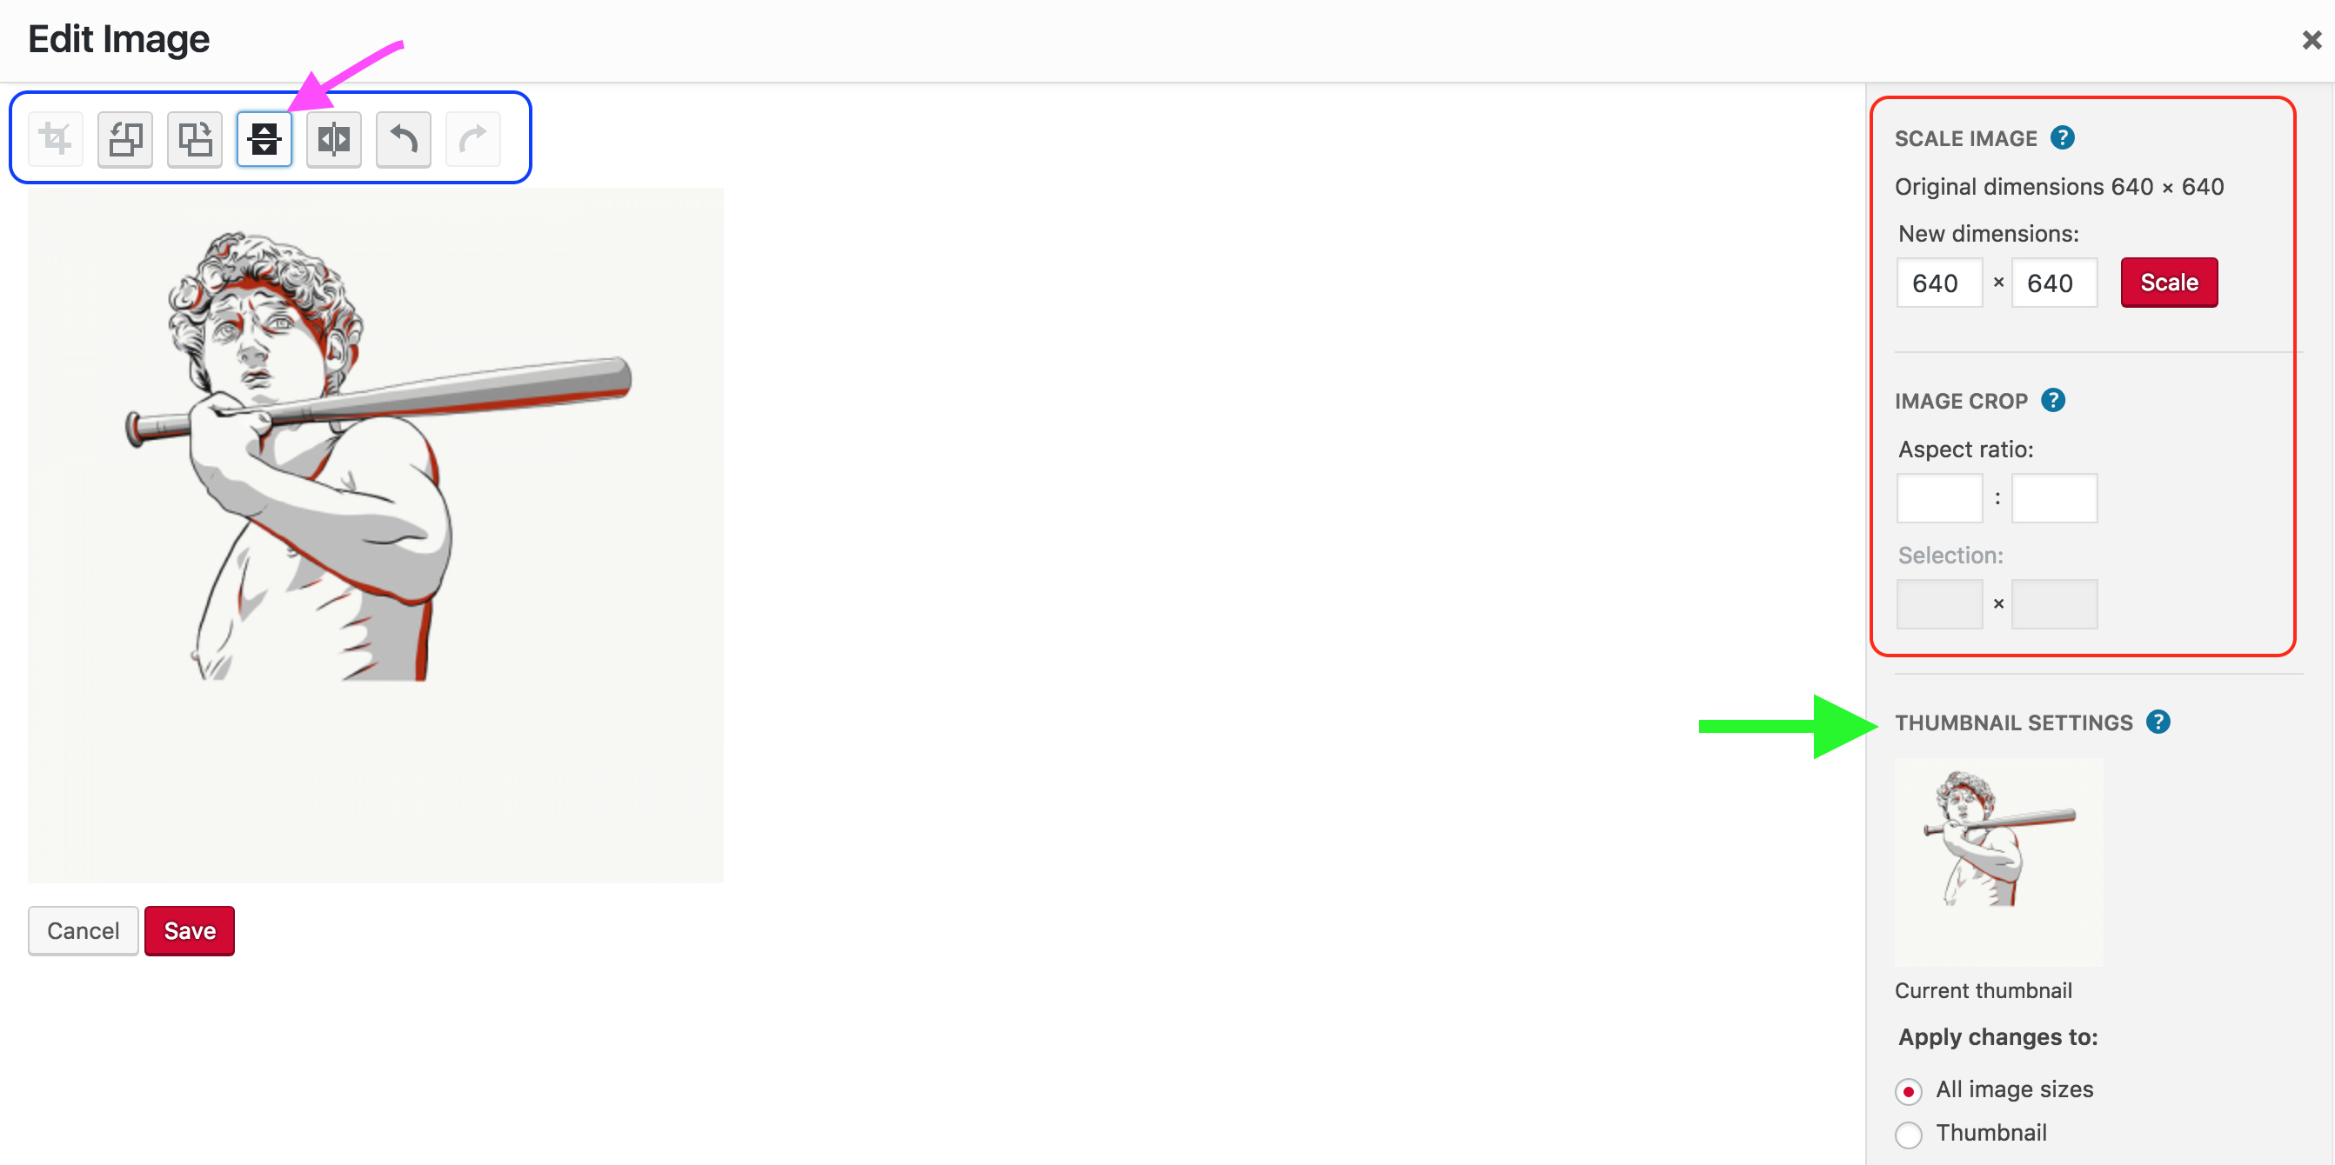
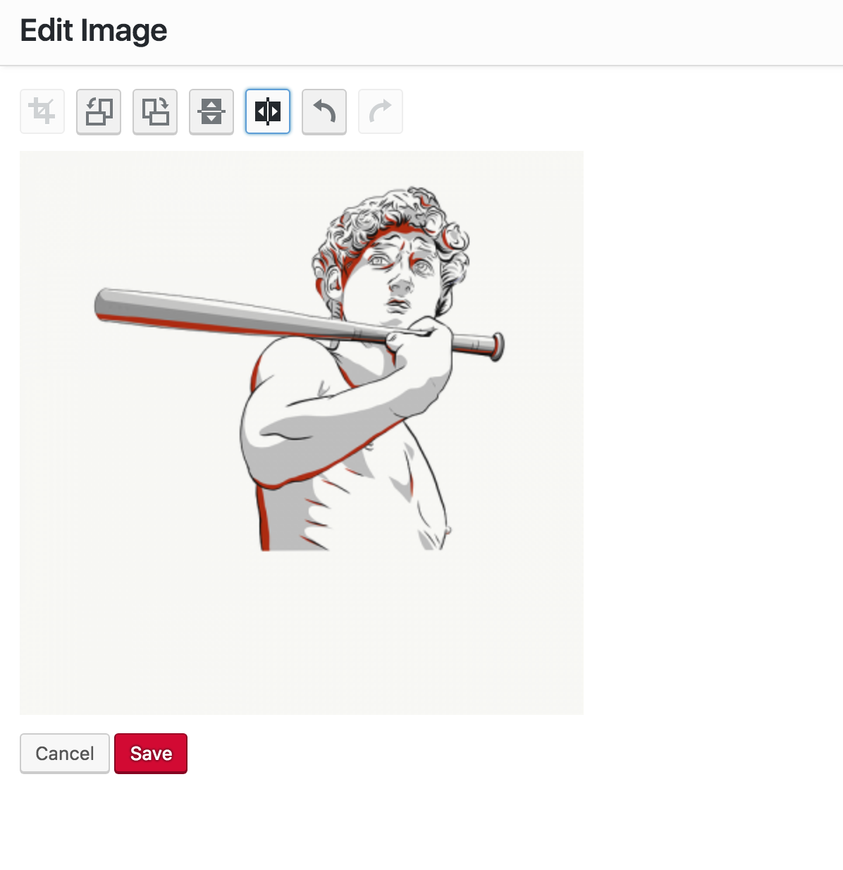
Notes:
If click on the “Edit Image” link, you will give these options.
Above the image are icons that provide a variety of functions such as:
Rotating the image clockwise
Rotating it counter-clockwise
Rotating it from left to right for a mirror image (indicated with the pink arrow; an example is provided as well)
Rotating upside down.
You can also use (circled in red):
“Scale Image” function and
“Image Crop.
“Thumbnail Settings” are also an option (indicated by the green arrow).
Here are the details….
NEXT SLIDE

Slide 28
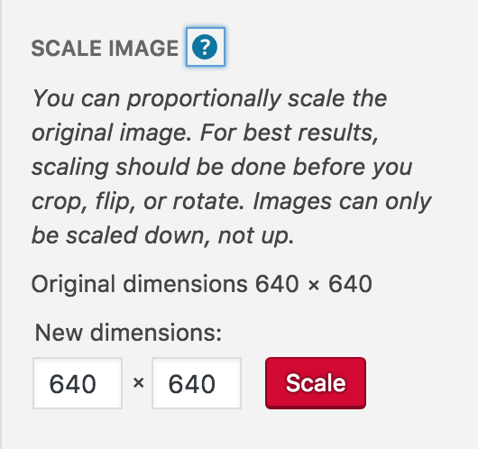
Notes:
”Scale Image” allows you to proportionally scale the original image. Here are a few points to note:
It’s recommended that this be done before making other changes such as cropping, flipping, or rotating the image.
Images can only be scaled down, not up.
The original dimensions are 640 x 640.
You are given a warning message after clicking the red “Scale” button.

Slide 29
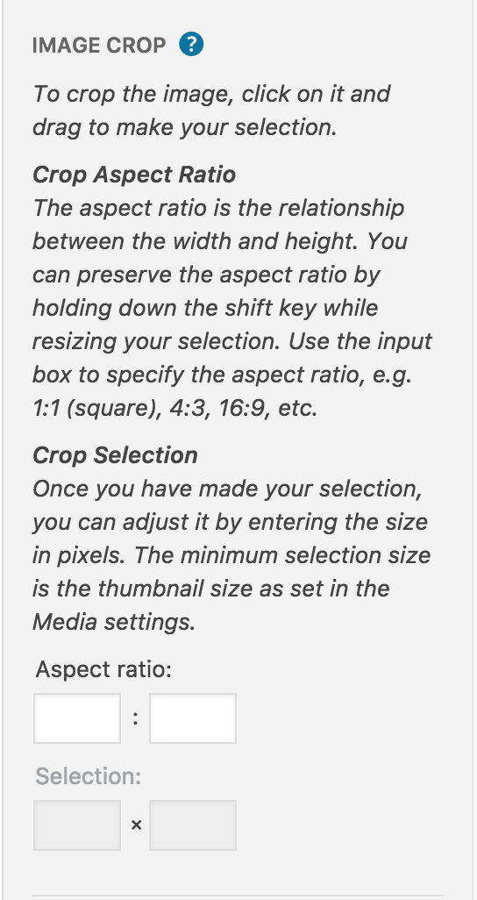
Notes:
“Image Crop” lets you crop or trim an image. Here are points to remember:
To crop the image, click on it and drag to make your selection.
The crop aspect ratio is the relationship between the width and height of the image.
To preserve this aspect ratio, hold down the Shift key during resizing OR
Use the Aspect ratio input boxes to specify the ratio
The Selection boxes can be used to set the size of the image in pixels.
The thumbnail size (viewed in Media settings) is the smallest you can go.

Slide 30
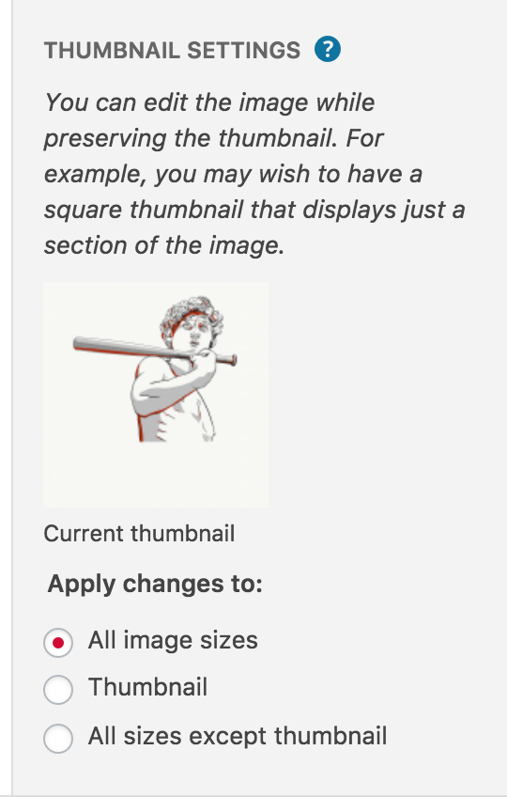
Notes:
“Thumbnail Settings” let you edit your image while preserving the thumbnail shape and size. This setting lets you select a portion of your image as the thumbnail option.

Slide 31
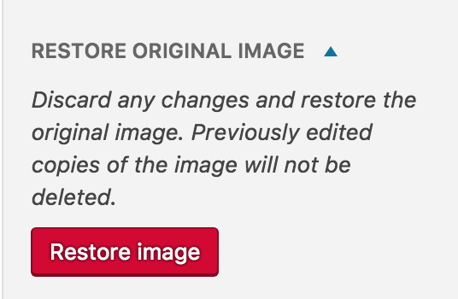
Notes:
Finally, if you don’t like any of the changes you’ve made, use the “Restore image” button to reinstate the image in its original state.
Note: All of these instructions and descriptions are available in Pressbooks the the info/ question mark icons; also, these slides will be posted in our Pressbooks Guide after this webinar.

Slide 32
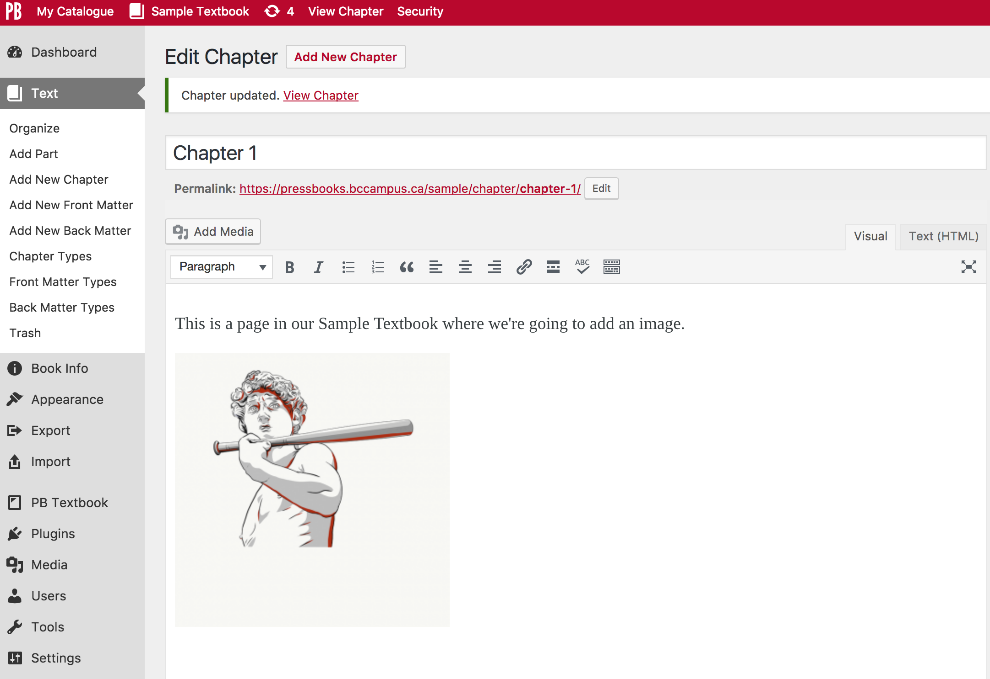
Notes:
If you want the image as is, without repositioning it, resizing it, or adding a caption, this is what you get. However, you can still edit the image…
NEXT SLIDE

Slide 33
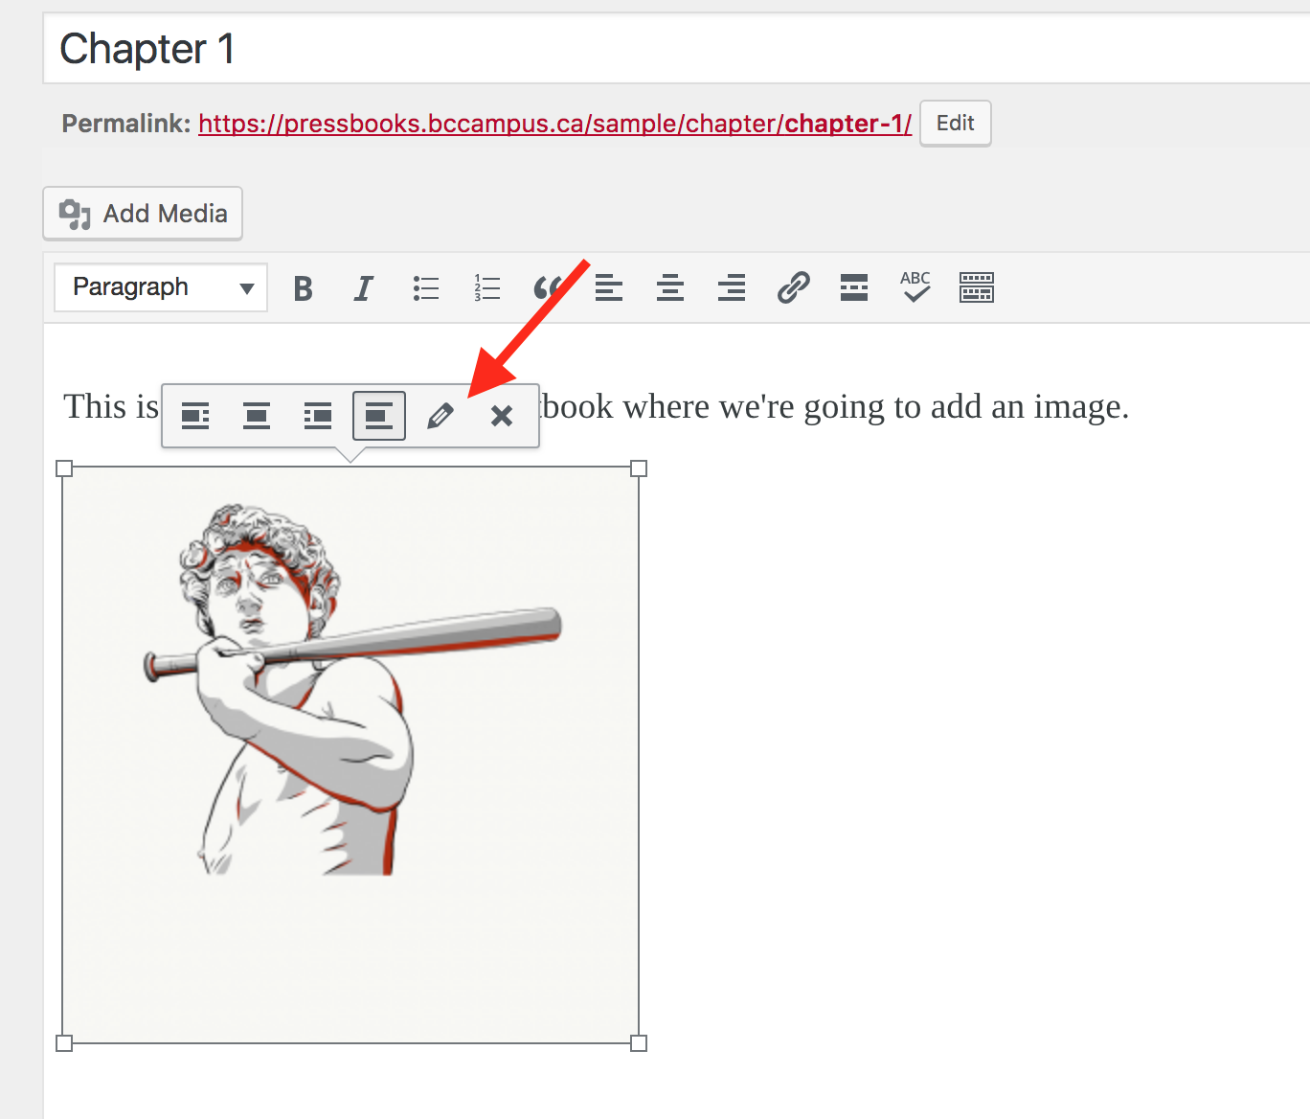
Notes:
Click on the image and the edit toolbar will appear. You’ll notice that:
The first four icons from left to right are for repositioning the image
The “X” is to delete the image from the page (but not the Media Library), and
The pencil icon is for editing (by the red arrow) which will take you to…
NEXT SLIDE

Slide 34
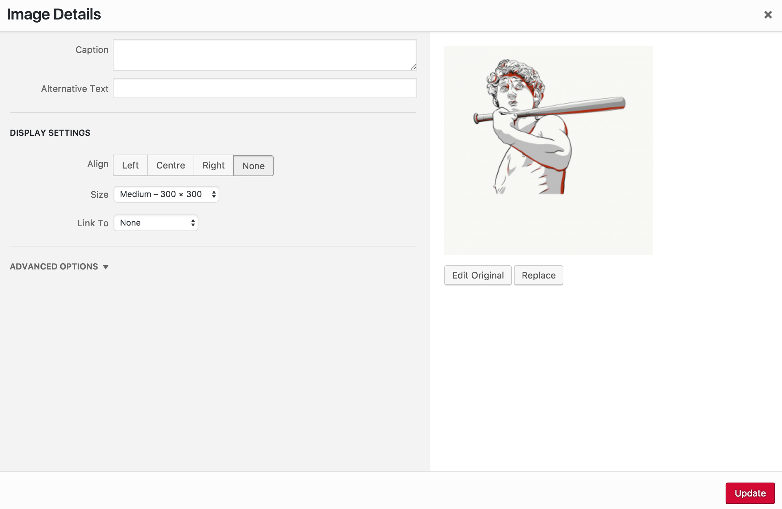
Notes:
… the Image Details page. From here you can:
Add a caption
Add Alt (alternative) Text
Align the image left, centre, or right
Choose a different size
Link it to a file.

Slide 35
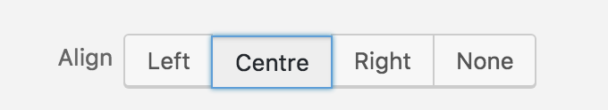
Notes:
Many of the textbooks we’ve worked on, with authors, have all images centered. We’ve learned that this is the simplest way to create a clean looking textbook without the need to spend a lot of time on layout. At this time, Pressbooks has not reached the point in its development where a complex layout can be created for PDFs, for example, as can be done with InDesign.

Slide 36
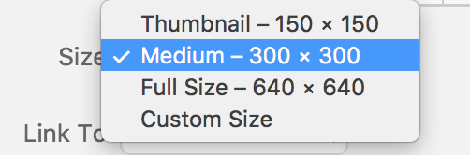
Notes:
From the Size dropdown menu, you select a variety of sizes, including the option to customizing the size….
NEXT SLIDE

Slide 37
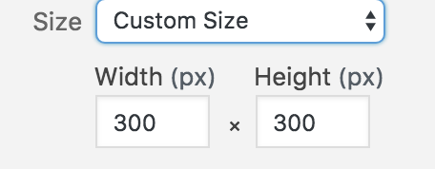
Notes:
When Custom Size is selected, Width and Height fields appear. Note that the aspect ratio is maintained so if you adjust the pixel width, the height will automatically change accordingly, and visa versa.

Slide 38
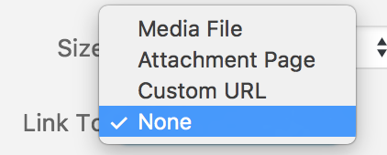
Notes:
The Link To option, lets you select where you want the image file to attach. We typically choose “Media File”, i.e., the image’s file in the Media Library.

Slide 39
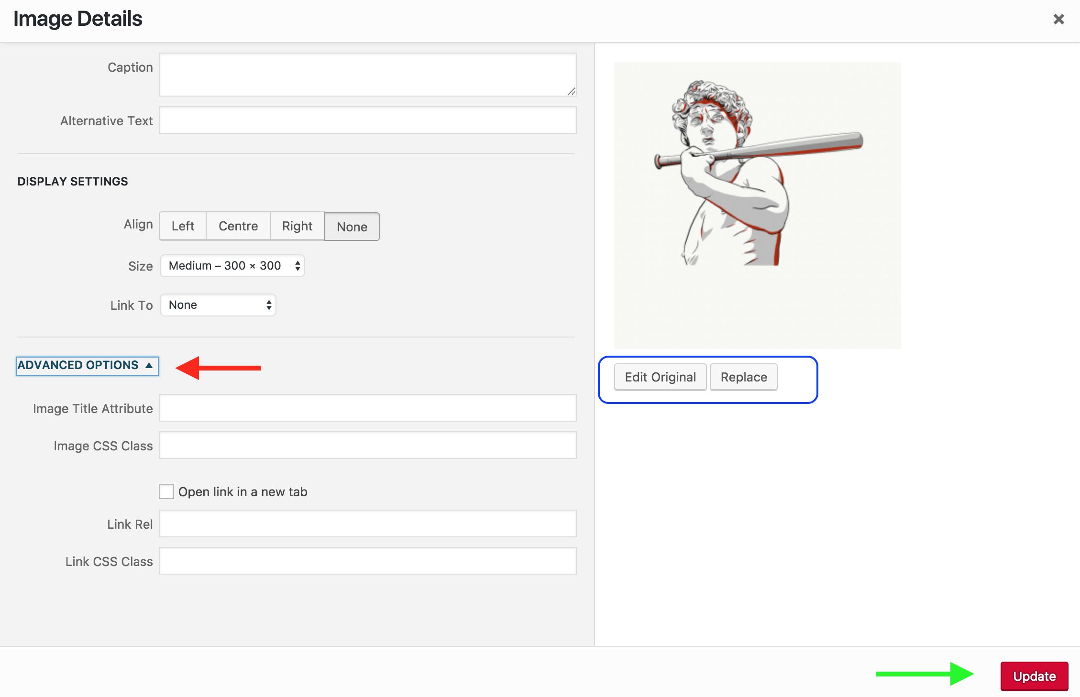
Notes:
Pressbooks now allows you to apply CSS styles to your image.
If you reveal “Advanced Options”, you’ll find:
“Image Title Attribute” allows you to give your image a title which is found by hovering over the image from the book view.
“Image CSS Class” that allows you to Indicate your image’s CSS class. (In CSS stylesheets, each CSS class will apply its own style. This tells Pressbooks which CSS style to use for that image.)
The remaining fields (“Link Rel” and “Link CSS Class”) allow you tostyle the image’s link and decide whether it should open a new browser window or not.
And to save all changes, select the red “Update” button.
The “Edit Original” button takes you to the same “Edit Image” page accessed when an image is selected from the Media Library and
“Replace” takes you back to the Media Library if you decide you prefer to use a different image.

Slide 40
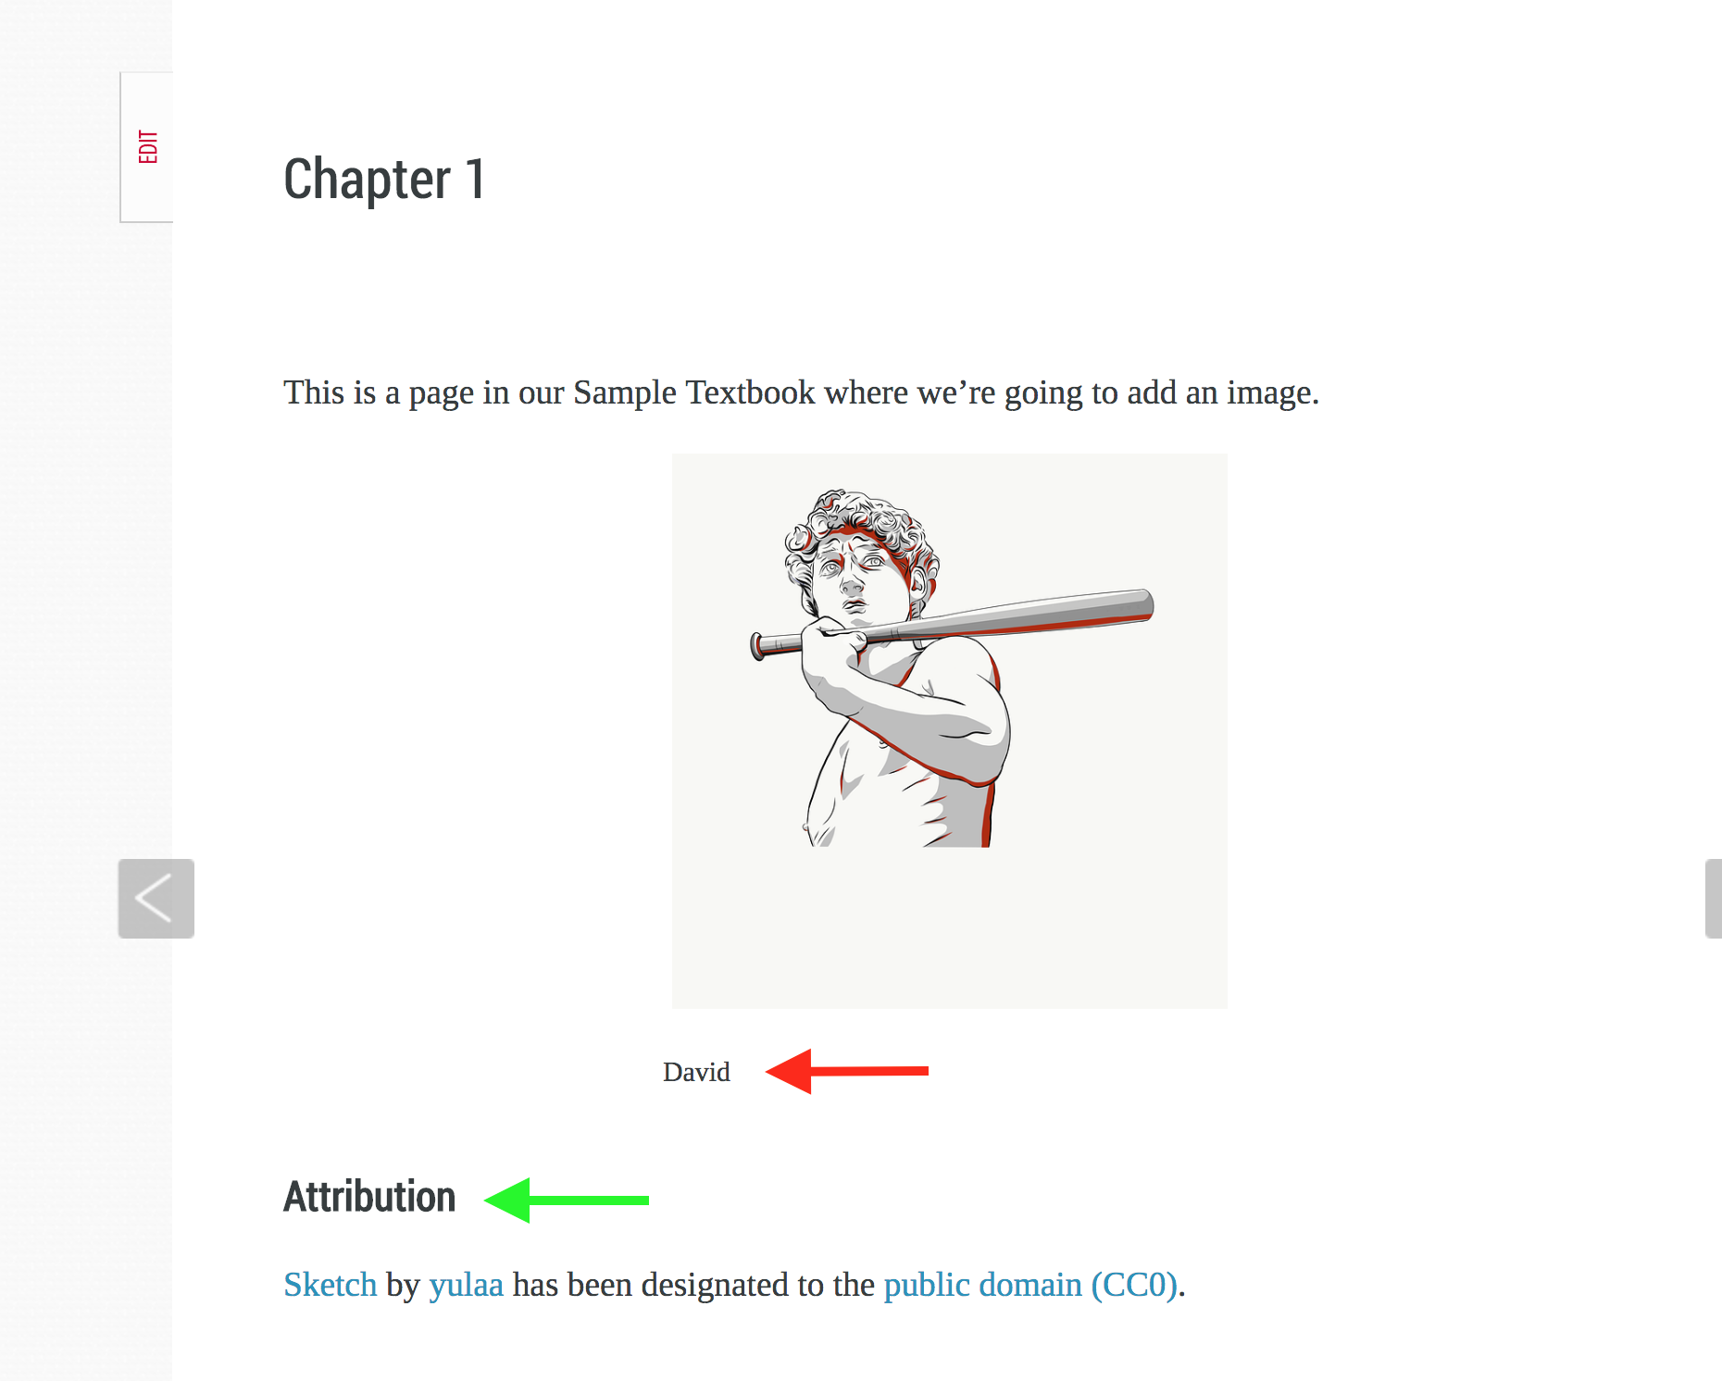
Notes:
Here is the embedded image with the caption “David” (by the red arrow) and an attribution statement (by the green arrow) at the bottom of the webpage.
The pressbooks.com guide warns that it is critical to give images a caption; those without will not render properly in all e-readers. Our group has also noticed that images without captions can not be repositioned or aligned within the text body.

Slide 41
Add image to the book using a URL
Notes:
An image can also be added by using a URL. This can only be done by starting from a chapter or part. Begin by clicking on the “Add Media” button by the blue arrow…
NEXT SLIDE

Slide 42
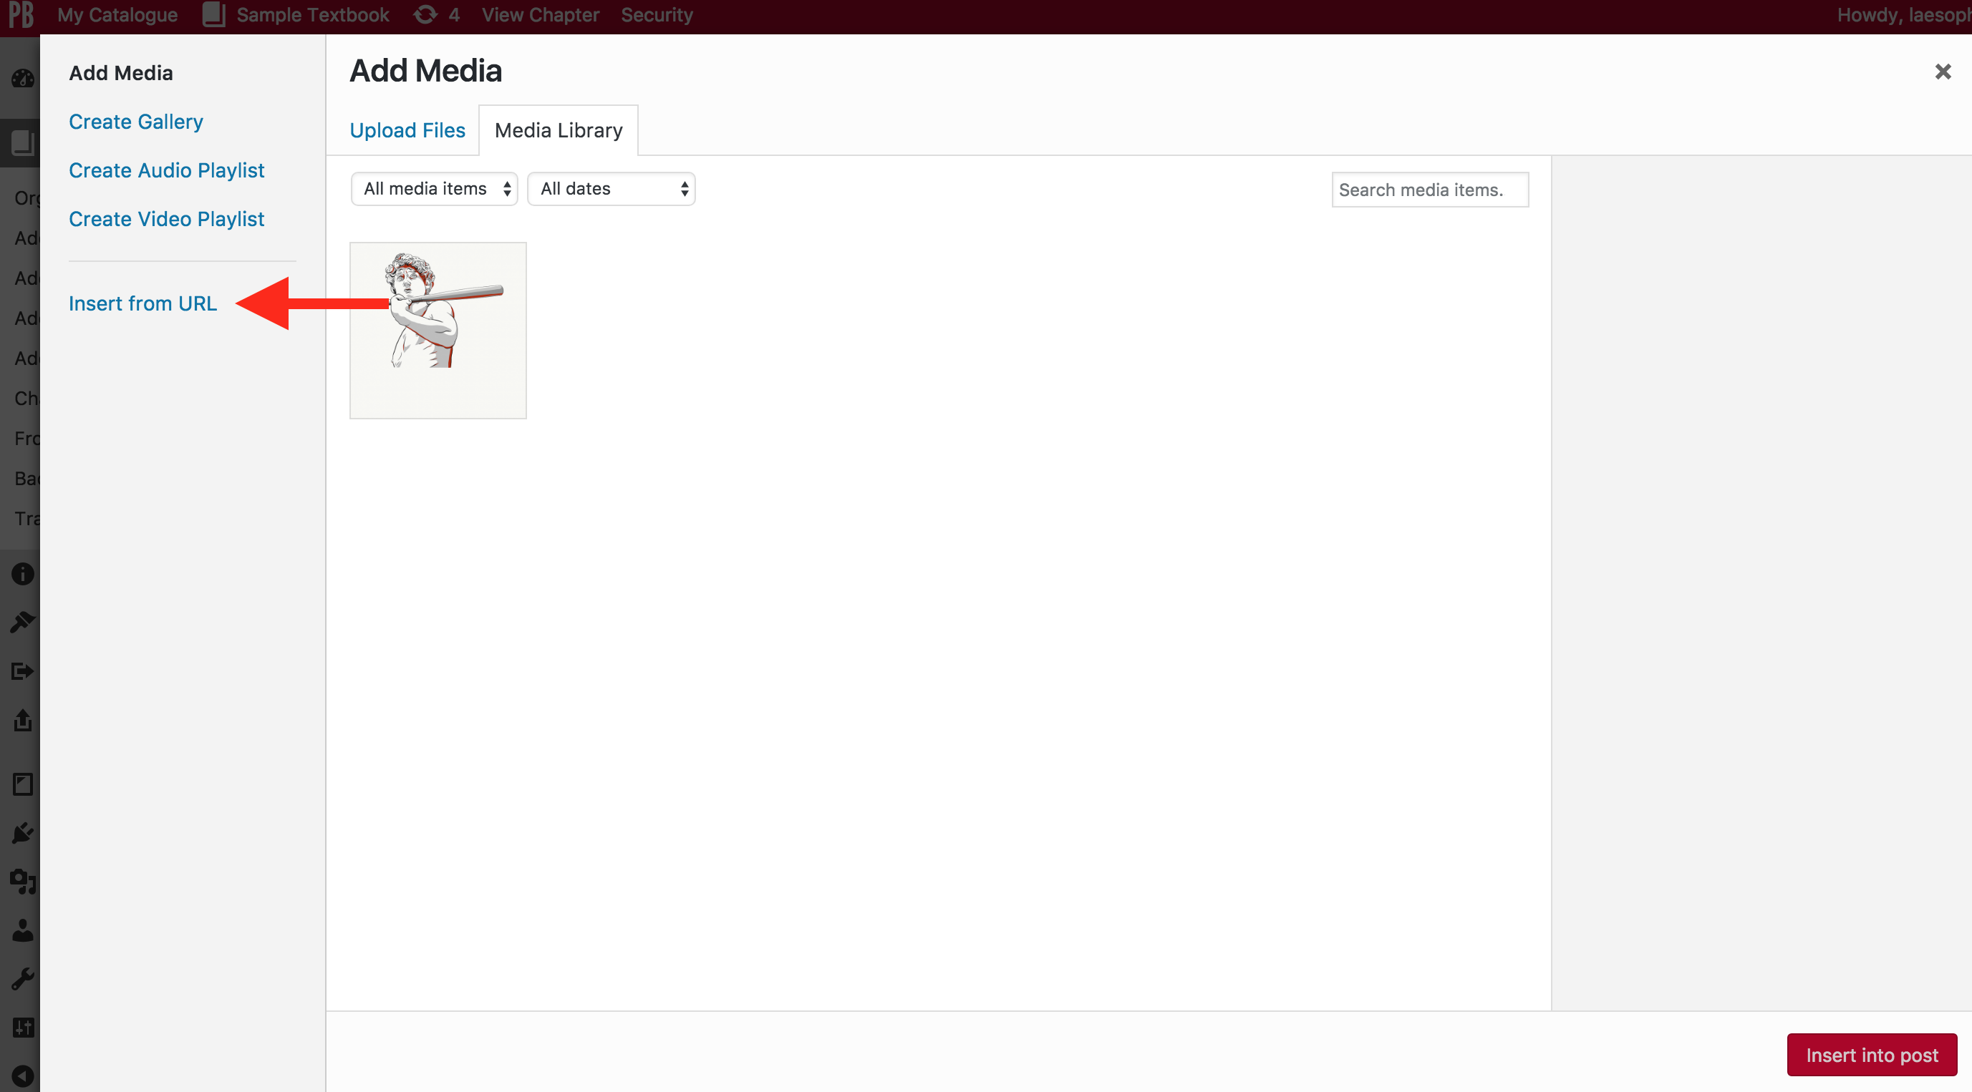
Notes:
After you land in the Media Library, click on the ”Insert from URL” link at the bottom of the “Add Media” options panel.

Slide 43
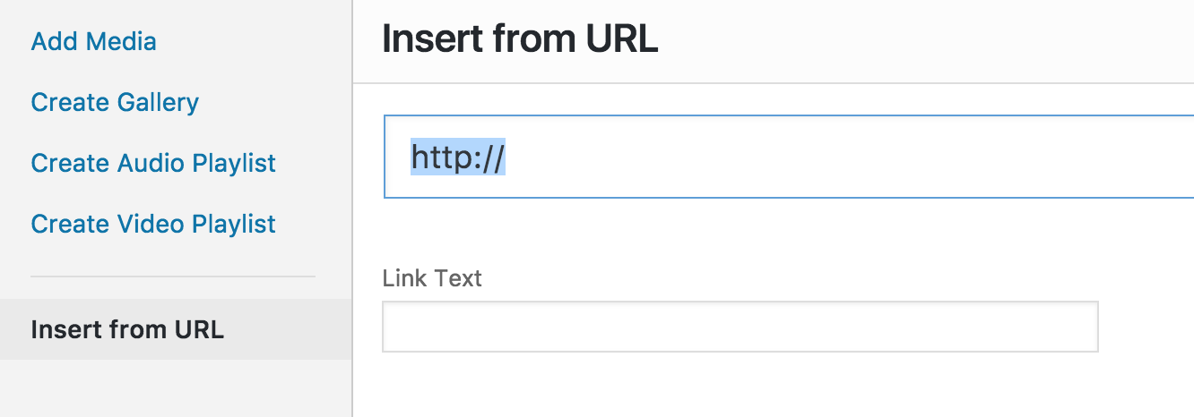
Notes:
Complete the URL field to pull in a link to a photo or other image on the internet. NOTE: This image will not be added to your textbook’s Media Library nor will the image be embedded into the chapter post. Only a link will be created.

Slide 44
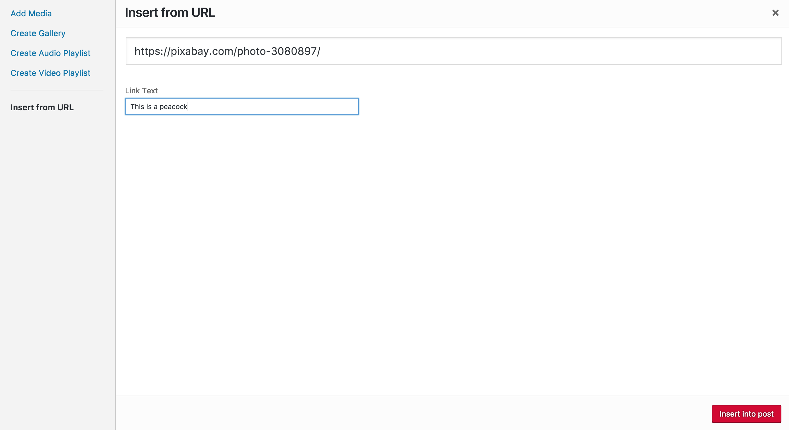
Notes:
Here, the URL to a photo on Pixabay has been added and the text “This is a peacock” has been inserted in the “Link Text” field. To complete, click on the red “Insert into post” button in the bottom right corner.
NOTE: You do not have the option to request that the link open in a different tab and window.

Slide 45
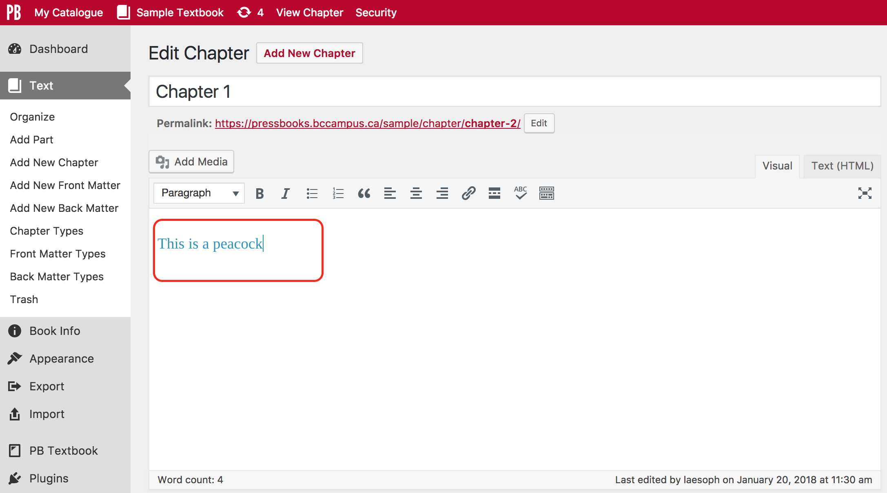
Notes:
This is the result.

Slide 46
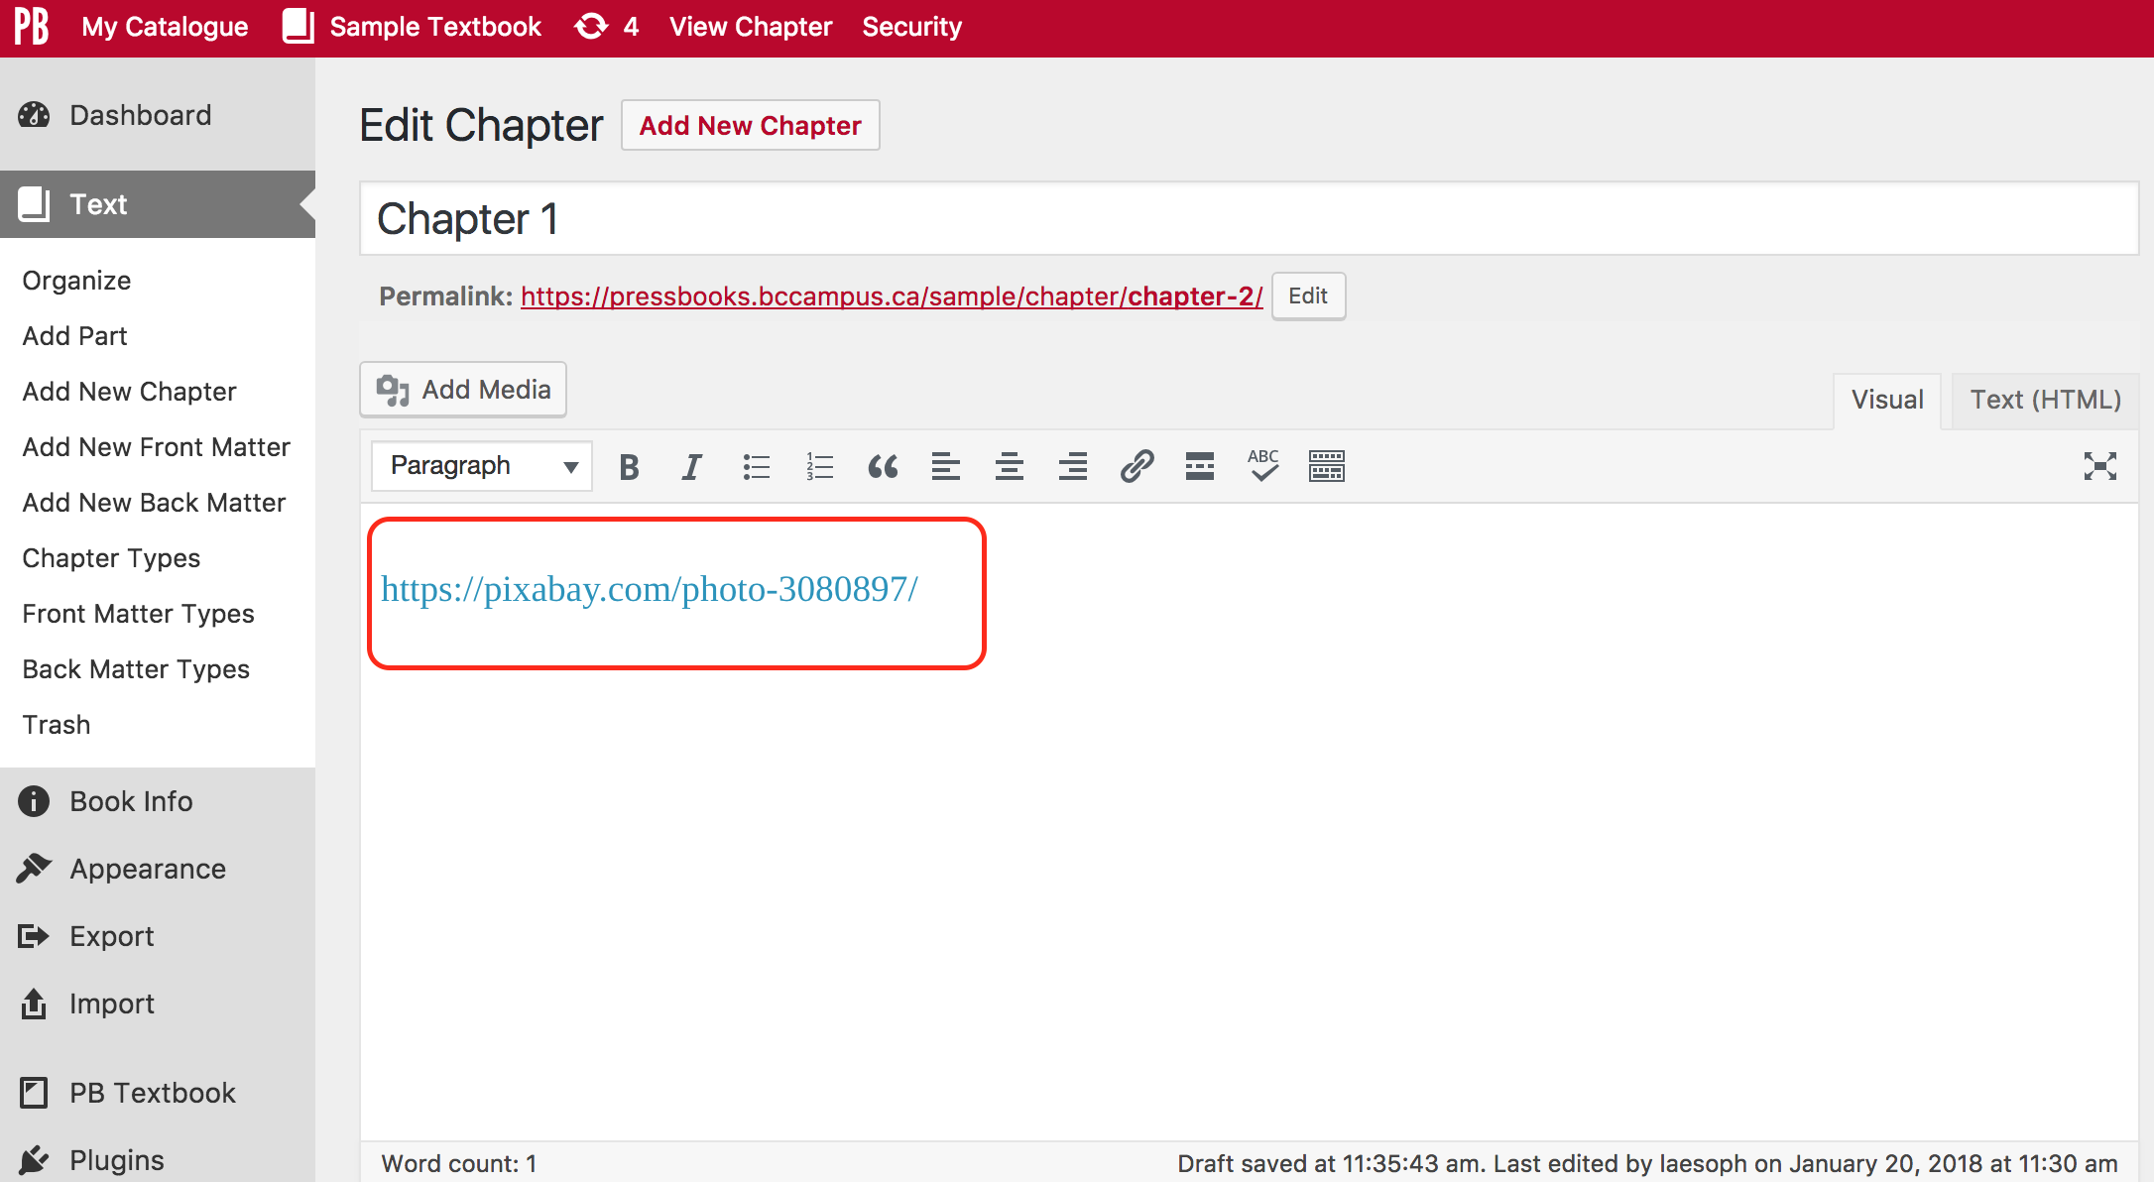
Notes:
If the display text is not specified, then the URL is displayed as shown above.
This function can also be used for linking other resources such as online books or webpages, videos and audio clips, particularly those for which rights are restricted and not openly licensed or in the public domain. (More on this later.)

Slide 47
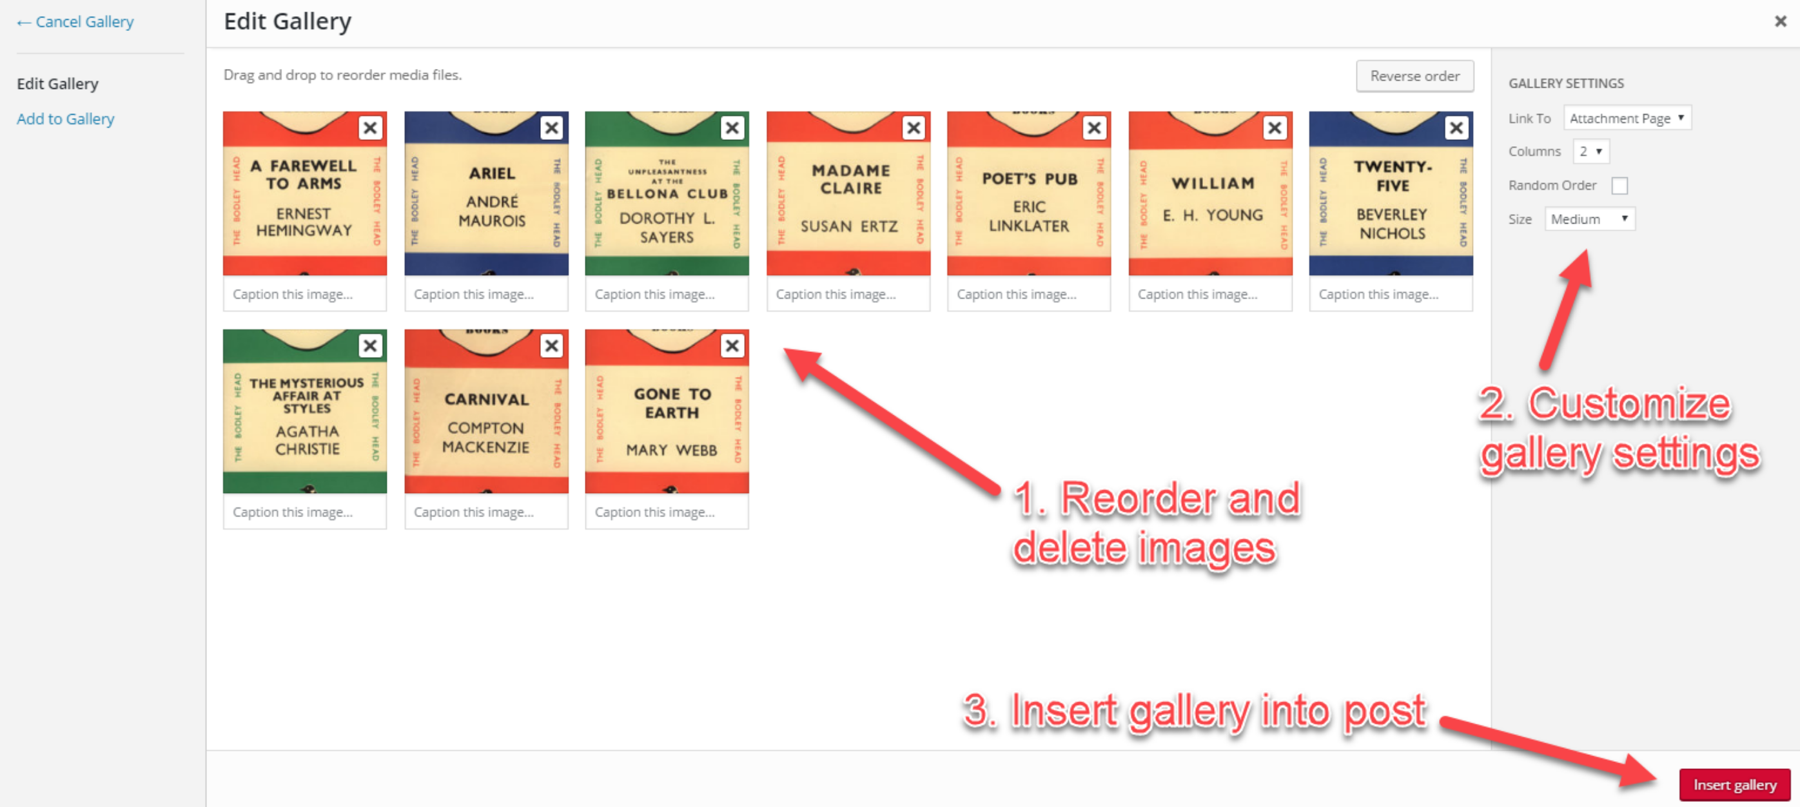
Create a Gallery
Notes:
When uploading media from within a chapter’s webpage, you also have the option to create a gallery. This allows for several images to be inserted into a post simultaneously, and to be formatted together.
Click “Add Media”, then “Create Gallery”
Select images for gallery from Media Library
Click “Create New Gallery”
NEXT SLIDE

Slide 48

Notes:
Reorder and delete media files as needed
Customize gallery settings on right hand menu (Link to, columns, order, image size)
Insert gallery into post

Slide 49
Lesson 3
When and how to
Embed or Link to a
Video

Slide 50
Embed a video
Notes:
Typically, the best way to add videos to a textbook is to host them on YouTube, and then embed them into the book afterwards. The instructions in this section assume that the videos to be embedded are already hosted on YouTube.
Also, be sure to change the license for these videos from the default Standard YouTube license to the Creative Commons Attribution license (reuse allowed). If you are going to embed a video in an open textbook or other OER, it must be covered by an open copyright license.

Slide 51
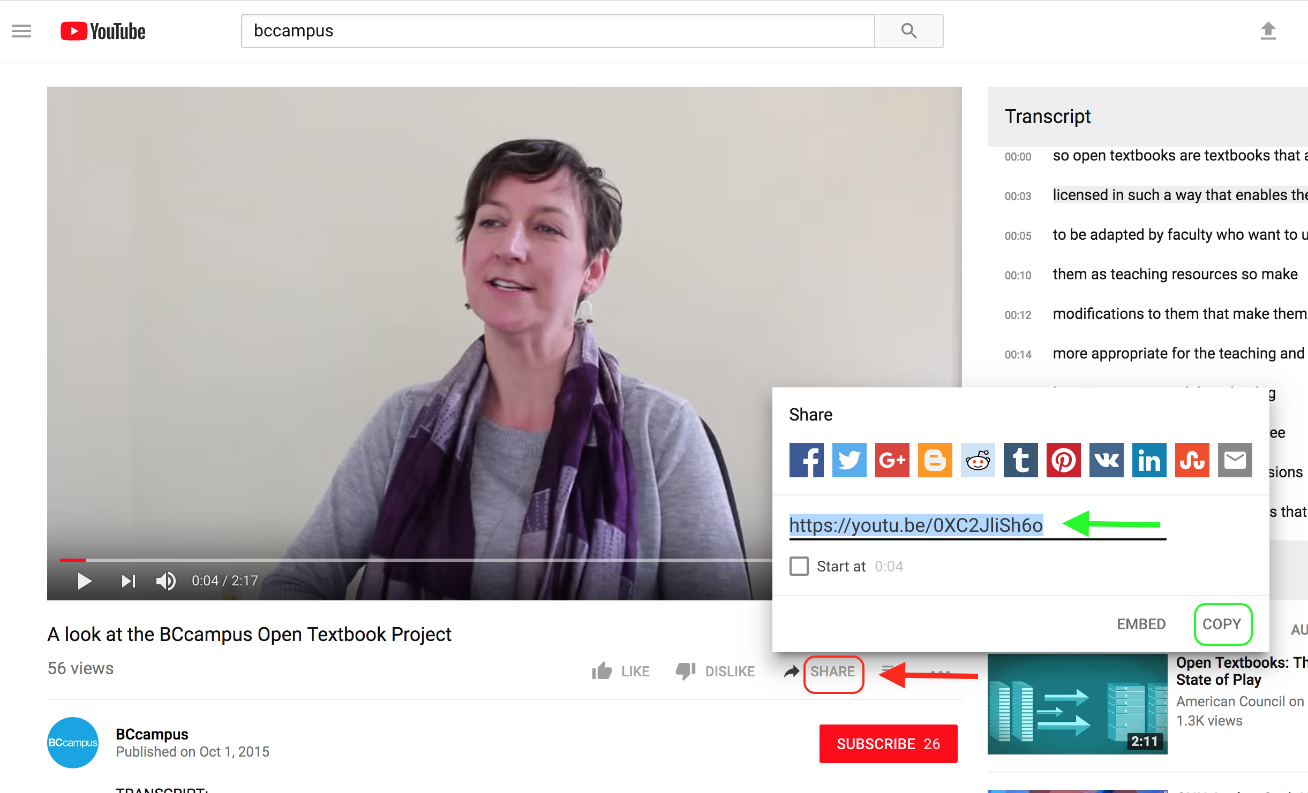
Notes:
This is done by taking a copy of the the video’s YouTube URL, and pasting it into the “Visual” editor/tab.
1. Begin, by locating the video on YouTube and clicking on Share (by the red arrow)
2. “Copy” the URL (circled in green) provided in the pop-up box (by the green arrow)…
NEXT SLIDE
Unfortunately, the URL for the video is not maintained in the exported PDF files. We are investigating this issue. In the meantime, provide a copy of the video’s URL as part of the text.

Slide 52
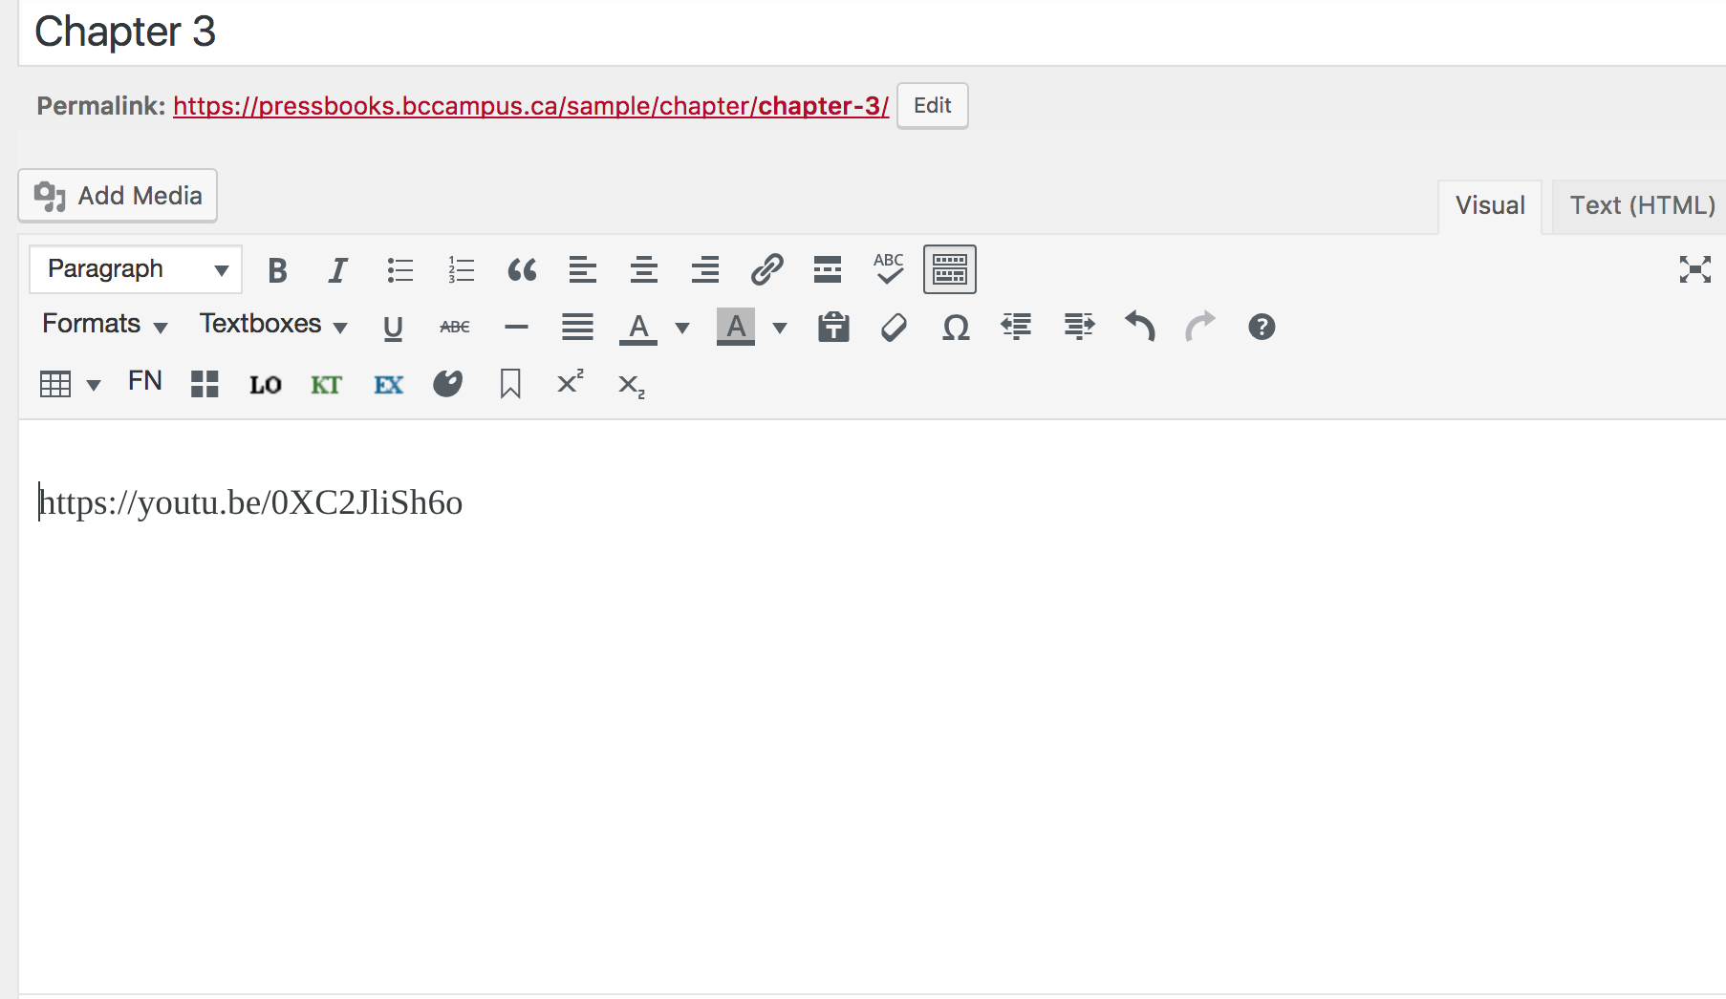
Notes:
…and
3. Paste the URL into the Visual editor of the chapter. Almost immediately, the URL will…
NEXT SLIDE

Slide 53

Notes:
…embed and appear like (by the blue arrow). To see how the video appears to the reader, click on “View Chapter” (by the green arrow)…

Slide 54

Notes:
…and this is what you’ll see.
By default all embedded videos align to the left. One of the problems with the embedding method is the inability to reposition the video to the center or to the right. However, there is a work around.
NEXT SLIDE

Slide 55


Notes:
After you add the video URL – even after it embeds itself – click on the “Text (HTML)” tab (by the green arrow) and back again to the “Visual” tab (by the red arrow). This action reverts the embedded video to its URL.
The URL is much easier to re-align. Here, the “Align centre” icon (circled in blue) has been selected for the video URL (by the blue arrow) which results in…
NEXT SLIDE

Slide 56

Notes:
…it being centered in the “Visual” tab editor and…
NEXT SLIDE

Slide 57
Notes:
…in the book or chapter view.
Note: If video URLs are placed in a standard or shaded textbox, they will not embed.
It should also be noted that currently URLs (or anything else indicating a video has been added to the web version of a book) for embedded videos do not show up in the exported PDF files. This is an issue we’re investigating. In the meantime, double check the PDFs for portions of your book that include videos and if the URLs do not display, add them manually.

Slide 58

When to link a video
Notes:
If you find a copyrighted video with “restricted rights” (i.e., permissions have not been released by the creator through an open copyright license OR by designating the video to the public domain) that you’d like to include in your open textbook, you can provide a link to the video. You cannot, however, embed it. It is highly recommended that this method be used as a last resort for times when you are unable to locate an openly licensed video (or do not have the resources to create your own) that adds significant value to your open textbook.
It’s also been noted that embedded videos are preferable to linked videos as students are more likely to watch them. Linked videos are often viewed as extra material and too much trouble to click on.

Slide 59

Notes:
Begin by creating a statement that will include the link to the video. Best practices and for accessibility reasons, avoid using words and phrases like “click here”. Instead, describe – in the linking text – the subject and type of media the reader will be directed to.
In this example:
The statement says “To learn more about patient care, watch this video on how to create a nursing care plan.”
“…watch this video on how to create a nursing care plan” has been highlighted (by the red arrow)
Next, click on the Insert/edit link icon (by the blue arrow)…
NEXT SLIDE

Slide 60

Notes:
For this example, we’ll assume that you’re using a video from YouTube.
3. Locate the video on YouTube and click on Share (by the red arrow)
4. “Copy” (circled in green) the URL provided in the pop-up box (by the green arrow)…
NEXT SLIDE

Slide 61


#1. Link options
#2. Open link in new tab
#3. Update
Notes:
… paste URL from YouTube into link field
1. If you to the video to open in a new tab, select the “Link options” icon (by the red arrow)
2. Click the checkbox by “Open link in a new tab” (by the blue arrow)
3. Save with the red “Update” button (by the green arrow).

Slide 62

Notes:
If you’re not concerned about linking options, select the “Apply” icon after you’ve pasted the YouTube URL in the linking field, and save.

Slide 63

How to link a video
Notes:
Here are examples of how videos were linked to from the Clinical Procedures for Safer Patient Care open textbook. Notice:
The introductory statement prior to the linked videos that describes the type of media (videos), how the student will use them (“watch”), and why they have been added to the textbook (“more information about how to move a patient up in bed”), circled in red.
For each video, a description of the student’s action (“take…this course”) and the title of the video (a description can also be used) form the phrase that will be linked all noted by the green arrow and green underline.
3. The remaining, unlinked portion of the sentence explains what, specifically, the student will learn from the video, marked by the blue arrow and underscore.
In addition, notice the layout and style used to present the linked video. This design was followed for all linked videos in this book, and was noted in the book’s Style Sheet. The styling used included:
A separate shaded textbox for each linked video
Centering of text within the textbook
Positioning the linking text at the beginning of the statement
Use of a full sentence
Placing the title of the video in italics

Slide 64

Adding video files to Pressbooks
Notes:
How video files might be added directly to Pressbooks has been an issue that BCcampus Open Education has grappled with for several years. The main challenge has been that most video files are too large to upload into Pressbooks, even after they’ve been compressed.
NEXT SLIDE

Slide 65



Notes:
Our solution has been to upload original openly licensed video files, supported with BCcampus grant funds,
to YouTube for embedding purposes and
to SOL*R, BCcampus’s “Shareable Online Learning Resources” repository as a way to share these videos as editable files.
Editable files are typically listed and linked to in the textbook’s record page in the B.C. Open Textbook Collection or in the textbook’s appendix.

Slide 66
Lesson 4
When and how to
Embed or Link to an
Audio Clip

Slide 67

Audio files: similar to images
Notes:
BCcampus OpenEd has some experience working with audio files in Pressbooks. However, most of our authors have not included this medium in their textbooks. Most of them are more likely to embed a video than include an audio clip. We are still learning, and continue to develop procedures and best practices for this medium.
Audio files tend to be quite a bit larger than image files, something to watch for when uploading them to Pressbooks.
To add an audio file, follow the same steps as is done for an image. Here you can see the file by the red arrow and the file’s details circled in red.
If enough audio files are collected, an “Audio Playlist” can be created (by the pink arrow).

Slide 68


Notes:
Here is the embedded file in the Visual editor (at top) and in the reader’s view (at the bottom).

Slide 69

Audio files: embed or link?
Notes:
If you find a recording that is copyrighted with restricted rights, you might choose to link to if it will add value to your textbook. Follow the same process used for videos.

Slide 70

What about linking to images?
Notes:
We’ve rarely seen it done, but occasionally, an author will choose to link to a restricted image. This might be done, for example, when the author wants to provide students with an example of a specific painting and is unable to locate an open version. In most cases, the appropriate image can be found or created. We suspect this is because images is much easier to produce than videos or audio.

Slide 71

Link to an uploaded PDF
Notes:
Another case where you might link to an uploaded “image” is when the file type is a PDF. As mentioned earlier, Pressbooks only displays images for JGP, PNG, and GIF file types. If you want readers to view a PDF that has been added to the Media Library, use a link. At BCcampus, when we feel a linked PDF is the best format to convey information in a guide or textbook, we often include a Word document also as an editable file or in place of the PDF.
NEXT SLIDE

Slide 72

Notes:
To do this,
Highlight the text to be link and
While you’re there copy the highlighted text as well
Click on the “Add Media” button…
NEXT SLIDE

Slide 73


Notes:
…from the Media Library,
4. Select the PDF file
5. Paste the copied text into the “Title” field
6. Click on the red “Insert into post” button.

Slide 74

Problem with audio and XML files
Notes:
We have found that the Pressbooks back-up files exported from textbooks containing audio files do not work and is an issue that our development team has not been able to resolve. Pressbooks back-up files have been the usual way that users create a copy of a book for their own use and customization.
Our solution has been to remove the Pressbooks (XML) files from affected books, and instruct users to instead clone the book. This new cloning feature bypasses the routine – and accompanying problems -- followed when manually importing the Pressbooks XML file into a new account. As you can see on this record page for Course Pack 2 of the BC Reads series (which includes several audio files), a link has been provided that takes the user to….
NEXT SLIDE

Slide 75

Notes:
… the “Cloning a Textbook” chapter in the BCcampus OpenEd Pressbooks Guide.

Slide 76
Lesson 5
Accessibility
and
Media
Notes:
Finally, let’s review best practices that should be applied to media, in your textbook, to ensure the broadest accessibility possible.

Slide 77


Accessibility Toolkits
Notes:
The topic of accessibility and how it applies to the various media added to a textbook in Pressbooks can be complex. So for our purposes today, an overview and one or two examples will be provided for each media type.
For a complete description on why and how to make your textbook as accessible as possible, refer to to the BCcampus Open Education Accessibility Toolkit, available in both English and French. We are currently updating this guide and will release the second edition later this year.

Slide 78

Images

Slide 79

Multimedia
Notes:
Multimedia can refer to either video or audio files.
During the planning stages as an author is deciding what resources to include in an open textbook, the author should ask themselves: What is the purpose of this video or audio file or link? Is it integral to the learning of the students?
Before you can determine what you need to do to make these materials accessible, you need to understand what is required for different types of multimedia. Consider the following questions:
Does your multimedia resource include audio narration or instruction? If so, you should:
Provide a complete transcript of all speech content and relevant non-speech content in the resource. This applies to both embedded and linked videos and audio clips.
Does your multimedia resource include audio that is synchronized with a video presentation? If so, you should:
Provide captions of all speech content and relevant non-speech content in the resource. (see the yellow arrow)
Does your multimedia resource include contextual visuals (e.g., charts, graphs) that are not addressed in the spoken content? If so, you should:
Provide audio descriptions of relevant visual materials in the resource.
Notice, too, in this screenshot that when the videographer added this video to YouTube, the license type was changed from the “Standard YouTube license” to a “Creative Commons Attribution license”.

Slide 80

Notes:
To assist you with tracking accessibility tasks in your book, refer to the “Checklist for Accessibility Toolkit” in the appendix of the Accessibility Toolkit. BCcampus OpenEd uses this checklist to determine whether a textbook in the B.C. Open Textbook Collection is accessibility; those that are, are marked with an “Accessibility” flag.

Slide 81


Pressbooks Updates
Notes:
For Pressbooks updates about recent upgrades, new features, enhancements, and fixes, go to the BCcampus Open Education site at open.bcampus.ca, select ”Pressbooks Support”, and then “Pressbooks Updates” at the top of the dropdown list.

Slide 82


Pressbooks Feedback
Notes:
We welcome your feedback about this webinar and Pressbooks in general and ask that you ;lease fill out our new Pressbooks Feedback form. Go to the BCcampus Open Education site at open.bcampus.ca, select ”Pressbooks Support”, and then “Pressbooks Feedback” at the bottom of the dropdown list.

Slide 83
Questions?
open.bccampus.ca

