Slide 1
Pressbooks Training Webinar series
Introduction
Unless otherwise noted, this work is released under a CC BY. 4.0 International Licence. Feel free to use, modify, or distribute any or all of this presentation with attribution.
Notes:
Last updated: April 10, 2018, LA

Slide 2
Curriculum
Lesson 1: How to create a self-serve Pressbooks account and book shell
How to recover or change your password
Lesson 2: How to customize your account profile
Lesson 3: How to navigate the Pressbooks Dashboard
Lesson 4: How to set up a book
How to add parts (including front/back matter) and chapters
How to order parts (including front/back matter) and chapters
How to add text as content
Notes:
Here are our topics for today.
A new lesson has been added: Lesson 2 – How to customize your account profile

Slide 3
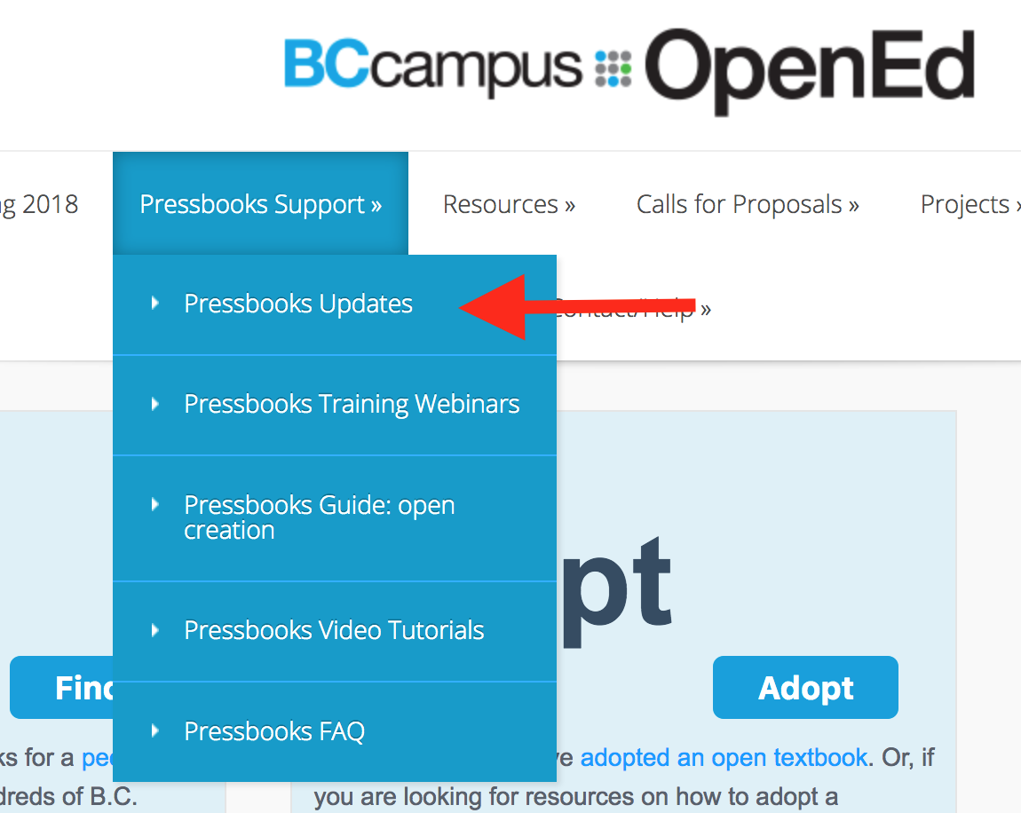
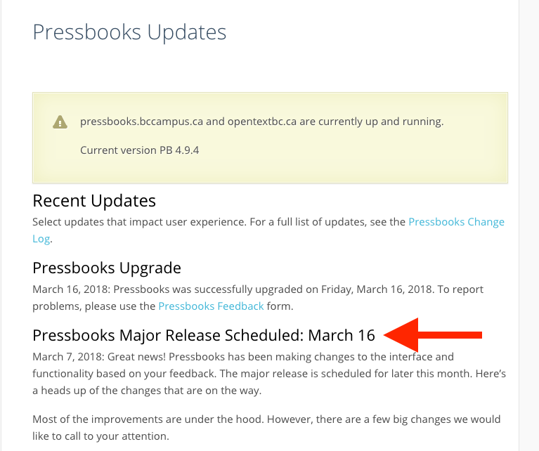
Pressbooks Updates
Notes:
The two BCcampus Pressbooks instances went through a major upgrade on March 16, 2018. For a list of changes made, see the “Pressbooks Updates” page under “Pressbooks Support” on the BCcampus Open Education website (open.bccampus.ca).

Slide 4
Lesson 1
How to create
an account
Notes:
Lesson 1: How to create a self -serve Pressbooks account and book shell
This lesson also includes steps on how to recover and change your password.
If you have already created a Pressbooks account, please log in and follow along.

Slide 5
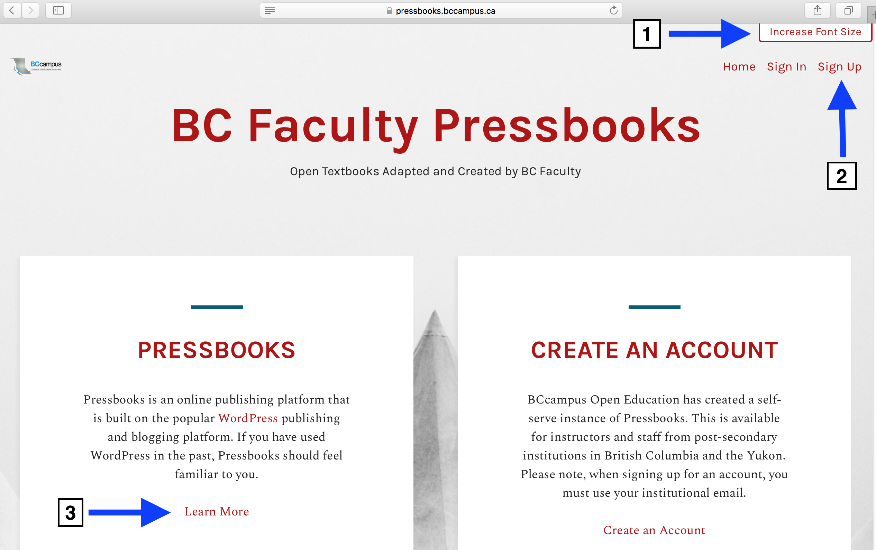
pressbooks.bccampus.ca
Notes:
To begin, go to pressbooks.bccampus.ca and click “Sign Up” (by #2).
Also take note of a couple new features on this page:
For those with visual impairment, accessibility has been enhanced with the ability to “Increase Font Size” in the upper right-hand corner.
For additional information about this self-serve instance of Pressbooks, click on “Learn More” by #3…
GO TO NEXT SLIDE

Slide 6
Notes:
…and if you scroll to the bottom of this web page, you’ll find links to our various Pressbooks support resources.

Slide 7
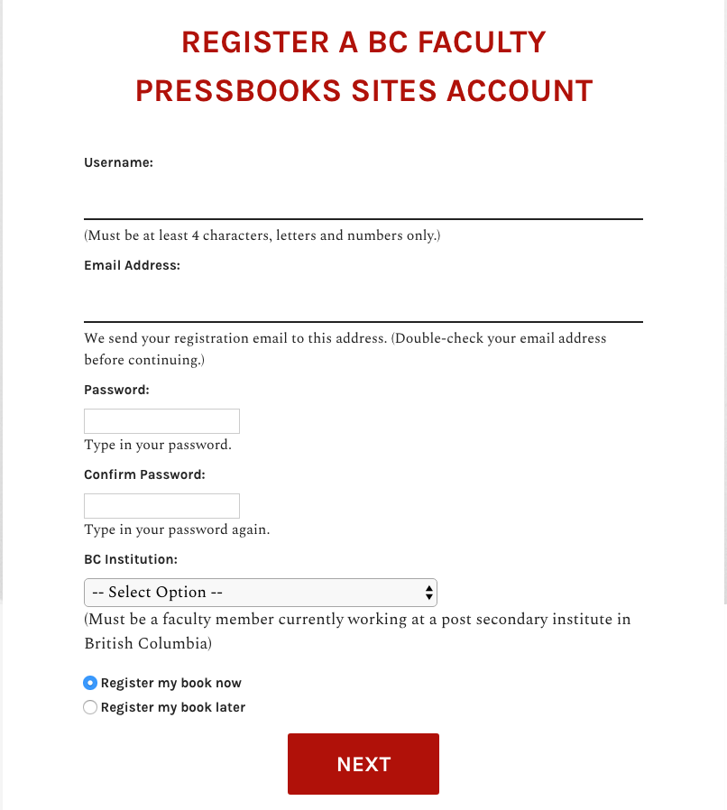
Notes:
After you click on “Sign Up”, to create an account, fill in the following fields:
Username (must be at least 4 characters; letters and numbers only; letters must be lowercase)
Email address; this is unique and an email address can only be used one time in this system. The email address must be from a public BC post-secondary institution.
Type and confirm your password
Select your institution from the drop-down list.

Slide 8
Notes:
At the bottom of this web page, notice a dark blue banner identified by the BCcampus OpenEd logo with links to “About” Pressbooks and “Help” for Pressbooks (circled in light green). These links will redirect you to information specific to this BCcampus instance of Pressbooks.
The black banner at the very bottom of the page is marked by “Powered by Pressbooks” and circled in light blue. These links redirect you to information and help provided by Pressbooks.com, the organization that developed this platform. If you need help, use the BCcampus help link and not these.

Slide 9
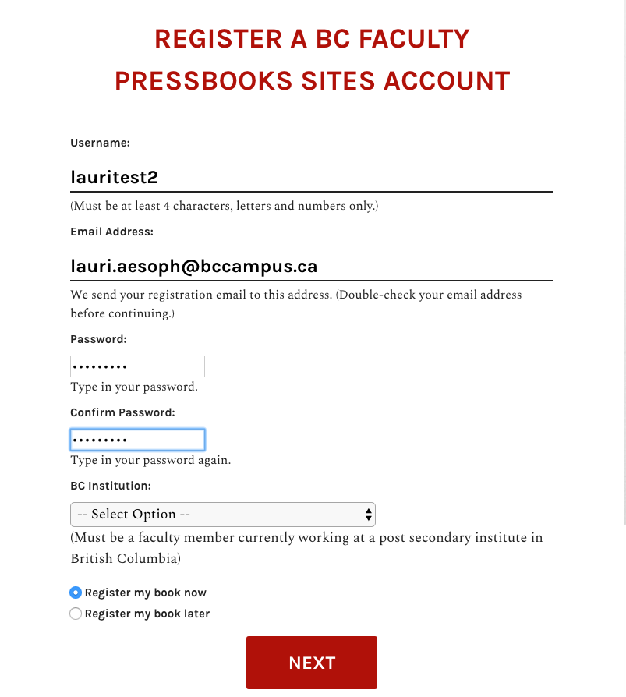
Notes:
The Sign up/Register page says you must be a post-secondary faculty member, but post-secondary staff are eligible as well.
Yukon faculty and staff are also eligible and Yukon College is included in the “B.C. Institution” drop-down list.
Only the public post-secondary institutions in BC (+ Yukon College) are listed on the drop-down list, but private post-secondary faculty and staff may use Pressbooks as well. Those from a private college or university should contact the BCcampus Helpdesk for account set-up assistance via email (helpdesk@bccampus.ca) or through the Contact/Help link on our website (open.bccampus.ca).

Slide 10
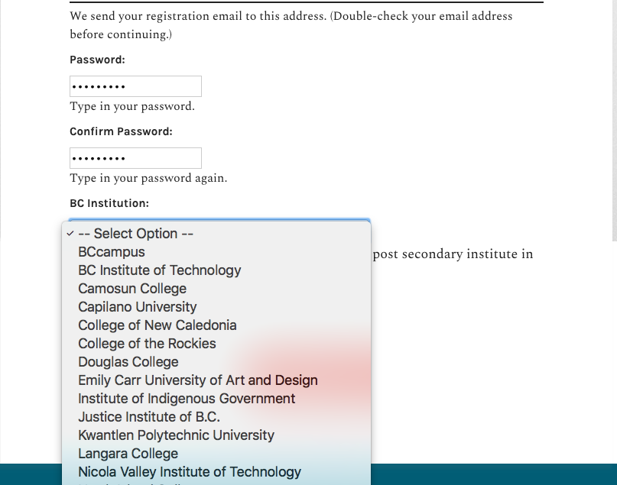
Notes:
Once you select your institution from the drop-down menu…
GO TO NEXT SLIDE

Slide 11
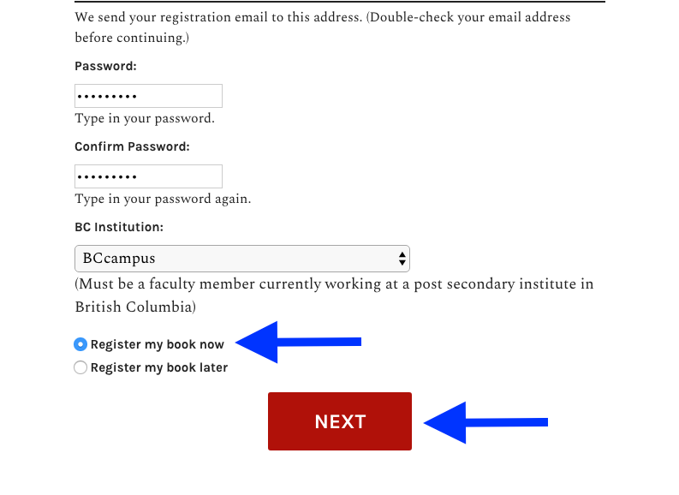
Notes:
You can “Register a book now” (this is the default setting, and means that a book shell will be created in addition to setting up your account) followed by clicking on “Next”. When you register a book, that means that you are creating a shell for either a new book or to upload an existing book. …
GO TO NEXT SLIDE

Slide 12
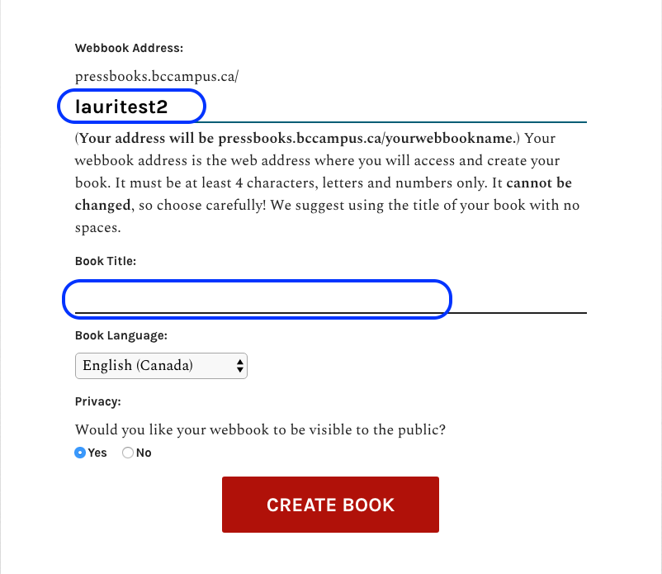
Notes:
Here, you’ll see that your username has been entered as a placeholder for what you’re going to append on the pressbooks.bccampus.ca URL with a descriptive phrase for your book.
The Book Title field has not been filled in yet.

Slide 13
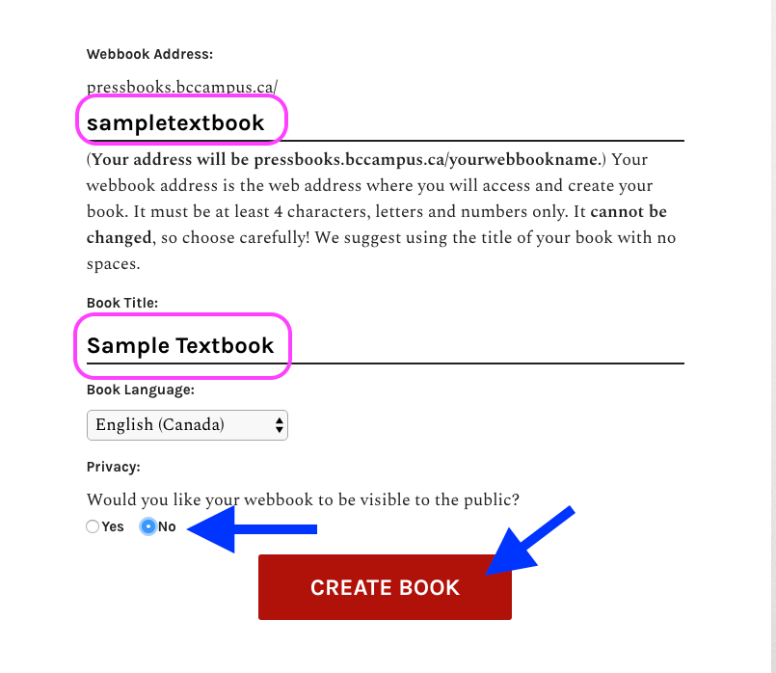
Notes:
1. When appending the pressbooks.bccampus.ca URL with a descriptive phrase for your book, choose carefully because this cannot be changed once the book is created. One suggestion is to use the title of your book with no spaces. In this example, I’m going to create my unique URL by appending “sampletextbook” to pressbooks.bccampus.ca/.
2. The book title can be changed later, so isn’t as much of a concern
3. The book’s language can be chosen. ”English (Canada)” is the default choice.
4. Under “Privacy”, it’s recommended that your book be set to private or “No” to public. The default setting is yes.
5. Finally, click on “Create a Book”.

Slide 14
Notes:
If you want to create or register the book in your account later, use “Register my book later”. Click “Next” and you’re done.
GO TO NEXT SLIDE

Slide 15
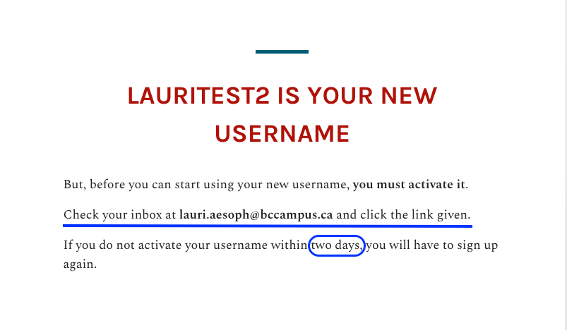
Notes:
To activate your account, you’ll need to retrieve the email generated by the system.
You have two days to get this done.

Slide 16
Notes:
This is what the activation email looks like. You’re required to click on the link in the message.

Slide 17
Notes:
This is the message you will see after clicking on the activation link in the email generated by Pressbooks.
From this point, you can choose to immediately log in or go back to the homepage where you can also log in by clicking on “Sign In”.
BTW: If you click on the BCcampus logo in the top left-hand corner (or anywhere else in this Pressbooks system), you will be redirected to the home page of pressbooks.bccampus.ca

Slide 18
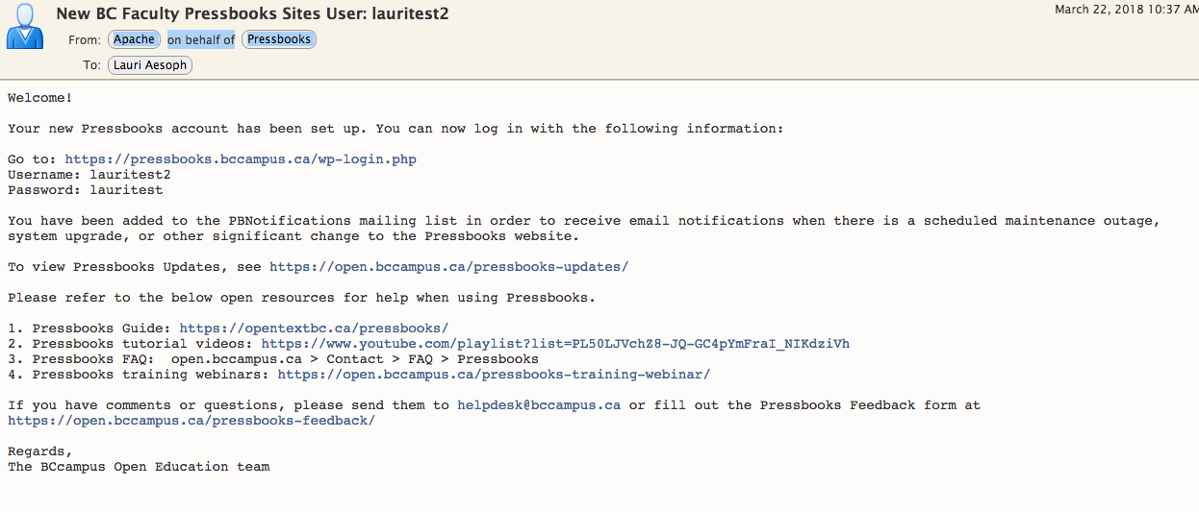
Notes:
Once you’ve activated your account by clicking on the activation link in that email, you will also receive this email about 5-10 minutes later containing the username and password that you chose for this account, along with a link to the login page on the BC Faculty Pressbooks website.
This email also contains a list of the resources available to help you use Pressbooks and informs that you have “been added to the PBNotifications mailing list in order to receive email notifications when there is a scheduled maintenance outage, system upgrade, or other significant change to the Pressbooks website.
You are asked to contact the BCcampus Helpdesk (helpdesk@bccampus.ca) if you have questions.

Slide 19
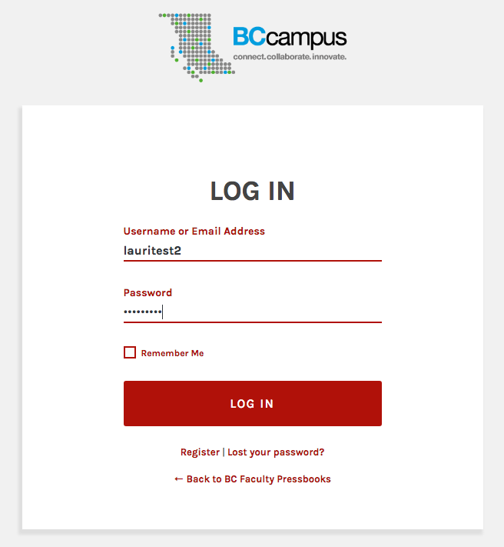
Notes:
This is the login page accessed through the “Log in” link from the activation message. It also appears when you select “Sign in” from the Pressbooks home page at pressbooks.bccampus.ca

Slide 20
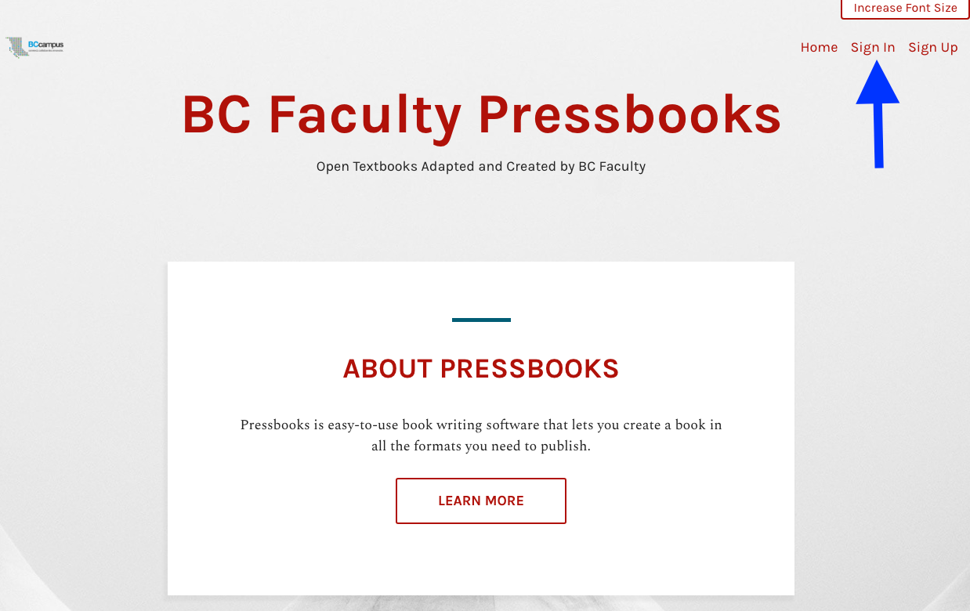
pressbooks.bccampus.ca
Notes:
As a reminder, here’s the home page where you started and created an account. It’s also where you can begin to sign in or log in. Use the same URL or web address: pressbooks.bccampus.ca

Slide 21
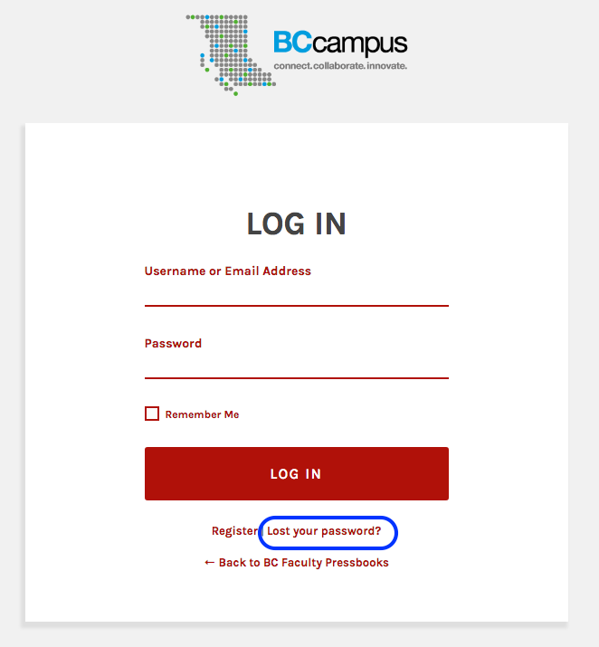
Notes:
If you ever forget your password, simply go to the “Sign in/Log in” page and click on the “Lost your password” link to reset it…
GO TO NEXT SLIDE

Slide 22
Notes:
…and you’ll be prompted to enter your username or the email address you used to create this account (if you also forget your username), after which you click on “Get New Password.”

Slide 23
Notes:
This is the email you receive which contains your username and a link to reset your password.

Slide 24
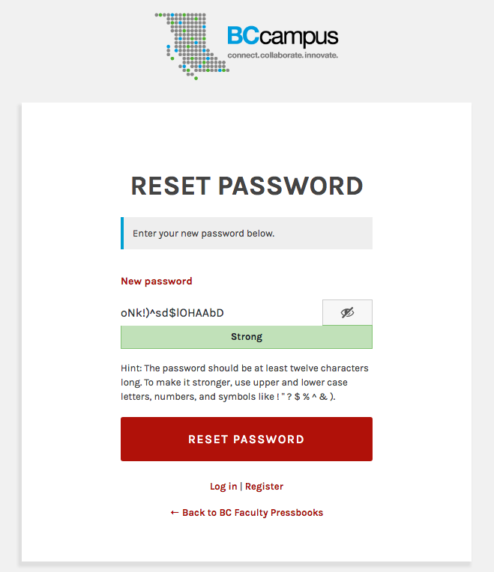
Notes:
When you click on the “Reset Password” link, this is the message you receive. You can accept the “strong” password provided by the system by clicking on “Reset Password” or clear this field and create your own. The system will judge the strength of your password as you enter it.
The criteria for a strong password include:
Lots of characters (12 mentioned here)
Upper and lower case letters, along with numbers and symbols

Slide 25
Notes:
Once your password has been reset, you can log in.

Slide 26
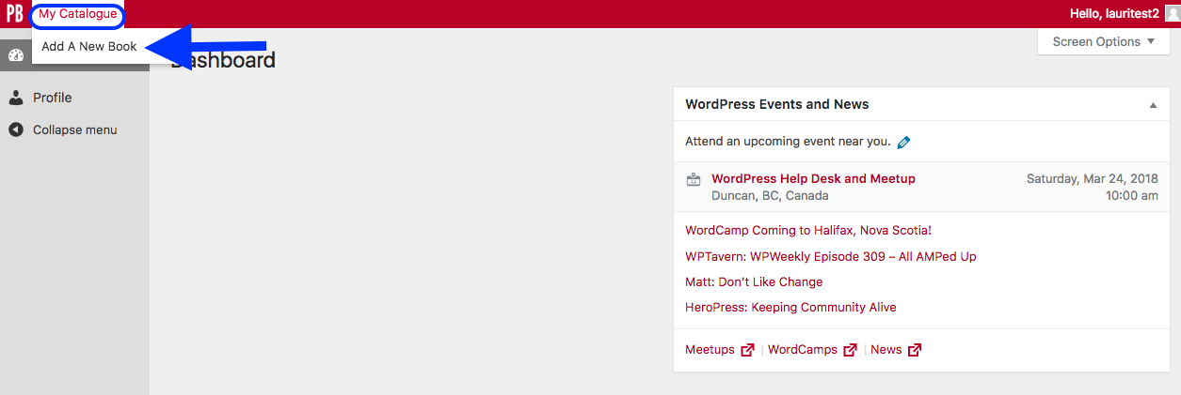
Notes:
Once you log in, if you have not created a book you will land on the Dashboard page of your account.
To add a book, scroll over the “My Catalogue” link in the top left-hand corner, and select “Add a New book”…
NEXT SLIDE

Slide 27
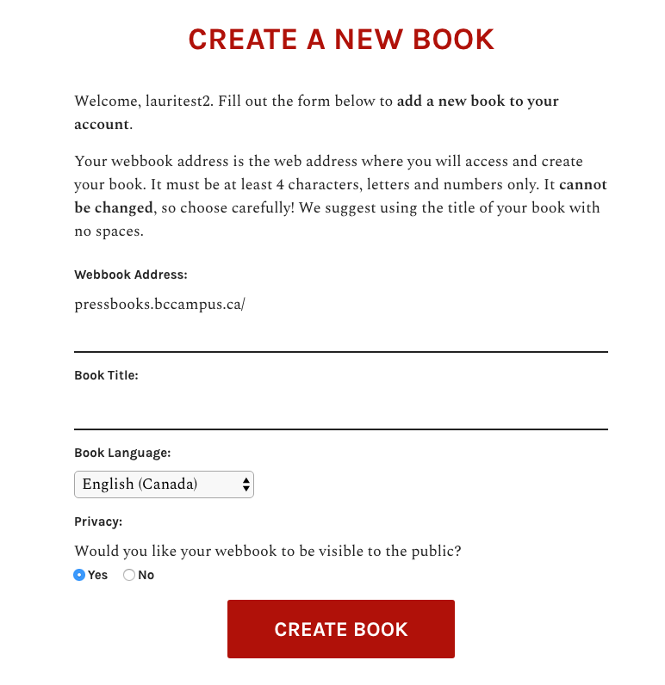
Notes:
… which will take you to the “Create a new book” page. This page is similar to the one you see if you register a book at the same time as you create a new account. The only difference is the “Create a New Book” label at the top of the web page.

Slide 28
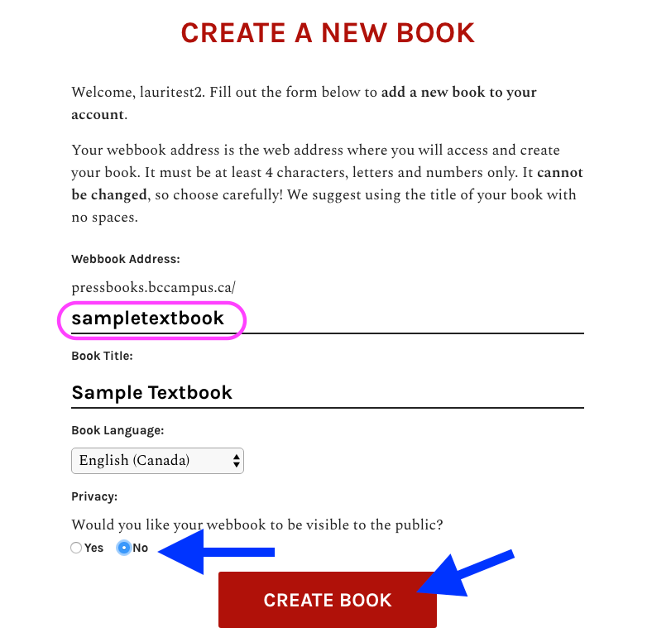
Notes:
As mentioned before:
1. When appending the pressbooks.bccampus.ca URL with a descriptive phrase for your book, choose carefully because this cannot be changed once the book is created. One suggestion is to use the title of your book with no spaces. In this example, a unique URL is created by appending “sampletextbook” to pressbooks.bccampus.ca/.
2. The book title can be changed later, so it isn’t as much of a concern.
3. The book’s language can be chosen. ”English (Canada)” is the default choice.
4. Under “Privacy”, it’s recommended that your book be set to private by selecting “No” to public. The default setting is “Yes.”
5. Finally, click on “Create Book.”

Slide 29
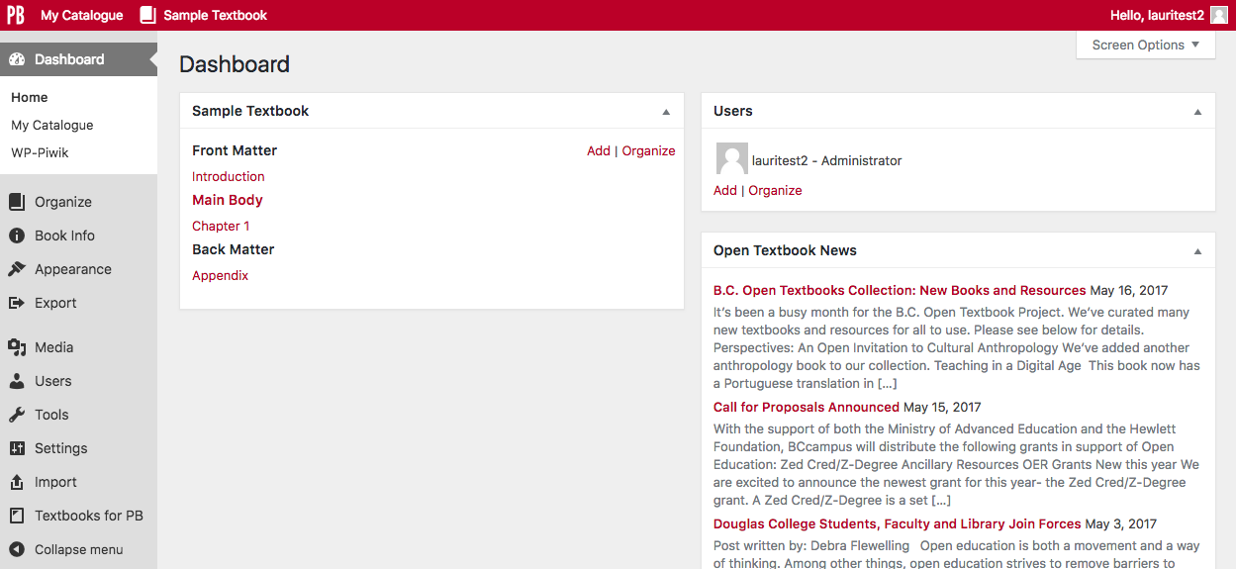
Notes:
When a book is created, you will be taken to the book’s Dashboard page. Lesson 3 will cover some of the basics about how to use the Dashboard.

Slide 30
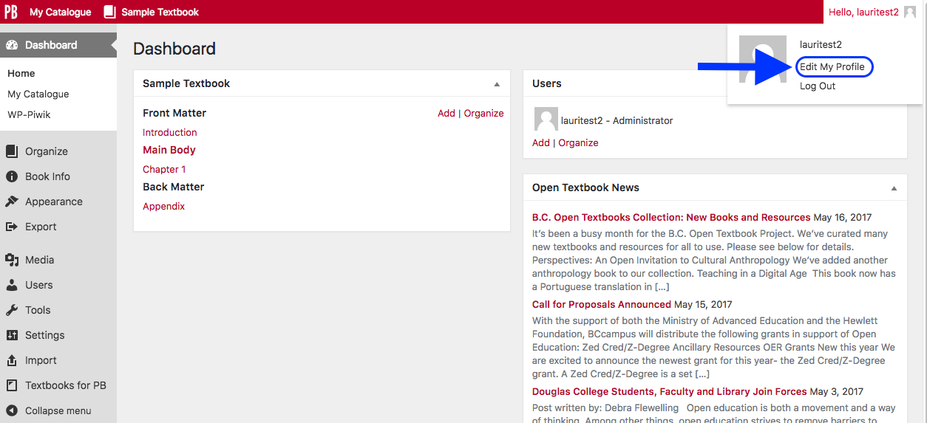
Notes:
You can change the password for your account from the Dashboard by scrolling over the greeting “Hello” to reveal the drop-down menu for your accoun and selecting “Edit My Profile.”

Slide 31
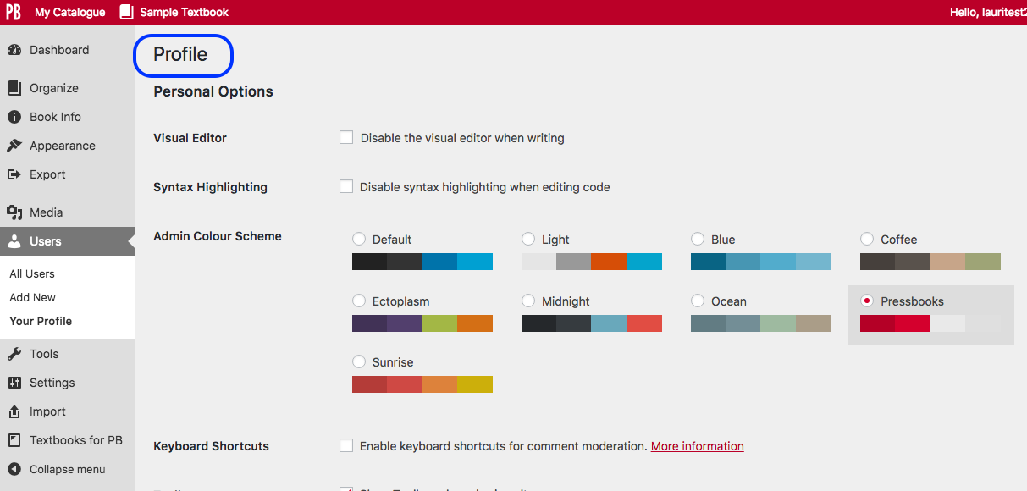
Notes:
This is what you’ll see this.
Note “Profile” in the top left corner
Scroll down this page until you see…
GO TO NEXT SLIDE

Slide 32
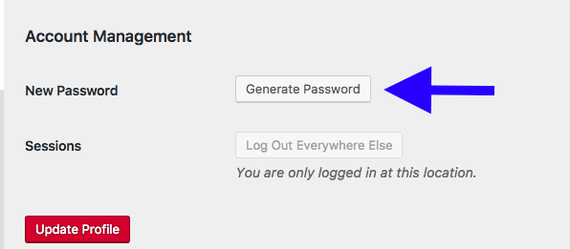
Notes:
… the “Account Management” section at the bottom of the web page.
If you click on the “Generate Password” button…
GO TO NEXT SLIDE

Slide 33
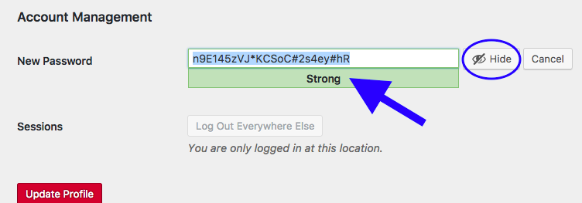
Notes:
…the system will generate a “Strong” password for you. If you clear the “New Password” field, the system will evaluate the strength of your password as you enter a self-selected password.
Notice the ability to Hide your password and a “Cancel” button beside it to cancel this action.

Slide 34
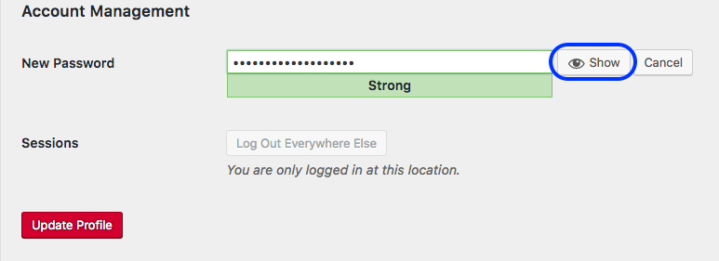
Notes:
Here your password is hidden, but you can display it again with the “Show” button.

Slide 35
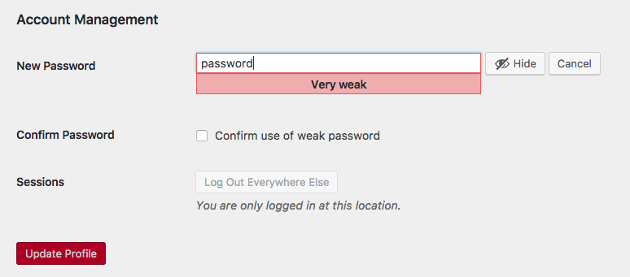
Notes:
Here is a “very weak” password
Notice that you can use a very weak password, but must check the “Confirm use of weak password” box before the system will allow you click the “Update Profile” button.
This “confirm” message appears for “very weak” and “weak” passwords.

Slide 36
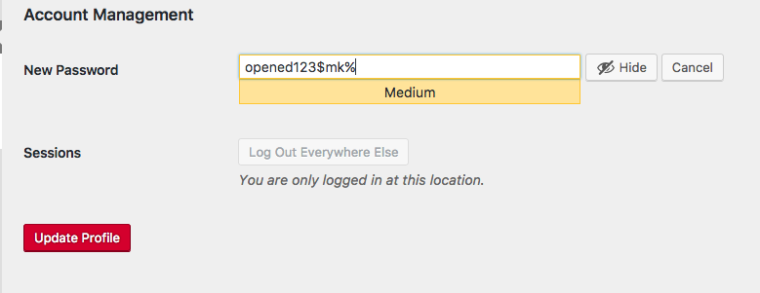
Notes:
Here’s a stronger password -- judged by the system to be of “medium” strength – which eliminates the confirmation checkbox.

Slide 37
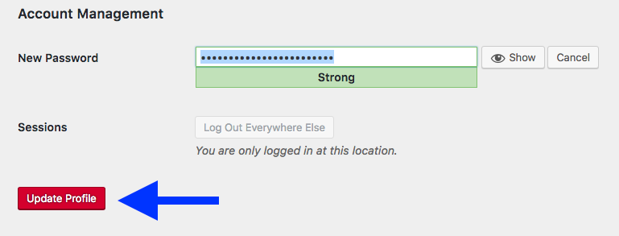
Notes:
Once you have selected a new password for our account, the final step is to click the “Update Profile” button.

Slide 38
Lesson 2
Customize the profile page in your account
Notes:
Lesson 2: Customizing the profile page in your account.
In this lesson, we’ll review some options on the Profile page of your account.

Slide 39
Notes:
As mentioned earlier, the Profile page is accessed via the drop-down list in the upper-right corner of your admin or book Dashboard view.

Slide 40
Notes:
You can customize the colour scheme of your account. For the BCcampus instances of Pressbooks, the “Pressbooks” colour scheme is actually the default setting, not the “Default setting.”
Regardless, choose your preferred colour from these selections. There is no need to save the new choice. The system saves it automatically.

Slide 41
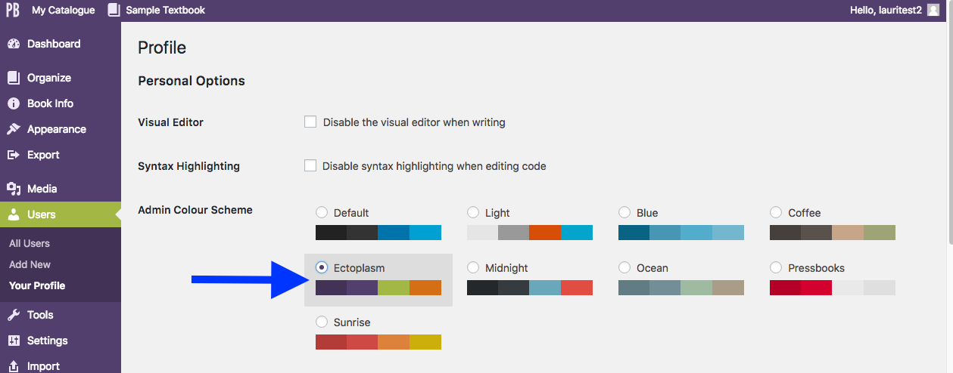
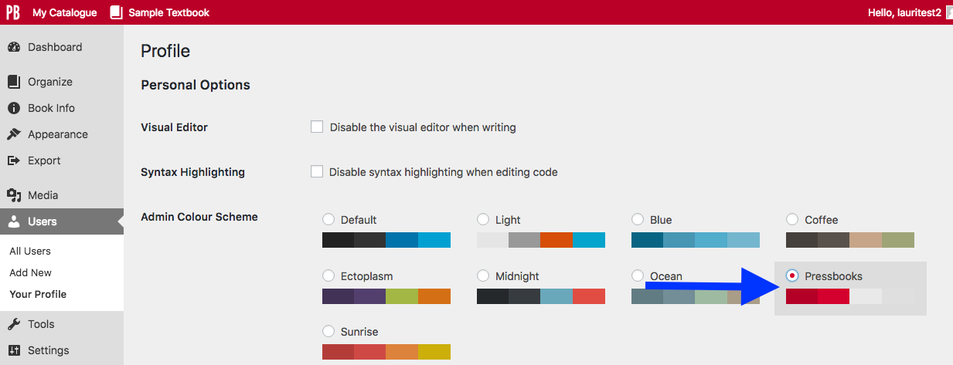
Notes:
Here is an example. At the top, the colour scheme “Ectoplasm” is selected.
Notice that the left-hand toolbar is purple and the highlighted “Users” link is light green compared to the default “Pressbooks” setting, shown under it, where red, white, and various shades of gray are applied.

Slide 42
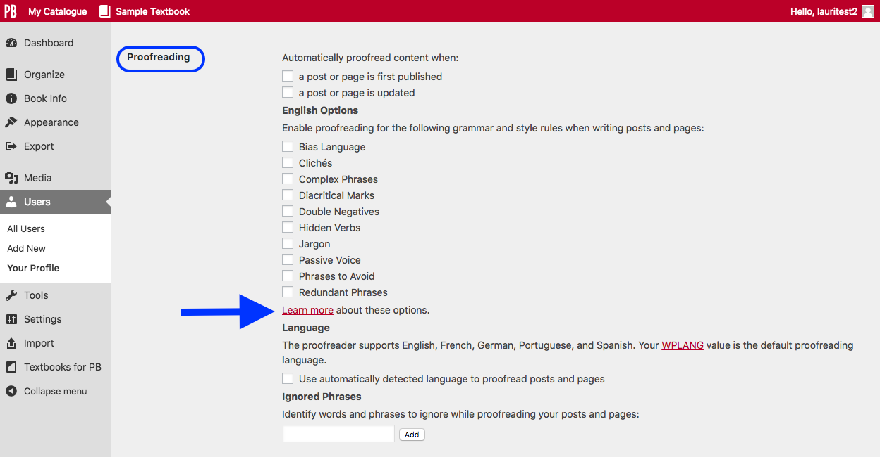
Notes:
There is a proofreading feature that allows you to pick a variety of rules that the system will monitor and point out as you write.
This feature also allows you to indicate when the proofreading feature should be enabled, i.e., when a page is first published and/or when it is updated.
Proofreading works for a variety of languages besides English such as French, German, Portuguese, and Spanish.
The system does not differentiate between Canadian, American, and British English…yet. However, the system houses words for each type of spelling.
For more information about this system, click on the “Learn more” link by the arrow.
NOTE: This system does not replace professional copy editing and proofreading that each open textbook or other educational resource should undergo before publishing.

Slide 43
Notes:
The “Name” section of your Profile page automatically populates the “Nickname” field with the username you chose.
This is a required field AND the warning message “Your Nickname must be different than your login name (i.e., username)” will occasionally appear at the top of the Profile page after updating or saving changed or new information.
However, at this time, the system does not enforce this requirement; in other words, if the Nickname isn’t changed, nothing happens.
GO TO NEXT SLIDE

Slide 44
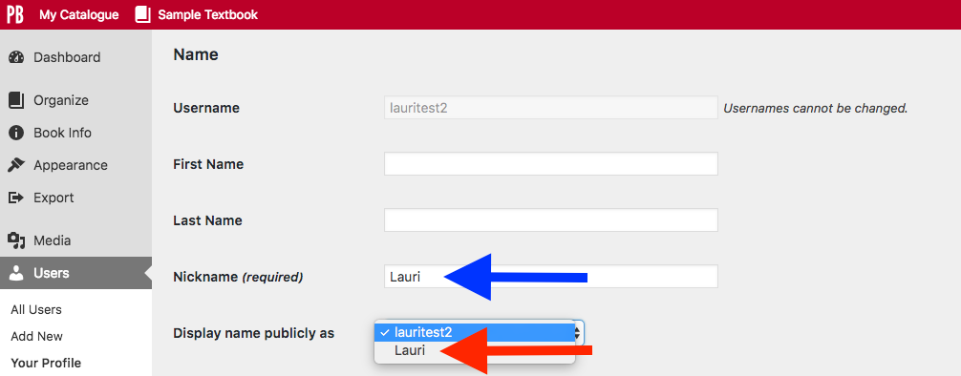
Notes:
However, as soon as you enter a new Nickname (here, ”Lauri” has been added), then it appears on the “Display name publicly as” drop-down list.
Whichever name you pick from this list and pdate at the bottom of the web page …
GO TO NEXT SLIDE

Slide 45
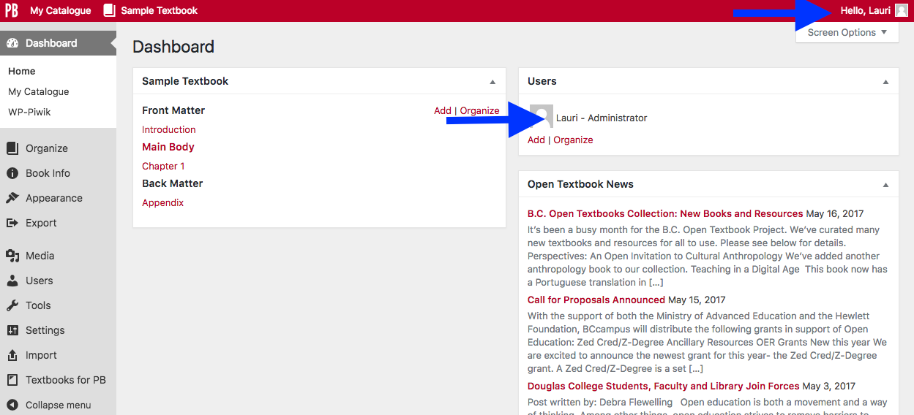
Notes:
…is displayed on the administrative interface, including your User label so that “lauritest2” is now “Lauri.”

Slide 46
Lesson 3
How to navigate the Dashboard
Notes:
Lesson 3: How to navigate the Dashboard will be covered next.
This will be a high level review of the tools available when working on a book in Pressbooks. More detailed discussions are offered in some of the intermediate Pressbooks webinars.

Slide 47
Notes:
This is the page you’ll see when you first log into your account. The “My Books” in the top right corner will take you to the Dashboard of your account.
Also notice new information about which browsers work best with Pressbooks. IE or Internet Explorer is no longer supported for this authoring platform so we advise that you either update your browser to Microsoft Edge or switch to other supported browsers such as Chrome, Firefox, or Safari.

Slide 48
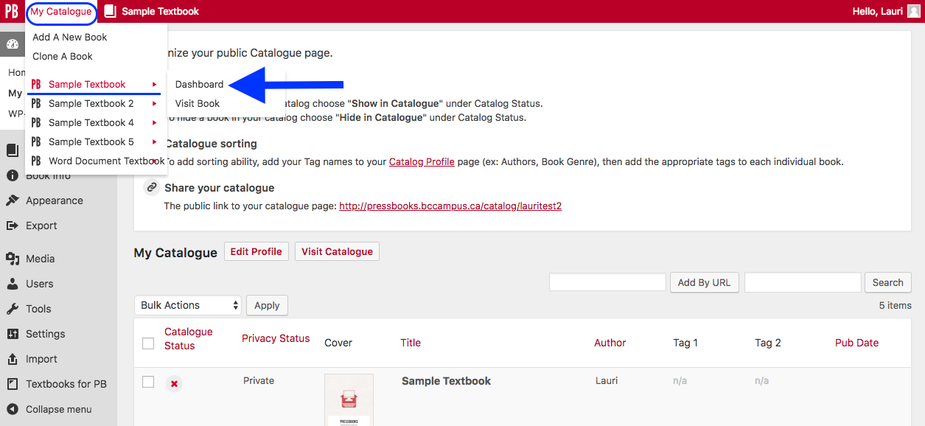
Notes:
From your account Dashboard:
Scroll over “My Catalogue”
Select the arrow by a book
Click on its “Dashboard” (this is the edit view)
“Visit Book” is the book or reader view

Slide 49
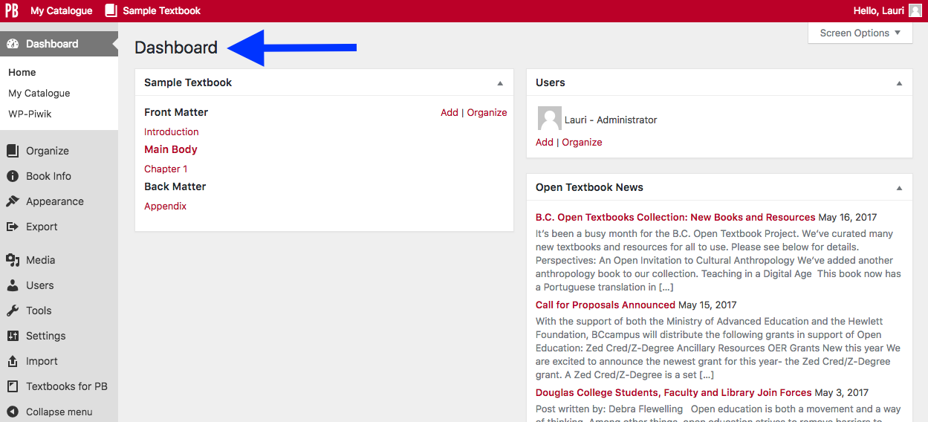
Notes:
The book Dashboard provides an overview of your book.
Various tools can be found in the left column toolbar
Parts and chapters of a book are in the middle
All Users who have access to a book are shown on the right
This book has no imported or newly created content yet. However, it does have:
An “Introduction” in the Front Matter
“Chapter 1” in the Main Body
An “Appendix” in the Back Matter
Pressbooks creates these sample shell “chapters” for each of a newly created book’s parts, i.e. the Front Matter part, the Main Body part, and the Back Matter part.

Slide 50
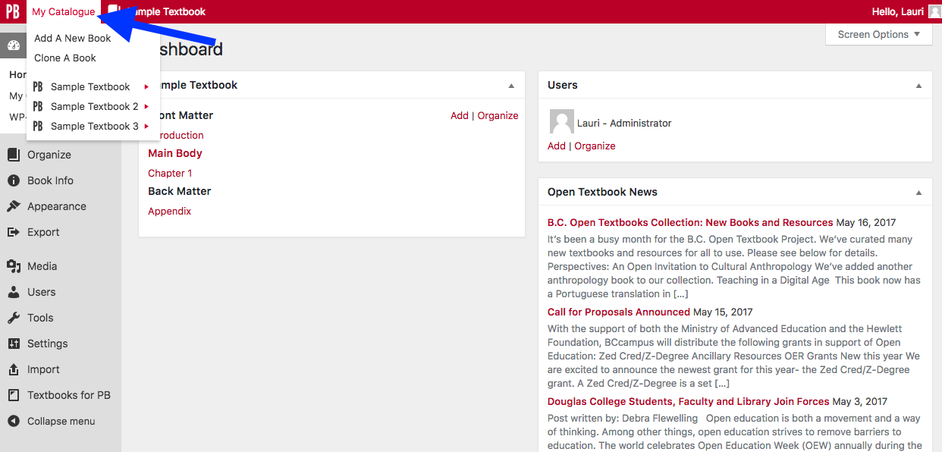
Notes:
As pointed out before, if you have more than one book in your account, use “My Catalogue” to expose a drop-down list with all books in your account.

Slide 51
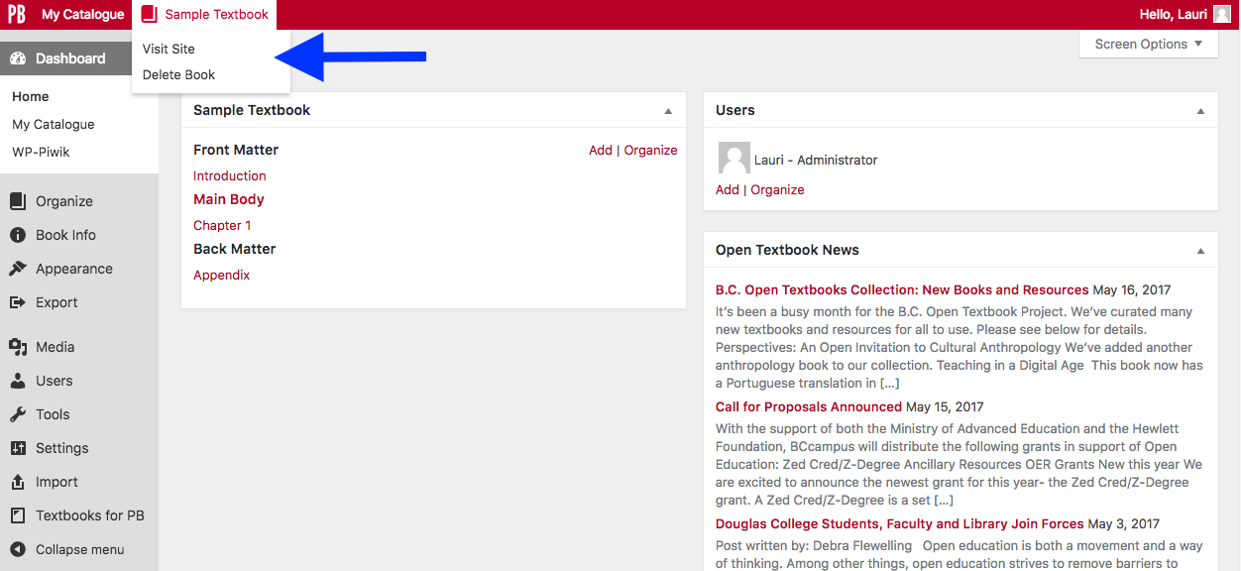
Notes:
When you scroll over a selected book title, three options will appear:
Visit Site – this is how the book appears online, the web version, to the reader.
If you click on the book’s title (with the book icon to the left of the title), this will accomplish the same thing.
Delete Book – this lets you to delete a book
Dashboard – exposes the Visual Editor where you can add content and make changes

Slide 52
Notes:
Here is the book as viewed online by the reader. There are several features to take note of.
In the top right-hand corner:
The “Home” link (circled in pink) will push the top white banner out of view and leave the home page of the book
The “Read” link (circled in red) takes you to the first page of the book. This can also be accomplished with the “Read Book” button by the red arrow.
The “Admin” link (by the blue arrow) takes you back to the Dashboard. Only individuals with administrative access to a book (the owner of the account and other users assigned to the book by the account owner) will see this link.
And the “Sign out” link, also viewable only by individuals with administrative access.

Slide 53
Notes:
Other items to take note of are:
The accessibility “Increase Font Size” feature in the top right corner (by the dark blue arrow)
The “Search” field, also in the top right corner (by the green arrow)
The spot where the book’s cover is displayed once it is uploaded into the book via the Book Info page (circled in light blue)
The book’s title (“Sample Textbook”)
The permissions for a book. This says “All Rights Reserved” indicating that an open-copyright licence has not yet been assigned to the book. This is done on the Book Info page. “All rights reserved” is the default setting for permissions for this system, and for copyright in general.
The icons to social media – Twitter and Facebook – by the red arrow and under the “Read Book” button

Slide 54
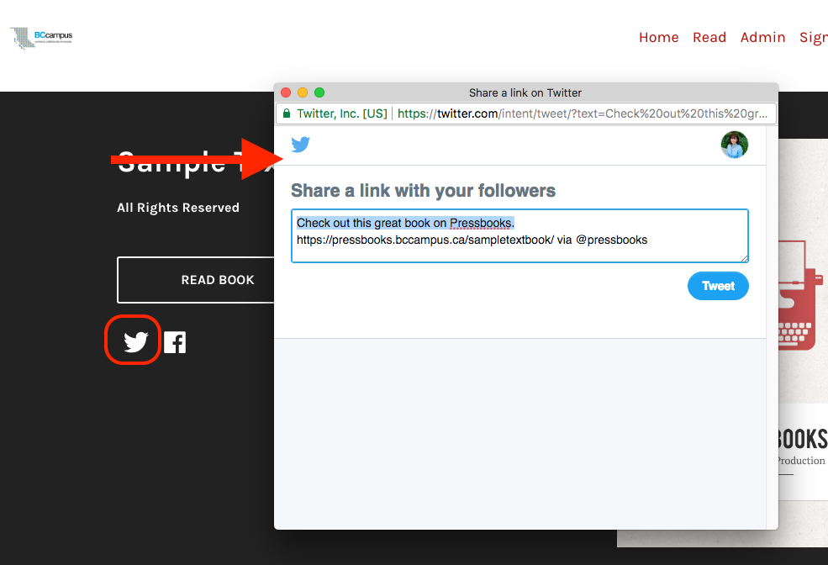
Notes:
For example, here is the pop-up web page that appears when the Twitter icon is clicked to help you tweet about a published book.

Slide 55
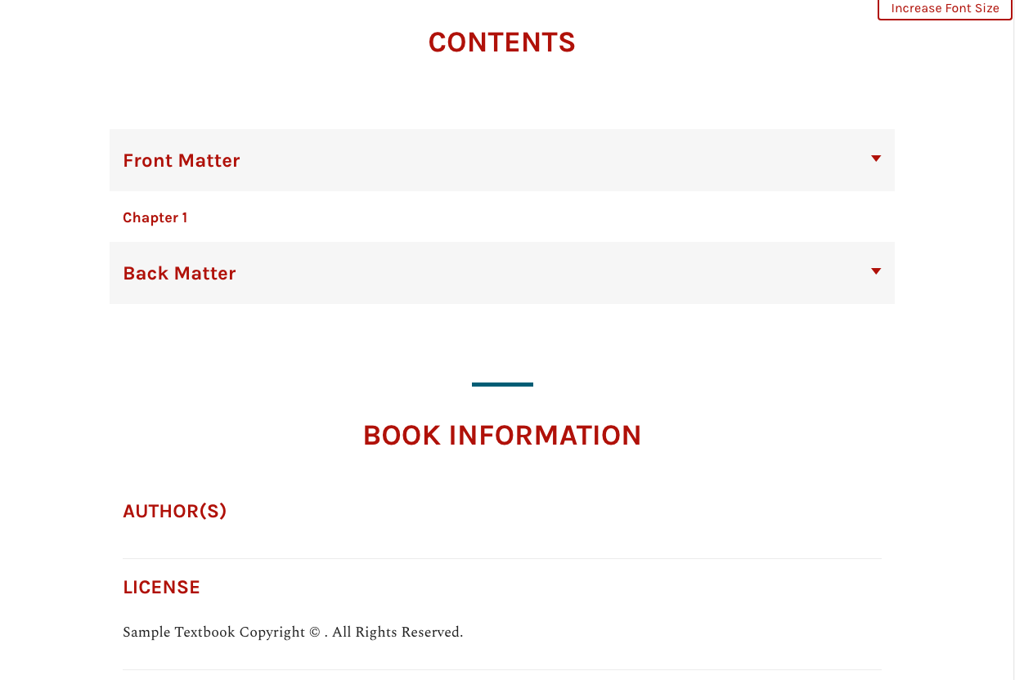
Notes:
This is the middle of a book’s home page where the table of contents are listed and information about the book appear. Once this information has been filled out on the Book Info page, this info will appear here.

Slide 56
Notes:
At the bottom of the book’s home is where metadata displays once it’s been added to the book.

Slide 57
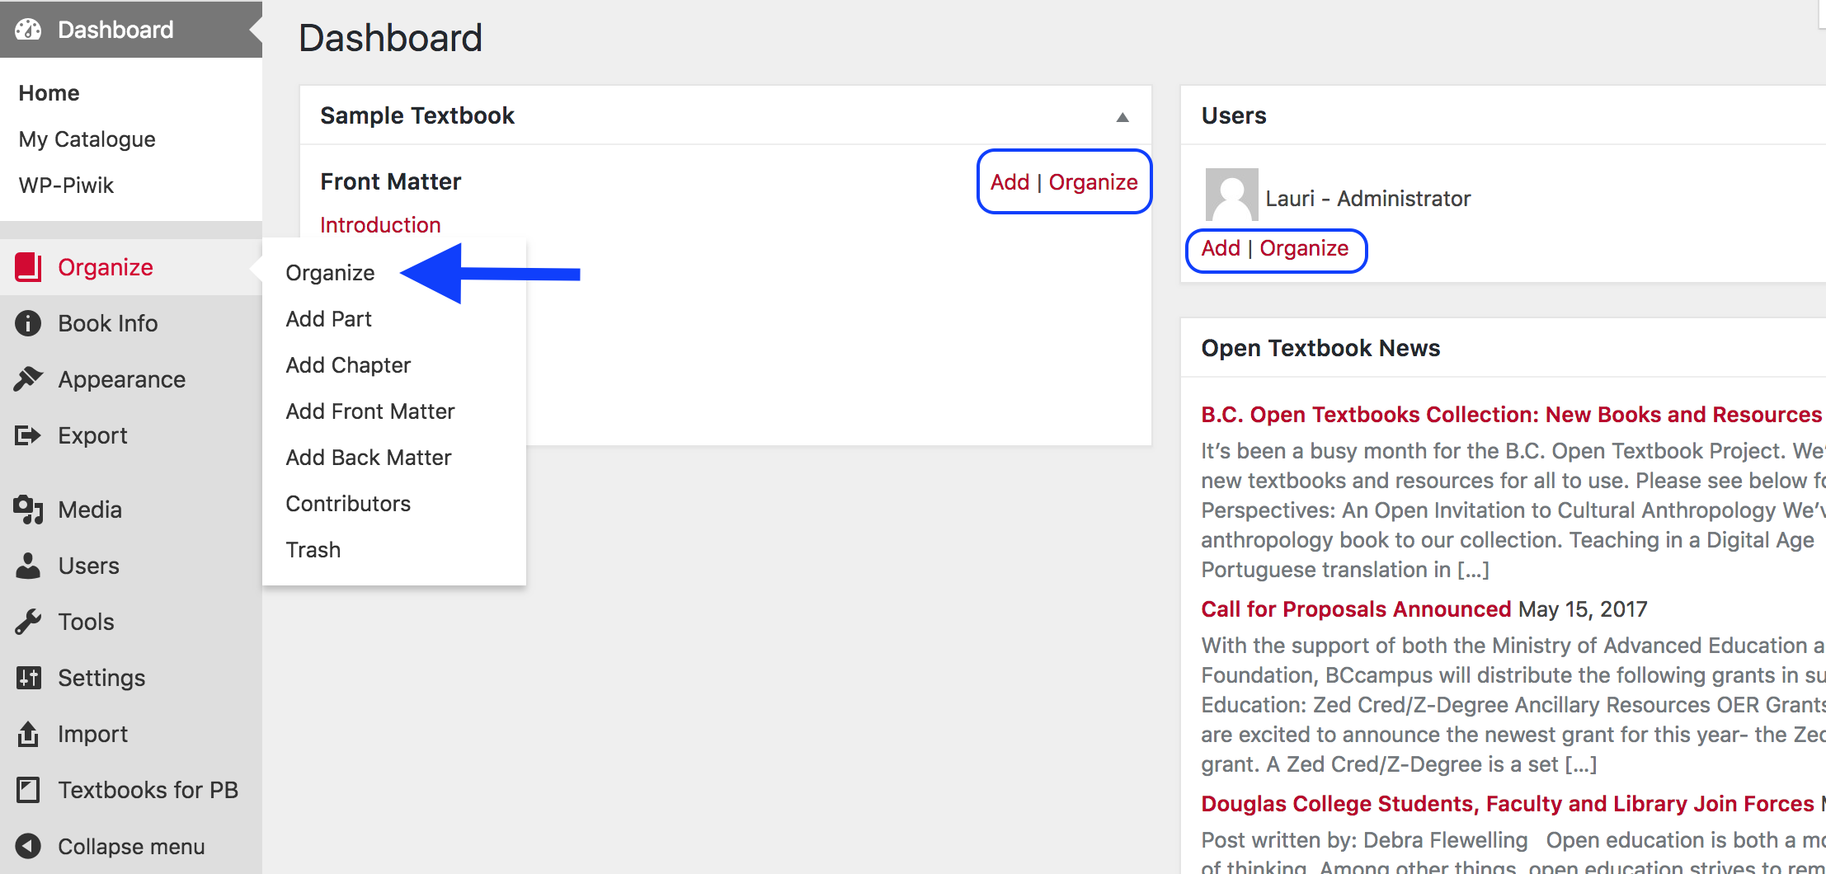
Notes:
Here we can see all of the tools available in the Dashboard view. When you create a Pressbooks account, you are automatically assigned as the administrator so you will have access to these functions. Lesser roles such as Editor, Author, and Subscriber do not see/access all of these tools.
When you click on “Organize”, the drop-down list allows you to do many things which we go over in a minute:
Organize parts and chapters
Add a part
Add a chapter
Add front matter
Add back matter
Add a contributing author (“Contributors”)
View what has been deleted in “Trash”
Notice too the “Add | Organize” options in the top right corner of the book layout box and under your “User” info to the right.
“Organize” is the same as the “Organiz”e link on the Dashboard
“Add” allows you to “Add a Chapter”

Slide 58
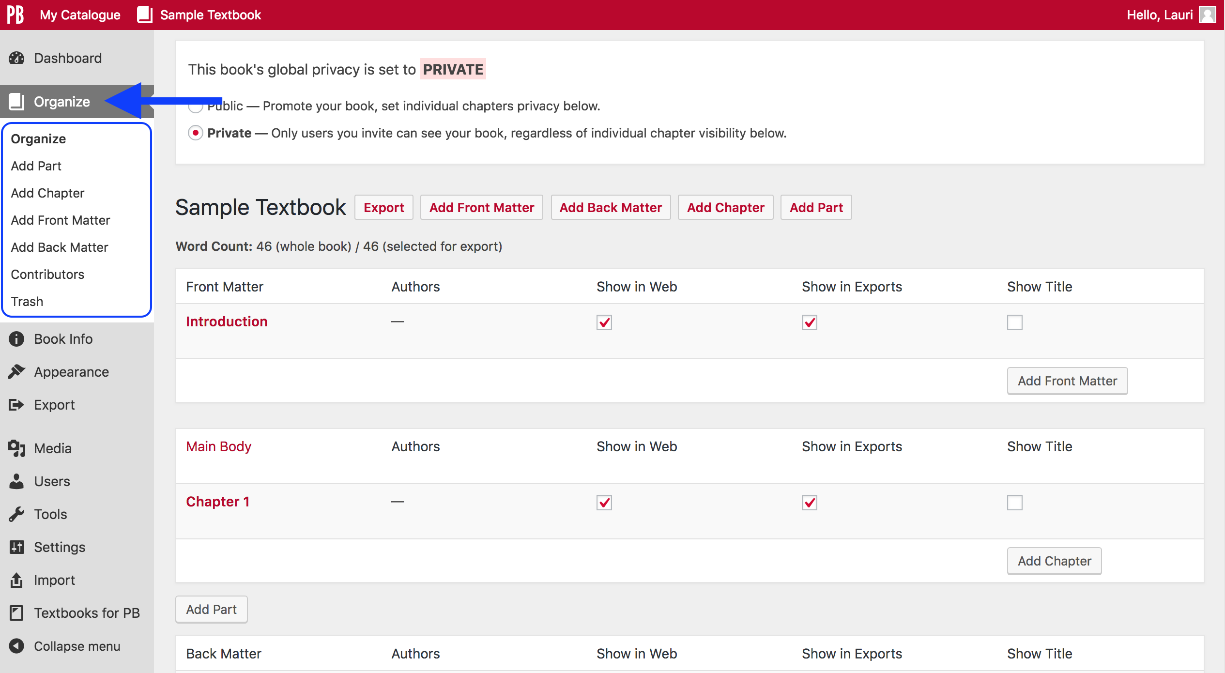
Notes:
In the “Organize” panel, you have all the tools needed for adding, editing, and organizing your book into parts and chapters.
Notice that the same drop-down list that appeared when you scroll over the “Organize” link, now appears in the Dashboard giving you easy access to these options.

Slide 59
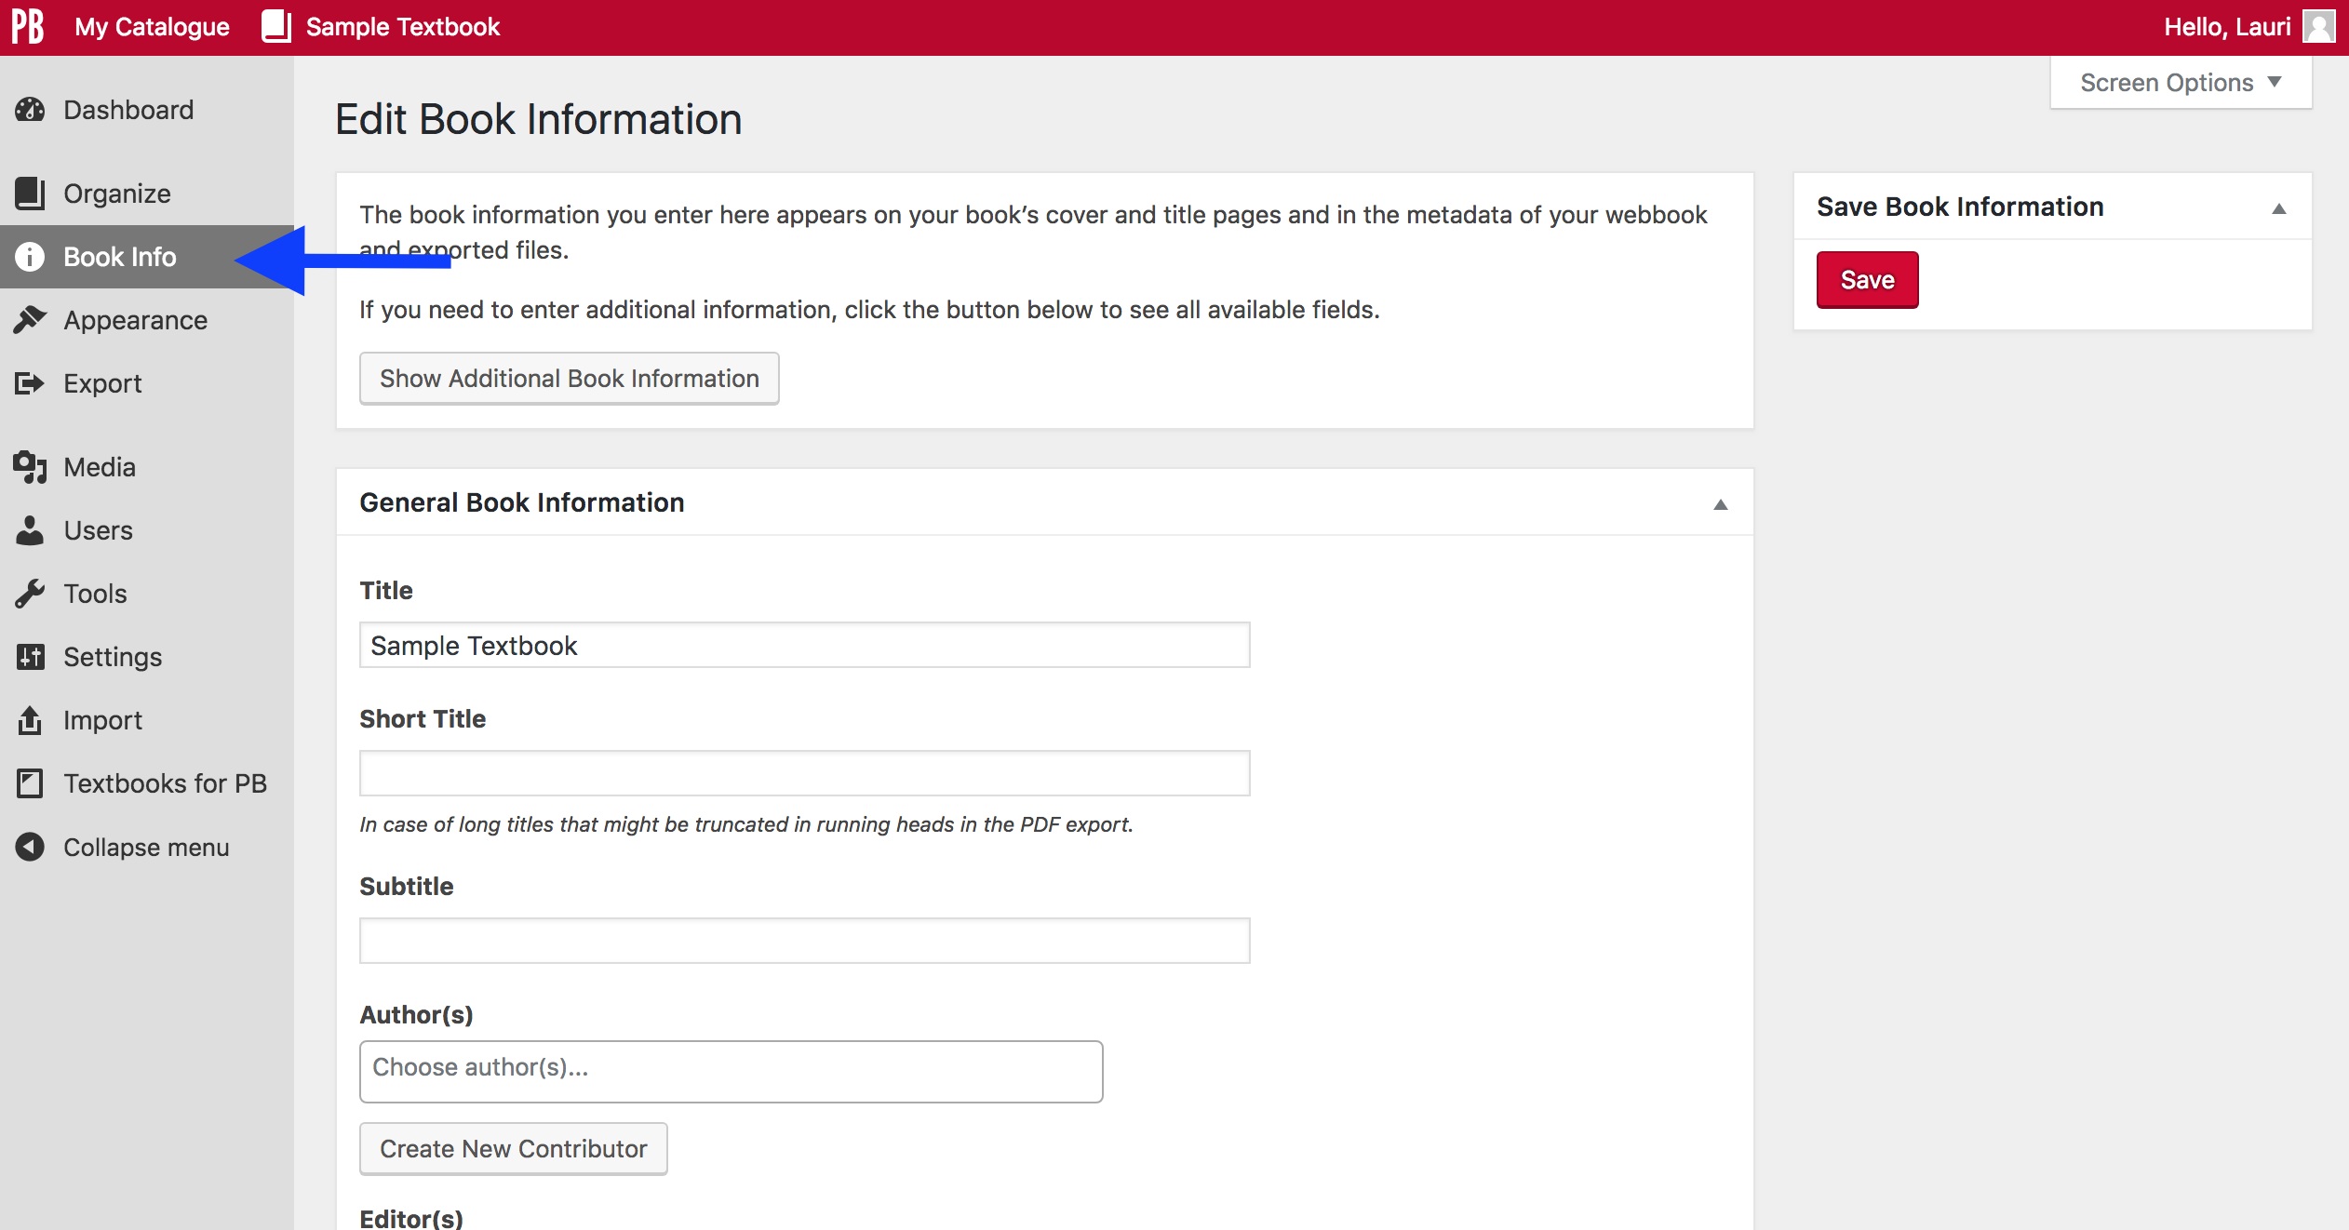
Notes:
This is the “Book Info” page which can be accessed from the Dashboard.
This page should be filled out as you go; however, be sure to review it at the end of the book project to ensure it is complete.
The “Book Info” page includes fields for the book title, author, copyright owner/year/notice, licence type, descriptions of the book, keywords, and other important information.
Much of the data entered here displays on the home page of the book’s web version, and as part of the various exported file formats such as the PDF.

Slide 60
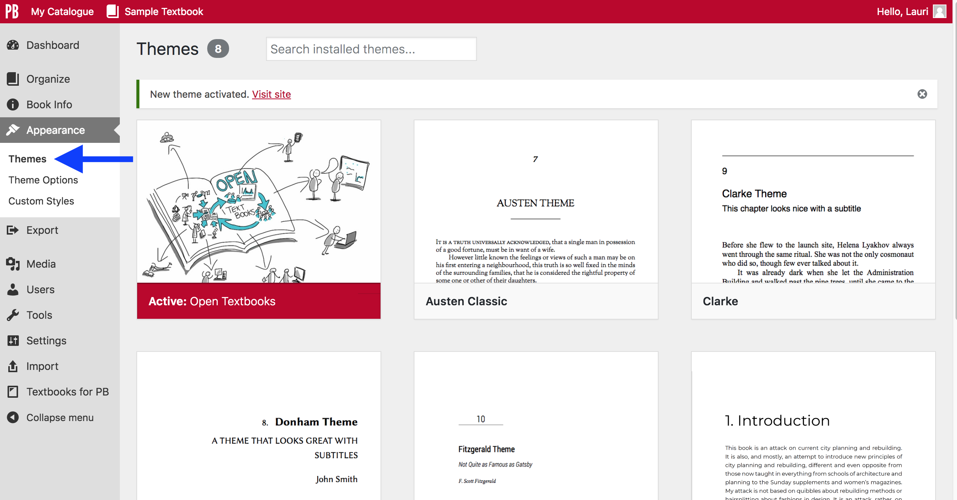
Notes:
Under “Appearance”, you’ll find eight different “Themes” that can be used for your open textbook. The “Open Textbook” theme is chosen by default when creating or registering a book in your account.
If you wish to change to a different theme, do it on this page. Themes differ by style, such as font types, headings, and textboxes.

Slide 61
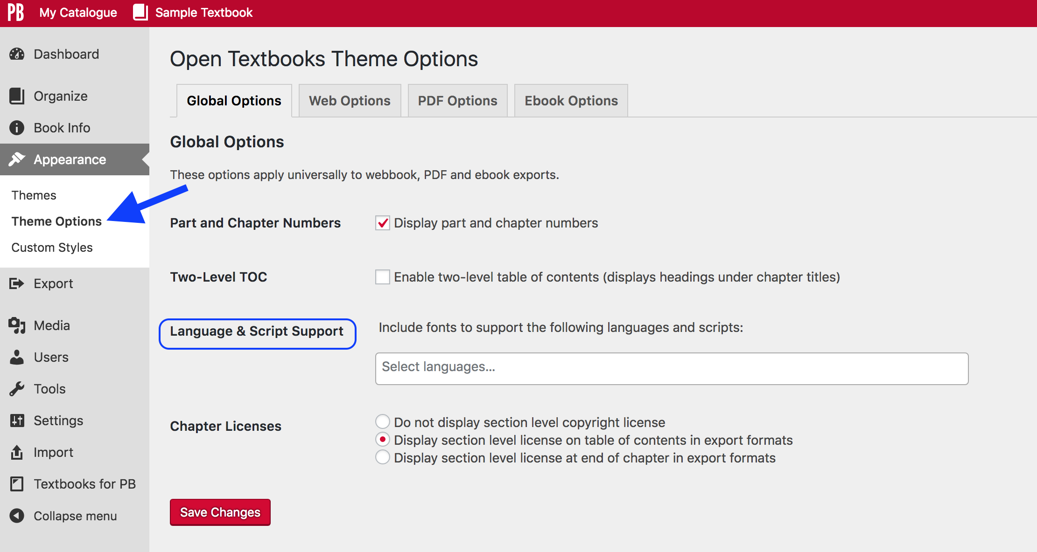
Notes:
“Theme Options” are also available under “Appearances”, and allow further customization of a book by file or format type.
The first tab is “Global Options” and presents options that apply to all formats of your book. Notice “Language & Script Support” which gives access to various fonts for languages that don’t use the Latin alphabet such as Greek, Arabic, Hindi, Chinese, Turkish and more. Some common First Nations fonts are available and labelled as “Canadian Indigenous Syllabics”. Punjabi was recently added as well.

Slide 62
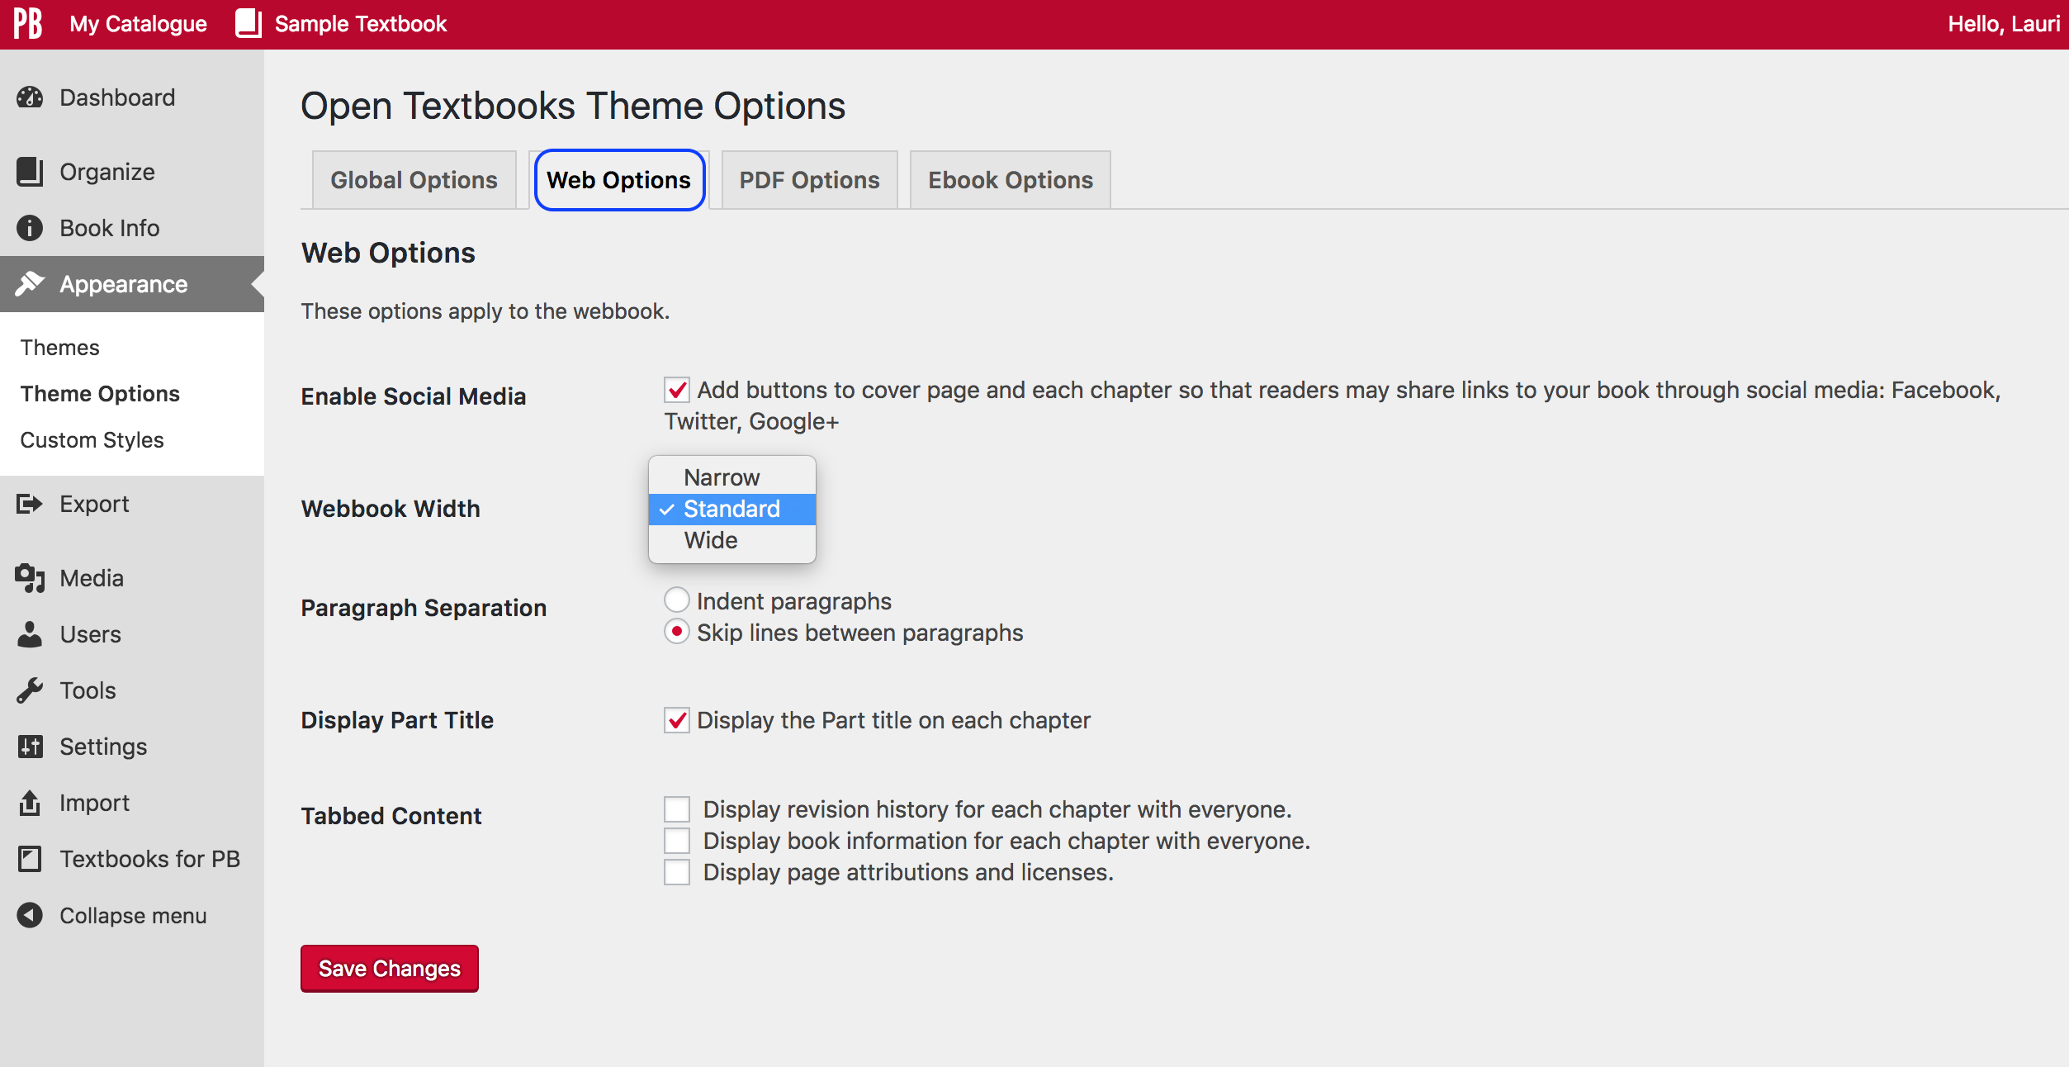
Notes:
The “Web Options” tab allows you to control the online version of a book including the width of the webbook.

Slide 63
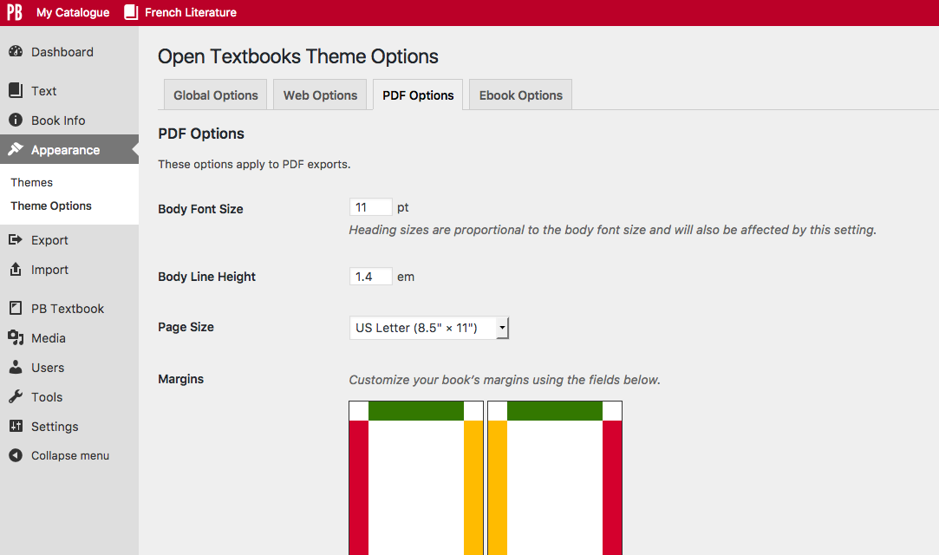
Notes:
The “PDF Options” tab lets you adjust the PDF file generated for a book.

Slide 64
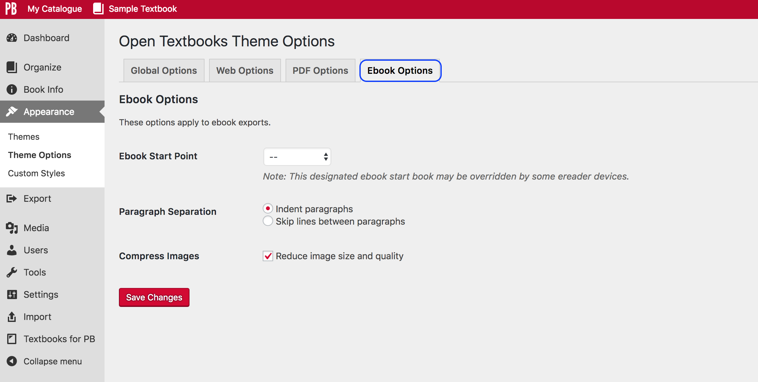
Notes:
And finally, “Ebook Options” allow some customization for EPUB and MOBI files used in eReaders or mobile devices and Kindle.

Slide 65
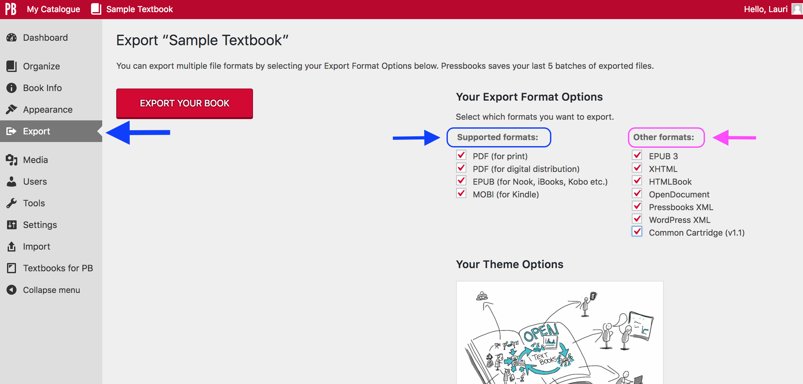
Notes:
A variety of file formats for a book can be exported on the “Export” page. There are 11 file types available, divided into “Supported formats” and “Other formats”. Check all that you want before clicking the “Export Your Book” red button.
For B.C. open textbooks, all file types are exported for others to use. Exported files display on the Home page of the web version of the book when the “Share Latest Export Files” option is marked on the “Sharing and Privacy Settings” page.
Notice:
There are two types of PDFs available: one for print and another for digital purposes
The Pressbooks XML file can be used by others to create a copy of your book in their own Pressbooks account

Slide 66
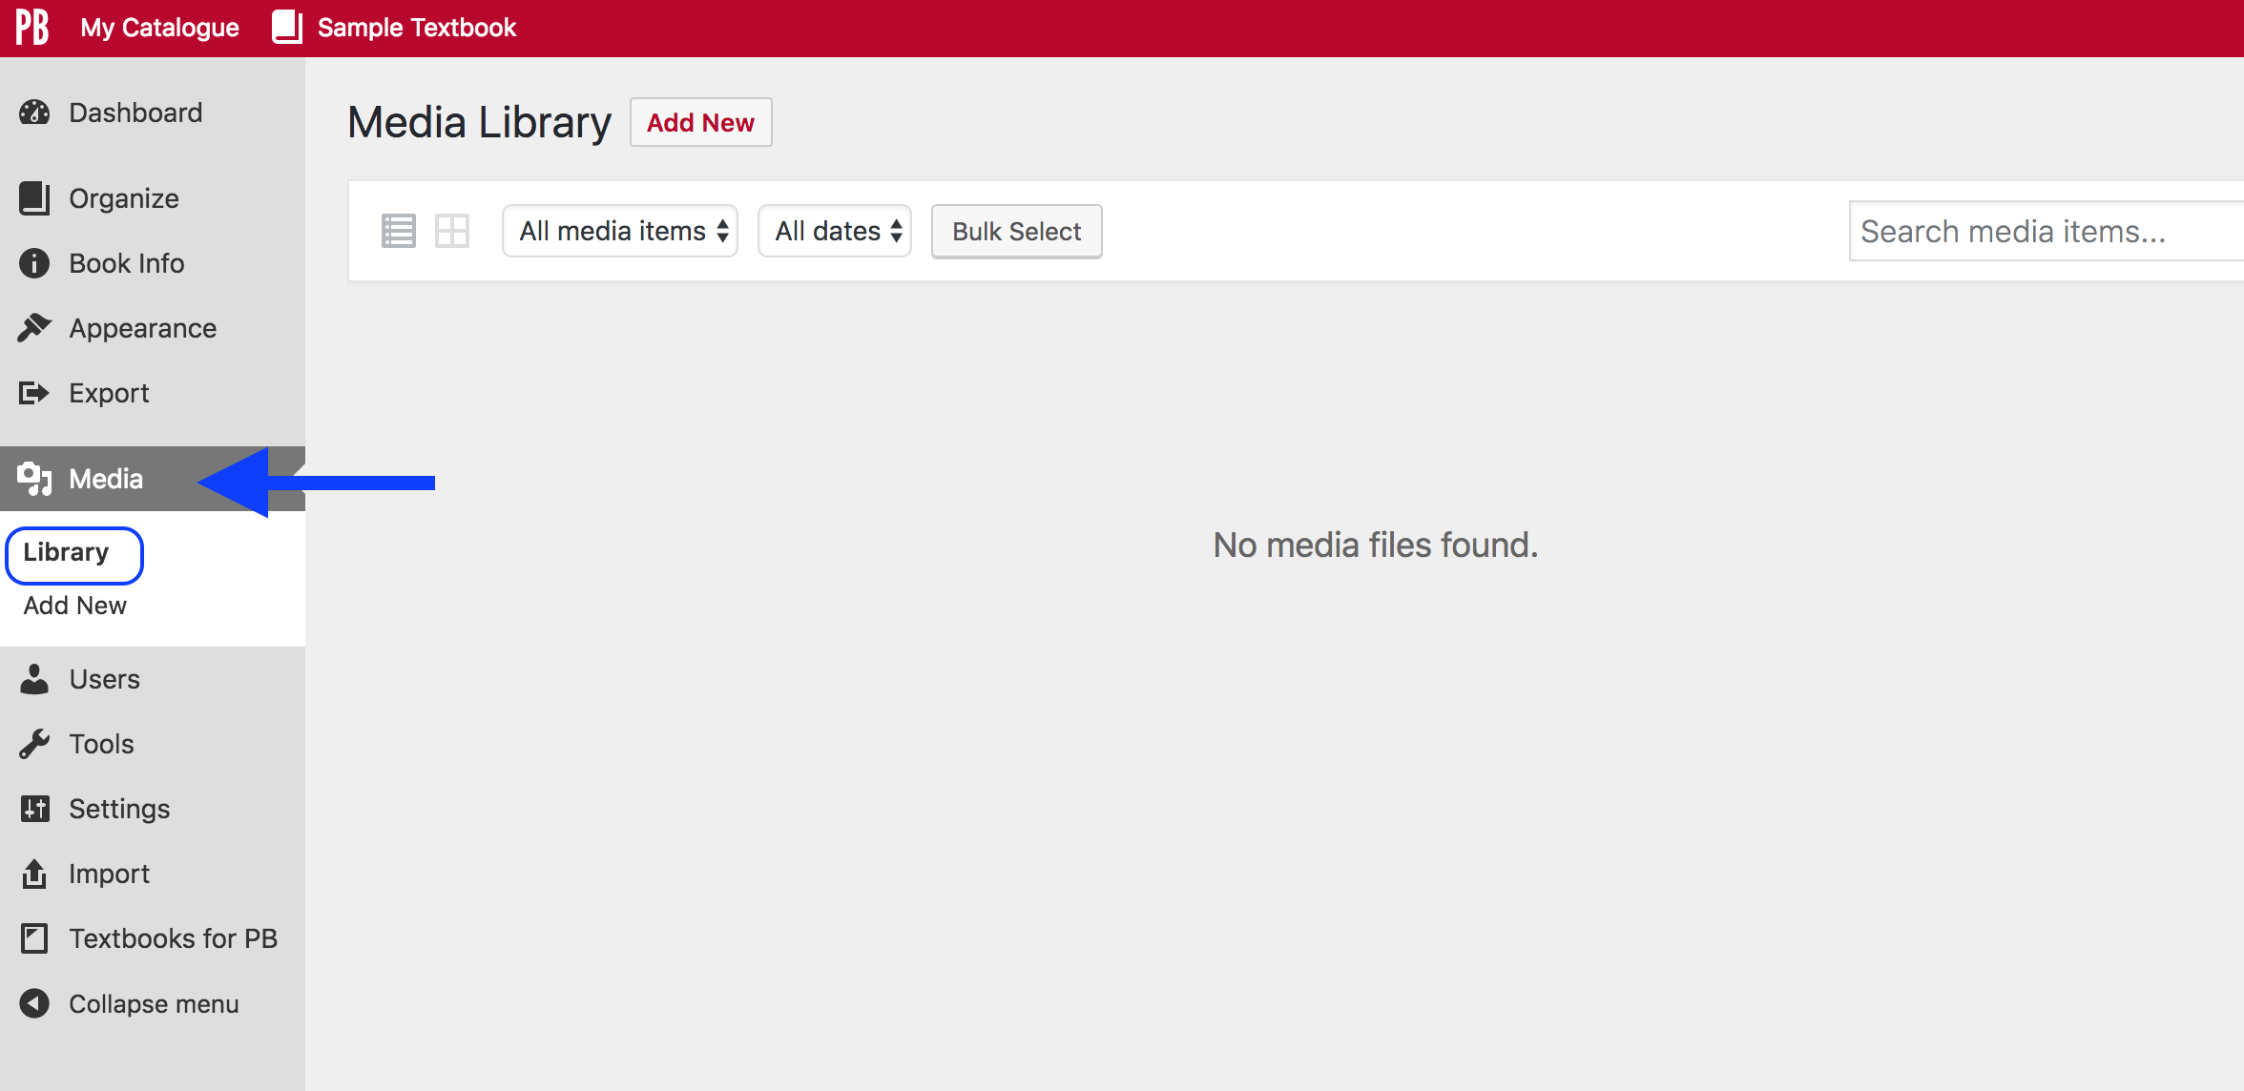
Notes:
The “Media” link takes you to both the “Library”, which holds all media added to Pressbooks for use in a book, and ”Add New” where images, videos, and others files can be added to the library. Because this is a new book, there are no files.

Slide 67
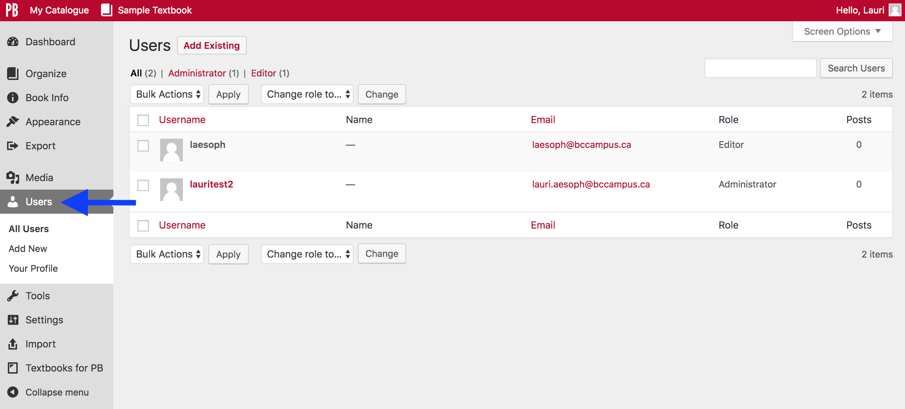
Notes:
The “User” tool allows you to see, add, delete and change the role of a User who has access to your book. Notice too, another link to “Your Profile” listed under this feature.

Slide 68
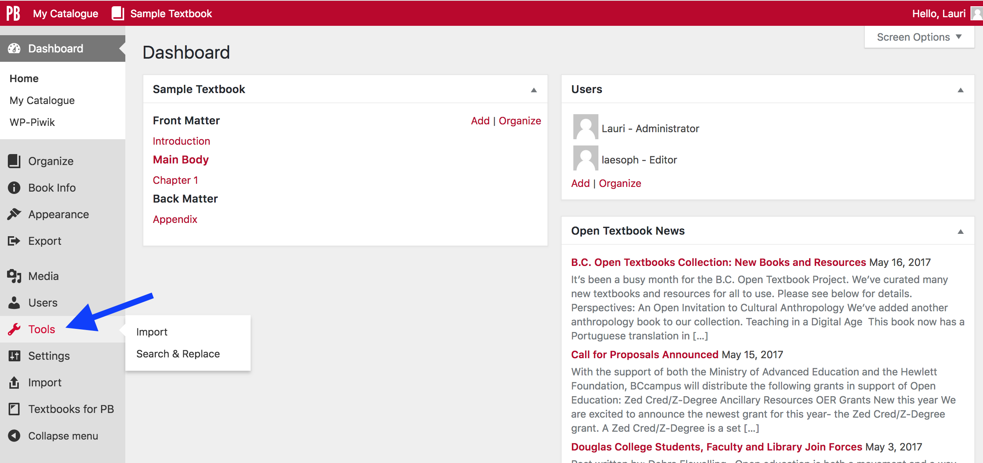
Notes:
The “Tools” link reveals a link to the “Import” page (also listed independently lower down on the Dashboard list) and a “Search & Replace” page.

Slide 69
Notes:
The “Settings” link reveals several drop-down options. A couple of key items to take note of are:
“Sharing and Privacy”, where you can manage the visibility of your book, comments, and the sharing of exported files, and
“Export” which provides additional settings for the “Export” page where files are exported

Slide 70
Notes:
This is the ”Import” panel and allows you to import existing material in a variety of formats including EPUB, Pressbooks or WordPress files, as well as Microsoft Word, OpenOffice (ODT), or HTML (via scraping content from a website).
The details about how to do this will be covered in a later webinar. There are also instructions in the Pressbooks Guide.

Slide 71
Notes:
This the main page of “Textbooks for PB”; (PB stands for Pressbooks.) It describes the why and what of open textbooks.
The drop-down list includes:
“Search and Import”, a feature that lets you search for other books in Pressbooks to import, and
“Download Textbooks” where publicly available books on this instance of Pressbooks (pressbooks.bccampus.ca) can be downloaded

Slide 72
Lesson 4
How to set up
a book
Notes:
Lesson 4 describes “How to set up a book.”
It also covers:
How to add parts (including front and back matter), and chapters
How to order or rearrange parts (including front and back matter), and chapters
How to add text as new content to a book

Slide 73
Notes:
It’s assumed that by this point you have created or registered a book in your account. Before we talk about set up, let’s review what is meant by “part” and “chapter”.
According to the Pressbooks Userguide (from pressbooks.com), “Pressbooks lets you divide your book into Parts: Front Matter, Main Body, other parts you designate and Back Matter.”
When you create or register a book shell in your account, notice that the shell automatically comes with a Front Matter part, “Main Body” part, and Back Matter part (each of these has been circled in the screenshot). In addition, each of these “auto” parts contains a chapter (identified with a blue arrow).
“Introduction” (Front Matter)
“Chapter 1” (Main Body)
Appendix ( Back Matter)
All of these automatically-generated parts and chapters can be used to add content, particularly if you are creating a new book; or they can be deleted if you’re importing an existing book or material.
Most open textbooks published by BCcampus used parts as chapter markers and chapters as chapter sections.
This was done:
so students and other readers could more easily view detailed book content via the table of contents
to avoid long web pages
to better organize a book’s content

Slide 74
Notes:
To add a part:
Go to the Dashboard
Scroll over “Organize” to reveal a drop-down list from which parts, chapters, front matter, and back matter can be added
Select “Add Part”

Slide 75
Notes:
Here is the the new part. Take note of:
The title field where the title for the part is entered
The text field where content can be added
When you’re done and want to csave the part you’ve added, click on the red “Save” button, in the top right-hand corner.

Slide 76
Notes:
To order or rearrange a part relative to other book parts, use the “Order” field in the “Page Attributes” box.
The first part should be numbered as “1”, the second as “2”, etc. In this example, the part is numbered as 2.
Pressbooks automatically assigns the next available number to the “Order” field as parts are added and saved.
To place parts in a different order, renumber accordingly.

Slide 77
Notes:
In the top red banner, click on “View Part” to see what a new part looks like in the book or reader’s view.
This link doesn’t appear until the part has been created or saved.

Slide 78
Notes:
Here is the reader’s view of a new part whether it’s part of the Main Body, Front Matter, or Back Matter.
The EDIT button on the left side, mid page. This appears only for the account holder and will take them back to the book’s Dashboard.
Also take note of:
“Home” which takes the reader to the home page of the web version of the book
“Read” which takes the reader to the first page of the book
“Admin” takes the account holder (not the reader) back to the Dashboard. The reader does not see the “Admin” link.
“Sign out” allows the account holder (not the reader) to sign out of the account holding this book

Slide 79
Notes:
To reveal the table of contents, click on the arrow by “CONTENTS”.
In this example, notice that each part of the book – Front Matter, Main Body, and Back Matter – are displayed.
Clicking on the arrow by a part shows all chapters within that part.
Notice too that:
Parts are labelled all in capital letters
A chapter label mirrors its title. For example, ”Appendix” above is exactly as it has been entered into the title field.

Slide 80
Notes:
From the Dashboard, this is how the “New Part” looks.

Slide 81
Notes:
The ”New Part” appears like this in the “Organize” view.
Notice the “Front Matter” part at the top of this view, and the “Back Matter” part at the bottom. These special parts are always positioned this way.
There are many features on this page, that are beyond the scope of this webinar, however a few items to take note of include:
Word count for the book at the top
Checkboxes can be used to display or hide:
chapters in the reader’s online view (“Show in Web”)
chapters when exporting various file types (“Show in Exports”)
chapter titles (“Show Title”)
“Add Chapter” button for each part
And the “Export”, “Add Front Matter”, ”Add Back Matter”, “Add Chapter”, and “Add Part” buttons at the top of the page

Slide 82
Notes:
Word count is also recorded for each part and chapter at the bottom of those web pages. In this example, the word count for Chapter 1 is 27.

Slide 83
Notes:
Adding a chapter is similar to adding a part.
Go to the Dashboard
Scroll over “Organize” to reveal the drop-down list
Select “Add Chapter”

Slide 84
Notes:
This is what a new chapter looks like; it is similar to a new part.
Take note of these features:
The field where the chapter title is entered
The text field where content for the chapter is added
The “Part” drop-down list; this makes moving a chapter to a new part easier
The red “Create” button used to save or create the chapter. (This button used to be called “Publish.”)
Once a chapter has been created, the “Create” button becomes a “Save” button.

Slide 85
Notes:
Once the chapter has been created, there are many features to help you.
Tools to style and format content.
Take note of the box to the far right of the top line marked. This is the Toolbar Toggle which hides and reveals the lower two lines of tools. Sometimes, authors lose tools because this function is minimized. Currently, the Open Textbook theme is set up to reveal all tools by default when a book is created. For other themes, Toolbar Toggle is minimized by default.
The “Add Media” button adds images and other media
The “View Chapter” link redirects to the book or reader’s view
There is also a ”View chapter” link under the “Edit Chapter” label.

Slide 86
Notes:
Other features include:
An “Add New” chapter link
“Edit Previous (Chapter)” link
“Edit Next (Chapter)” link

Slide 87
Notes:
This is what the new chapter looks like in the “Organize” view.
This is also where chapters can be reordered within a part by dragging and dropping them into place.

Slide 88
Notes:
To add sections to the front matter and back matter:
Use the “Add Front Matter” link from the “Organize” drop-down list and
“Add Back Matter”
Remember, the “Front Matter” and “Back Matter” parts are added automatically when a book is created. These special parts cannot be moved or deleted.

Slide 89
Notes:
Adding a section to the front matter or back matter is much like adding a chapter to a Main Body part.
Examples of sections added to front matter include: Preface, Acknowledgements, Dedication, Introduction, Prologue
Sections added to back matter might include appendices, Author Bio, Bibliography, Reference List, Glossary
Notice:
The “Front Matter (or “Back Matter) Attributes” that allows the ordering or rearranging of these sections.
These sections can be rearranged by dragging and dropping them into position on the “Organize” page, like chapters.
Unique to these special parts is a drop-down list in the bottom right corner called “Front Matter Type” or “Back Matter Type”.
From here, select the kind of front or back matter for the section….
GO TO NEXT SLIDE

Slide 90
Notes:
.. here are some of the choices.

Slide 91
Notes:
The reader’s view of a new front or back matter section can be viewed through a link in the top red toolbar, e.g., “View Front Matter”, like is done with a chapter or part.

Slide 92
Notes:
From the Dashboard view, notice how each section, chapter, and part is listed:
New Front Matter section
New chapter
New part
New Back Matter section

Slide 93
Pressbooks Feedback
Notes:
We welcome your feedback about this webinar and Pressbooks in genera,l and ask that you fill out the Pressbooks Feedback form.
Go to the BCcampus Open Education site at open.bcampus.ca, select ”Pressbooks Support”, and then “Pressbooks Feedback” at the bottom of the drop-down list.

Slide 94
Questions?
open.bccampus.ca

