Slide 1

Pressbooks Training Webinar
series
Intermediate 2
Layout and styling tips
Unless otherwise noted, this work is released under a CC BY. 4.0 International Licence. Feel free to use, modify, or distribute any or all of this presentation with attribution.
Notes:
Last updated: June 6, 2018, LA

Slide 2
Curriculum
Lesson 1: How to add text boxes: regular and specialized
Lesson 2: How to add block quotes
Lesson 3: How to add and style tables
Lesson 4: How to add and use bulleted and numbered lists
Lesson 5: How to link text
Notes:
Here are our topics for today.

Slide 3
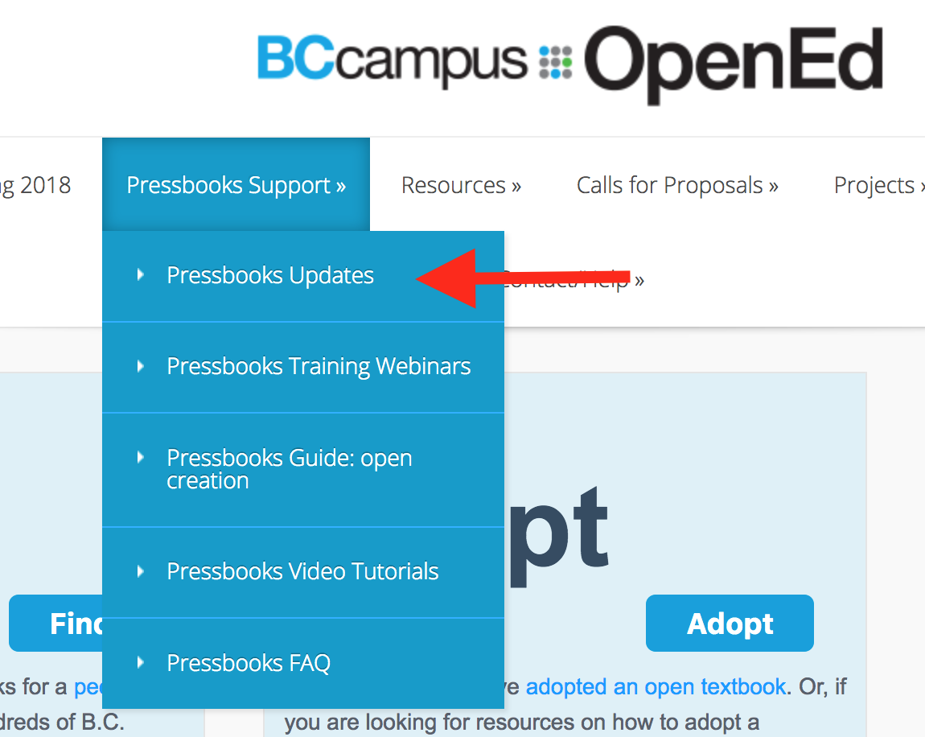
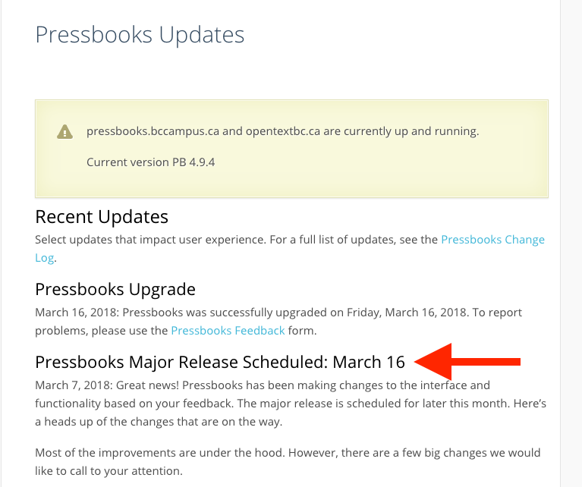
Pressbooks Updates
Notes:
The two BCcampus Pressbooks instances went through a major upgrade on March 16, 2018. For a list of changes made, see our “Pressbooks Updates” page under “Pressbooks Support” on the BCcampus Open Education website (open.bccampus.ca).

Slide 4
Lesson 1
How to add
Text boxes
Notes:
Lesson 1: How to add text boxes.
In this lesson, you will learn how to add standard and shaded textboxes, as well as specialized boxes used in a textbook.
If you have already created an account, please follow along.

Slide 5
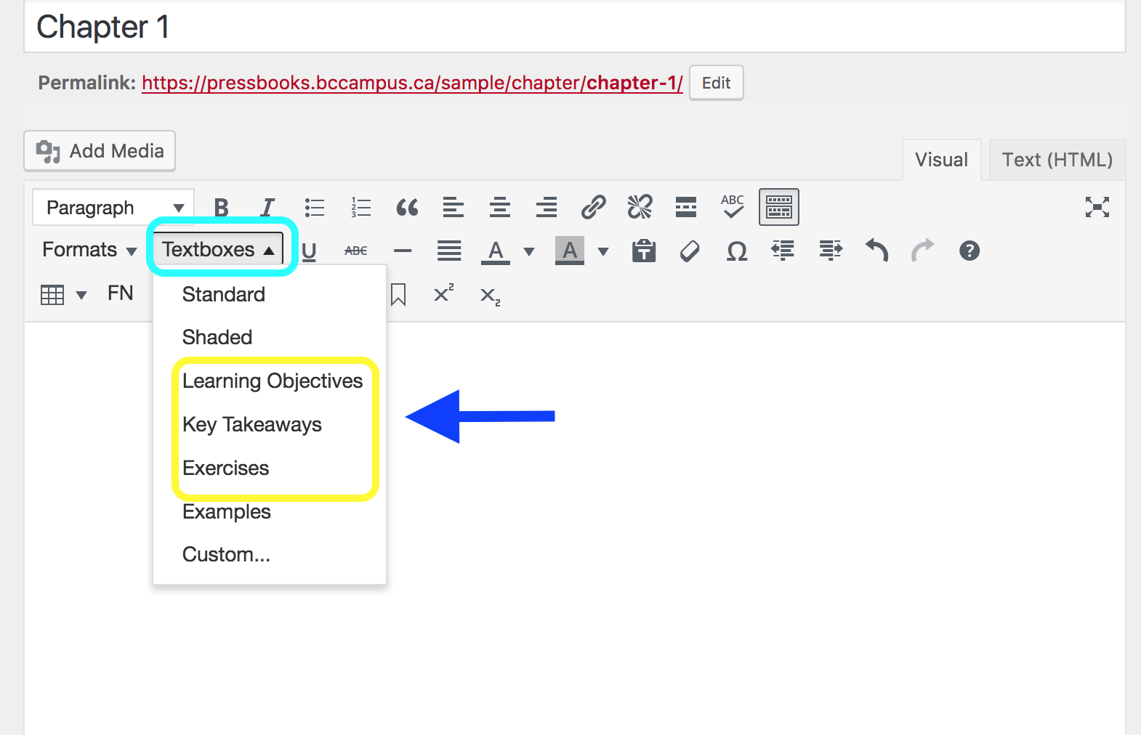
Notes:
In this section, we’ll review how to add a variety of text boxes.
Here is a screenshot showing the Textboxes feature found in the second row of tools. There are seven options available in this dropdown menu. They are:
Standard (clear, plain textbox)
Shaded (shaded, plain textbox)
The three special-styled text boxes originally created for the Pressbooks Textbook plugin: Learning Objectives, Key Takeaways, Exercises
A special styled textbox called and used for Examples
Custom textbox

Slide 6
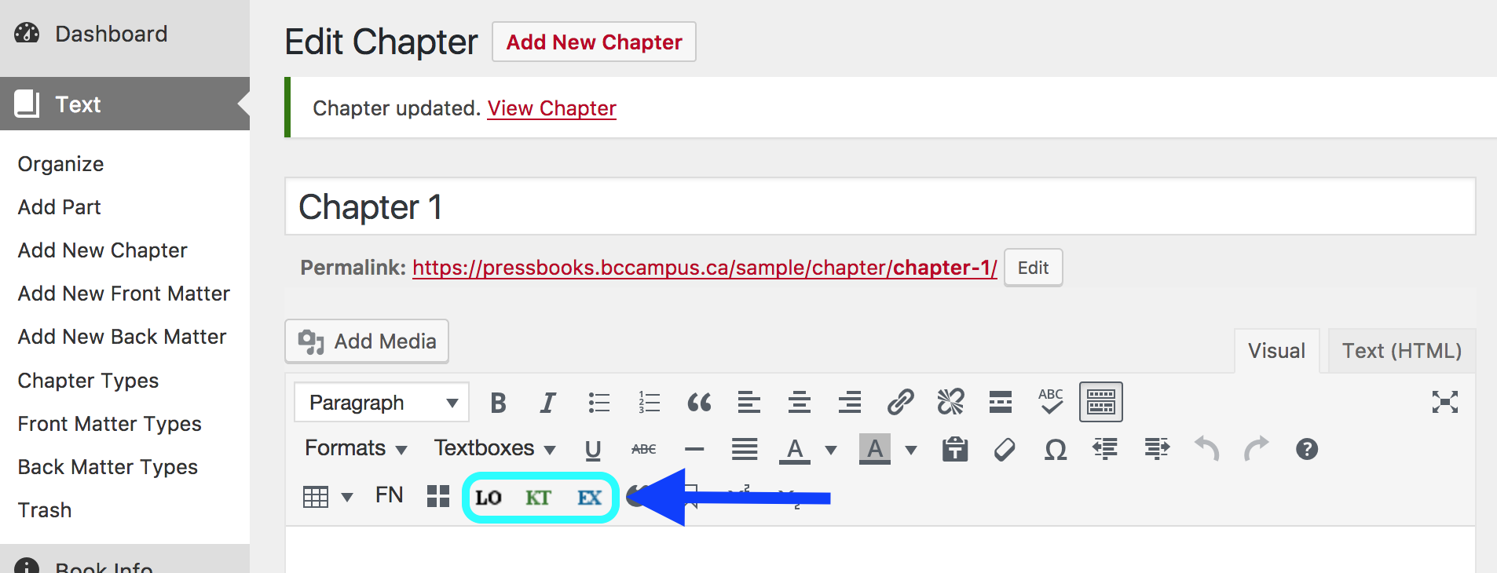
Notes:
Once all tool rows have been exposed, you can see the icons for the special styled textboxes in the last row.
There are several specialized text boxes that have been designed for the Pressbooks Textbook plugin. Each of these is designed with special content in mind and are colour coded; metadata has also been added for search engines.
LO = Learning Objectives (or learning outcomes) - black and gray
KT = Key Takeaways (or Key Terms or Glossary) - green
EX = Exercises (or lessons or quizzes) – blue
It is highly recommended that these special text boxes be used as designed.

Slide 7
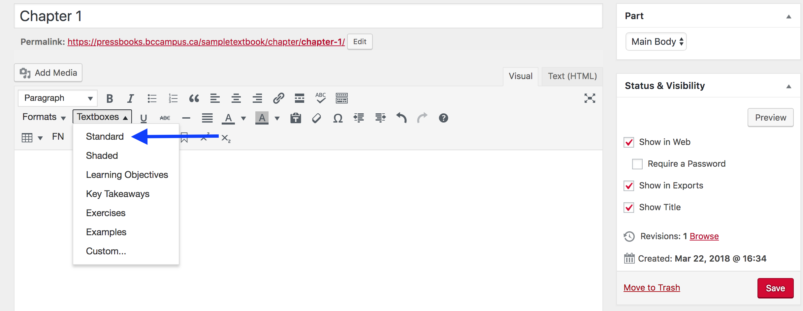
Notes:
Let’s begin by looking at how to add a Standard or clear text box.
As with the LO, KT, and EX text boxes, begin by selecting the type of text box you want to add. This is done by revealing the dropdown menu from the “Textboxes” feature and selecting “Standard” at the top of the menu. The blue arrow points to this selection which is marked by a light gray highlight and white text for the word “Standard.”

Slide 8
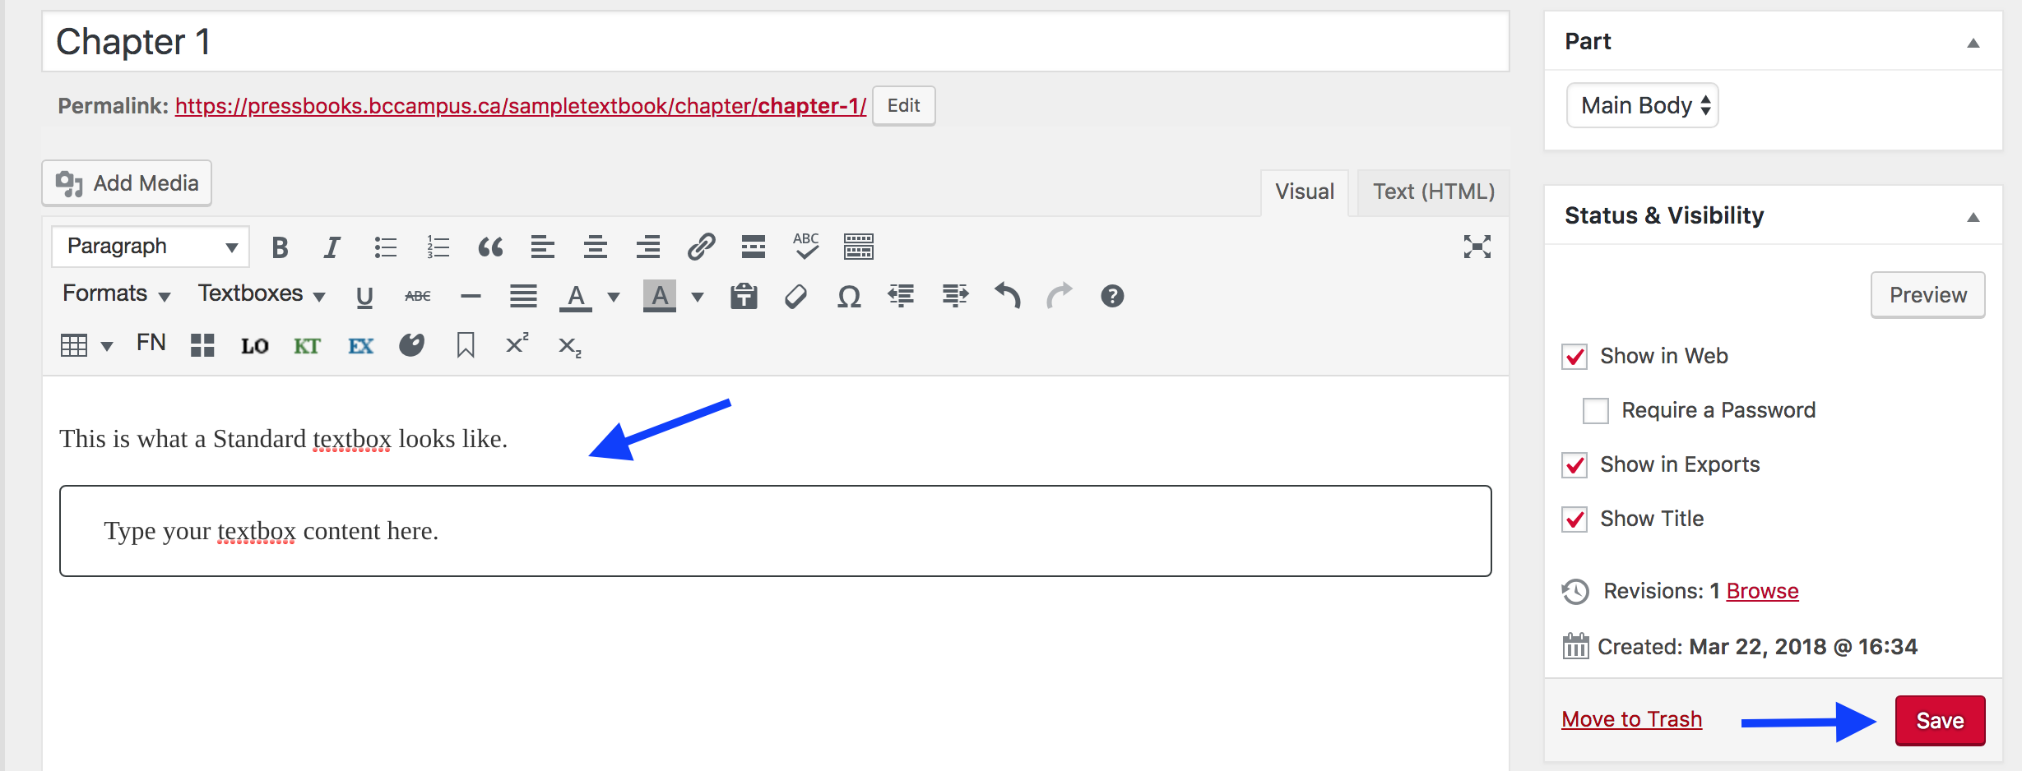
Notes:
This is what the Standard text box looks like including the default, instructive language inside it that says “Type your textbox content here.”
To save use the red “Save” button in the lower-right corner.

Slide 9
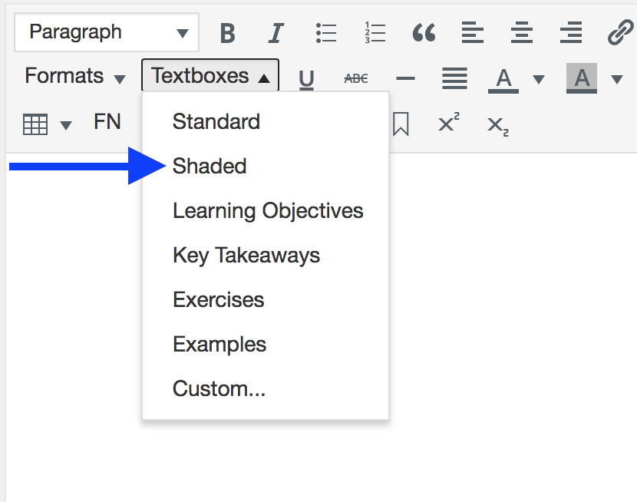
Notes:
For a Shaded box, select this second option from the Textboxes dropdown menu….
NEXT SLIDE

Slide 10
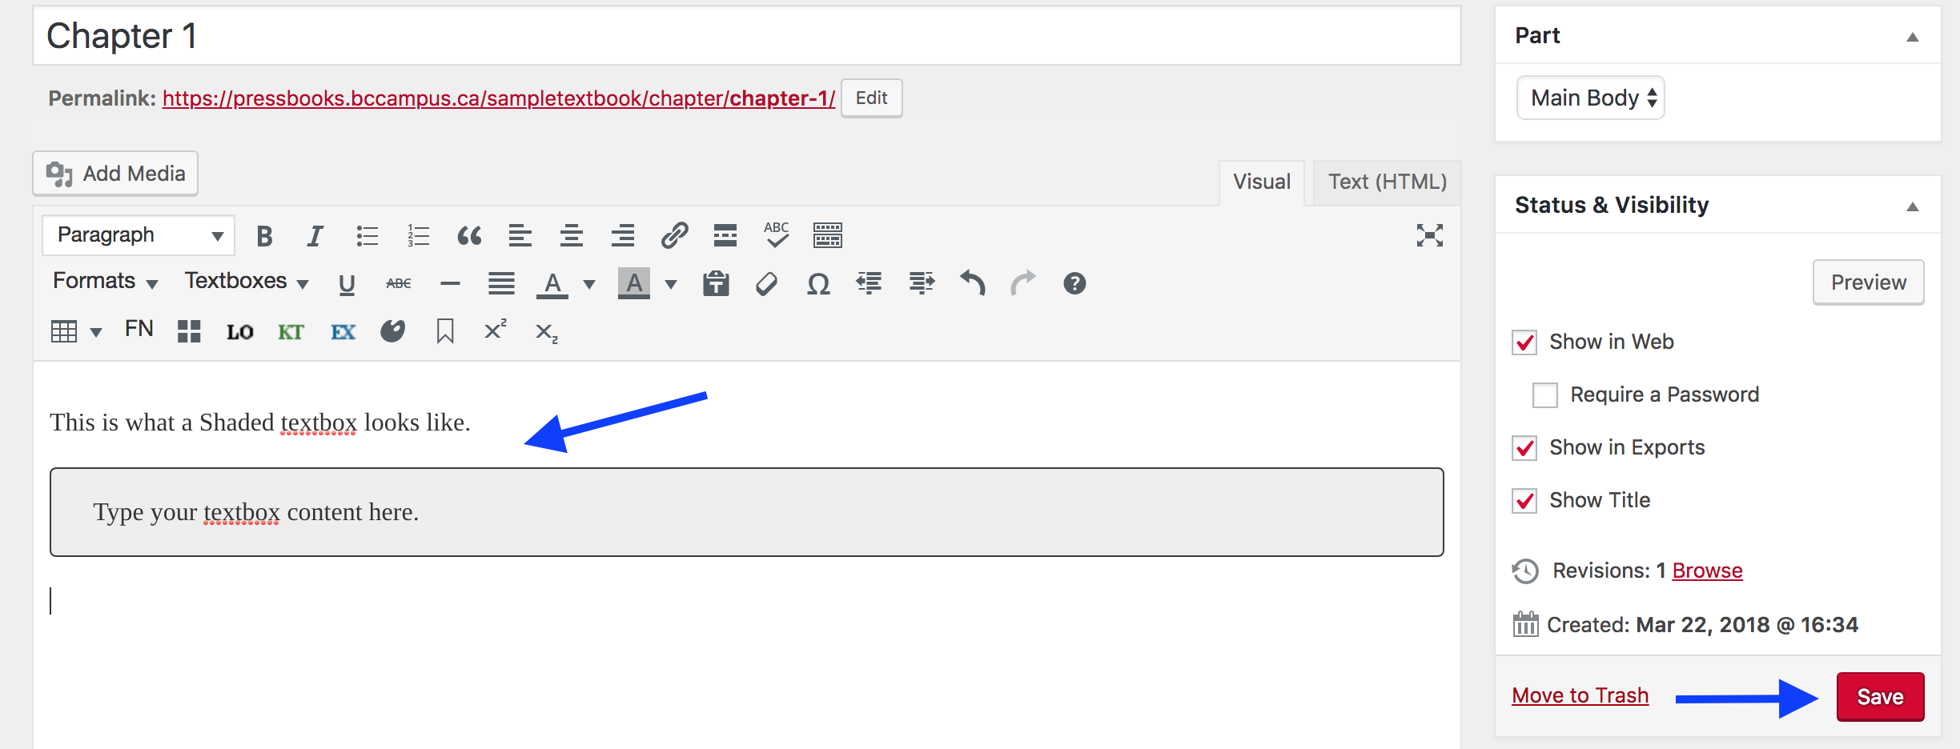
Notes:
This is what is looks like. Remember to save using the Update button in the bottom right corner.
Note: When typing text in the Standard and Shaded textboxes, avoid using “Enter” for a hard. Doing this will push your cursor outside of the box. Instead, use Shift + Enter.

Slide 11
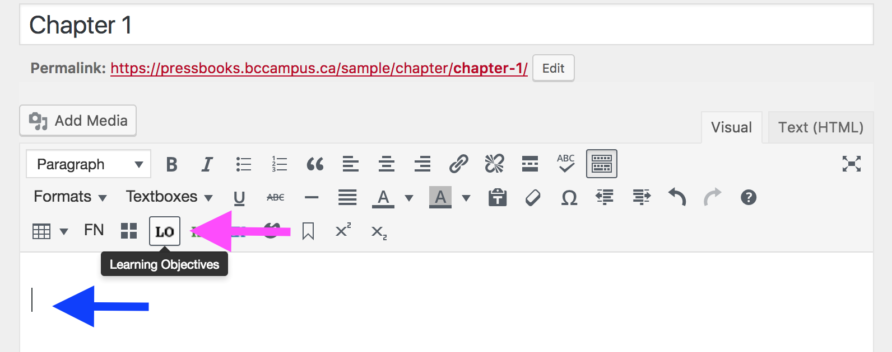
Learning Objectives
Notes:
For the special-styled textboxes, let’s begin with the Learning Objectives box. To add this textbox, place your cursor in the text body (see the blue arrow in this screenshot) and click on the “LO” icon identified here by the pink arrow.

Slide 12
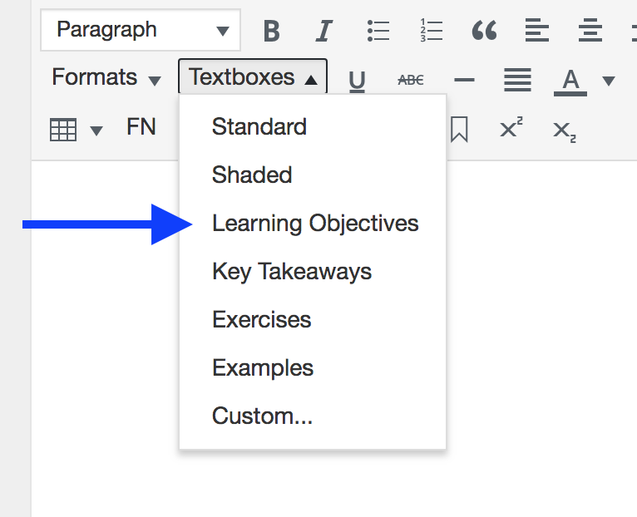
Notes:
If you decide to use the Textboxes dropdown to add the Learning Objectives box…
NEXT SLIDE

Slide 13
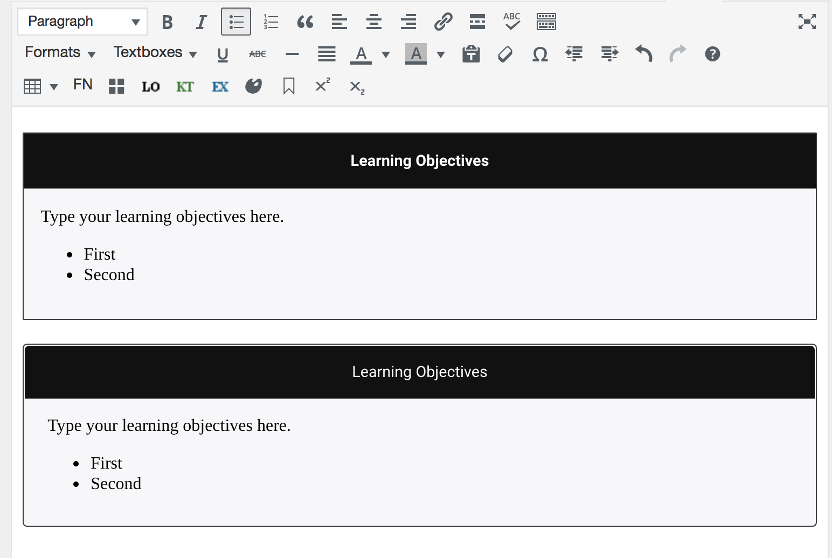
Notes:
…this is what you’ll see. The Learning Objectives textbox added by this method is the one at top of this screenshot, while the lower box was added using the LO icon. There are very slight differences between the two version that are easier to see in Pressbooks. Specifically, for the LO box added with the dropdown menu: the edges of the textbox box are square rather than rounded and the title is in bold.
This textbox is tagged for and designed for Learning Objectives (LO) or learning outcomes, which are typically placed at the beginning of a textbook’s chapter or chapter section.
Some items to note are:
The title “Learning Objectives” in the black banner can be changed.
The textbox comes with instructive default language. This can be deleted and changed.
Bulleted or numbered lists can be used within the body of the textbox.
Once information has been added, or changed, save by clicking on the red “Save” button in the lower-right corner.

Slide 14
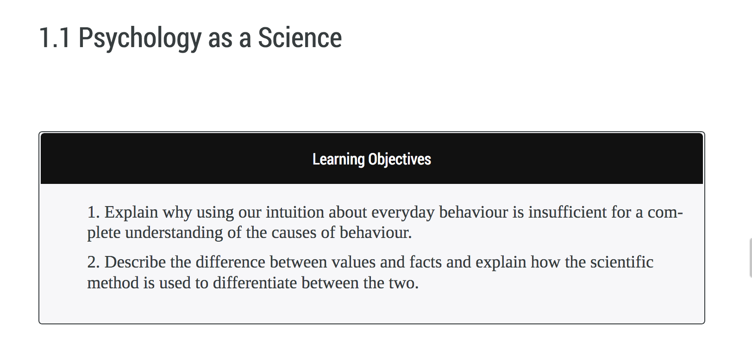
Notes:
Here’s an example of how the Learning Objectives textbox was used in the “Introduction to Psychology – 1st Canadian Edition” open textbook
This author chose to use a numbered list and complete sentences when listing learning objectives. These styling choices should be decided during the planning stage of authoring or adapting an open textbook, and recorded on the textbook’s style sheet.
______________________________________________________________________________________________________
Attribution: Screenshot taken from Introduction to Psychology – 1st Canadian Edition by Jennifer Walinga, Charles Stangor used under a CC BY license.

Slide 15
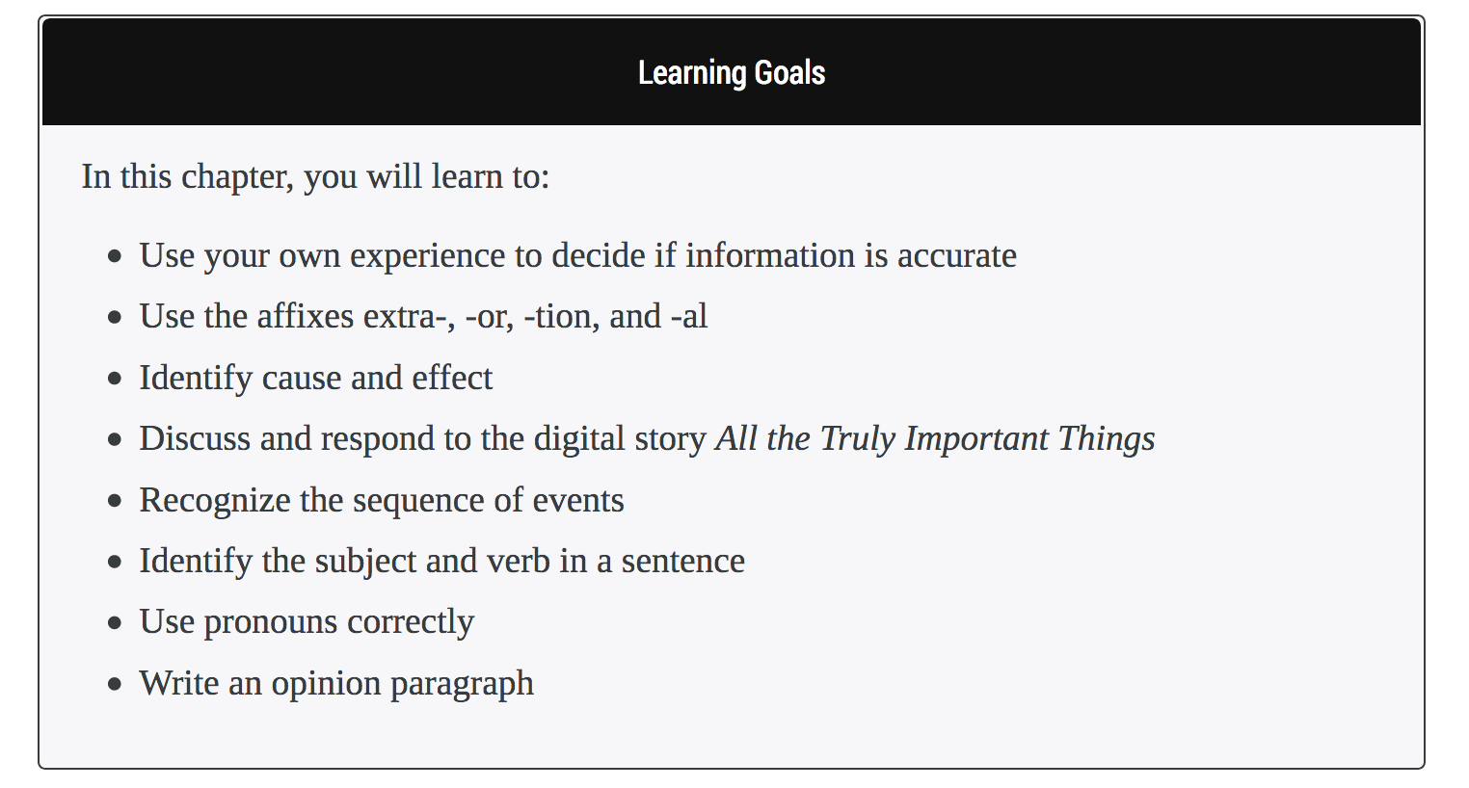
Notes:
This is from the “BC Reads” series, “Course Pack 6.”
This author renamed “Learning Objectives” as “Learning Goals” and provided an introductory phrase before listing the goals in a bulleted list. Also notice that for each statement, the first word is capitalized but, because the phrase is not a complete sentence, there is no period at the end of the phrase. Other styling elements include italicizing the title of the digital story (point number 4), and the use of hyphens to express the prefix and suffixes of words (point number 2).
______________________________________________________________________________________________________
Attribution: Screenshot taken from BC Reads: Adult Literacy Fundamental English – Course Pack 6 by Shantel Ivits used under a CC BY license.

Slide 16
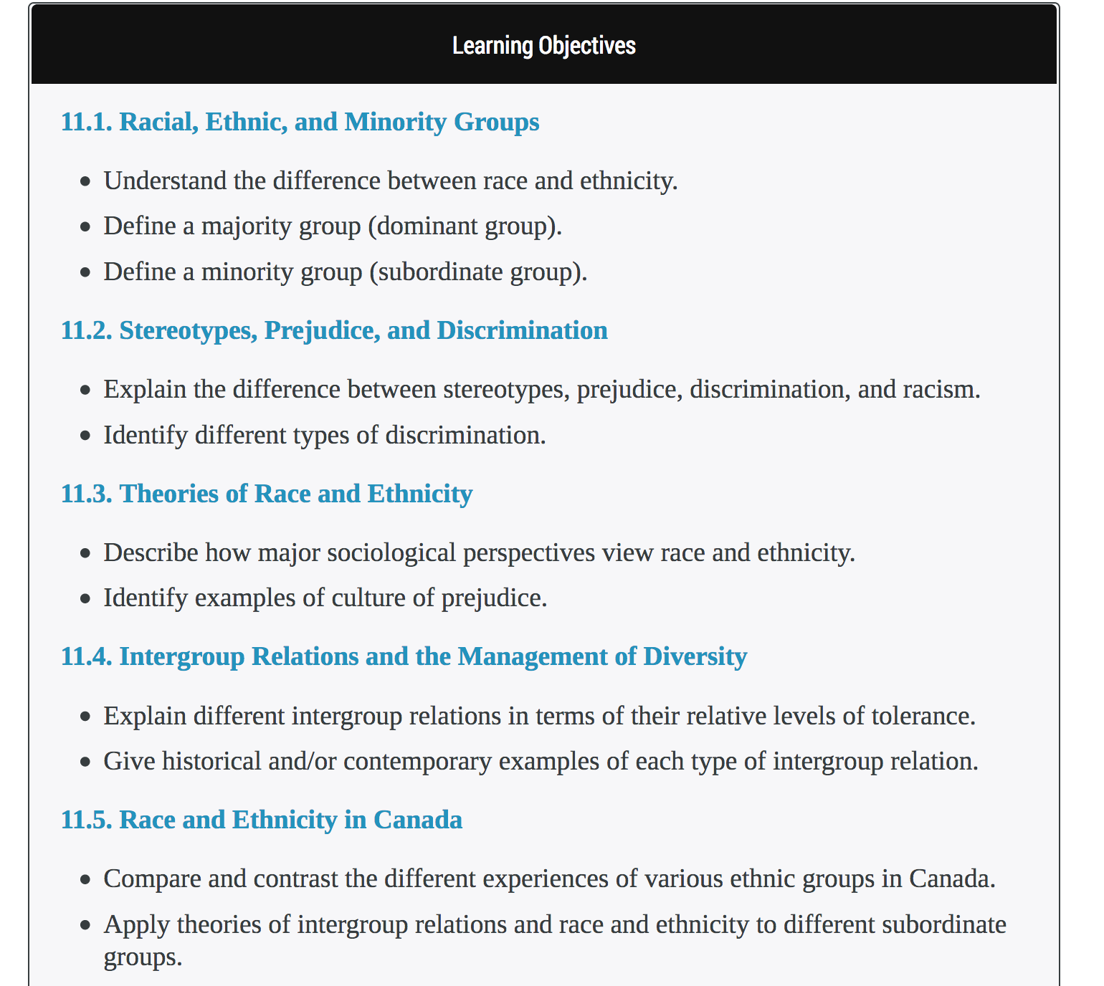
Notes:
This set of Learning Objectives is from “Introduction to Sociology – 2nd Canadian Edition”.
This authors chose to place a full set of Learning Objectives at the beginning of each chapter that includes defined outcomes for each chapter section within that chapter. Each chapter section is clearly identify with a number and title, coloured in light blue; the title text links to the beginning of that chapter section.
The authors also decided to place a period at the end of each phrase even though they are not completed sentences.
Something you don’t see in this screenshot is the photo placed before each Learning Objectives textbox that mirrors the chapter’s content. Each photo includes a descriptive caption.
______________________________________________________________________________________________________
Attribution: Screenshot taken from Introduction to Sociology – 2nd Canadian Edition by William Little, Ron McGivern, Nathan Keirns, Eric Strayer, Heather Griffiths, Susan Cody-Rydzewski, Gail Scaramuzzo, Tommy Sadler, Sally Vyain is used under a CC BY license.

Slide 17
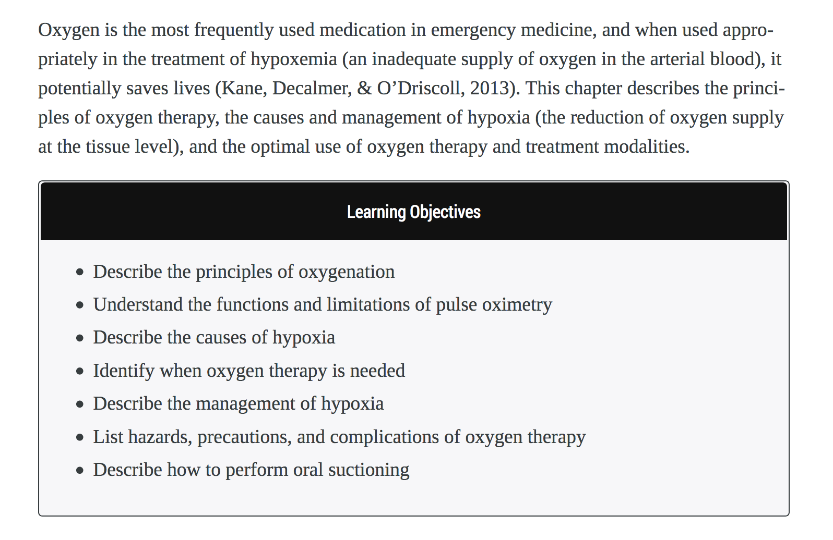
Notes:
The last example is this Learning Objectives text box from “Clinical Procedures for Safer Patient Care”.
What’s notable here is the introductory text – typically several paragraphs long – that precedes the LO box in each chapter. The authors felt it was important to provide this introductory narrative before the student read the learning objectives.
______________________________________________________________________________________________________
Attribution: Screenshot taken from Clinical Procedures for Safer Patient Care by Glynda Rees Doyle and Jodie Anita McCutcheon is used under a CC BY license.

Slide 18
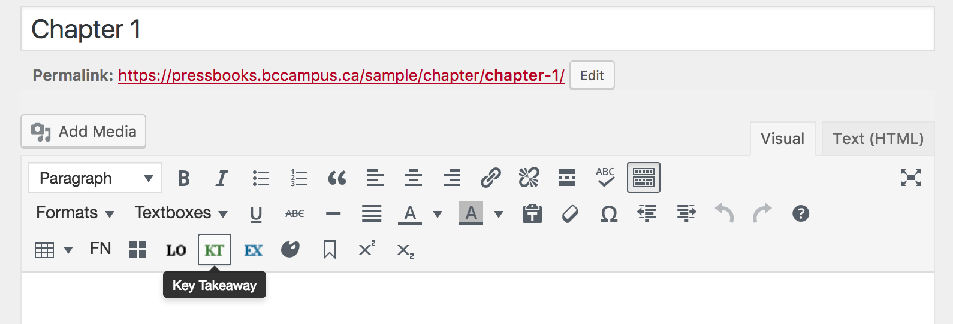
Key Takeaways
Notes:
Next is the Key Takeaways or KT textbox. To add it, do as was done for the Learning Objectives box:
Place your cursor in the body of the chapter and
Click on the KT icon.

Slide 19
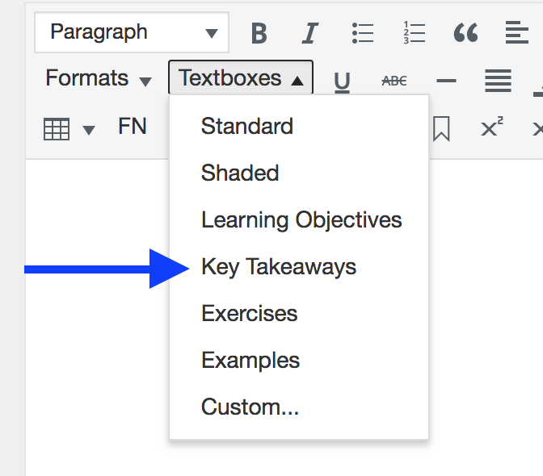
Notes:
If you want to use the Textboxes dropdown to add the Key Takeaways box…
NEXT SLIDE

Slide 20
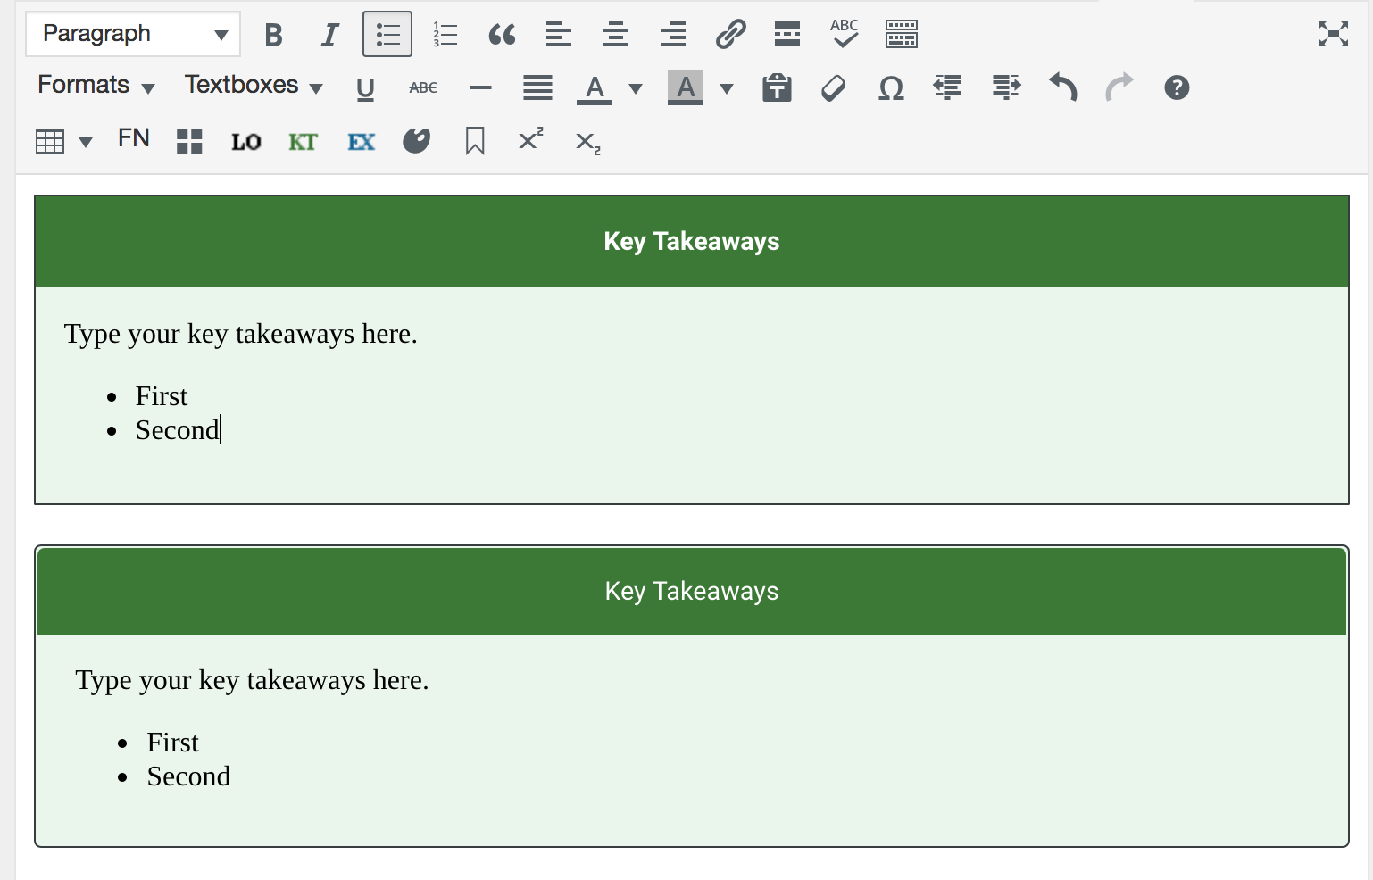
Notes:
…this is what you’ll see. The Key Takeaways textbox added by this method is the one at top while the lower one was added using the KT icon. Both are very similar to the Learning Objectives textboxes, the differences being the colour green (to quickly identify its purpose) and the metadata.

Slide 21
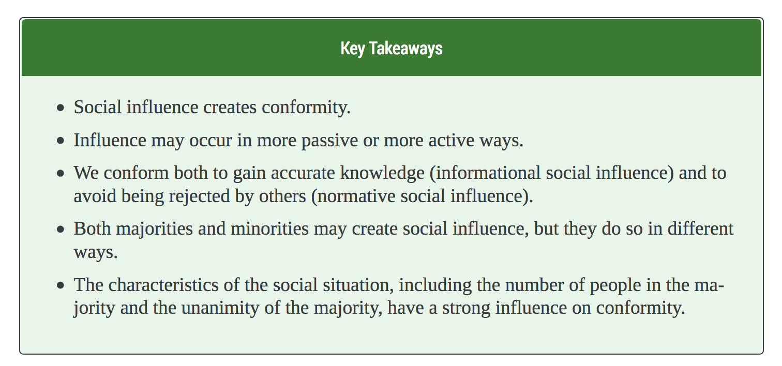
Notes:
Here is an example from the “Principles of Social Psychology – 1st International Edition” where the KT textbox is being used as designed. For styling, bullet points and full sentences are used. The textbox’s title has not been changed.
______________________________________________________________________________________________________
Attribution: Screenshot taken from Principles of Social Psychology – 1st International Edition by Dr. Rajiv Jhangiani, Dr. Hammond Tarry, Dr. Charles Stangor is used under a CC BY-NC-SA license.

Slide 22
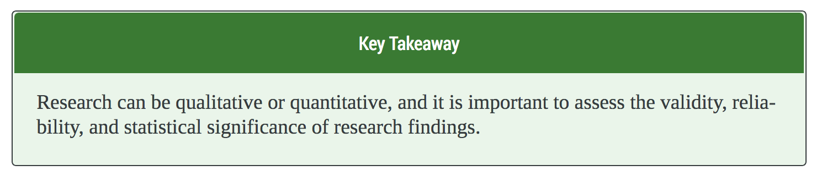
Notes:
In the open textbook, “Business Communication for Success”, only one key takeaway is offered at the end of each chapter.
______________________________________________________________________________________________________
Attribution: Screenshot taken from Business Communication for Success by University of Minnesota Libraries' Publishing Services (Adapted version) is used under a CC BY-NC-SA license.

Slide 23
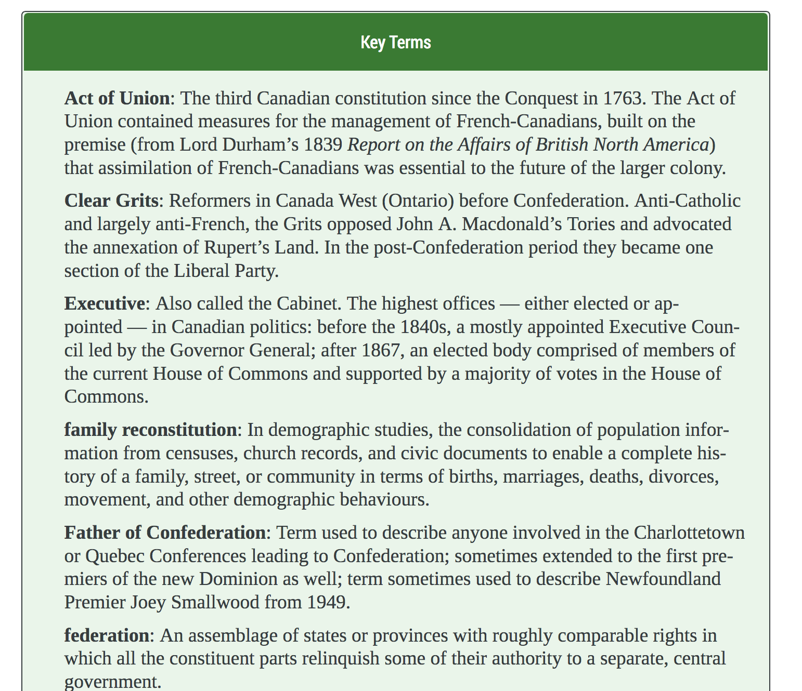
Notes:
This is an example taken from ”Canadian History: Post-Confederation”. Here the author chose to use the Key Takeaways box to highlight “Key Terms” used in the chapter. He changed the title of the box, in the dark green banner, to fit this usage. Throughout the chapter, the key terms listed here were set in bold for easy identification…
NEXT SLIDE…
______________________________________________________________________________________________________
Attribution: Screenshot taken from Canadian History: Post-Confederation by John Douglas Belshaw is used under a CC BY license.

Slide 24
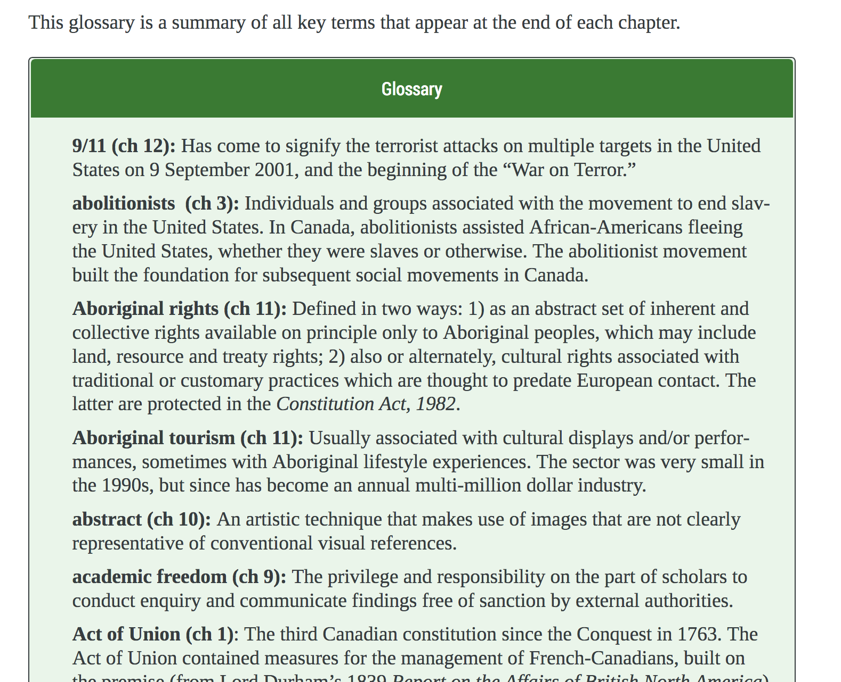
Notes:
…then, in the book’s back matter, all key terms were listed in a glossary. See the sentence at the top of the glossary page describing this design. The green KT box was also used for the glossary and renamed.
______________________________________________________________________________________________________
Attribution: Screenshot taken from Canadian History: Post-Confederation by John Douglas Belshaw is used under a CC BY license.

Slide 25
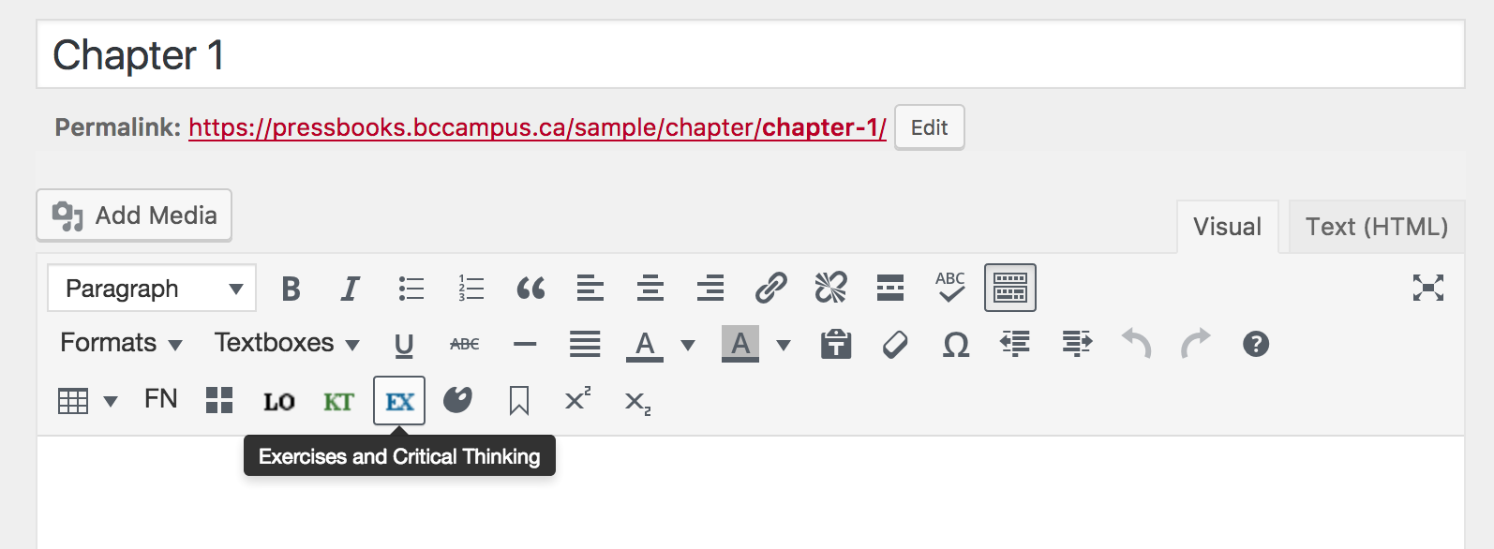
Exercises
Notes:
Finally, we have the EX text box, labelled here as the Exercises and Critical Thinking box.

Slide 26
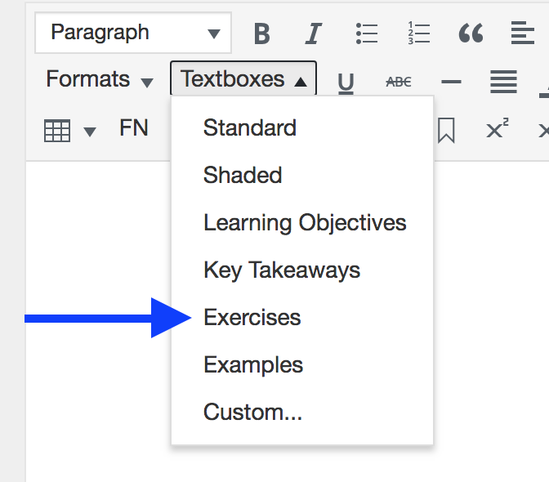
Notes:
If you want to use the Textboxes dropdown to add the Exercises box…
NEXT SLIDE

Slide 27
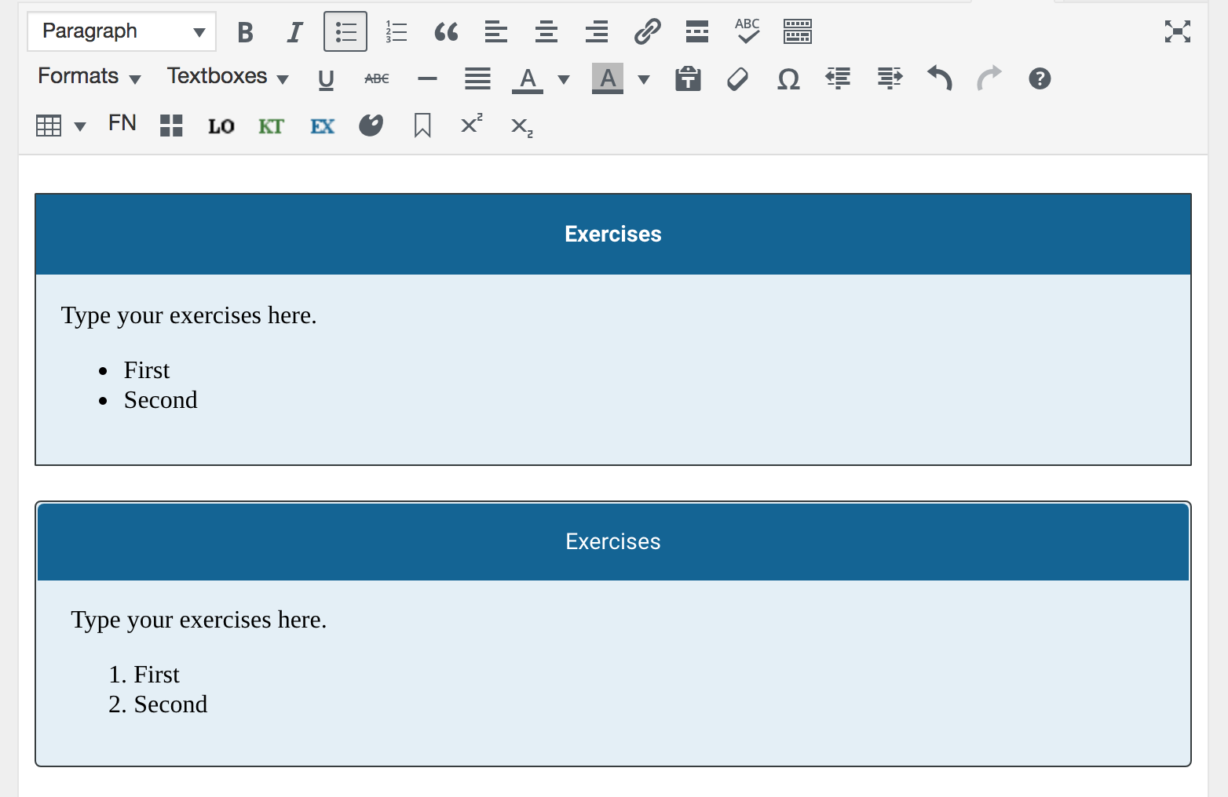
Notes:
…this is what you’ll see. Again, the dropdown version is at the top and the EX icon one is at the bottom. Blue is used for quick identification of testing materials such as exercises; metadata has been added which is specific to the boxes’ usage.

Slide 28
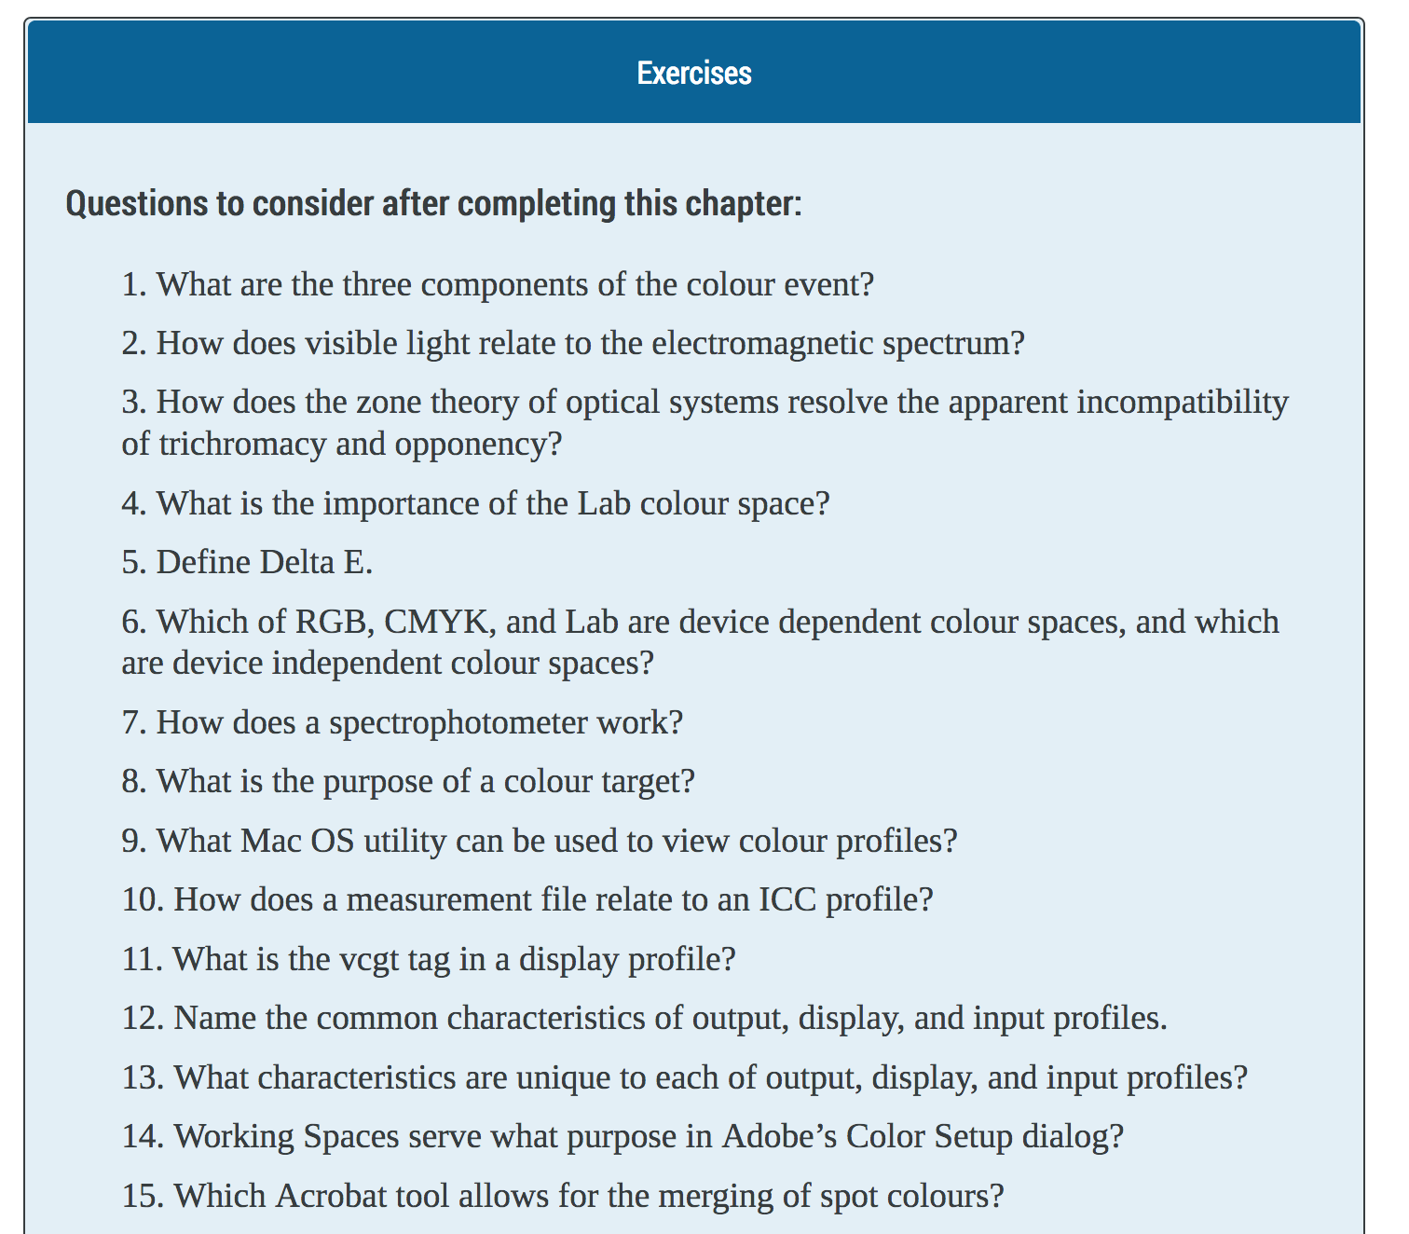
Notes:
In this example, the authors of “Graphic Design and Print Production Fundamentals”, used the Exercises text box to present a list of questions for students to review after reading the chapter. An instructor could also use these questions for testing purposes.
______________________________________________________________________________________________________
Attribution: Screenshot taken from Graphic Design and Print Production Fundamentals by Graphic Communications Open Textbook Collective, British Columbia Institute of Technology is used under a CC BY license.

Slide 29
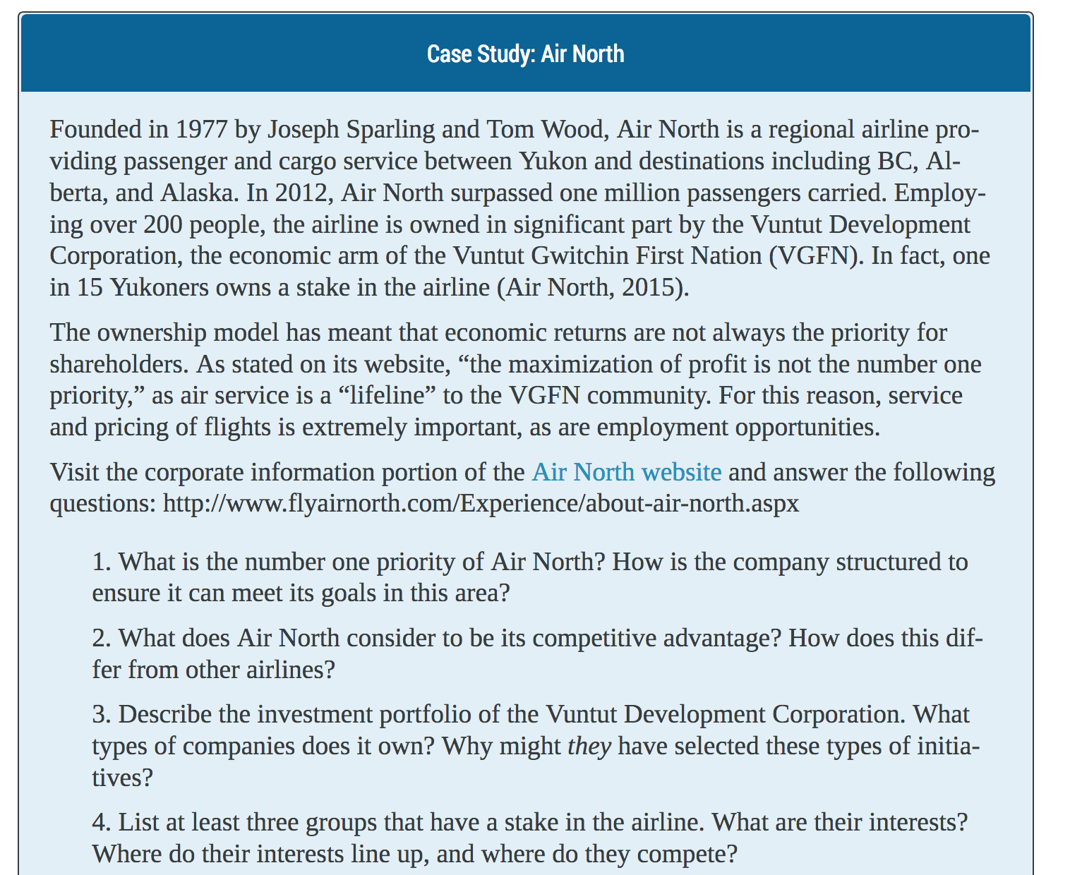
Notes:
This example is from “Introduction to Tourism and Hospitality in BC” where the authors chose to highlight case studies followed by questions, in the Exercises text box.
______________________________________________________________________________________________________
Attribution: Screenshot taken from Introduction to Tourism and Hospitality in BC by Morgan Westcott (ed) is used under a CC BY license.

Slide 30
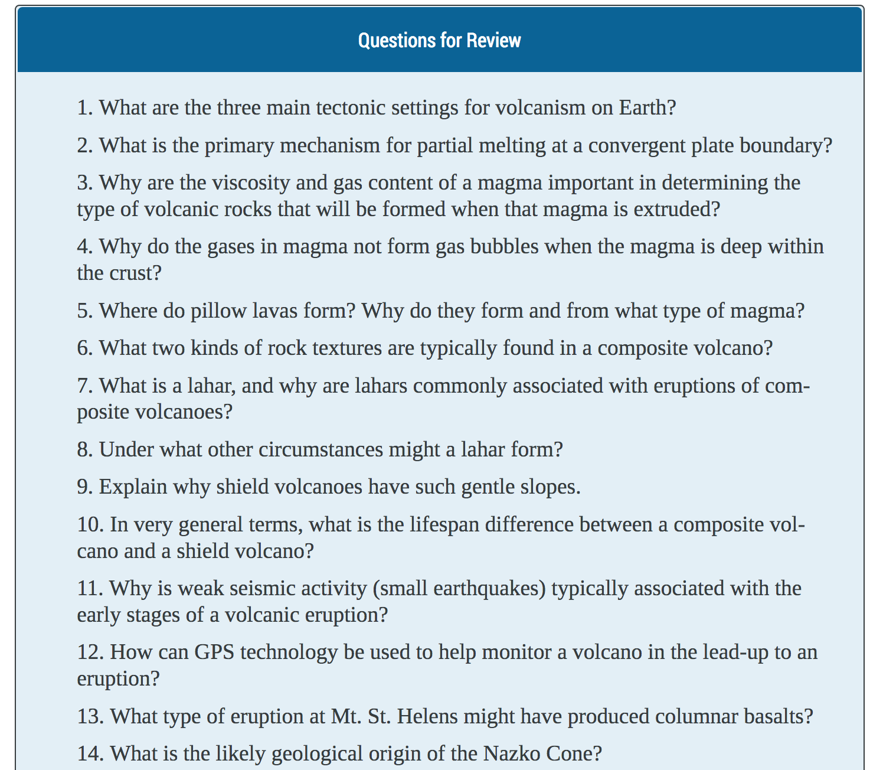
Notes:
In the “Physical Geology” textbook, the Exercises text box has been renamed “Questions for Review” followed by just that.
______________________________________________________________________________________________________
Attribution: Screenshot taken from Physical Geology by Steve Earle is used under a CC BY license.

Slide 31
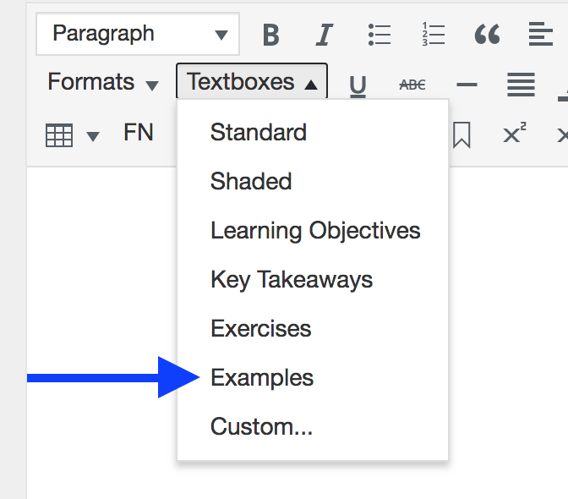
Notes:
Finally, adding the Examples text box using the dropdown…
NEXT SLIDE

Slide 32
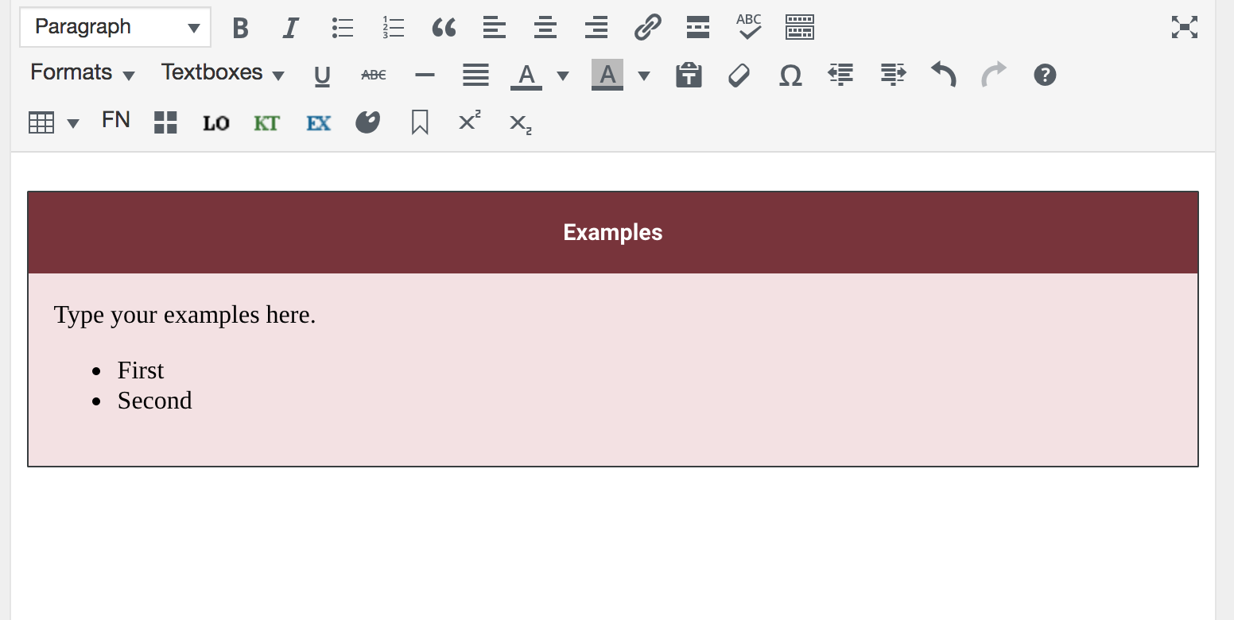
Notes:
…results in this.
This specialized text box was designed for Pressbooks core (pressbooks.com) and not the Pressbooks Textbook plugin specifically. However, as you can see, it can certainly be used in a similar manner to the LO, KT, and EX boxes and is handy for offering examples of the subject being discussed.

Slide 33
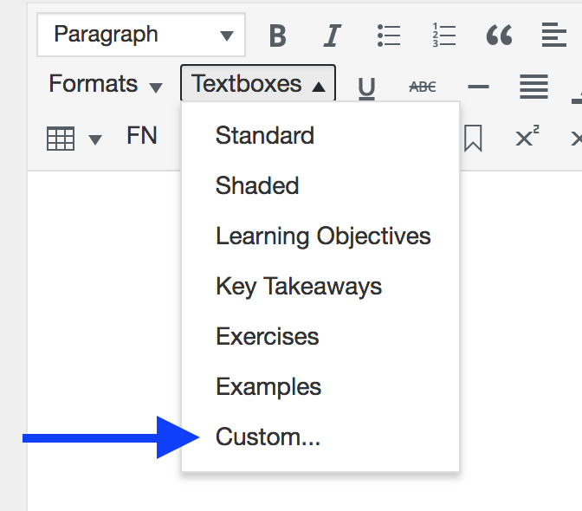
Notes:
Finally a Custom version is offered…
NEXT SLIDE

Slide 34
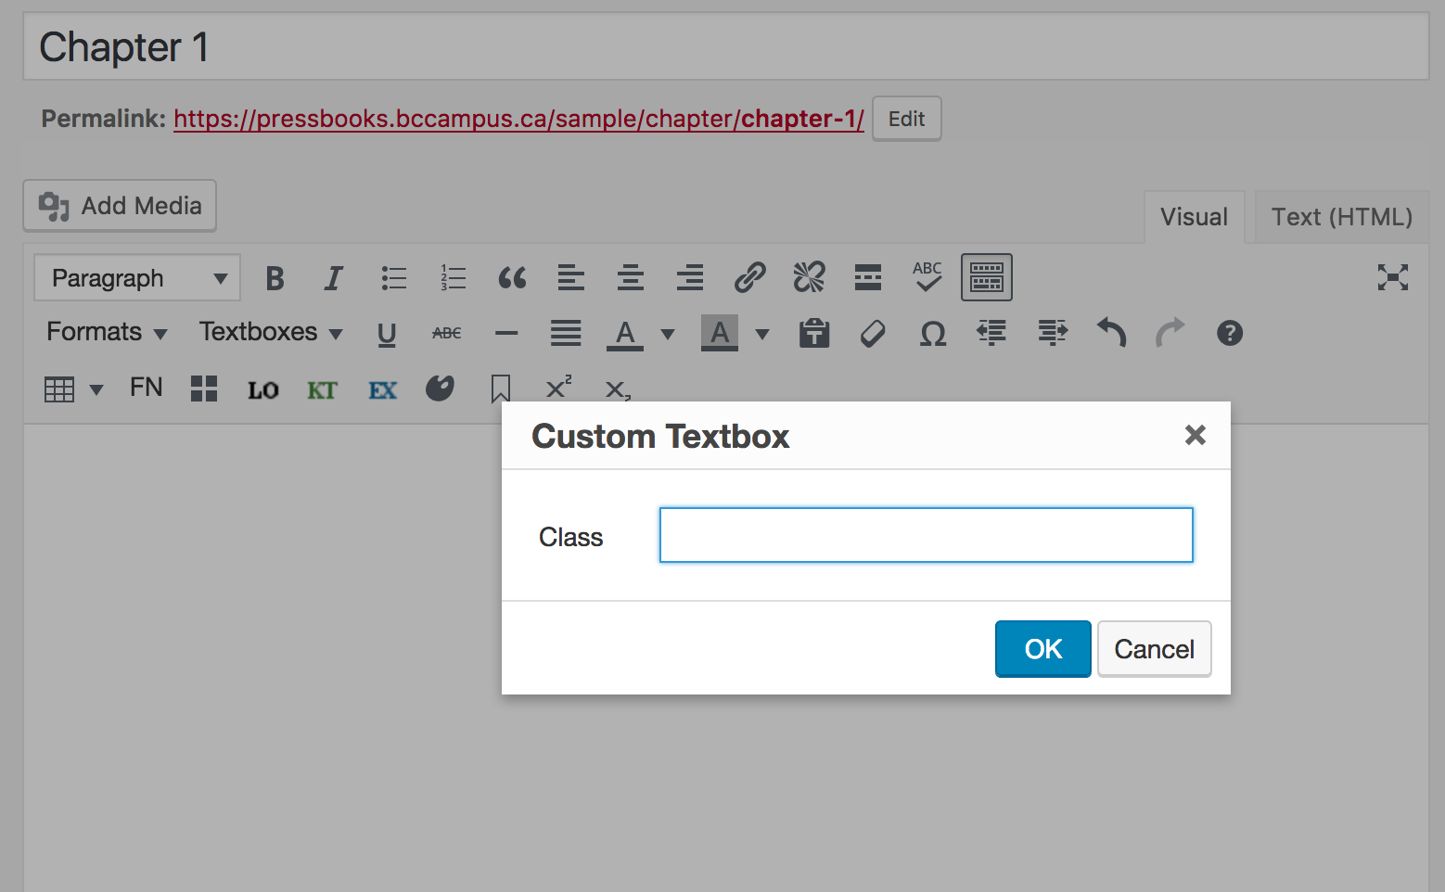
Notes:
… and produces this pop-up box when selected allowing you to add a custom CSS class that you can then style in the CSS editor.

Slide 35
Lesson 2
How to add
block quotes
Notes:
Lesson 3: How to add block quotes

Slide 36
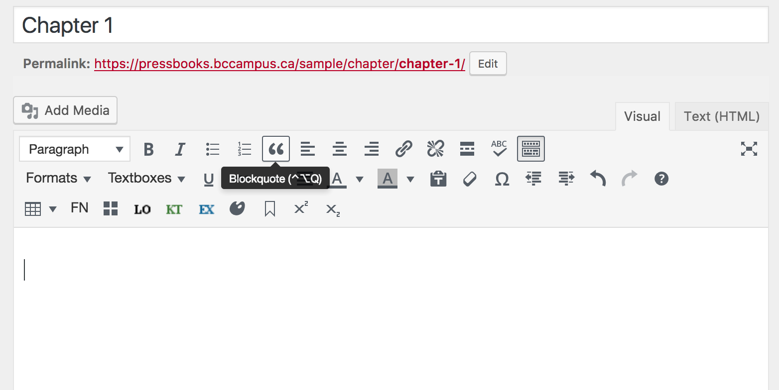
Notes:
Now we’re going to talk about how to use the block quote feature in Pressbooks. This feature is identified by an open double quotation mark icon and in this screenshot, the pop-up label is also displayed.
Block quotes are used for long quotations that must be placed in a stand-alone block of text without using quotation marks. The block quote feature is useful because it automatically formats the text according to block quote requirements
For guidelines for when quotations should be used and how long a quotation should be in order for block quotes to be applied, check guidelines for the citation style being used.

Slide 37
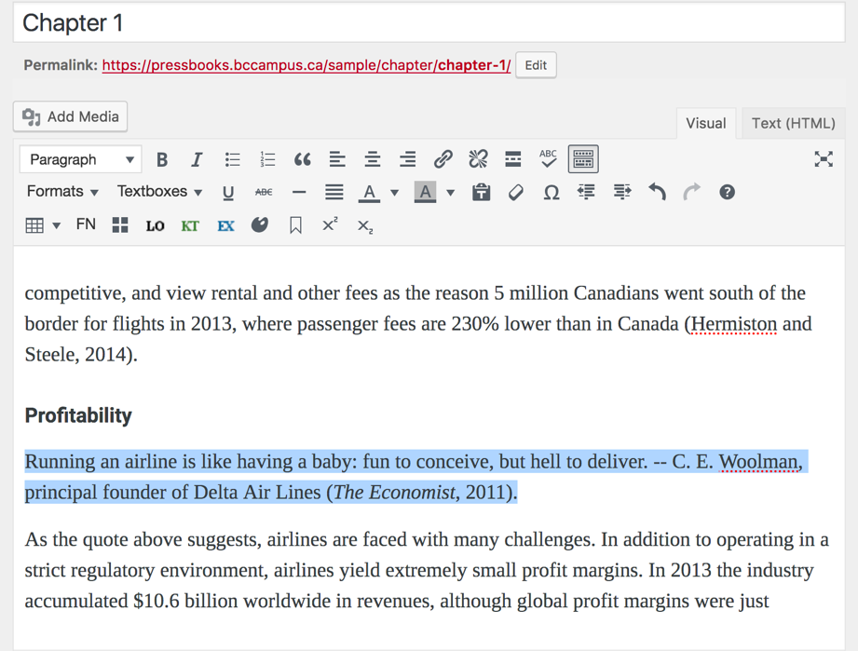
Notes:
This is how to use this feature.
Highlight the quotation including the in-text citation…
NEXT SLIDE

Slide 38
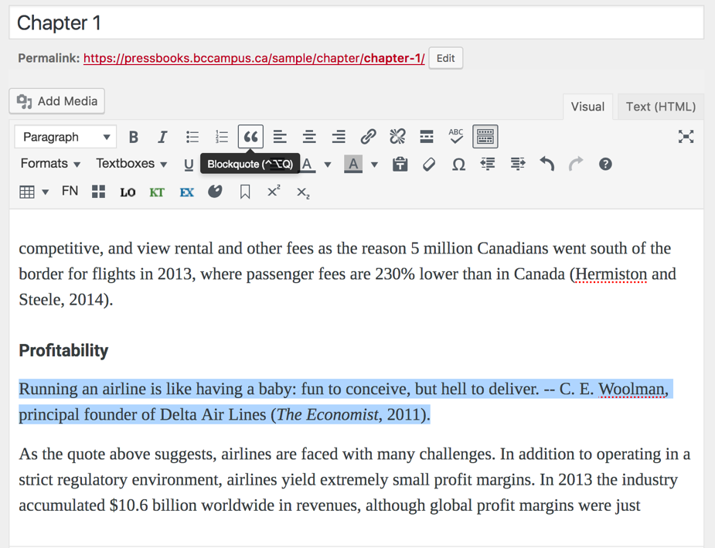
Notes:
… click on the block quote icon
NEXT SLIDE

Slide 39
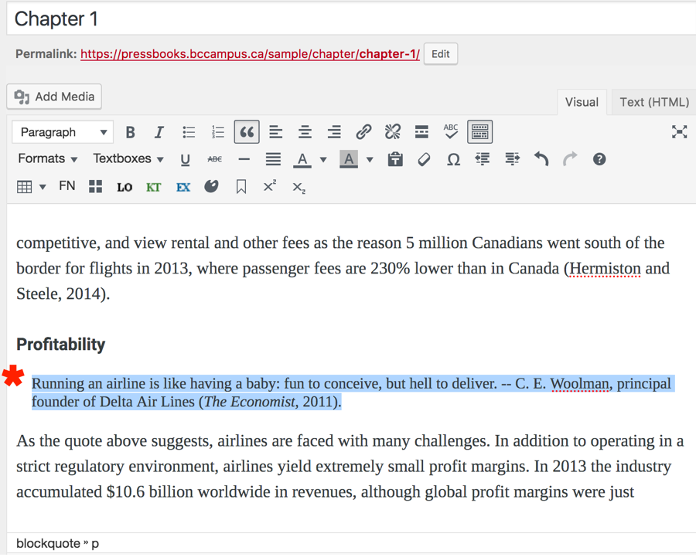
Notes:
… and this is what you’ll see using the Visual Editor/tab. The block of text that has been marked as a block quote has been indented and the font is smaller.
You can use the Preview Changes button to view what it will look like live or after saving.

Slide 40

Notes:
This is what the reader sees. This is an actual screenshot from “Introduction to Tourism and Hospitality in BC”. Notice that the block quote is indented and identified with a gray highlight.
______________________________________________________________________________________________________
Attribution: Screenshot taken from Introduction to Tourism and Hospitality in BC by Morgan Westcott (ed) used under a CC BY license.

Slide 41
Lesson 3
How to add and style tables
Notes:
Lesson 6: How to add and adjust tables

Slide 42
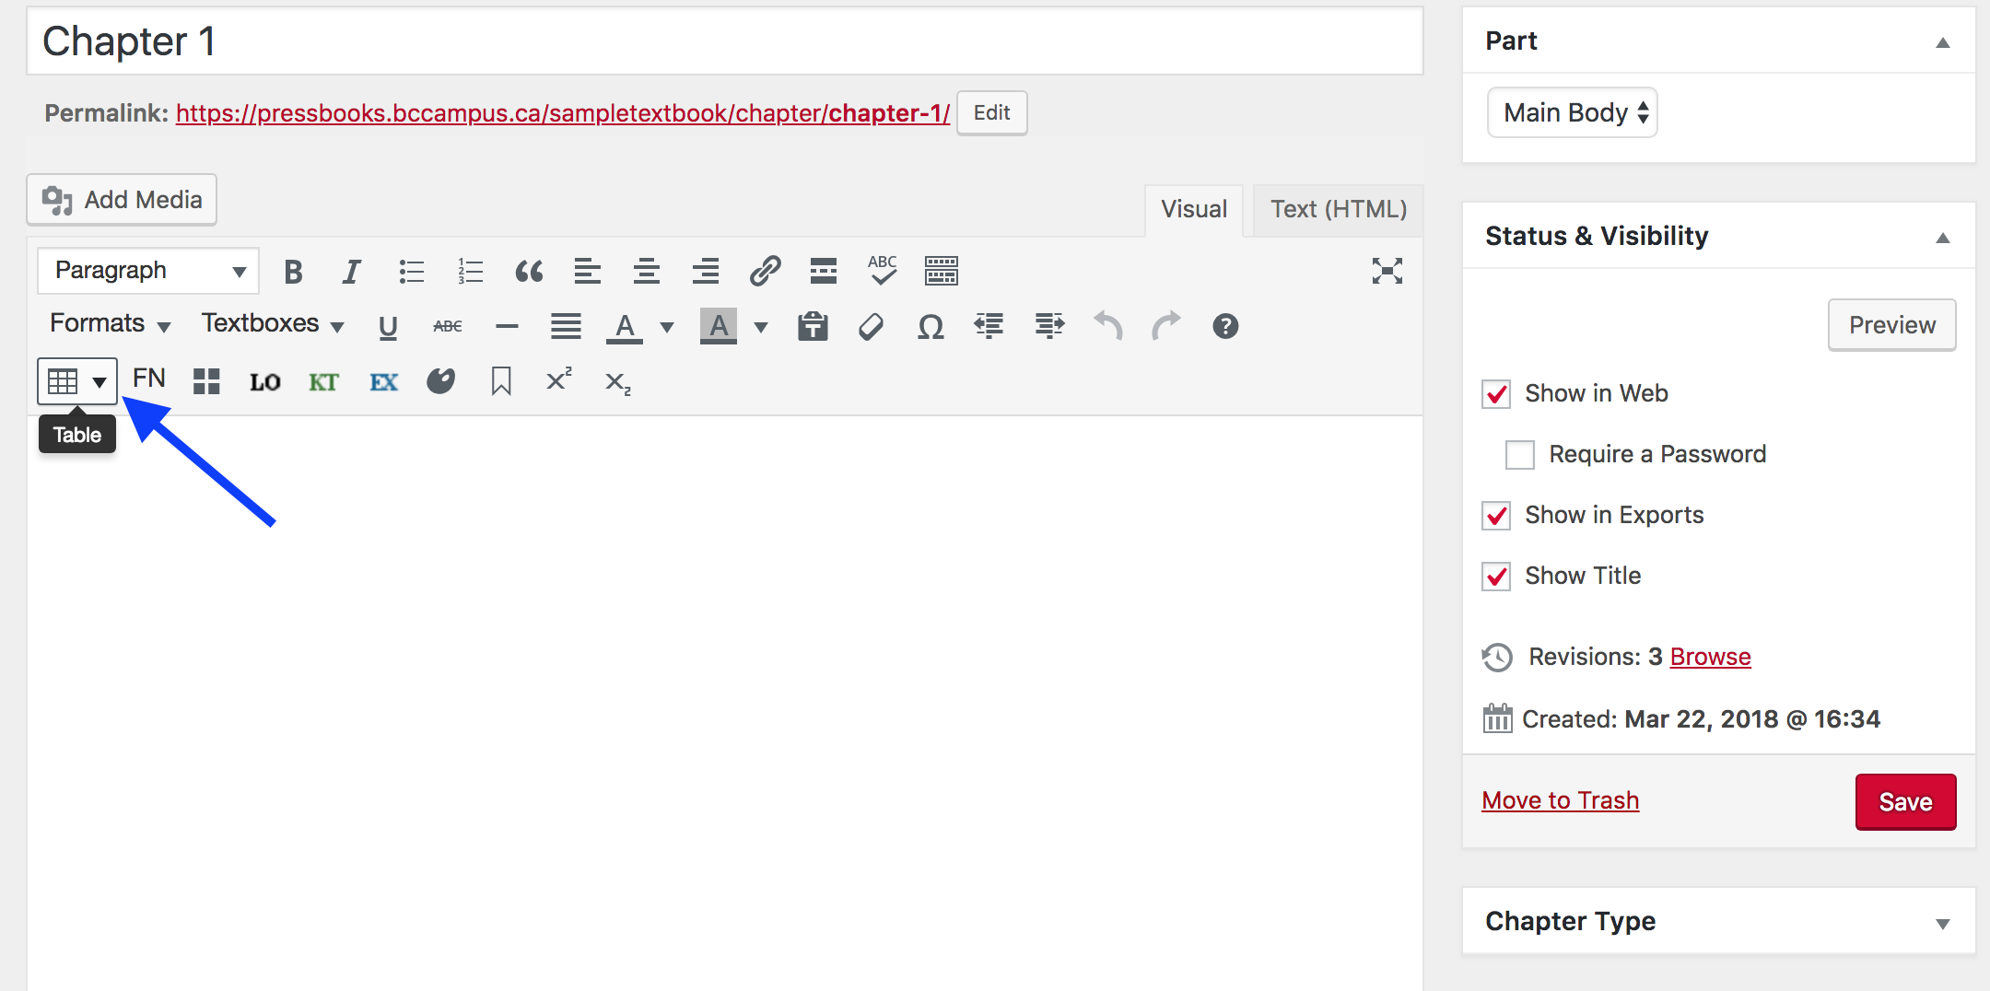
Notes:
This screenshot shows the “Table” tool icon by the blue arrow.

Slide 43
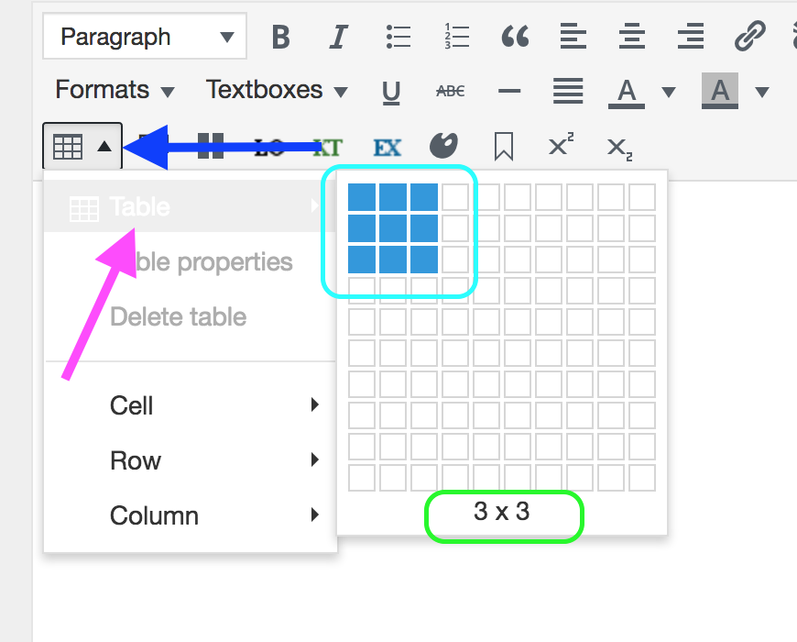
Notes:
To add a table,
Click on the triangle/arrow beside the Table icon. This action will reveal a dropdown menu.
From the dropdown menu, select “Table”. (This is difficult to see in this screenshot because of the white text set against a light gray background.)
This action will produce a grid. From the grid, indicate the size of the table you want by highlighting the number of columns and rows needed. (Circled in light blue.)
Note the numbers at the bottom of this grid – 3 x 3 – circled in green. This indicates the number of Columns by the number of Rows.
Place your cursor in one of the highlighted cells in the grid, and click to add.

Slide 44
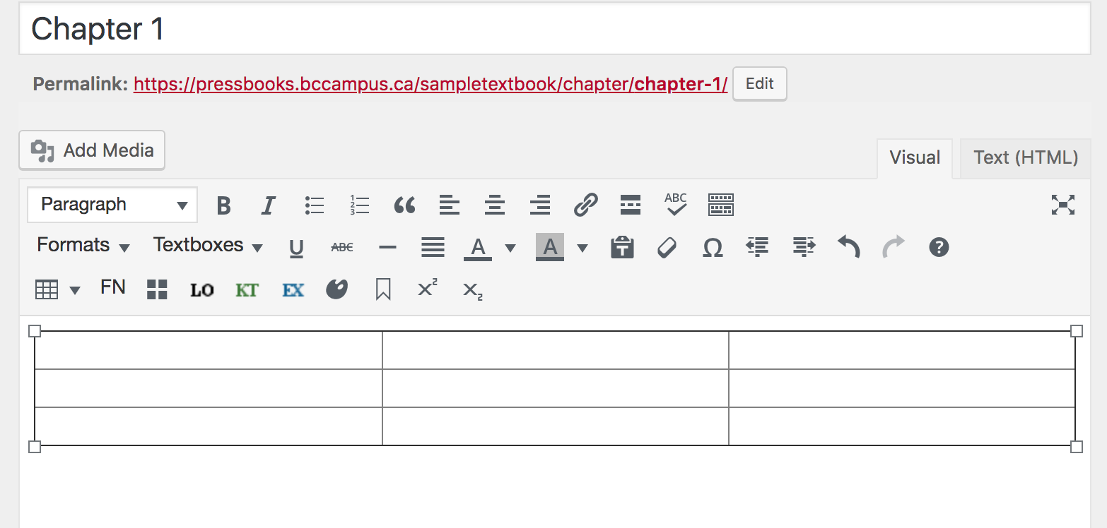
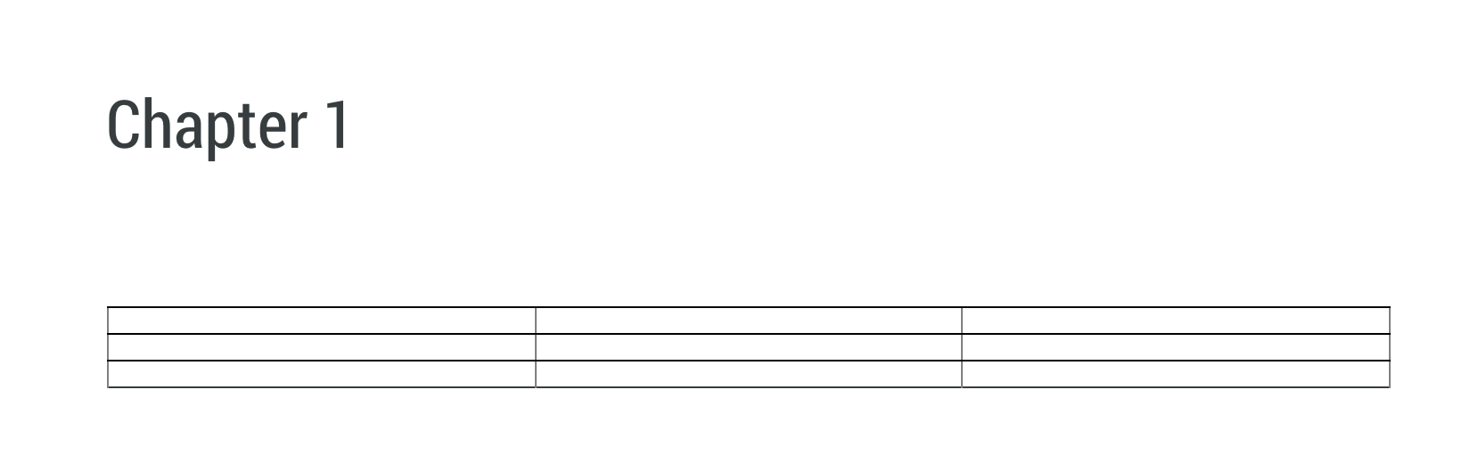
Notes:
This is what you see in the Visual Editor, at the top. The reader’s view is very similar, seen at the bottom of this slide.
NEXT SLIDE

Slide 45
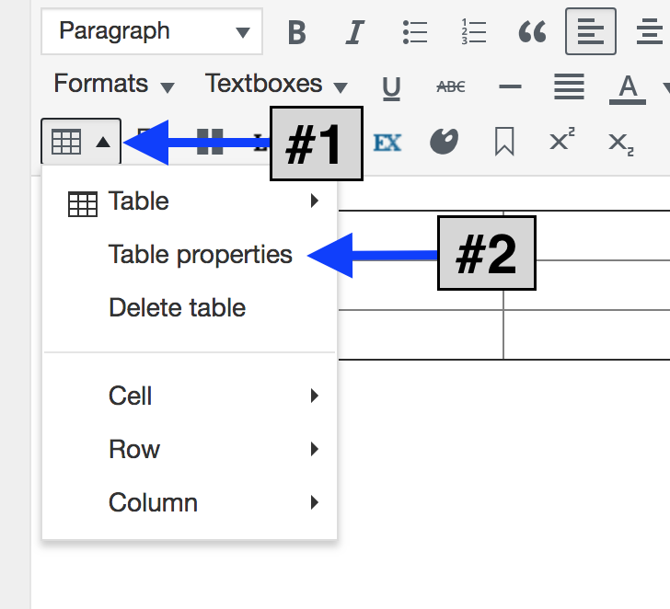
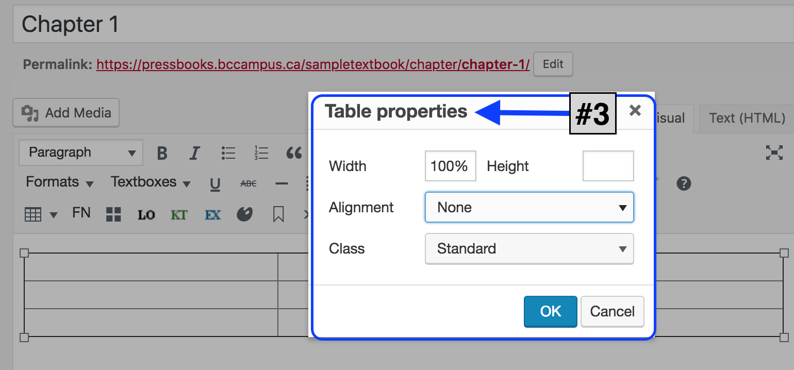
Notes:
To adjust a table’s properties:
Click on the arrow by the table icon
Select “Table properties” from the dropdown menu
And a “Table properties” pop-up box will appear. From here you can:
Adjust the width or height of the table
Align the table, currently set as “None”
Choose the Class of table, set as “Standard” here.

Slide 46
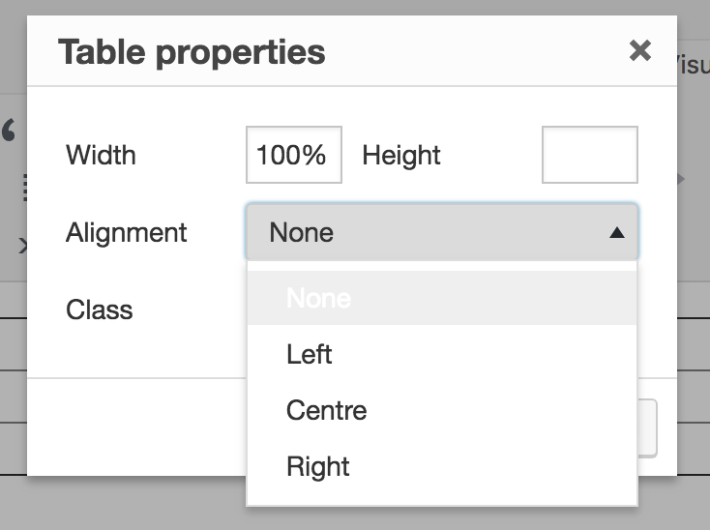
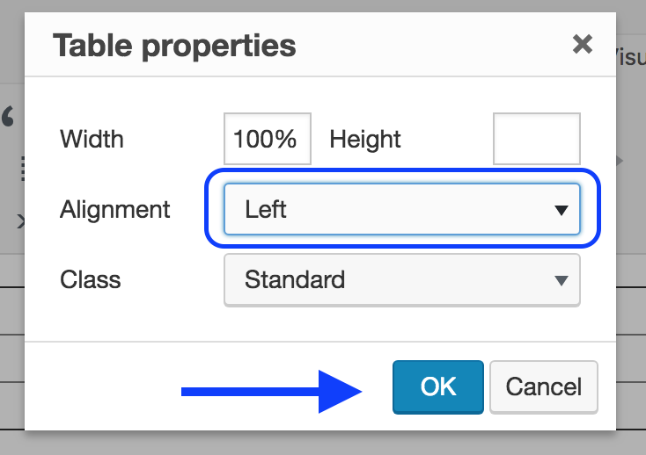
Notes:
The “Alignment” tool allows you to position a table as follows:
None = no alignment
Left
Centre
Right
To enact this feature,
Add a table to the web page
Position your cursor in any cell within the table
Select the desired position from this dropdown list. Here “Left” has been chosen.
Click on “OK”.

Slide 47
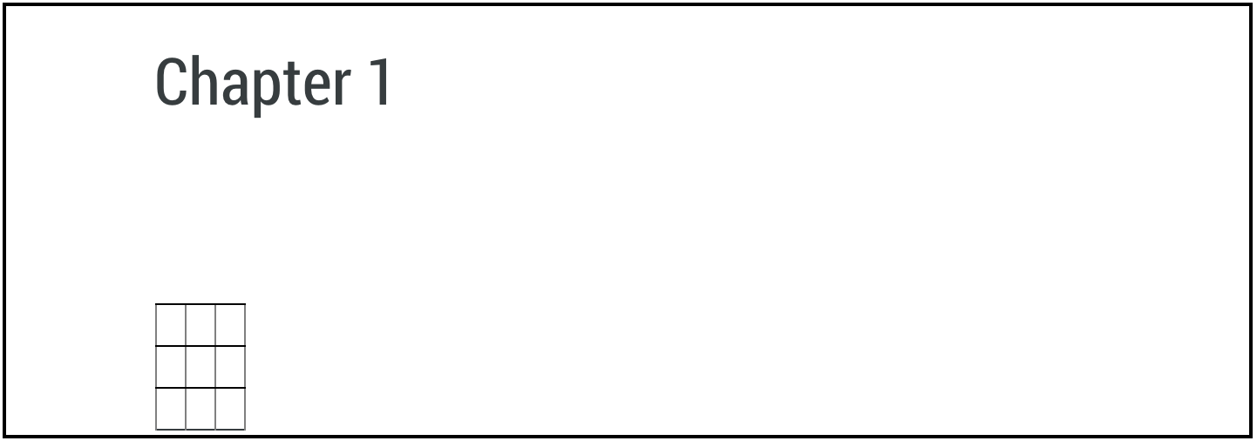
Notes:
The position of the table in the Visual Editor/tab will not change. (See at the top of this slide.)
However, in the reader’s view, the table will shift to the left. (At the bottom of this slide.)

Slide 48
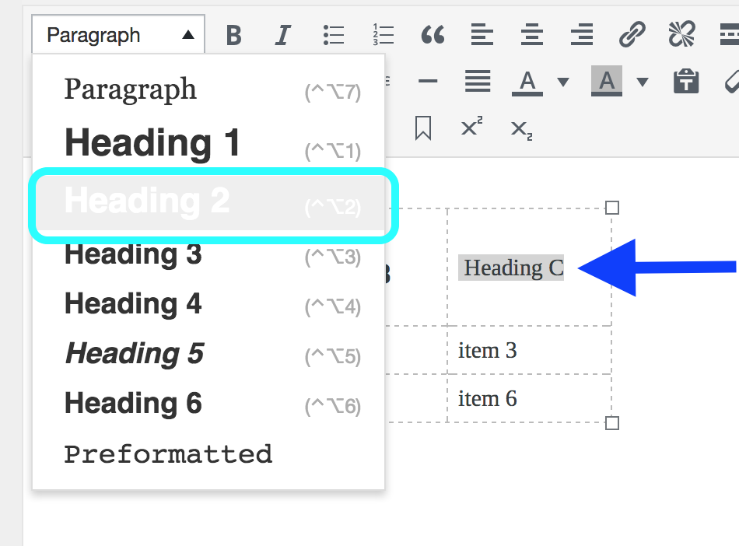
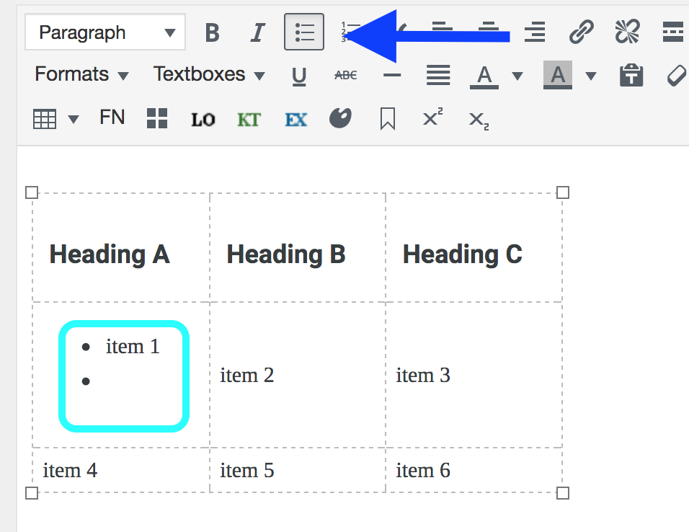
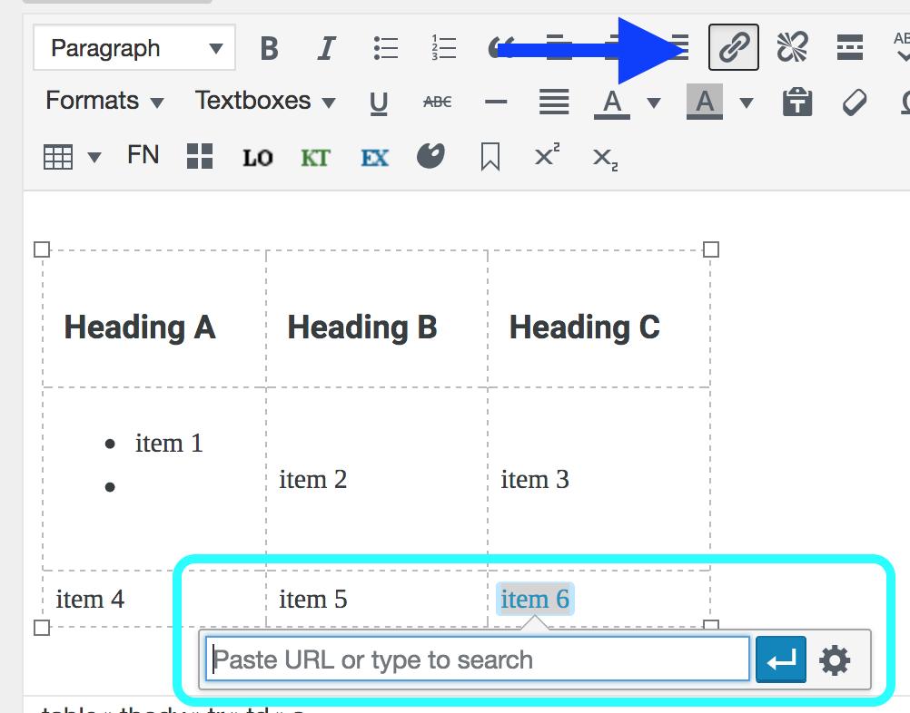
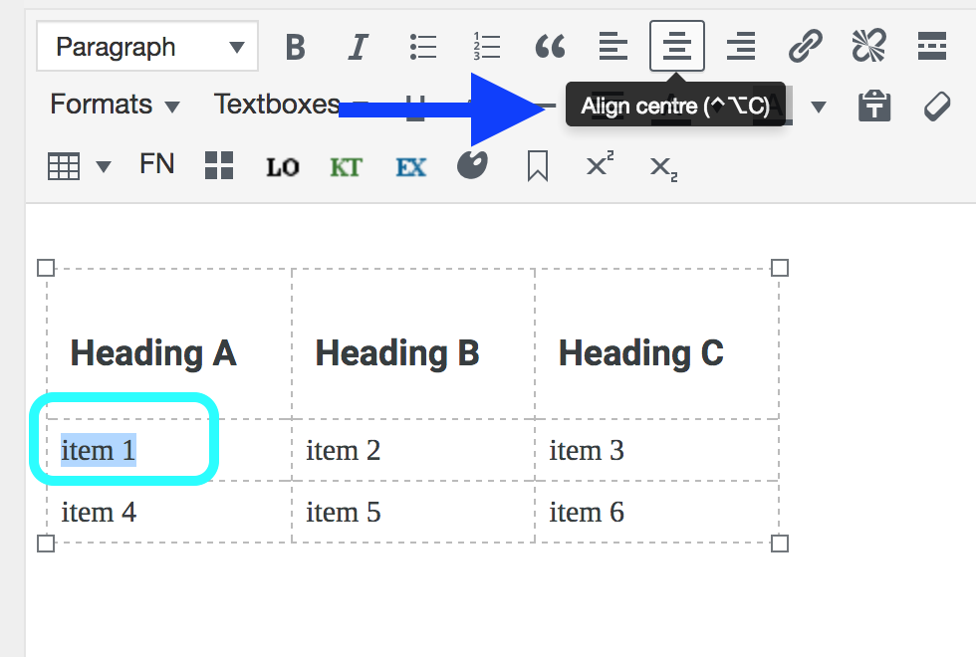
#1
#2
#3
#4
Notes:
The text within each table cell can be styled according to your preference. For example,
In example number 1, the heading labels for the table have been set as Heading 2
Example # shows a bulleted list was added to the items in one of the cells
For example #3, text “item 6” was linked
In example #4, text “item 1” is centered within the cell.

Slide 49
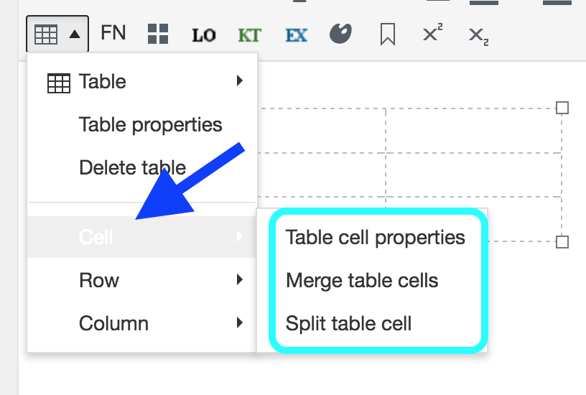


#1
#2
#3
Notes:
We don’t have time during this webinar to delve into all of the properties and functions available for tables, however, here are some features that you can look at and try. Hint: whenever you see an arrow by an item, click on it to reveal more options.
In this screenshot, notice that after revealing the main dropdown menu for the Table tool, clicking on the arrow by:
Cell (#1)
Row (#2)
Column (#3)
…reveals sub-menus with options for that specific item.
In addition, selecting any option with “properties” in the title, will expose another features box. For example, “Table cell properties” and “Table row properties”.

Slide 50

Notes:
There a few issues with the tables tool to be aware of. We have resolved some of these, such as alignment. However, Pressbooks developers are continuing to work on remaining issues. Some of these include:
The styling between the Visual Editor’s view and reader’s view, and various exported files, such as PDFs, can be inconsistent.
The table “Class” option still requires some work.
Some authors have used the Text (HTML) tab to enter html to compensate for these issues. This was done in Clinical Procedures for Safer Patient care. The table in this slide is from this book, and is a good example of how both text and images can be inserted into a table for maximum effect.
____________________________________________________________________________________________________
Attribution: Screenshot taken from Clinical Procedures for Safer Patient Care by Glynda Rees Doyle and Jodie Anita McCutcheon is used under a CC BY license.

Slide 51
Lesson 4
How to add
bulleted and numbered lists
Notes:
Lesson 4: How to create bulleted and numbered lists

Slide 52


Notes:
Next we’ll look at lists. As you can see in this screenshot, there are two options: a bulleted list and a numbered list.

Slide 53

Notes:
Adding a bulleted list is similar to how other features are inserted into your textbook’s body.
Begin by placing the cursor in the spot where you want the list to appear (indicated by the blue arrow)
Then click on the bullet list icon (by the pink arrow).

Slide 54

Notes:
This is the result.

Slide 55

Notes:
To create another bullet, you must add text to the first bullet and then press Enter to create the next bullet on a new line.

Slide 56

Notes:
Here we have two items in a bulleted list.

Slide 57

Notes:
What if you want to create a multilevel bulleted list with “Downtown” and “Gastown” (circled in light blue) as secondary items listed under “Vancouver”?
This can be done with the “Increase indent” feature indicated here with the blue arrow.

Slide 58

Notes:
Begin by highlighting the items you want as secondary bullets (by the blue arrow)
Then click on the ”Increase indent” icon (by the pink arrow).

Slide 59

Notes:
This is the result.

Slide 60

Notes:
To revert an item back to its original level on the bulleted list,
Highlight it or place your cursor in or next to the word or phrase
Then click on the “Decrease indent” icon, indicated by the pink arrow and to the left of the “Increase indent” icon.

Slide 61

Notes:
This is the result.

Slide 62

Notes:
To create a tertiary list, follow the same procedure.

Slide 63

Notes:
This is the result in the Visual editing view. Notice that the bullet style is different for the first three bullet levels.
NEXT SLIDE

Slide 64

Notes:
This is the reader’s view.

Slide 65

Notes:
The maximum number of list levels has been increased. Here are 11 levels.
Notice that the bullet style remains the same from level 3 onward in the Visual editing view (and the reader’s view).

Slide 66

Notes:
Creating a numbered list follows the same steps except you use the “Numbered list feature, indicated in this screenshot by the pink arrow.

Slide 67

Notes:
Here is an example of two items in a numbered list.

Slide 68

Notes:
And here, this is how a three-level numbered list appears in the Visual editing view….
NEXT SLIDE

Slide 69

Notes:
.. and how it looks to the reader.
Don’t forget that when creating or making changes to a bulleted or numbered list, save your work by clicking the red Update button.
Finally let’s look at how a couple of authors have used lists in their open textbooks.

Slide 70

Notes:
In this example from “Research Methods in Psychology, 2nd Canadian edition”, you can see how the authors used both a numbered list (inside the Learning Objectives text box) and a bulleted list in the main body of the text. Both list types can be used in the various text boxes described earlier.
______________________________________________________________________________________________________
Attribution: Screenshot taken from Research Methods in Psychology, 2nd Canadian edition by Dr. Rajiv S. Jhangiani, Dr. I-Chant A. Chiang, and Dr. Paul C. Price used under a CC BY-NC-SA license.

Slide 71

Notes:
In this example, from ”Course Pack 3” of the BC Reads series, the author used a two-level numbered list for a multiple choice review quiz.
______________________________________________________________________________________________________
Attribution: Screenshot taken from BC Reads: Adult Literacy Fundamental English – Course Pack 3 by Shantel Ivits used under a CC BY license.

Slide 72
Lesson 5
How to link text
Notes:
Lesson 4: How to link text

Slide 73


Notes:
Next, we’ll discuss how to link text to either an external web page or an internal page within your textbooks.
The tools used are the “Insert/edit” link and “Remove link”… shown here.

Slide 74

Notes:
Let’s begin with linking to an external source.
In this example, ”external source” has been highlighted. It is the phrase that is going to be linked to an external web page, online PDF, page in another textbook, or other resource online.

Slide 75

Notes:
After highlighting the text, click on the “Insert link” icon identified with the pink arrow. A field pops up indicated by the blue arrow. Note the help text provided in that field: “Paste URL or type to search”.
(Note: The field does not search for a URL outside of the book.)

Slide 76



Notes:
The three steps to link text are:
Highlight text to link (blue arrow)
Type in the web address or URL (pink arrow)
Click the “Apply” icon (green arrow).
Notice that only the “resource name” portion of the web address, in this example is google.ca, has been entered.

Slide 77

Notes:
This is the final result in the Visual edit view….
NEXT SLIDE

Slide 78

Notes:
And this is what the reader sees.

Slide 79


Notes:
Here, the full web address has been entered which includes the protocol identifier (“https” or “http”) and/or the subdomain (“www”) portion of the web address. However, as you can see in the bottom screenshot, the URL has been shortened to google.ca by the linking feature. The end result is the same.

Slide 80

Notes:
If you discover a mistake after entering, applying, and saving the web address, use the Edit pencil icon (shown with the blue arrow here) to correct it.
In this example, the “e” is missing from “google”.
To begin, click on the Edit pencil icon…
NEXT SLIDE

Slide 81

Notes:
…correct the error and click on the Apply arrow.
Remember to save your work with red Update button.

Slide 82

Notes:
If you want to remove a link, one tap on the linked text with your cursor will highlight that text and prompt a view of the web address where the text is being linked along with a “Remove link” feature. Clicking on this will remove the link.
Notice a “Remove link” icon is also offered in the first tool row by the pink arrow.

Slide 83

Notes:
For more options when linking text, look to the right of the “Apply” arrow for the “Link options” icon. If you click on this…
NEXT SLIDE

Slide 84

Notes:
…this pop-up box appears. There are many ways this can be used.
First,
Notice:
The highlighted “external source” text in the Link Text field and
The URL field that can be used to enter the web address for the linked text, called the “destination URL” here.
Once this is done, click on the red “Add Link” button in the lower right corner by the pink arrow.
If you use this feature to correct a URL, the “Add Link” button will be renamed “Update”

Slide 85

Notes:
If you want the linked text result to open in a new tab, check the “Open link in a new tab” box.
However, it should be noted that best practices for accessibility state that:
“In general, it is better if weblinks do not open new windows and tabs since they can be disorienting for people, especially people who have difficulty perceiving visual content.^{[2]}
“However, if a link must open in a new window, it is best practice to include a textual reference. For example, Information on the BC Open Textbook Project [New Window] is available online.^{[3]”}
For more information about this, see the Weblinks chapter in the BC Open Textbook Accessibility Toolkit (https://opentextbc.ca/accessibilitytoolkit/).

Slide 86

Notes:
To begin our discussion about linking text internally, i.e. to other sections and chapters within your textbook, let’s look at the Search feature in the “Insert/edit link” box.
Here, you see a “Search” field, noted by the blue arrow, and above that field instructions that say: “…link to existing content”. This refers to content that currently exists in your textbook. Under the “Search or use up and down arrow keys to select an item.” are all of the Parts and Chapters for this book.

Slide 87

Notes:
In this example, “introduction” has been entered into the Search field. Once that is done, the system searches for this word in both the titles and text body of all Parts and Chapters of the textbook. The results appear below the Search field immediately after typing.
Here, only the Introduction in the Front Matter contains the word “introduction so it is the only choice.
If there is more than one Chapter or Part that contains the entered word or phrase, the system will permit you to only select one.
If a phrase is entered, the system will search for that exact phrase.

Slide 88

Notes:
To complete this task, click on “Introduction” in Front Matter. This action highlights that selection with light gray and automatically populates the URL field with the web address.
Finally, click on the red “Add Link” button in the lower right corner.

Slide 89

Notes:
Here’s another way to link to an internal page.
Open the page tyou want to link TO in the reader’s view. Here we want to link to the Introduction page in the Front Matter.
Then copy the URL segment that comes after “https://pressbooks.ca”. This includes the first and final back slash.
NEXT SLIDE

Slide 90

Notes:
3. As was illustrated before, highlight the text to be linked (“internal Chapter or Part”) and
4. Click on the “Insert link” icon (by the red arrow). This will prompt the URL field to pop up.
5. Paste the URL segment you’ve copied into this field (by the blue arrow)
6. Click the Apply arrow (by the green arrow)
7. And save by clicking the red Update button in the lower right corner.
Note: If the entire URL is used instead, the text will link in the online version of the textbook, but in the exported digital files (for a PDF for example) the linked text will redirect to the web page of the online book rather than the targeted page in the PDF.

Slide 91

Notes:
To link internally to a specific place in a Chapter or Part page within a textbook, use the Anchor feature identified here with the blue arrow. Here is how.
As before, go to the Chapter or Part you want to link to.
Determine where you want the text to link to on the page.
Place your cursor in front of the section of this text, in this case the “Section” heading…
NEXT SLIDE

Slide 92

Notes:
4. Pick a label for the anchor and enter it in the “Name” field in the Anchor pop-up box. In this example, “section” is used.
5. Press the blue “OK” button
6. Click “Update.

Slide 93

Notes:
This is the result.
For an excellent discussion about hyperlinks, see the Adding Hyperlinks, Internal and External in the Pressbooks.com Userguide: https://guide.pressbooks.com/chapter/adding-hyperlinks-internal-and-external/

Slide 94


Pressbooks Feedback
Notes:
We welcome your feedback about this webinar and Pressbooks in general and ask that you fill out our Pressbooks Feedback form.
Go to the BCcampus Open Education site at open.bcampus.ca, select ”Pressbooks Support”, and then “Pressbooks Feedback” at the bottom of the drop-down list.

Slide 95
Questions?
open.bccampus.ca

