Slide 1
Promoting Your Physical and Mental Health

Slide 2
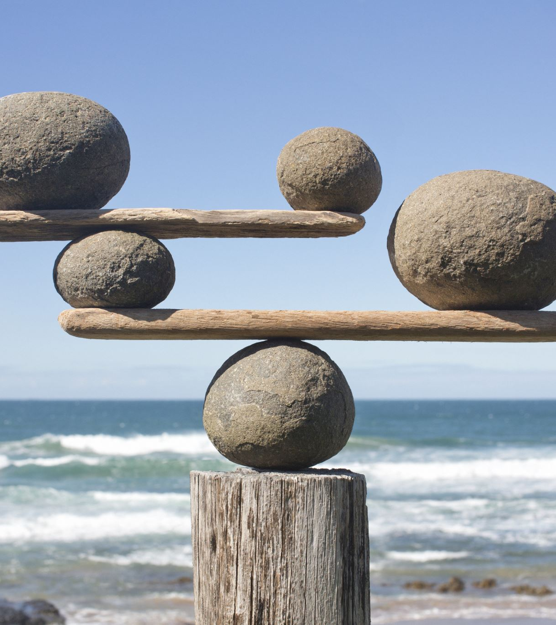
Achieving a Lifestyle Balance
You cannot care for others unless you take care of yourself.
Nutrition
Physical Activity
Leisure and Rest
Reducing other risk factors.

Slide 3
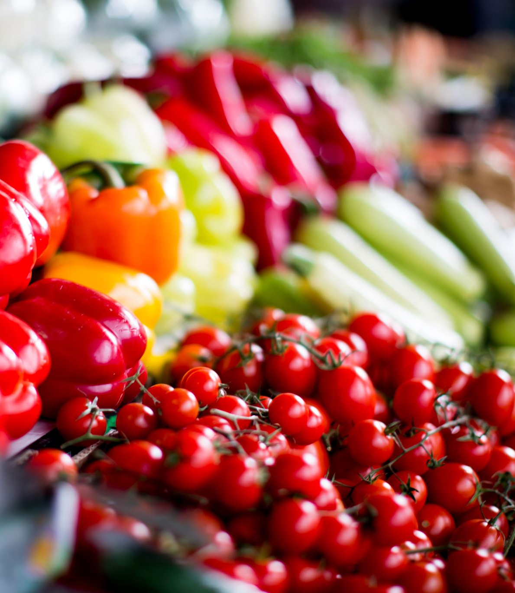
Nutrition
As Educators, one of our most important roles is to be a good models to the children in our care. As such we need to maintain a healthy relationship with food.
However, is not the only reason why you should maintain a healthy outcome - As you will learn in Section 4: Nutrition, maintaining a healthy diet and regular physical activity is important for both your physical and mental well being.
Food provides us with energy to complete the many tasks we need to do each day. Eating nutritional foods keeps our minds and bodies functioning at their optimum level.
Eating nutritionally also helps to prevent injury and illness.

Slide 4
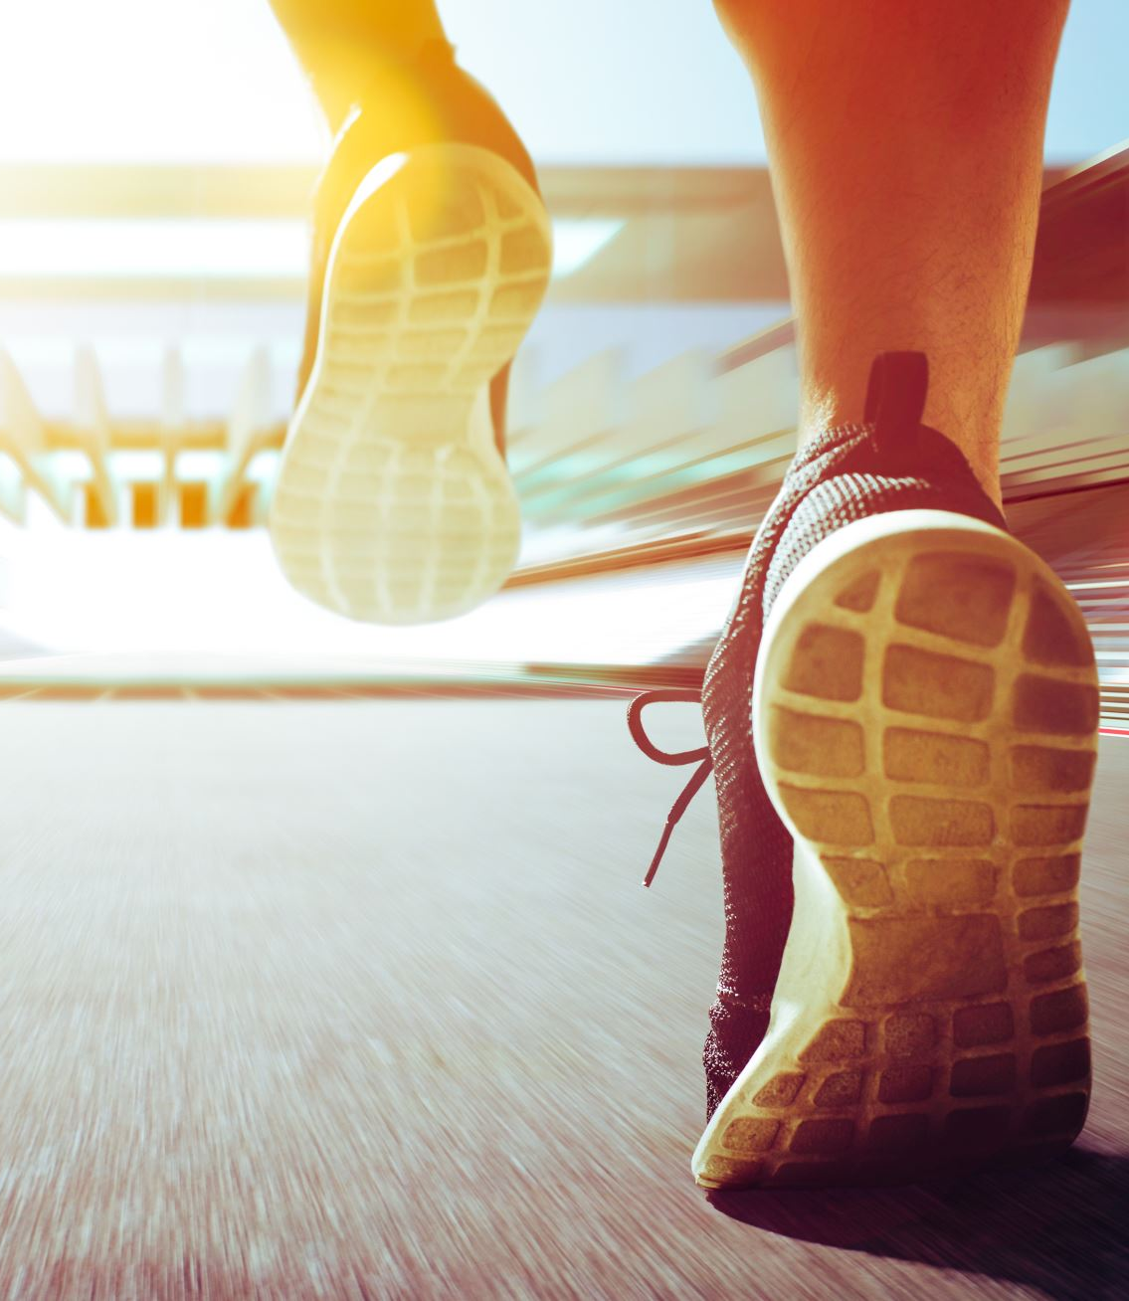
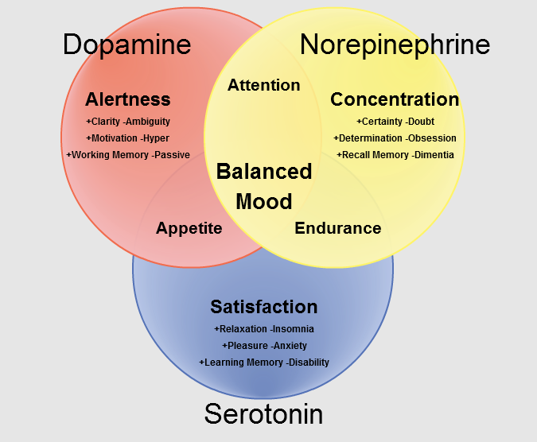
Physical Activity
Healthy eating and physical activity is a winning combination.
Brain health – physical activity elevates and balances the three brain transmitters – Serotonin, Norepinephrine and Dopamine – each positively influences your mental health (Pimento and Kernsested, 2019).

Slide 5
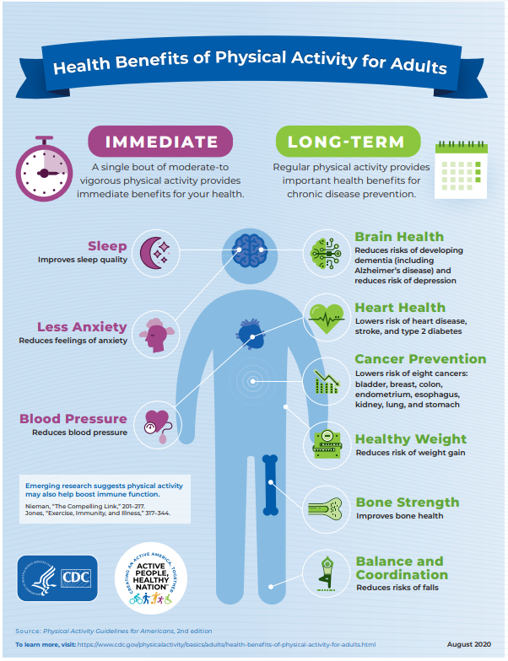
Physical Activity
According to the CDC “Regular physical activity is one of the most important things you can do for your health. Being physically active can improve your brain health, help manage weight, reduce risk of disease, strengthen bone and muscles and improve your ability to do everyday things” (CDC, 2023).
Taken from: Centers for Disease Control and Prevention (CDC), 2020

Slide 6
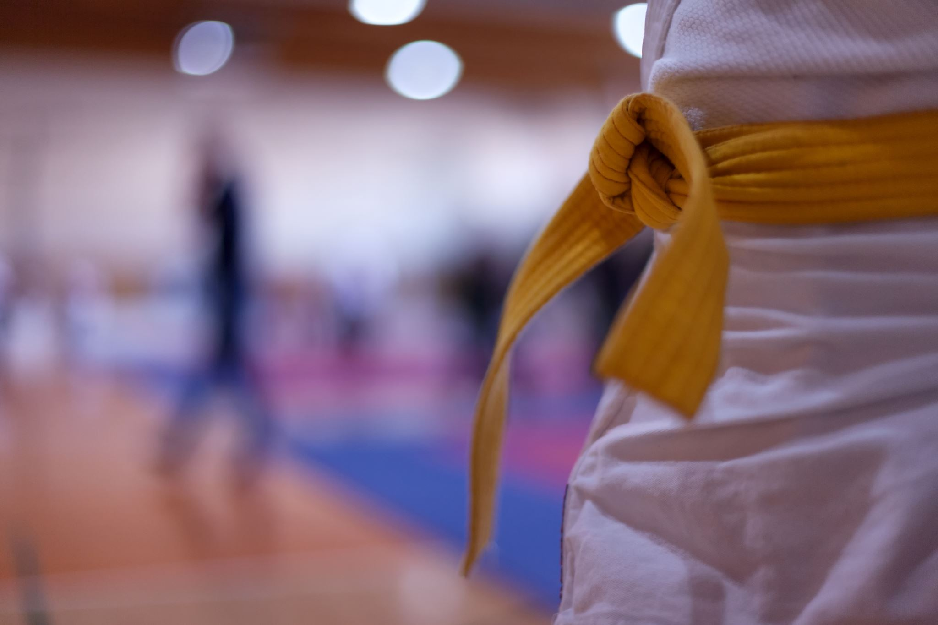
Physical Activity:
The Five (5)Fitness Components
Cardiovascular Endurance:
  the ability of the heart and lungs to deliver the oxygen needed to perform a medium to high intensity activity for an amount of time.
Flexibility:
  The ability to move muscles and joints though a range of motion.
Strength:
  Our ability to exert force during an activity
Muscular Endurance:
  The ability of our muscles to continue to perform an activity without fatiguing.
Body Composition:
  The amount of body fat, muscle, bone and other tissues that make up our body.

Slide 7


Leisure and Rest
Leisure and rest mean different things to different people. The commonality that we all share is that we all need time to relax.
Taking time to relax allows us to reset. Rest allows our bodies and mind to repair and revitalize.
Stress take a toll on both your mind and your body.
Ways to Relax:
Meditation
Mindfulness
Socialize
Read a book
Go for a walk
Listen to music
Photo by Jamie Street from upslpash.com

Slide 8

Reducing other risk factors to achieve a lifestyle balance
Quitting smoking
Limit alcohol
Avoiding illegal drugs
Take medication as prescribed.
Schedule regular yearly physicals with your doctor
Schedule regular dental check-ups
Perform monthly self-examination of breasts or testicles for signs of cancer
Practice safe sex
Maintain your immunizations

