Slide 1

Accessible Presentations
BCcampus Inclusive Design Webinar Series
Josie Gray
Coordinator of Collection Quality
@josiea_g
February 12, 2019
Notes:
Thank you for joining me today to talk about accessible presentations. My name is Josie Gray, and I work as the Coordinator of Collection Quality at BCcampus Open Education in Victoria, B.C. I have been working in web accessibility for two and a half years now. I work on an open textbook project in B.C. and I spend a lot of time learning, advising, and teaching about digital accessibility as it relates to open textbooks and open publishing platforms, like Pressbooks.
This webinar is part two of 4-part webinar series on inclusive design. For those of you who joined us last week, we met with Jess Mitchell from the Inclusive Design Research Centre to talk about what inclusive design means and what it looks like. Jess defined inclusive design as “Design that considers the full range of human diversity with respect to ability, language, culture, gender, age, and other forms of human difference.”
In this webinar, I will be talking about some concrete things that you can do to make your presentation slides accessible to people with disabilities. I will also highlight strategies that can make your presentation style more inclusive generally and demonstrate how sharing your presentation materials openly can increase the reach of what you have to say.
This webinar is scheduled for one hour, but the presentation will only be a portion of that. Once done, I will open up the room for discussion and questions. This will give us a change to clarify points, exchange ideas, and think about what accessible presentations may look like in practise. If you have questions while we go, feel free to put them in the chat and we will come back to them at the end.

Slide 2
Outline
Slide set up
Slide content
Inclusive presentation strategies
After the presentation
Notes:
When thinking about how to make presentations accessible, there is a lot to keep in mind. In many ways, inclusive and accessible presentations are really hard to achieve, especially when they haven't been designed with inclusiveness in mind, and there is often no one right way to do it.
When designing your presentation, your first consideration should be the people in the room when you give the presentation.
How do you make sure everyone in the room can hear, even if they are at the back? If not everyone can hear you, what can you do to make it so they can follow what you’re saying another way?
How do you make sure everyone can read or understand the content of your slide? If they can’t, how can you convey that content in another way?
For example, maybe you teach in a small classroom and your lectures have a lot of notes and information. In this case, the way you set up and lay out your slides will be really important, and the type of information you include on your slides will be very important, and how you talk about the content of those slides will be very important.
But maybe your slides are simple. Maybe they act primarily as visual aids but don’t actually contain much information. In this case, your slides themselves will be less important, but sharing your speaking notes may help people who have trouble hearing you follow along.
When designing your presentation, you also need to keep in mind the people who couldn’t attend your talk or lecture. If there are people who wanted to be there but couldn’t, I would encourage you to share your presentation in some way. How you do this may change depending on the context. If you are giving a keynote, there will likely be a video or audio recording for sharing. Or if you are speaking to a smaller group of people, you may decide instead to share your slides and speaker notes in multiple formats. Regardless of how you share your materials, by designing your presentation so it is open, complete, and accessible will help ensure that you’re presentation will have a reach much beyond the immediate room.

Slide 3
Part 1: Slide Set Up
Notes:
First, I am going to talk about setting up your slides in PowerPoint so that your Powerpoint file is accessible. While this information specifically deals with PowerPoint, a lot of what I talk about can be applied to other presentation softwares.

Slide 4
Visual Design
“We get so fond of the way something looks that we lose our ability to be critical of it. We lose our ability to really do inclusive design.”
-Jess Mitchell
Notes:
As you will probably notice, my slides aren’t especially pretty. But I think that’s okay, and prettiness is not a priority here. While creating visually pleasing presentations is something that we can absolutely keep in mind, it should not be the priority.
In the webinar last week, Jess warned that when we get attached to the way something looks, we lose our ability to be critical of it. And if we can’t be critical of it, we lose our ability to do inclusive design. As we go through the next few sections, this is something that I’d like to encourage you to keep in mind.

Slide 5
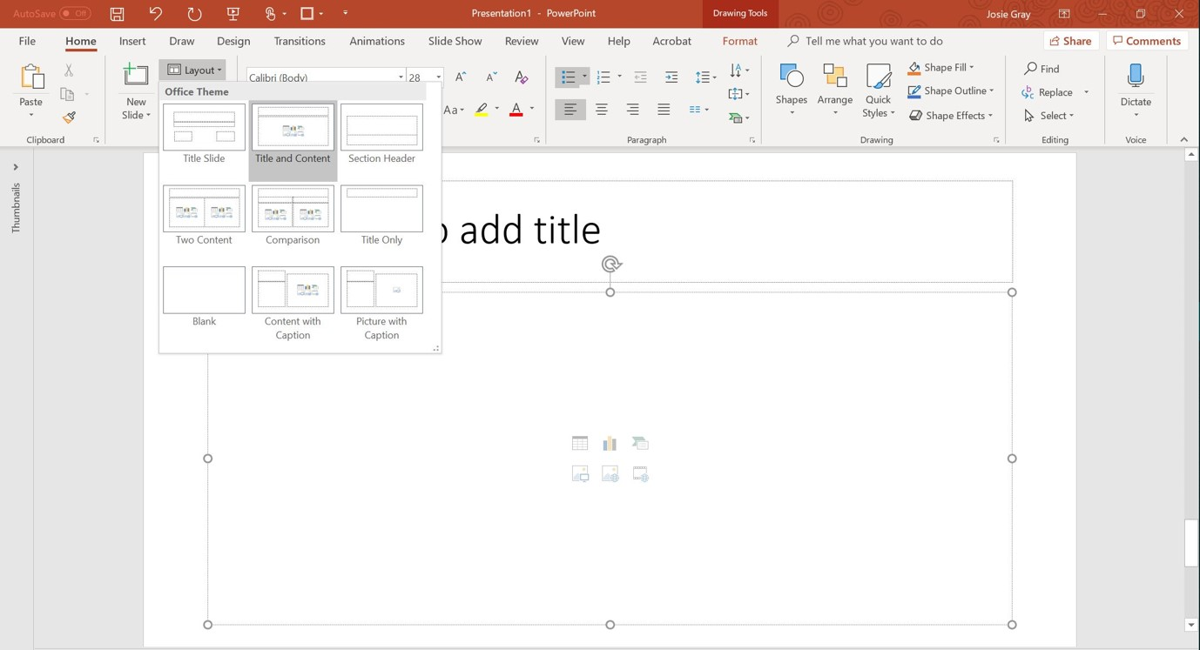
Slide Layouts
Notes:
When creating slides in PowerPoint, you will want to use the slide layouts, which act as templates. Slide layouts use place holders for different content types (like headings, images, and text), which ensures that the information on your slide can be accessed by people using screen readers and that the screen readers will present the information in the correct order. In addition, slide layouts can make your slide design so much easier, especially if there is a consistent style that you want applied throughout your presentation. You can access your slide layout options in the Home tab under the “Layout” drop-down menu.
Using slide layouts will also help you avoid the use of textboxes. Textboxes are not accessible for people using screen readers, so if you are using textboxes, you will have to provide an alt text description for any textboxes you use. This can create a lot of extra work. For example, the layout of the slide displayed here has room for a title and one content type. But let’s say I want this slide to have room for two separate sections of text. Instead of adding a textbox, I can select the “Two content” layout option from the layout drop-down menu. If I do this, there is no need to provide an alt text description.
Image Attributions
PowerPoint screenshot used with permission from Microsoft.

Slide 6
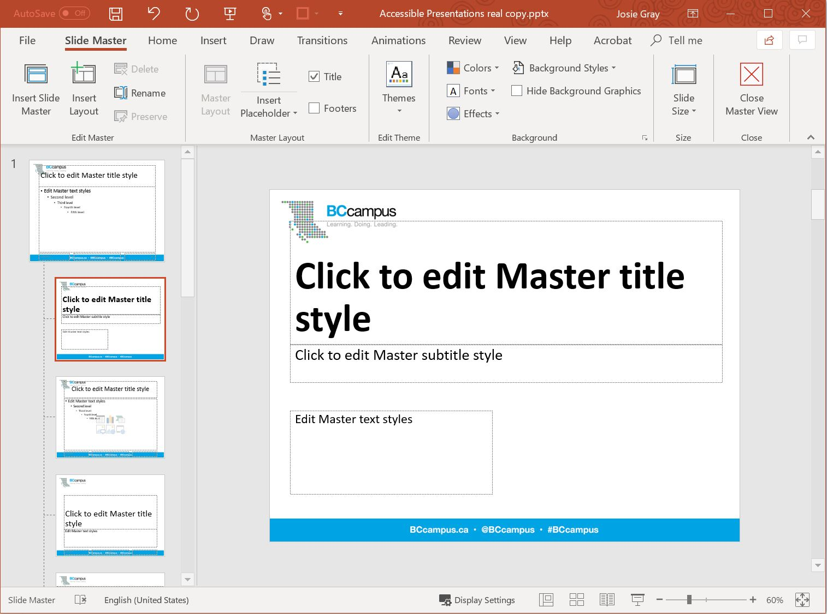
Slide Master
You can access slide master from the “View” tab
Notes:
PowerPoint provides you with a number of default slide layouts, but you are able to customize and style the layouts however you wish and have those customizations apply to all slides using that layout. This is done in the Slide Master view. In PowerPoint, you can access “Slide Master” under the View tab.
The slide master acts as the style sheet for all of your slides. It is where you can style your slide layouts by selecting the your font type, size, and colour; you can apply a background to all layout types at once; and you can edit the layouts or make your own by adding, removing, or repositioning different place holders.
Any changes made to these layouts will be reflected in your slides. And any new layouts you create will be available to select when you go back to your slides.
Image Attributions
PowerPoint screenshot used with permission from Microsoft.

Slide 7
Unique Headings
Accessible Presentations
Outline
Part 1: Slide Set Up
Slide Layouts
Slide Master
Colour Contrast
Font and Text
Unique Headings
Notes:
As with all of web content, headings are important. When it comes to presentations, it is important that you put your headings in the heading placeholder available in slide layouts and not a textbox or a general text placeholder. It sill also important to ensure that every slide in your presentation has a unique heading.
Here I have listed all of the titles for my slides in this presentation so far. The main thing I want you to note is that each heading is unique and it describes what is covered on that slide as precisely as possible. If you are sharing your slides, this will make them easy to navigate so people can go back and find information easily. It also helps people who use screen readers. People using screen readers can use headings to scan through a presentation to find what they want, and using unique headings makes that a lot easier.

Slide 8
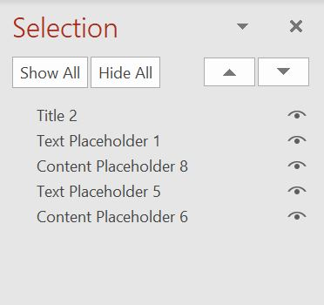
Order of Objects
To check the order of objects on a slide:
Select a slide
Click “Home” tab, select “Arrange”
Click “Selection Pane”
Move objects so they are in the correct order
Notes:
The final thing that I want to cover in this section is order of objects. That means the order that your slide content will be presented in to someone using a screen reader.
As I mentioned earlier, by using layouts PowerPoint will have a decent idea of what order to present information in. But things can get mixed up, especially if content is added in a different order, so it’s a good practice to check the order of objects on each of your slides.
To edit the order of objects on a slide in PowerPoint, go to the Home tab, select the “Arrange” drop-down menu, and click “Selection Pane.” A Selection panel will pop up listing the order of objects on the slide you have open. When you click on the placeholder, the object that it corresponds to in your slide will be selected as well. You can drag and drop these objects to put them in order, or you can use the arrows to move objects up and down.
Image Attributions
PowerPoint screenshot used with permission from Microsoft.

Slide 9
Part 2: Slide Content
Notes:
Now I will be looking at the actual content of your slide and how it is presented.

Slide 10
Font and Text
Use large text size with lots of white space.
Keep your font choices simple.
Avoid using all capital letters and excessive italics or underlines.
Notes:
When adding text to your slides, there are a few things to keep in mind. First, use a large text and lots of white space. The minimum size of your text will change depending on the size of the room you are presenting in. For example, in a webinar like this where most of you are probably viewing this on your computer screen, I can probably get away with smaller text than I could if I were presenting in a large lecture hall.
In relation to this, avoid including too much text on a slide. Too much text can distract from what you’re saying as people try to read your slide content, and it may be overwhelming for people trying to listen and take detailed notes at the same time.
In addition, keep font styling simple – avoid using all capital letters and excessive italics or underlines.

Slide 11
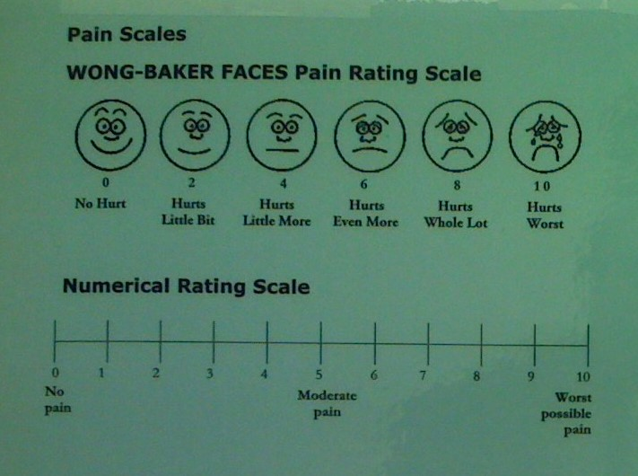
Alt Text
Image
Alt Text
The Wong-Baker Faces Pain-Rating Scale uses cartoon faces to illustrate the different levels of pain.
Notes:
In PowerPoint, you can add alternative text descriptions (or alt text) to all non-text content that conveys information. This includes things like images, textboxes, graphs, and tables. People who use screen readers require alternative text descriptions to perceive the visual content on your slides.
Describing complex images can be tricky. But the main thing is to prioritize the significance of the image, rather than the visual apperance, and leave out irrelevant details. If an image is just for decorative purposes, it does not need to be described.
In this example there is an image. The alternative text description reads: “The Wong-Baker Faces pain-rating scale uses cartoon faces to illustrate the different levels of pain.” In this case, the alt text only provides a brief description of the image, but if I were describing this image for nursing students, I might also provide a description of each of the cartoon faces and what they correspond to on the 10-point scale.
To add alt text to an object, select the object, right click, and select “Edit Alt text.”
Image Attributions
“Pain Scales” by Juhan Sonin has been modified (cropped) by BCcampus and is used under a CC BY 2.0 Licence.

Slide 12
Colour Contrast
Think about the colour you are using.
Is there sufficient colour contrast between the foreground and background?
What if the text was smaller?
Can you read this?
contrastchecker.com
Notes:
Because slides are visual mediums, your use of colour on your slides and the colour contrast is very important. This applies to your text, background, and any graphics that you add to your slides.
Paying attention to colour contrast benefits people who have poor eyesight or problems differentiating between colours. But it is also helpful for people who are far away from your slides, are trying to take a picture of your slides in poor lighting, or are viewing it on a screen with low brightness.
When picking your slide colours, some recommend that if you will be presenting in a dark room to use a dark background with light text. And if you are presenting in a light room, to use a light background with dark text.
In the end, the simpler the colour scheme of your slides and the higher the contrast, the easier it will be for people. I will be sharing links to tools and resources separately, but one tool that I use for checking colour contrast is contrastchecker.com.

Slide 13
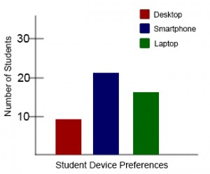
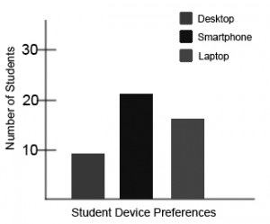
Use of Colour
A bar graph in colour
Grey-scale view
Notes:
In relation to colour contrast, I also want to talk about how you use colour.
Many people are colour blind or have low-contrast vision. As such, it’s important to never use colour alone to convey information. This means that you should not label or categorize information on your slides with colour alone and you should not use colour to direct people’s attention to certain points on your slides. For example, saying “The red bar shows the number of students who prefer to use desktops” won’t work for someone who is colour blind. When viewed in grey-scale, it’s impossible to tell which bar is red.
If you want to test the use of colour on your slides, there is a setting in PowerPoint that lets you view your slides in black and white or grayscale. This can be found under the “View” tab.
Image Attributions:
Bar graph (colour) and Bar graph (grey scale) by BCcampus are used under a CC BY Licence.

Slide 14
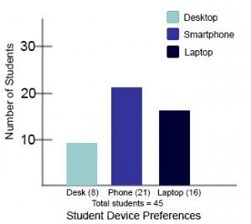
An Accessible Bar Graph
Notes:
Here is an example of a more accessible version of the previous bar graph. Not only has the contrast between colours has been increased, but labels have been added to each bar as well. If referring to this graph in a presentation, rather than referencing the colours I might say, “Out of 45 students, only eight prefer desktop computers.”

Slide 15
Links
Use descriptive link text
Provide short, easy-to-remember links
Example: Checkout the Accessibility Toolkit https://opentextbc.ca/accessibilitytoolkit/
Notes:
In presentations, you may want to share links with your audience. The biggest thing here is to make the link easy to remember for those taking notes. You will want to read the web address out for those who cannot see the text, and use descriptive link text if sharing your slides. If your link is long and complicated, you may want to provide a shorter alternative using a link shortening service like bitly.
For example, in this case I might say: “Checkout the Accessibility Toolkit at opentextbc.ca/accessibilitytoolkit/ and use “Accessibility Toolkit” as the link text.

Slide 16
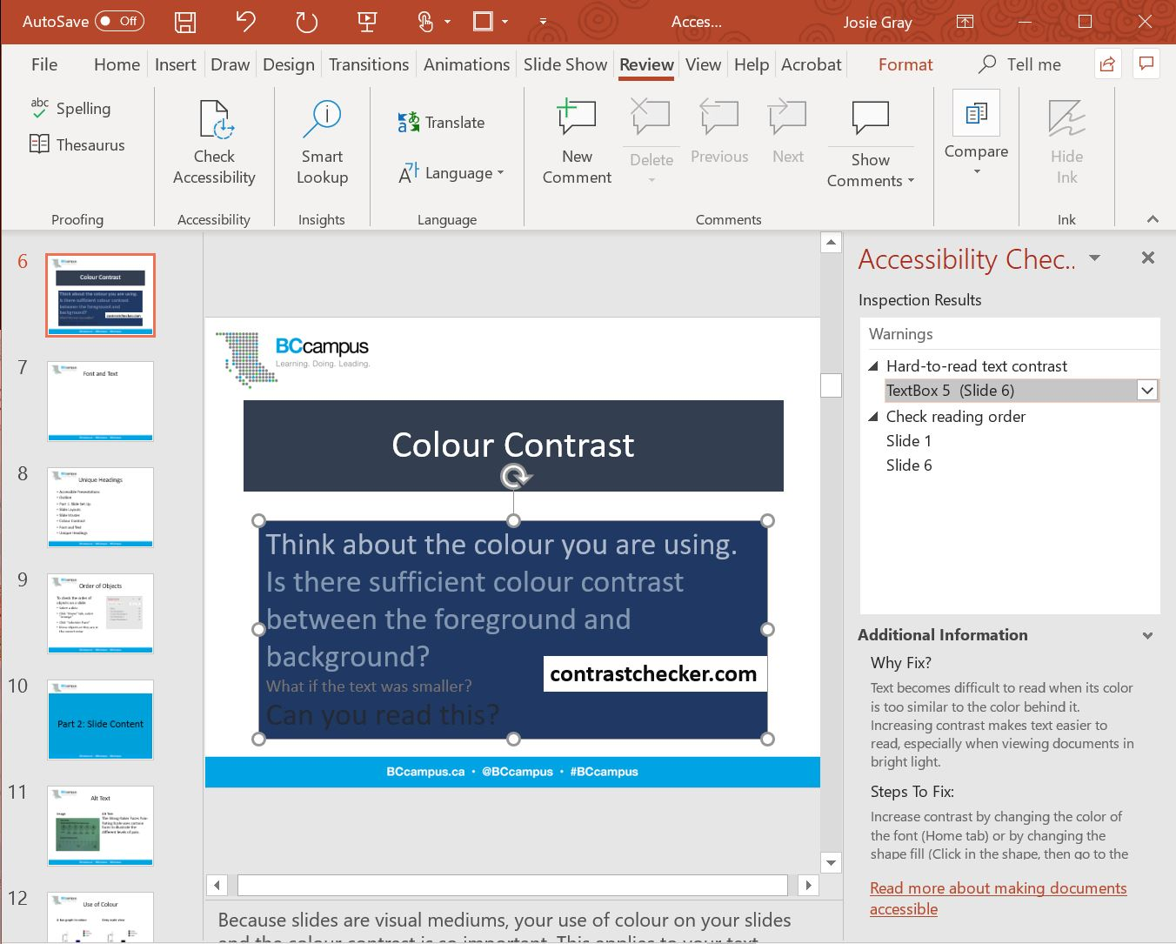
Accessibility Checker
Notes:
PowerPoint has a tool that can review the accessibility of your slides. It will list objects that are missing alt text descriptions, check your colour contrast, and point out slides where you may need to check the reading order. Note that using this tool doesn’t guarantee that your slides will be accessible to all, but it can help make sure you’re not missing things like alt tags.
In this example, the accessibility checker has highlighted the colour contrast problems on the slide I created to demonstrate poor colour contrast.
You can access the accessibility checker under the Review tab in PowerPoint where it says “Check Accessibility.”
Image Attributions
PowerPoint screenshot used with permission from Microsoft.

Slide 17
Part 3:
During the Presentation
Notes:
In this section, I will highlight ways that you can make your presentation style more inclusive and accessible. Note that I am not addressing good public speaking skills, although those skills are absolutely relevant. Speaking slowly and clearly, tying your language to your audience, presenting topics in a logical order, and minimizing distracting body movements are all things that make presentations easier to follow. However, in this section, I want to move beyond what we consider key to being a good public speaker.

Slide 18
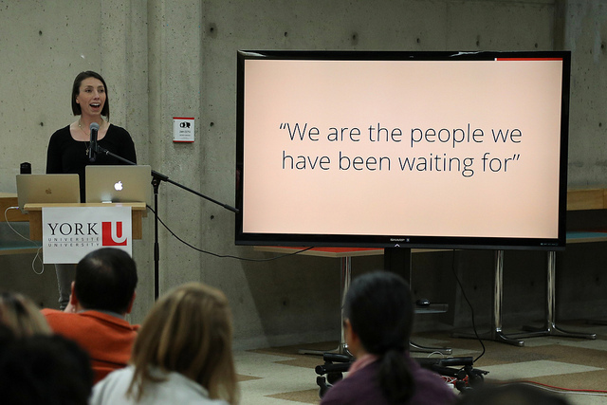
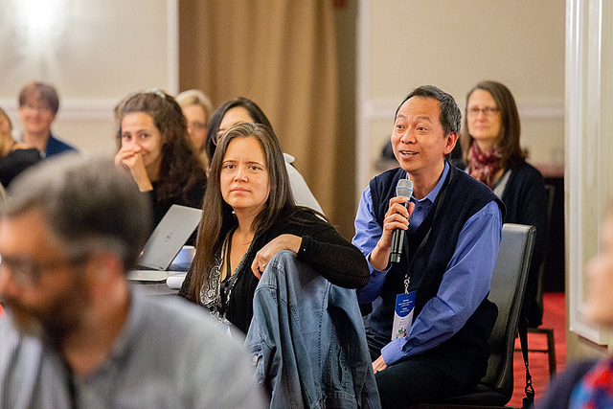
Microphones
Notes:
Using microphones when presenting is so important. While it may not be necessary with a small group, it is vital when in a large and crowded room, no matter how loud your voice is. This is especially important for those who are hard of hearing or if the presentation is being recorded or streamed. Keep in mind, asking “Can everyone here me?” is pointless if someone can’t hear you ask the question in the first place or is not comfortable speaking up.
When it comes time for questions, make mics available for people who have questions so they can be heard by everyone listening. Use wireless mics and mic runners to make sure people with mobility issues still have the option to ask questions. If you don’t have extra mics, you should repeat the question into your microphone for the benefit of people who couldn’t hear or who are listening to the recording.
I’ve recently experienced the frustration with people not using mics myself listening to a podcast recorded with a live audience. They didn’t have mics for audience members who asked questions, and the hosts didn’t think to repeat the question. I was left trying to guess what the question was based on the answer.
Image Attributions:
Person using a mic to ask a question by BCcampus is used under a CC BY-SA Licence.
Nicole Allen by the Right to Research Coalition is used under a CC BY-SA Licence.

Slide 19
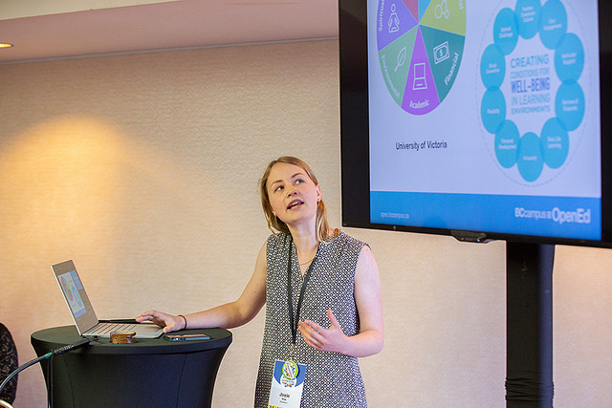
Describe All Visual Content
Notes:
One of the most important presentation strategies you can employ to make your presentation more inclusive is to get into the practice of describing your slides. This includes describing graphs and images as well as text. While it may not be necessary to read text word-for-word, people who can’t see your slides should still know what you are talking about.
When you present with the assumption that no one can see your slides, you make your presentation more powerful and useful. Describing the content of your slides can have many benefits:
It accommodates people who are blind or have poor vision.
It allows people to focus on taking notes while you talk
It ensures that someone who is sitting in the corner, way in the back, or just behind a really tall person doesn’t have to worry about not being able to see
It increases the value of an audio recording or transcript.
Image Attributions:
Josie Gray Presenting by BCcampus is used under a CC BY-SA Licence.

Slide 20
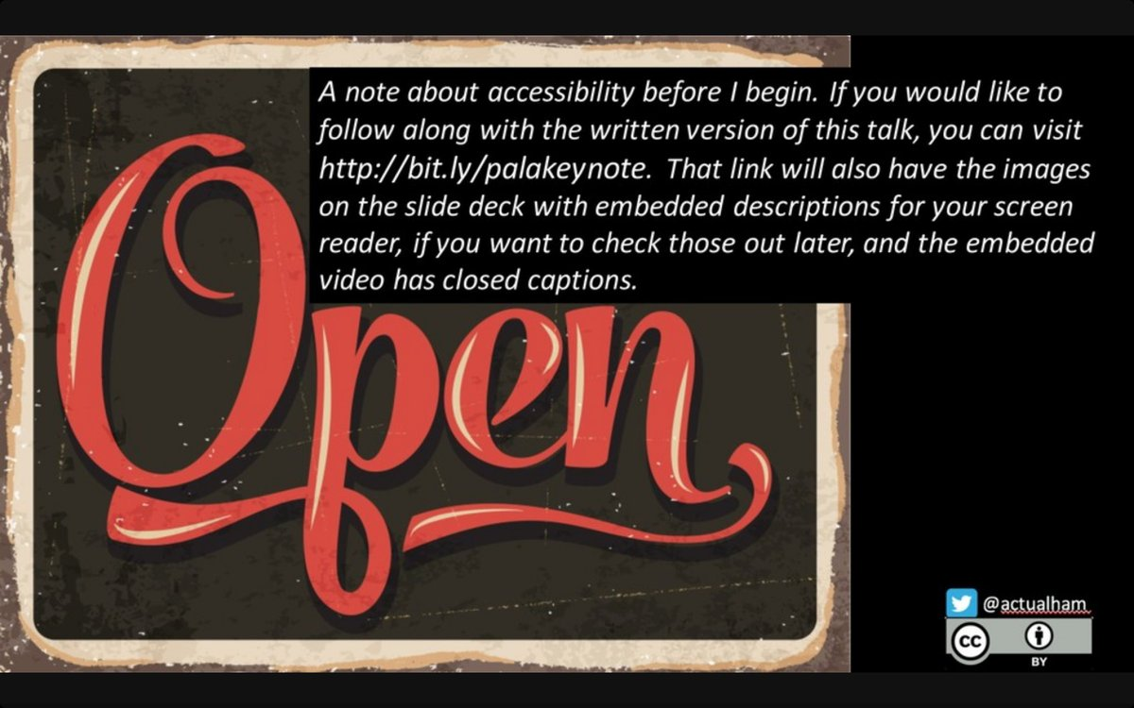
Share Your Presentation Materials
Notes:
You may also want to consider providing a text alternative of your presentation before you even begin.
This is an opening slide for a keynote by Robin DeRosa that she shared on Twitter back in October 2018.
On this slide, Robin provided a link to where audience members could download a written version of her talk along with the slide deck which had been designed to work with a screen reader.
After this talk, Robin shared on Twitter that she was approached by someone with a cochlear implant who thanked her for providing a text alternative to her talk.
By sharing her slides and her speaking notes, Robin’s presentation included someone who may not have been included otherwise. While this may not be a common practice or something that should be expected, it does demonstrate how being proactive about accessibility has the potential to reduce barriers for your audience.
Image attributions:
A note about accessibility slide by Robin DeRosa is used under a CC BY Licence.

Slide 21
Part 4:
After the Presentation
Notes:
I work in open education so openly licencing and sharing the materials I create is part of my job and everyday practice. Depending on your context, it might not be for you, and that’s okay.
But when it comes to creating an inclusively designed presentation, sharing your materials and how you share those materials becomes really important. Last week, Jess Mitchell talked about the importance of multimodal design and giving people a choice in how they want to interact with your content. Not only does this help people with disabilities – as it did in Robin’s example – but it can also increase the impact and reach of your presentation. Sharing your presentation materials in multiple formats allows people to choose how they would like to engage in your presentation. Not only will it allow for people to revisit your points, but it allows people who couldn’t be in the room when you presented the chance to hear what you have to say.
As such, I am going to encourage you to make your presentation materials available early – maybe even before you have given the talk as Robin did – and to keep them available after you present, even if you don’t put an open licence on them.
I recognize that this may not be practical or necessary in every instance. For example, an instructor who has daily lectures will probably have little desire to create a transcript of their lecture to share or make presentation materials available in advance. But I’d like for you to keep in mind the possibilities that emerge when we provide people options, whether you are giving a workshop, teaching in class, or keynoting for hundreds of people.

Slide 22
Multimodal Presentations
Share video/audio recordings
  Provide transcripts or captions
Share your slides with speaker notes
  PowerPoint
  Word/PDF
  Html/online
Notes:
There are many different formats you can share you presentation in. For talks or keynotes with large audiences, there is often a video or audio recording that can be shared after. If this is an option, captions or transcriptions for that recording need to be provided.
You can also share you presentation materials, which is a common practice in the open education movement. If sharing your materials, you need to make sure they are accessible. There are a few options here, but the exact formats that you make available will vary depending on your context and the needs of your audience.
You can share your PowerPoint slides with accompanying speaker notes. People who use screen readers will be able to navigate through the content of your slides and everyone will be able to read through your notes for each side to get an idea of what you said. This can range from bullet points to word-for-word transcription.
You can also export your slides as a handout which will put your slides and speaker notes next to each other on a page. PowerPoint will export handouts as Word documents, which can in turn be saved as PDFs or html files that can be viewed in any browser. While this makes for easy sharing and works for people who don’t have PowerPoint, the slides themselves will be turned into image files, and the text content and alt tags on the slides will no longer be available to people using screen readers. However, if your speaker notes convey the visual information of the slides, that shouldn’t be a problem.
Another option, would be to share a complete transcript of your talk with your slides online – as a blog post for example.

Slide 23
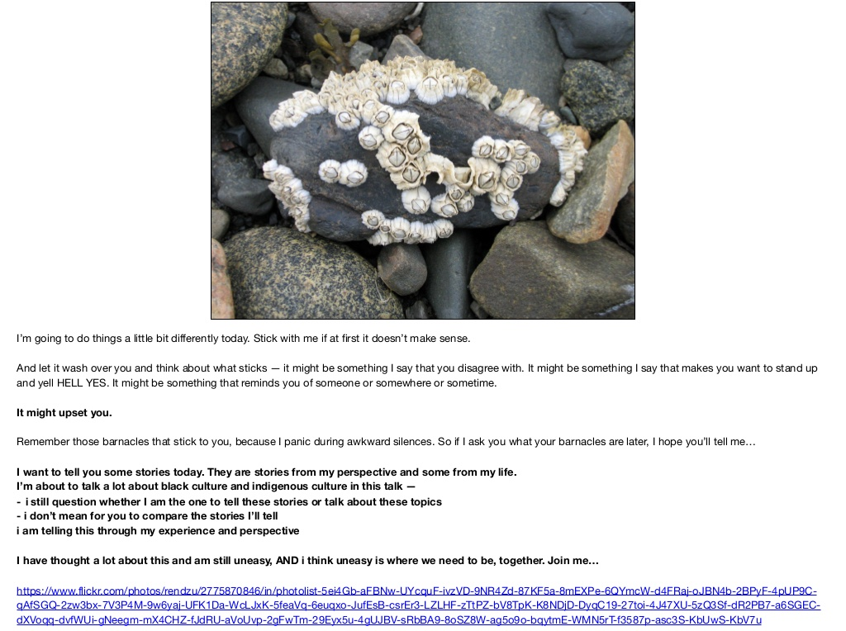
Share Your Slide Notes
Notes:
One example I’d like to highlight is Jess Mitchell’s keynote at OpenEd18. I didn’t get to attend this conference so I missed the keynote. But Jess shared her slides and slide notes. And her slide notes were so detailed and descriptive that it made it possible for me to read through her presentation and feel like I was there. I may not have heard her voice, but Jess’ notes meant that I didn’t miss anything.
Another example is Robin DeRosa’s keynote at Simon Fraser University titled “The Future of the Public Mission of Universities.” Robin shared a complete transcript of her talk as a blog post, along with the accompanying images, links, and the works cited. This is also a talk I would have missed if these materials had not been shared. And I am sure I am not the only one.
Not only did these people share their slides, but they shared the transcripts of their talks, which ensured that people beyond the immediate room were able to experience and engage with the talk.
Image Attribution: Barnacles slide from Tolerance for Failure: Open Education and the Ethical Edges by Jess Mitchell is used under a CC BY Licence.

Slide 24
Thank you

Slide 25
References
“Accessible Slides: Start to finish.” Accessible U YouTube Channel. Updated 30 September 2016. Accessed November 20, 2018. https://youtu.be/UQcae_pvro0
“Authoring Techniques for Accessible Office Documents: Microsoft PowerPoint 2010.” Accessible Digital Office Document (ADOD) Project. Updated 9 April 2013. Accessed 6 December 2018. https://adod.idrc.ocadu.ca/powerpoint2010
Bugstahler, Sheryl. “Equal Access: Universal Design of Your Presentation.” The Center for Universal Design in Education. Accessed 6 December 2018. https://www.washington.edu/doit/equal-access-universal-design-your-presentation
“How to Make Your Presentations Accessible to All.” W3C Web Accessibility Initiative. Updated 24 May 2018. Accessed 6 December 2018. https://www.w3.org/WAI/teach-advocate/accessible-presentations/
“Make your PowerPoint presentations accessible.” Microsoft. Accessed 6 December 2018. https://support.office.com/en-us/article/make-your-powerpoint-presentations-accessible-6f7772b2-2f33-4bd2-8ca7-dae3b2b3ef25
“PowerPoint Accessibility.” WebAIM. Updated 27 March 2018. Accessed 6 December 6 2018. https://webaim.org/techniques/powerpoint/

