Slide 1

How to Use

Slide 2
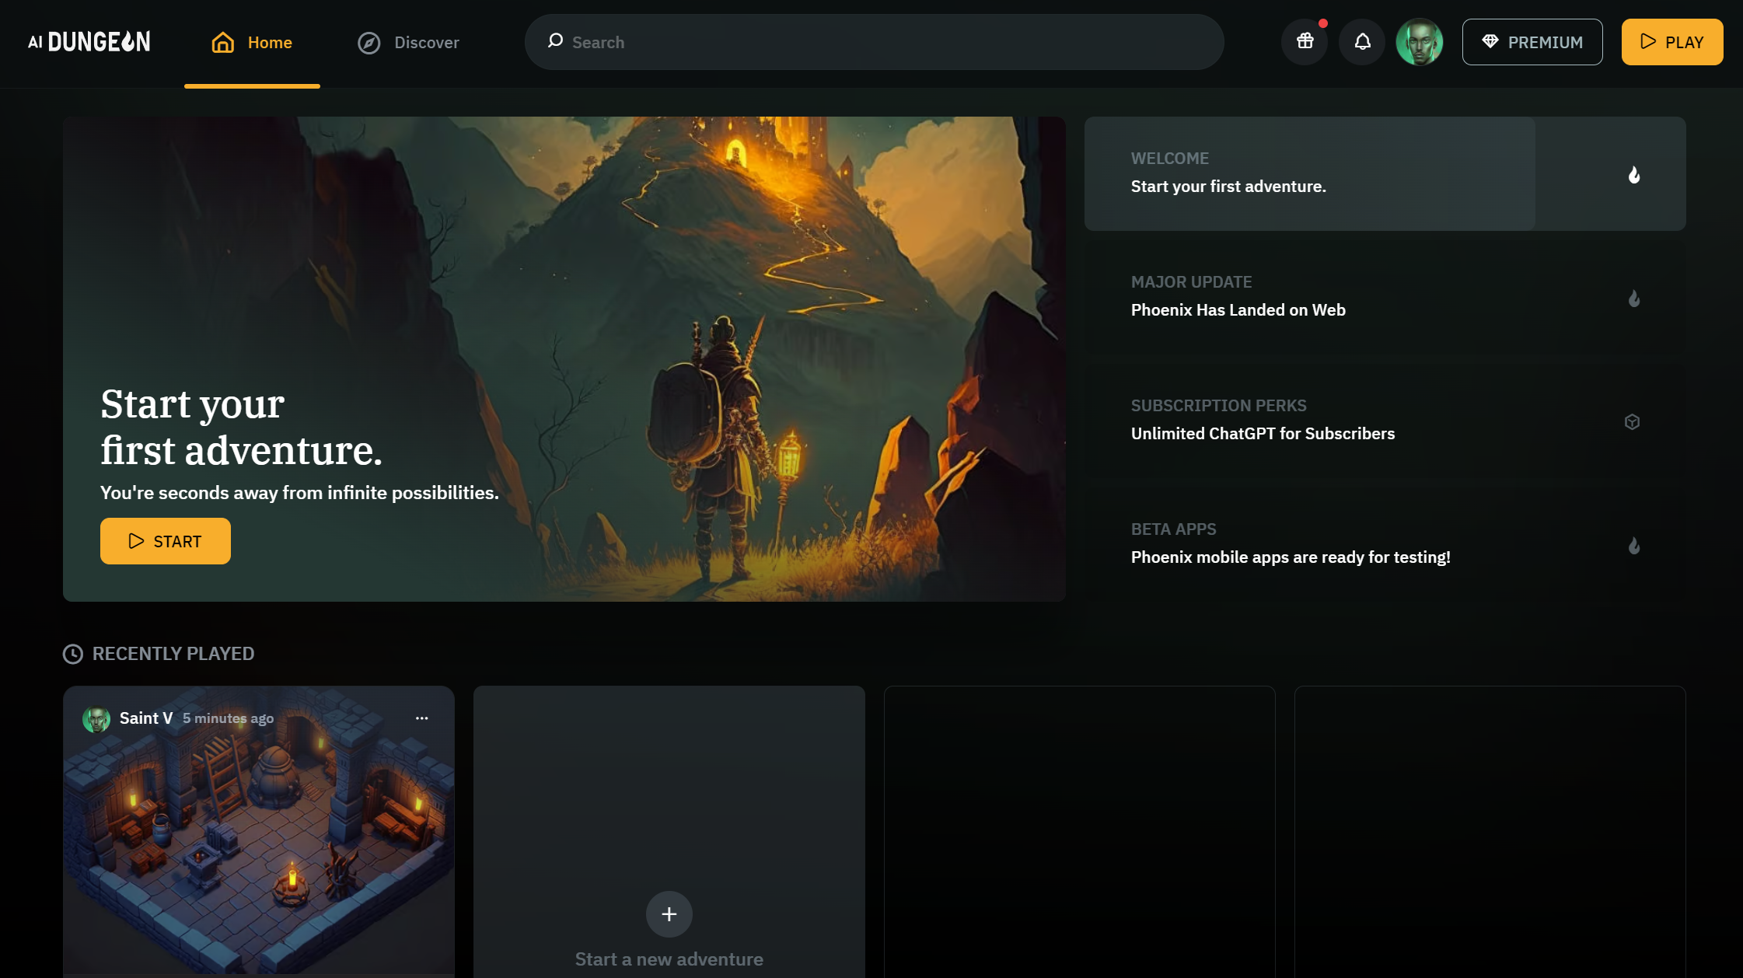
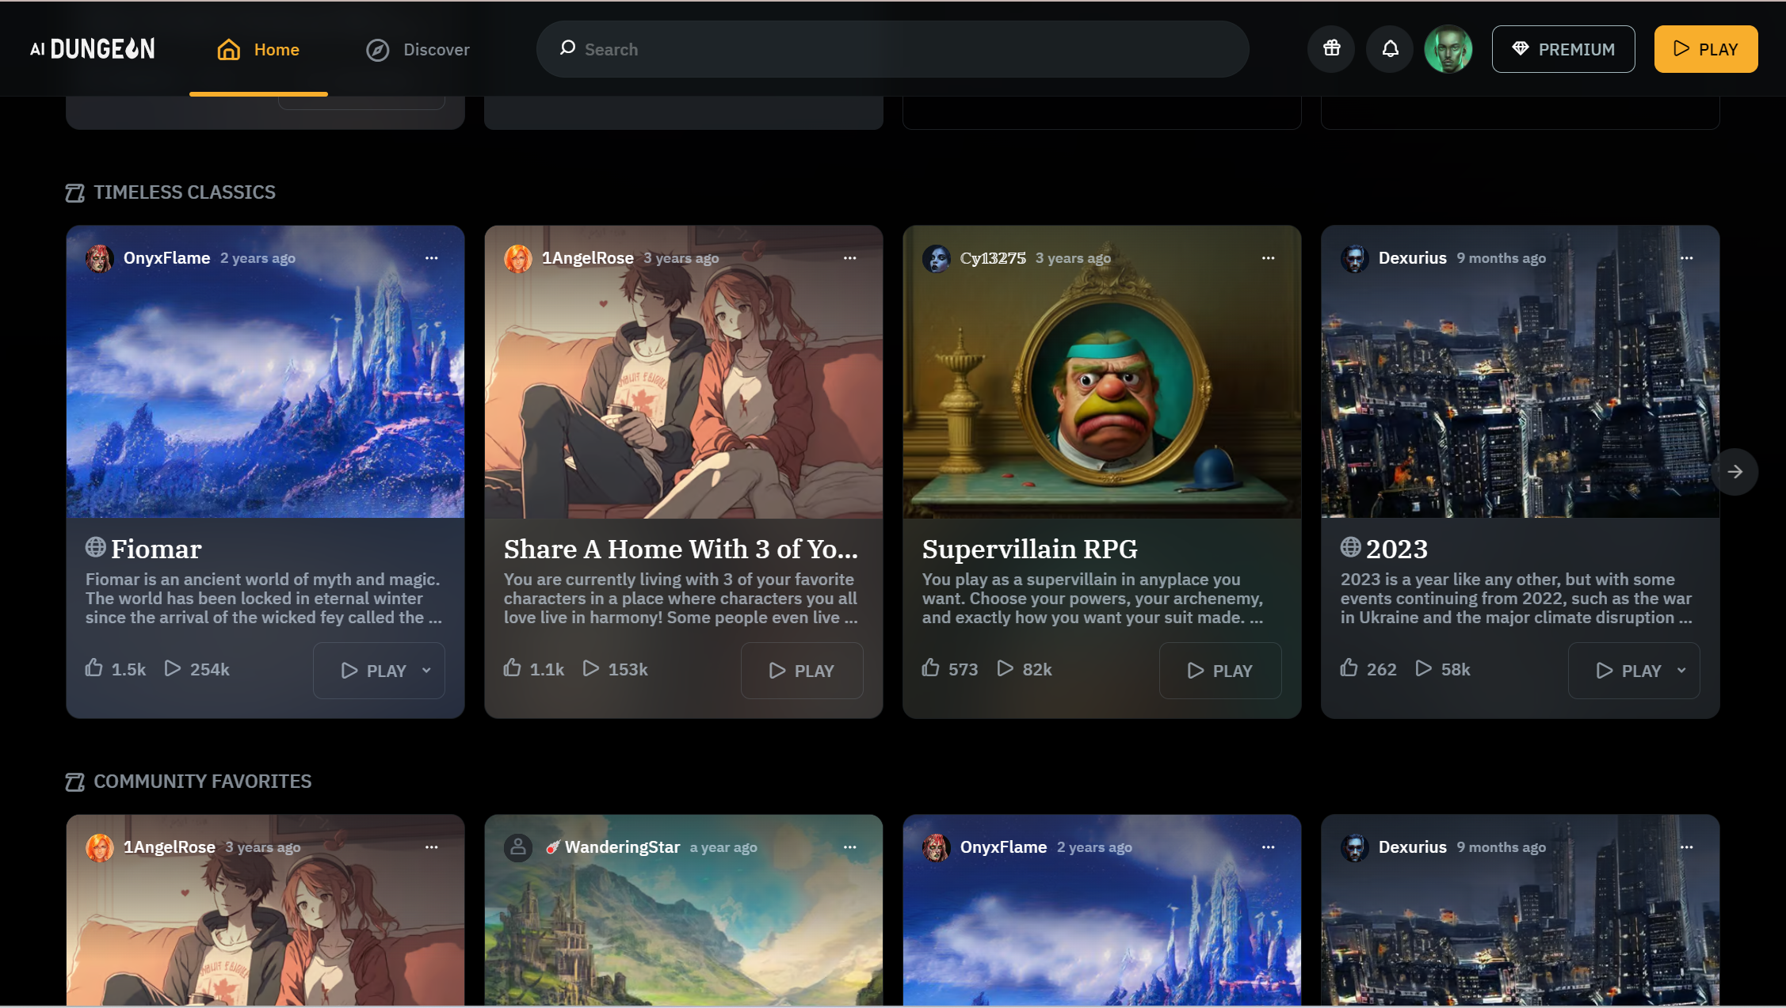
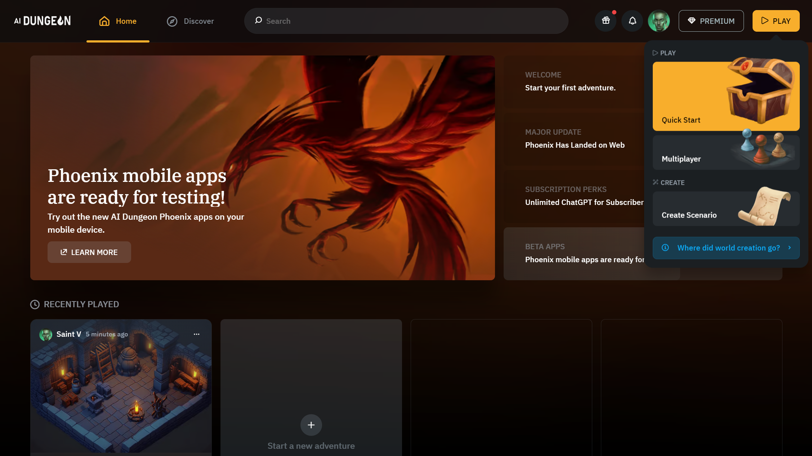
Home Page
The Home Page is where you can find all the stories you have made and where you can start creating new stories. You can access different stories that others have created and change the outline yourself.
By clicking play, you can see what your options are when creating new stories
You can either, create stories by yourself or with your friends – up to 3 people can join you.

Slide 3
Home Page
The Home Page is where you can find all the stories you have made and where you can start creating new stories. You can access different stories that others have created and change the outline yourself.
By clicking play, you can see what your options are when creating new stories
You can either, create stories by yourself or with your friends – up to 3 people can join you.

Slide 4
Home Page
The Home Page is where you can find all the stories you have made and where you can start creating new stories. You can access different stories that others have created and change the outline yourself.
By clicking play, you can see what your options are when creating new stories
You can either, create stories by yourself or with your friends – up to 3 people can join you.

Slide 5
Creator Tools
Do
Say
See
Story
Do
What is it?
Have your character perform an action.
Tip:
- Anything that you type in DO mode is recognized by the AI as an action performed by your
character, and it reacts by generating the outcome of that action within the context of the story.
-You can use DO to input more interesting Say actions; shout, cry, ponder, or even combine actions while saying something

Slide 6
Creator Tools
Do
Say
See
Story
Say
What is it?
Have your character say what you type in.
Tip:
- The AI treats Say inputs similarly to Do inputs, so anything you type is recognized by the AI as a
speaking action perform by your character, and it reacts by generating a response to that action
within the context of the story.

Slide 7
Creator Tools
Do
Say
See
Story
See
What is it?
Have the AI generate an image.
Tip:
- When generating your images, See, list information from most important, what makes up more of your image (medium and foreground) to least (various details). The AI considers the beginning of your prompt first and may forget the end if the prompt is too long.
- When generating photo-realistic images, always talk about the LIGHTING: dramatic, high-key, low-key, etc.

Slide 8
Creator Tools
Do
Say
See
Story
Story
What is it?
Have the AI respond to your own narration.
Tip:
-In Story, the inputs are treated the same as AI outputs, so no icon appears next to these actions in the game screen. If you combine the Story inputs with Do and Say to guide the AI during your adventures, or they can be used entirely on their own to create standalone stories without any ‘game’ like-elements.

Slide 9
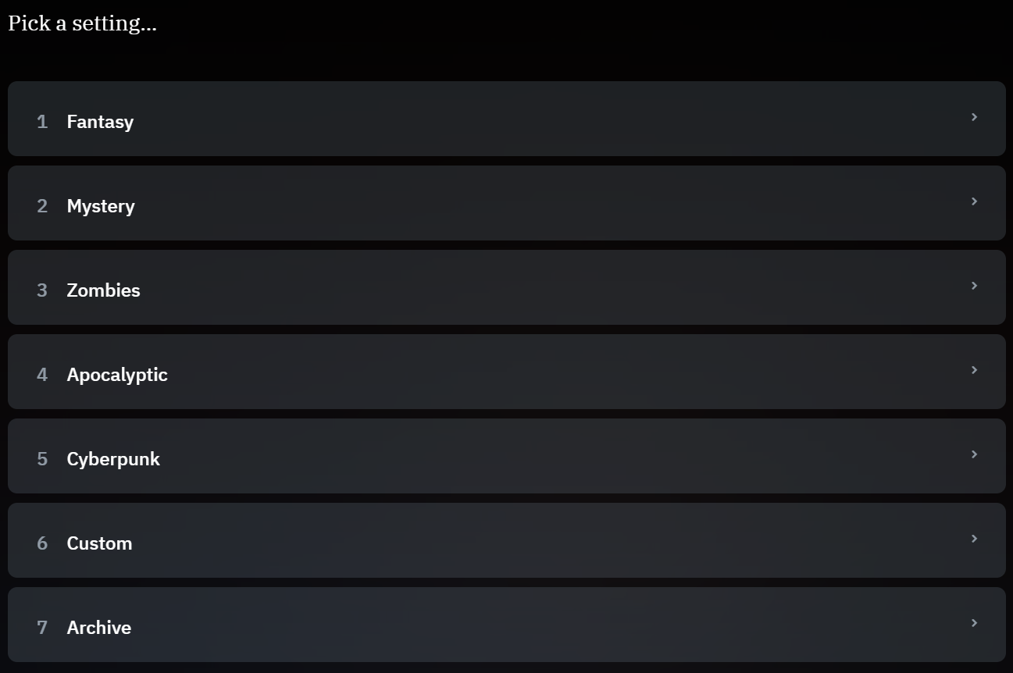
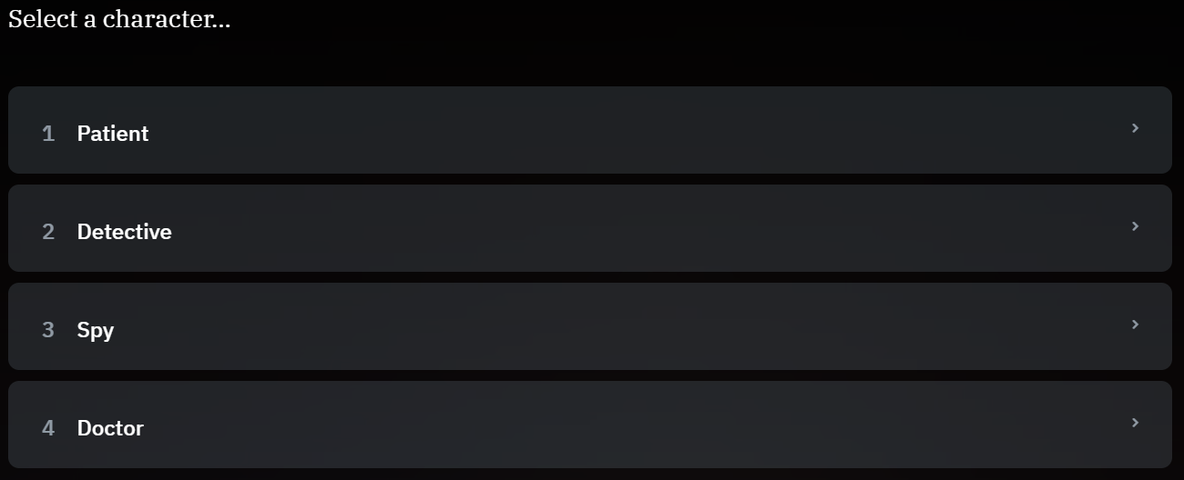
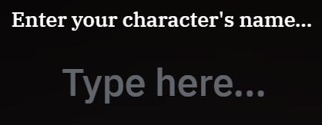
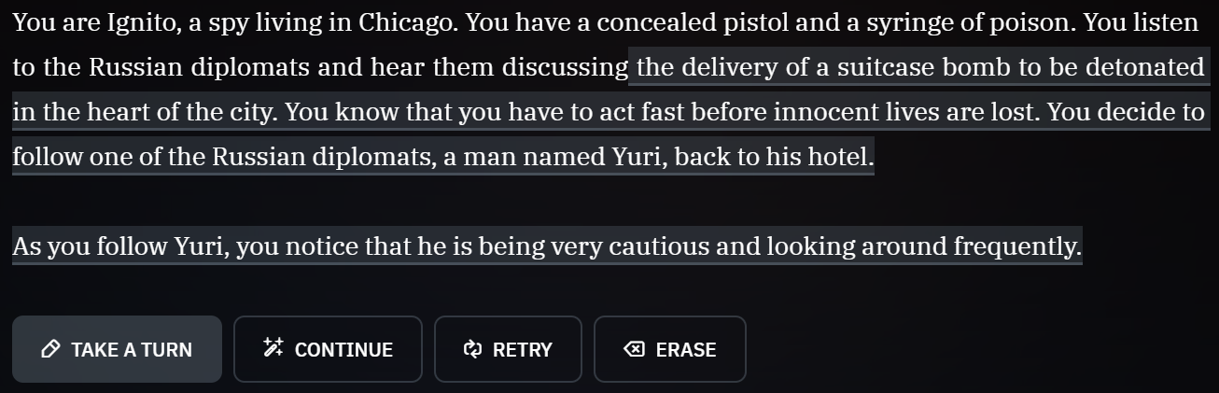
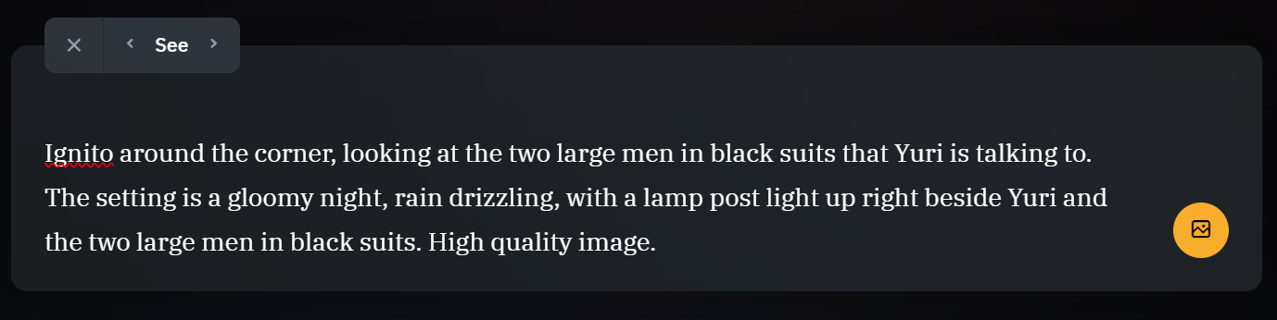
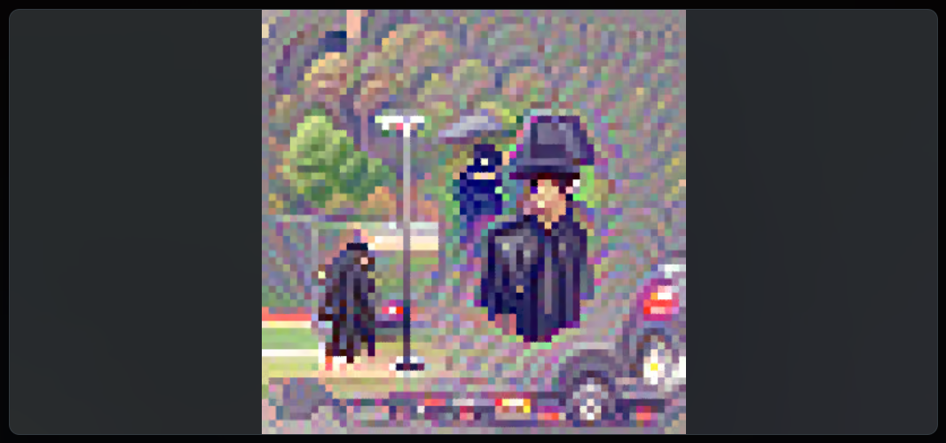
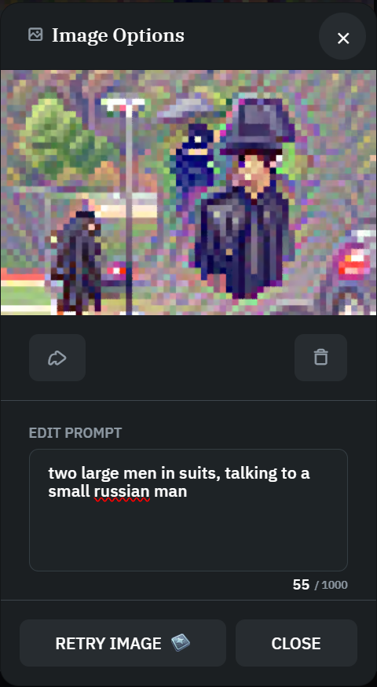
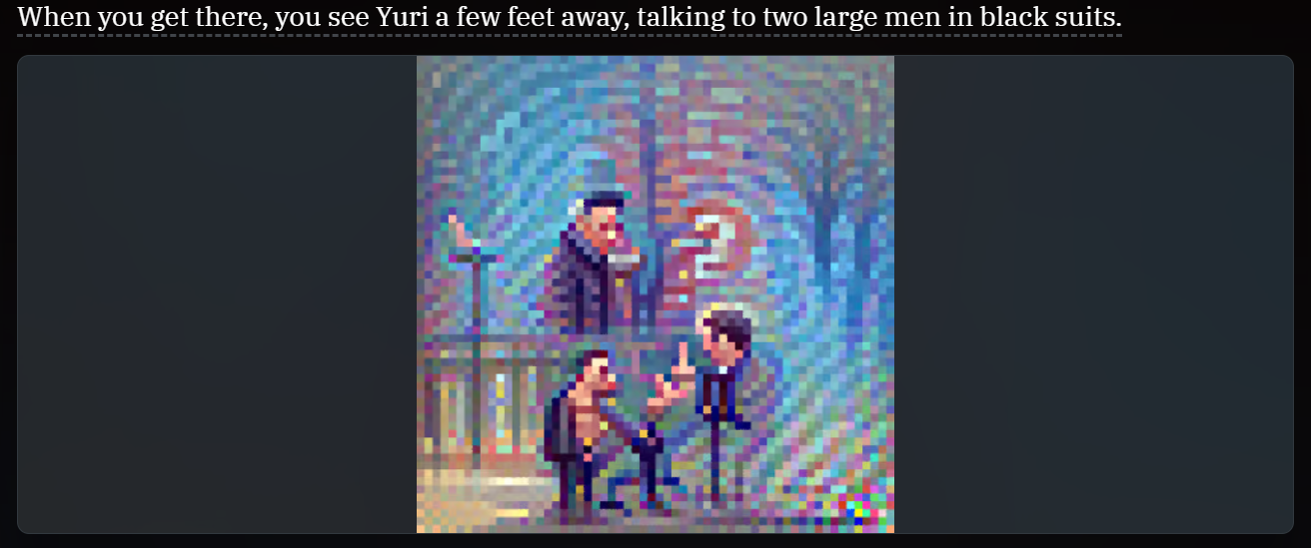
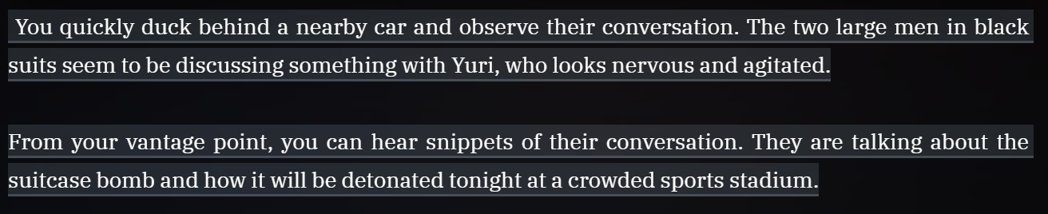
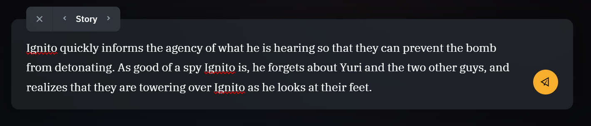
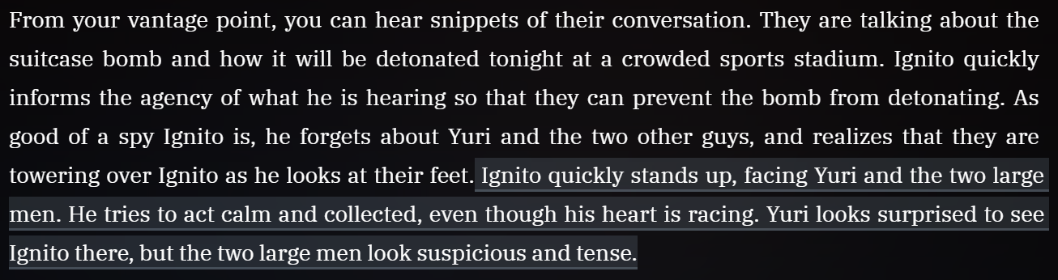
Let’s Create!
When you first load up your story, you are the AI asks a few questions to start your story.
First is setting.
Then your character.
Which is different based on the setting you chose.
You then name your character that you chose.
This is what the AI wrote me for the beginning of my interactive story. Now I can either:
Take A Turn (Do, Say, Story, See)
Continue (Let AI create the next part of my story)
Retry (Ask to create a different part)
Erase (To delete what ever was written)
I chose See and wrote this prompt.
This is the image I got, based on the prompt I wrote down, which I did not like.
It's only pixelated because it is the free version.
I then made it simpler and wrote this instead.
Which allowed me to achieve this image and I like it way better.
I then chose Continue let the AI create the next part of the story.
Then I chose story, and I wrote this.
Then AI gave me this to continue from what I wrote as a prompt.
It’s your turn to create one!

Slide 10
Let’s Create!
When you first load up your story, you are the AI asks a few questions to start your story.
First is setting.
Then your character.
Which is different based on the setting you chose.
You then name your character that you chose.
This is what the AI wrote me for the beginning of my interactive story. Now I can either:
Take A Turn (Do, Say, Story, See)
Continue (Let AI create the next part of my story)
Retry (Ask to create a different part)
Erase (To delete what ever was written)
I chose See and wrote this prompt.
This is the image I got, based on the prompt I wrote down, which I did not like.
It's only pixelated because it is the free version.
I then made it simpler and wrote this instead.
Which allowed me to achieve this image and I like it way better.
I then chose Continue let the AI create the next part of the story.
Then I chose story, and I wrote this.
Then AI gave me this to continue from what I wrote as a prompt.
It’s your turn to create one!

Slide 11
Let’s Create!
When you first load up your story, you are the AI asks a few questions to start your story.
First is setting.
Then your character.
Which is different based on the setting you chose.
You then name your character that you chose.
This is what the AI wrote me for the beginning of my interactive story. Now I can either:
Take A Turn (Do, Say, Story, See)
Continue (Let AI create the next part of my story)
Retry (Ask to create a different part)
Erase (To delete what ever was written)
I chose See and wrote this prompt.
This is the image I got, based on the prompt I wrote down, which I did not like.
It's only pixelated because it is the free version.
I then made it simpler and wrote this instead.
Which allowed me to achieve this image and I like it way better.
I then chose Continue let the AI create the next part of the story.
Then I chose story, and I wrote this.
Then AI gave me this to continue from what I wrote as a prompt.
It’s your turn to create one!

Slide 12
Let’s Create!
When you first load up your story, you are the AI asks a few questions to start your story.
First is setting.
Then your character.
Which is different based on the setting you chose.
You then name your character that you chose.
This is what the AI wrote me for the beginning of my interactive story. Now I can either:
Take A Turn (Do, Say, Story, See)
Continue (Let AI create the next part of my story)
Retry (Ask to create a different part)
Erase (To delete what ever was written)
I chose See and wrote this prompt.
This is the image I got, based on the prompt I wrote down, which I did not like.
It's only pixelated because it is the free version.
I then made it simpler and wrote this instead.
Which allowed me to achieve this image and I like it way better.
I then chose Continue let the AI create the next part of the story.
Then I chose story, and I wrote this.
Then AI gave me this to continue from what I wrote as a prompt.
It’s your turn to create one!

Slide 13
Let’s Create!
When you first load up your story, you are the AI asks a few questions to start your story.
First is setting.
Then your character.
Which is different based on the setting you chose.
You then name your character that you chose.
This is what the AI wrote me for the beginning of my interactive story. Now I can either:
Take A Turn (Do, Say, Story, See)
Continue (Let AI create the next part of my story)
Retry (Ask to create a different part)
Erase (To delete what ever was written)
I chose See and wrote this prompt.
This is the image I got, based on the prompt I wrote down, which I did not like.
It's only pixelated because it is the free version.
I then made it simpler and wrote this instead.
Which allowed me to achieve this image and I like it way better.
I then chose Continue let the AI create the next part of the story.
Then I chose story, and I wrote this.
Then AI gave me this to continue from what I wrote as a prompt.
It’s your turn to create one!

Slide 14
Let’s Create!
When you first load up your story, you are the AI asks a few questions to start your story.
First is setting.
Then your character.
Which is different based on the setting you chose.
You then name your character that you chose.
This is what the AI wrote me for the beginning of my interactive story. Now I can either:
Take A Turn (Do, Say, Story, See)
Continue (Let AI create the next part of my story)
Retry (Ask to create a different part)
Erase (To delete what ever was written)
I chose See and wrote this prompt.
This is the image I got, based on the prompt I wrote down, which I did not like.
It's only pixelated because it is the free version.
I then made it simpler and wrote this instead.
Which allowed me to achieve this image and I like it way better.
I then chose Continue let the AI create the next part of the story.
Then I chose story, and I wrote this.
Then AI gave me this to continue from what I wrote as a prompt.
It’s your turn to create one!

Slide 15
Let’s Create!
When you first load up your story, you are the AI asks a few questions to start your story.
First is setting.
Then your character.
Which is different based on the setting you chose.
You then name your character that you chose.
This is what the AI wrote me for the beginning of my interactive story. Now I can either:
Take A Turn (Do, Say, Story, See)
Continue (Let AI create the next part of my story)
Retry (Ask to create a different part)
Erase (To delete what ever was written)
I chose See and wrote this prompt.
This is the image I got, based on the prompt I wrote down, which I did not like.
It's only pixelated because it is the free version.
I then made it simpler and wrote this instead.
Which allowed me to achieve this image and I like it way better.
I then chose Continue let the AI create the next part of the story.
Then I chose story, and I wrote this.
Then AI gave me this to continue from what I wrote as a prompt.
It’s your turn to create one!

Slide 16
Let’s Create!
When you first load up your story, you are the AI asks a few questions to start your story.
First is setting.
Then your character.
Which is different based on the setting you chose.
You then name your character that you chose.
This is what the AI wrote me for the beginning of my interactive story. Now I can either:
Take A Turn (Do, Say, Story, See)
Continue (Let AI create the next part of my story)
Retry (Ask to create a different part)
Erase (To delete what ever was written)
I chose See and wrote this prompt.
This is the image I got, based on the prompt I wrote down, which I did not like.
It's only pixelated because it is the free version.
I then made it simpler and wrote this instead.
Which allowed me to achieve this image and I like it way better.
I then chose Continue let the AI create the next part of the story.
Then I chose story, and I wrote this.
Then AI gave me this to continue from what I wrote as a prompt.
It’s your turn to create one!

Slide 17
Let’s Create!
When you first load up your story, you are the AI asks a few questions to start your story.
First is setting.
Then your character.
Which is different based on the setting you chose.
You then name your character that you chose.
This is what the AI wrote me for the beginning of my interactive story. Now I can either:
Take A Turn (Do, Say, Story, See)
Continue (Let AI create the next part of my story)
Retry (Ask to create a different part)
Erase (To delete what ever was written)
I chose See and wrote this prompt.
This is the image I got, based on the prompt I wrote down, which I did not like.
It's only pixelated because it is the free version.
I then made it simpler and wrote this instead.
Which allowed me to achieve this image and I like it way better.
I then chose Continue let the AI create the next part of the story.
Then I chose story, and I wrote this.
Then AI gave me this to continue from what I wrote as a prompt.
It’s your turn to create one!

Slide 18
Let’s Create!
When you first load up your story, you are the AI asks a few questions to start your story.
First is setting.
Then your character.
Which is different based on the setting you chose.
You then name your character that you chose.
This is what the AI wrote me for the beginning of my interactive story. Now I can either:
Take A Turn (Do, Say, Story, See)
Continue (Let AI create the next part of my story)
Retry (Ask to create a different part)
Erase (To delete what ever was written)
I chose See and wrote this prompt.
This is the image I got, based on the prompt I wrote down, which I did not like.
It's only pixelated because it is the free version.
I then made it simpler and wrote this instead.
Which allowed me to achieve this image and I like it way better.
I then chose Continue let the AI create the next part of the story.
Then I chose story, and I wrote this.
Then AI gave me this to continue from what I wrote as a prompt.
It’s your turn to create one!

Slide 19
Let’s Create!
When you first load up your story, you are the AI asks a few questions to start your story.
First is setting.
Then your character.
Which is different based on the setting you chose.
You then name your character that you chose.
This is what the AI wrote me for the beginning of my interactive story. Now I can either:
Take A Turn (Do, Say, Story, See)
Continue (Let AI create the next part of my story)
Retry (Ask to create a different part)
Erase (To delete what ever was written)
I chose See and wrote this prompt.
This is the image I got, based on the prompt I wrote down, which I did not like.
It's only pixelated because it is the free version.
I then made it simpler and wrote this instead.
Which allowed me to achieve this image and I like it way better.
I then chose Continue let the AI create the next part of the story.
Then I chose story, and I wrote this.
Then AI gave me this to continue from what I wrote as a prompt.
It’s your turn to create one!

Slide 20
Let’s Create!
When you first load up your story, you are the AI asks a few questions to start your story.
First is setting.
Then your character.
Which is different based on the setting you chose.
You then name your character that you chose.
This is what the AI wrote me for the beginning of my interactive story. Now I can either:
Take A Turn (Do, Say, Story, See)
Continue (Let AI create the next part of my story)
Retry (Ask to create a different part)
Erase (To delete what ever was written)
I chose See and wrote this prompt.
This is the image I got, based on the prompt I wrote down, which I did not like.
It's only pixelated because it is the free version.
I then made it simpler and wrote this instead.
Which allowed me to achieve this image and I like it way better.
I then chose Continue let the AI create the next part of the story.
Then I chose story, and I wrote this.
Then AI gave me this to continue from what I wrote as a prompt.
It’s your turn to create one!

Slide 21
Thank You

