Slide 1
Creative Commons Licensing Workshop
Christina Winter May 9, 2022
This work is licensed under CC BY 4.0
n
"Creative Commons - cc stickers" by Kalexanderson is licensed under CC BY 2.0 .

Slide 2
Overview
Understanding Creative Commons licenses when creating and sharing your own learning resources
Finding and using existing resources that have been published with a CC license
Implications and considerations when including existing CC licensed resources in a resource you are creating

Slide 3
Creative Commons Background
Sonny Bono Copyright Term Extension Act (US) - increased by 20 years to life of the author +70 years
Eldred v Ashcroft (2003) - lost appeal at Supreme Court of the United States
CC - Nonprofit founded in 2002 by Lawrence Lessig
Set of public copyright licenses
Part of the larger open movement

Slide 4
Why Creative Commons?
Default of copyright law is “all rights reserved”
Need for public copyright licenses that work with copyright law - only a copyright owner can apply a CC license to a work
Allows creators to determine how their work can be used - “some rights reserved”
CC licenses communicate to the end user how to work can be used in advance
No need for further permission or payment as long as the use complies with the license terms

Slide 5
4 License Elements
lkjkt
This is the “Attribution” or “BY” symbol. Requirement to credit the creator of the work.
This is the “ShareAlike” or “SA” symbol. Adaptation of a SA work must be licensed under the same terms.
This is the “NonCommercial” or “NC” symbol. Only noncommercial uses of the work are permitted.
This is the “NoDerivatives” or “ND” symbol. Adaptations of the work are not permitted.

Slide 6
6 Creative Commons Licenses
Content on this slide has been adapted from the Creative Commons Certificate Resources by Creative Commons available under a CC BY 4.0 license.
The Attribution license or “CC BY” allows people to use the work for any purpose (even commercially and even in modified form) as long as they give attribution to the creator.
The Attribution-NonCommercial license or “BY-NC” allows people to use the work for noncommercial purposes only, and only as long as they give attribution to the creator.
The Attribution-ShareAlike license or “BY-SA” allows people to use the work for any purpose (even commercially and even in modified form), as long as they give attribution to the creator and make any adaptations they share with others available under the same or a compatible license.
The Attribution-NonCommercial-ShareAlike license or “BY-NC-SA” allows people to use the work for noncommercial purposes only, and only as long as they give attribution to the creator and make any adaptations they share with others available under the same or a compatible license.
The Attribution-NonCommercial-NoDerivatives license or “BY-NC-ND” is the most restrictive license offered by CC. It allows people to use the unadapted work for noncommercial purposes only, and only as long as they give attribution to the licensor.
The Attribution-NoDerivatives license or “BY-ND” allows people to use the unadapted work for any purpose (even commercially), as long as they give attribution to the creator.

Slide 7
Applying a CC License to Your Own Work
Some things to consider:
Irrevocability
Type of Material
Nature and adequacy of rights
Type of license
Source: CC Wiki,Considerations for licensors and licensees, CC BY 4.0

Slide 8
Activity #1 - How to Find CC Licensed Content in Google or Bing
Google
Search Google Images: Click on Tools, Select Usage Rights, Click on Creative Commons Licenses.
Bing
Select Images
Click on Filter, License, Select “All Creative Commons”

Slide 9
Find CC Licensed Videos on Youtube
Enter search term
Open search filters Under Features - select Creative Commons

Slide 10
Activity # -2 Find a CC Licensed Work that Can Be Modified
Use any search engine (Google, Bing, etc.) or resource to find a CC licensed work that can be modified. Make some changes, and show how you would attribute the work.

Slide 11
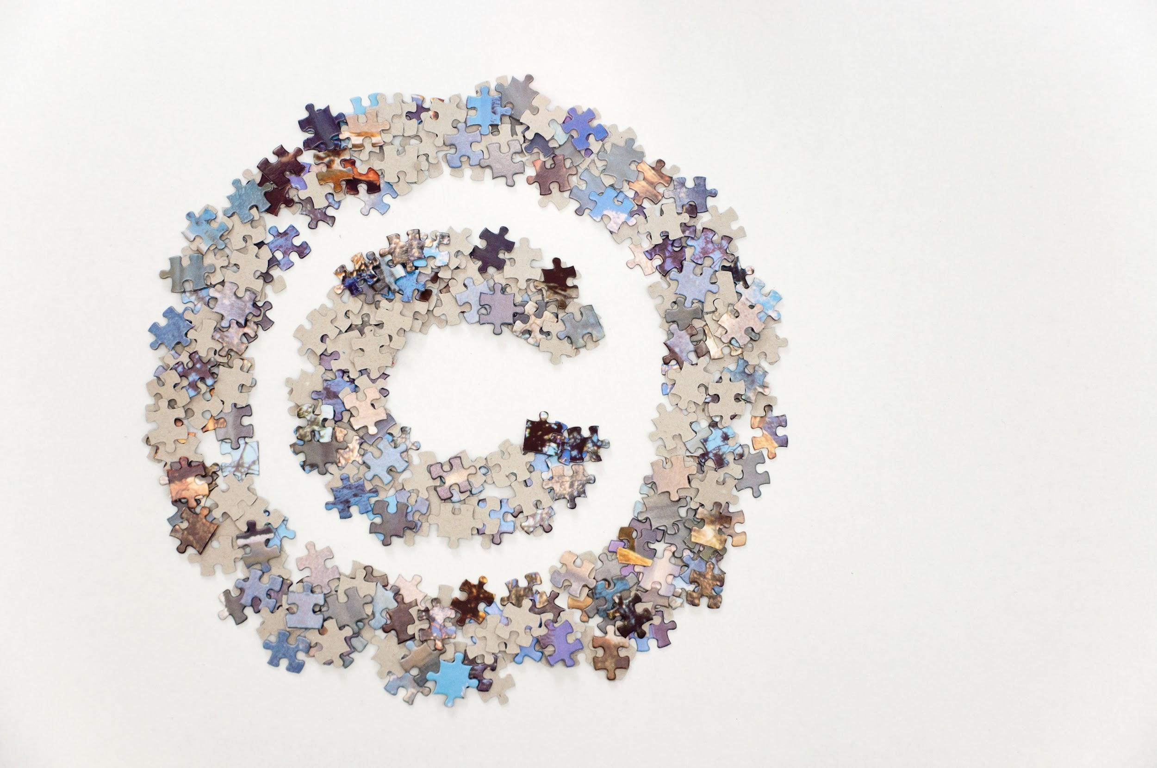
How to Attribute a CC Licensed work
Include:
Ttitle Author Source License
“Best practices for attribution” by CC Wiki is licensed under CC BY 4.0.
"Large copyright sign made of jigsaw puzzle pieces" by Horia Varlan is licensed under CC BY 2.0

Slide 12
License Chooser
Need help to decide which CC license to apply to
your work?
Check out the Choose a License tool (beta)
https://chooser-beta.creativecommons.org/
"Question mark" by konradfoerstner is licensed under CC BY 2.0

Slide 13
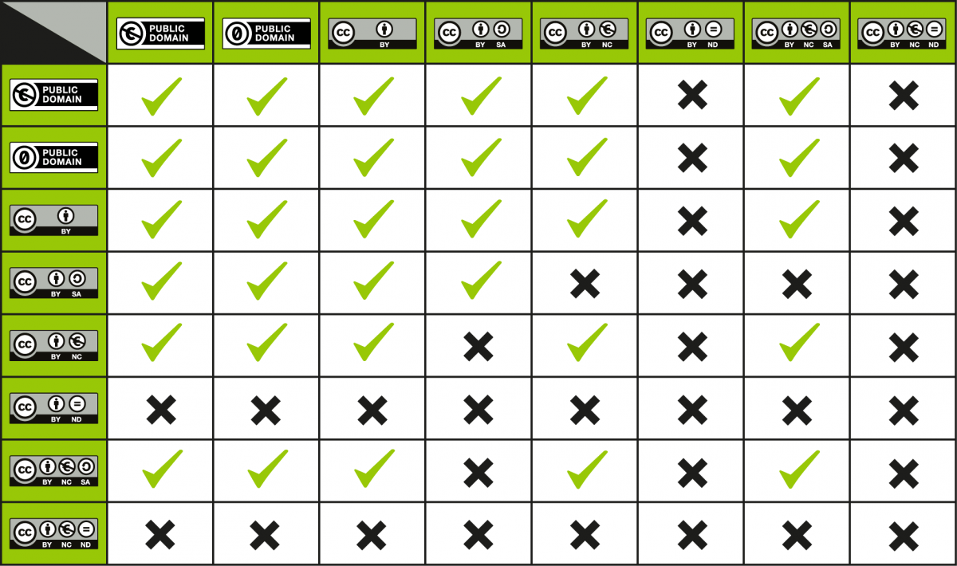
Some Considerations When Using a CC Licensed Work
CC Wiki, License Compatibility Chart, CC BY 4.0

Slide 14
Additional Resources
OER Program Manager
Library: copyright, understanding licences, finding OER, subject support, publishing
CARL Copyright Open Educational Resource for University Instructors and Staff, Openly Licensed Materials, available under CC BY-NC 4.0.
University of Alberta Opening Up Copyright (OUC) Instructional Modules, Open Licensing and Creative Commons, available under CC BY 4.0.
University of Alberta Opening Up Copyright (OUC) Instructional Modules, Finding Open and Creative Commons Content, available under CC BY 4.0.
Creative Commons, Creative Commons Certificate for Educators, Academic Librarians and GLAM, available under CC BY.

Slide 15
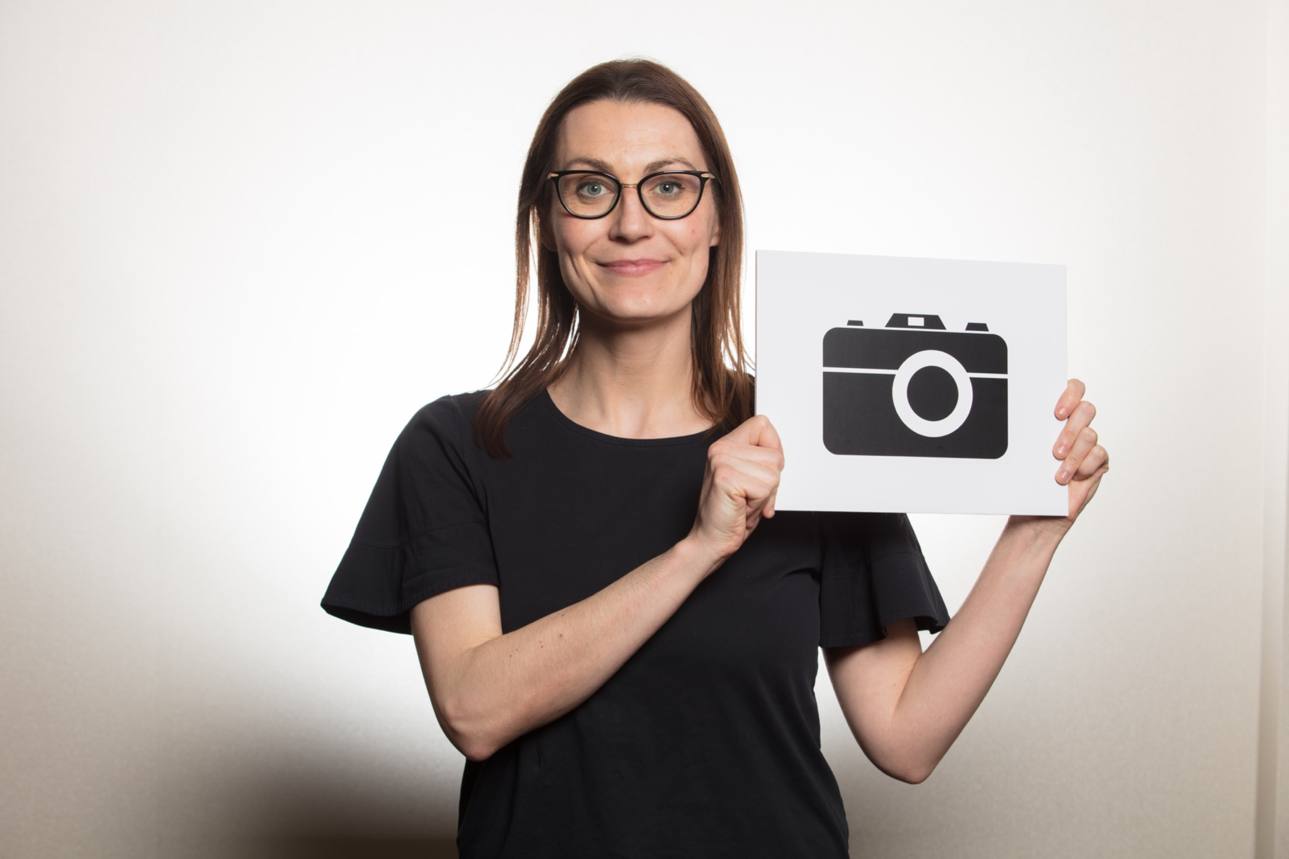
Thank You!
"Humans of the Commons at the Creative Commons Global Summit 2018" by Sebastiaan ter Burg is marked with CC BY 2.0.

Slide 16
References and Further Reading
4 License Elements Slide:
Creative Commons Attribution 4.0 International License http://creativecommons.org/licenses/by/4.0/ Creative Commons Attribution-Non-Commercial 4.0 International License https://creativecommons.org/licenses/by-nc/4.0/ Creative Commons Attribution-NoDerivatives 4.0 International License http://creativecommons.org/licenses/by-nd/4.0/ Creative Commons Attribution-NonCommercial 4.0 International License http://creativecommons.org/licenses/by-nc/4.0/

Slide 17
References and Further Reading
Stewart,D. (2021). Rise of the Copyleft Trolls: When Photographers Sue After Creative
Commons Licenses Go Awry. (May 11, 2021). Available at SSRN:
https://ssrn.com/abstract=3844180 or http://dx.doi.org/10.2139/ssrn.3844180

Slide 18
Acknowledgements
Some of this content has been adapted from the Creative Commons slides (March 22, 2022) by Christina Winter and Brad Doerksen and is licensed under CC BY 4.0.

