Slide 1
Open Education Resources – The Biology Edition
Laura Ambrose
Luther College
Biology
laura.ambrose@uregina.ca

Slide 2
From proprietary to open source – a journey of a thousand clicks
Proprietary
Familiar
Resources
Transition
Redesign
Write own content
OpenStax
Free, peer reviewed
Adaptable

Slide 3
OpenStax
When you really want a textbook
Open source, peer reviewed
BCcampus
Open Textbook Collection
Committed to accessibility
PhET
Physics Education Technology Simulations
Interactive resources for math and science
Interactive, adaptable
Free, online, PDF
Actively encourage OER development (ex. Canadian version of Concepts of Biology)
Fully supported for both students and instructors
Rice University, Texas
https://openstax.org/subjects
Review open-source textbooks from various sources
https://open.bccampus.ca/browse-our-collection/find-open-textbooks/?subject=Biology
https://phet.colorado.edu/en/simulations/filter?subjects=biology&type=html,prototype
Natural selection, gene expression, and colour vision

Slide 4
Some resources I have used over the years
NCCSTS
National Center for Case Study Teaching in Science (NSTA)
HHMI
Howard Hughes Medical Institute
Comprehensive – resources, interactive, assessment
CellsAlive
One person with a camera and a website
Interactive
Adaptable
Some are adaptable (source available) and meet accessibility standards
www.cellsalive.com
Repository of images and videos
Found on MERLOT with linked adaptable materials
Case studies to extend thinking - interdisciplinary
AP/IB/1st to 4th year post secondary
https://www.nsta.org/case-studies
Tangled Bank Studios – films https://www.tangledbankstudios.org/
Undergraduate and Graduate programs – the institutional level https://www.hhmi.org/science-education/programs
BioInteractive – teaching resources, including assessments and interactives - https://www.biointeractive.org/

Slide 5
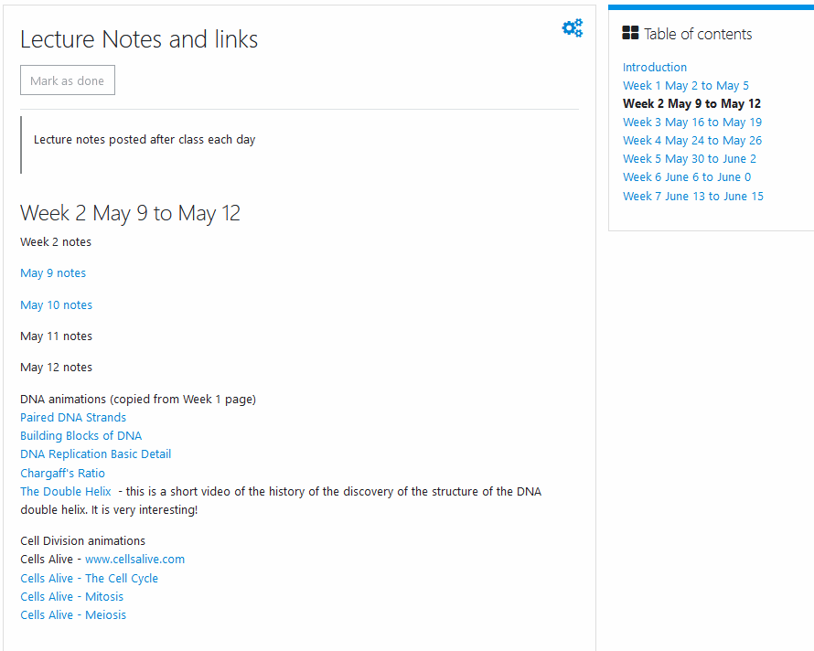
Using OER in class and online

Slide 6
Checklist for evaluation OER – some points
Relevance – needs to be more than flashy fun
Accuracy – it is no good to have to correct the video
Does the information directly address one or more of the class objectives?
Is the information accurate?
Has the material been peer reviewed?
Are there major content errors or omissions?

Slide 7
Checklist for evaluation OER
Production Quality – could you use it when you test positive?
Accessibility – can all of the students use it?
Is the layout and interface easy to navigate?
Is the resource available in alternative formats (e.g. .doc or .odf)?
For multimedia resources, are the audio/video quality high?
For audio or video resources, is there a transcript or subtitles?

Slide 8
Checklist for evaluation OER
Interactivity – passive is boring
Licensing – the legal bits
Does the resource encourage active learning and class participation? If not, are you able to add that to the resource?
What is the license?
Are there opportunities for students to test their understanding of the material (e.g. a video with embedded questions)?
Modifications – allowed? Do you have the skills?

Slide 9
Social awareness
Improved technology
Pandemic-created opportunities

Slide 10
Social awareness
Improved technology
Pandemic-created opportunities
The intersection between our awareness of our students, the technology we can use, and the opportunities presented to us during the pandemic is the space in which we can deliver excellent biology content to enhance the learning of all our students.

Slide 11
Questions?
I am happy to chat about OER and the resources I use
laura.ambrose@uregina.ca

Slide 12
Resources
Evaluating OER
Checklist
BCOER Librarians (2015). Faculty Guide for Evaluating Open Education Resources, Licensed under a Creative Commons Attribution 4.0 International License. Retrieved from https://open.bccampus.ca/files/2014/07/Faculty-Guide-22-Apr-15.pdf

