Slide 1
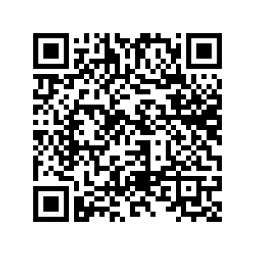
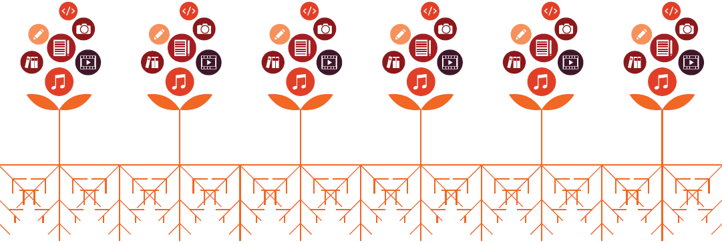
Open Textbooks & International Student Success: An Exploratory Study.
WHAT IMPACT DO FREE OPEN TEXTBOOKS HAVE ON INTERNATIONAL STUDENTS’ ACADEMIC SUCCESS?
COMMERCIAL TEXTBOOK COSTS
The cost of commercial textbooks has increased by 153% over the past 10 years (U.S. Bureau of Labor Statistics).
In 2018, Canadian university students spent an average of $773 on textbooks. In response to these pressures, students report sharing and pirating textbooks, borrowing library course reserves, or forgoing assigned readings all together (Florida Virtual Campus, 2016).
RESEARCH DESIGN
The researchers used purposeful sampling to recruit participants within courses currently using open textbooks. Data was collected through: (1) a quantitative survey (demographic and educational information), and (2) in-depth interviews with six participants.
There is a dearth of qualitative studies and Canadian perspectives within the existing body of open textbook research. As such, this small-scale pilot study represents a novel contribution to the field and may encourage further research.
OPEN TEXTBOOKS + LANGARA
Open textbooks have saved Langara students over $1,037,000 since 2013. Langara is the second heaviest user of open textbooks among B.C. post-secondary institutions.
Studies have found that course completion rates, “C- or better” grades, and enrollment intensity are higher among students using free open textbooks versus commercial textbooks (Fisher, Hilton, Robinson, & Wiley, 2015).
EMERGING THEMES
Differences in cost and distribution models for learning materials between countries. Participants reported that textbooks are inexpensive or included in tuition fees in their home countries.
Moving beyond the letter grade. Letter grades, course completion, and enrollment intensity are common measures of impact within open textbook research. However, participants offered a wide range of measures for academic success, including improved cross-cultural communication skills.
INTERNATIONAL STUDENTS
During the 2018-2019 academic year, 3,715 international students were enrolled in full-time university transfer, career, and post-degree diploma programs at Langara.
International students increasingly report feeling under-prepared for the cost of living and studying in Vancouver, one of North America's most expensive cities.
CONTACT
Julian Prior (co-investigator) │ jprior@langara.ca │ @jpodcaster
Lindsay Tripp (co-investigator) │ ltripp@langara.ca │ @lltripp
This research is funded by Langara’s Research & Scholarly Activities Fund. Special thanks to our Research Assistant, Crislana Rafael.
Scan to see our References

