Slide 1
Scaling up Open Education: Creating a Sustainable Program
Jessica Norman
jessica.norman@sait.ca • @jplacke
Notes:
SAIT is a polytechnic/technical institute located in Calgary, Alberta.
We offer certificate, diploma, applied degree, and degree programs in the broad areas of business, culinary, health, technology, engineering sciences, transportation, manufacturing and automation.
We’re venturing into graduate certificates (post-diploma and post-degree) and growing our non-credit certificate offerings.
We have approximately 16,000 daytime students and around 60,000 if you include continuing education/distance students.

Slide 2
OER Activities at SAIT
2016
October: OER Exploratory Committee formed
2017
May: “OER at SAIT” Report
July: New librarian position
2018
2019
October: Ed Plan released
OER Policy Committee formed
May: OER Policy approved by BOG
August: OER Listening Tour
Student campaign
March: OER Strat Plan approved
August: OER training program launches?
Notes:
2015-16: ABOER grants 2017: Ed Plan: Effective Teaching Methods, “Supports faculty in adopting, adapting, and creating open education resources that increase access to relevant, flexible learning content.” page 17
---------------------------------------------------------------------------------
The survey found most students had not heard of OERs or confused the materials with any content found on the internet. Even though they were not clear about exact examples of OERs, almost all of the respondents thought the concept was beneficial to their learning and that OERs could help alleviate concerns about textbook costs.
Almost all students (90%) reported textbook costs as being ‘very much’ or ‘somewhat’ a concern.
If given a choice, 63% of students would choose an OER course over a traditional one.
_______________________________________________________________
From Business Analytics and Intelligence: Previous work in 2017 determined that only half of faculty were familiar with OERS but a large number (86%) wanted to learn more. Faculty are more critical as they will have to do the work to implement.
_____________________________________________________________
Q1) How many folks have OER policy?
Q2) How many folks have OER position/ OER in job description?
Q3) How many folks have formal OER program?
Q4) How many have OER strategic plan?

Slide 3
The Drawbacks to Success
Notes:
What it feels like when everyone needs some of your time.
How to transition from a one woman show to an integrated, sustainable program?

Slide 4
Creating an OER Policy, Generally Speaking….
Policies typically provide specific information to support creation, adoption, and sharing of OER
“Well-crafted policies that reflect institutional priorities while providing support for faculty will increase the acceptance and use of OER and will help scale OEP.” (Green et.al., 2018)
Notes:
Answers the “who, what, where, when, why” questions.
“Flexible policies that shift the default setting to open can raise awareness and nudge behavior without invoking concerns about academic freedom”
Quote from 7 things you should know about open education: policies. Educause

Slide 5
Creating an OER Policy at SAIT
SAIT policy addresses:
Licensing
Selection and evaluation
Intellectual property
Technology such as hosting and authoring tools
Support structure
Supports developed:
Advisory committee
Evaluation rubric
Communication plan
FAQ
Advocacy materials
Listening tour
Student education campaign
Notes:
At time of development, we found OER programs and policy was in infancy. Found two publically available in North America (BCIT, Tidewater Comm College). Survey of Canadian institutions (188 institutions, 39 responded), 7 had training/support programs, no named positions, 6 ad hoc committees, no policies.
Policy Highlights
OER use is not mandatory
OER use is appropriate where materials are of equal quality to commercial products
OERs can be adopted verbatim, adapted and modified, or created from scratch
Intellectual Property policy (AC.2.11) still applies, so OER creation is determined by Academic Chair and/or Dean in consultation with faculty
OER should be considered as part of new curriculum projects
It is responsibility of instructor/SME to apply correct Creative Commons licence to OERs based on previous licence (CC-BY licence preferred)
OERs may have to be posted back to repositories (based on licence)
OER best practices include accessibility & technology considerations
CLT, the Library, and the copyright officer will provide training and support
We noted (and other institutions report similar) engaging OER and open practices has led to conversations around as inclusivity, accessibility, flexibility and care for students (costs, social justice issues, etc.)

Slide 6
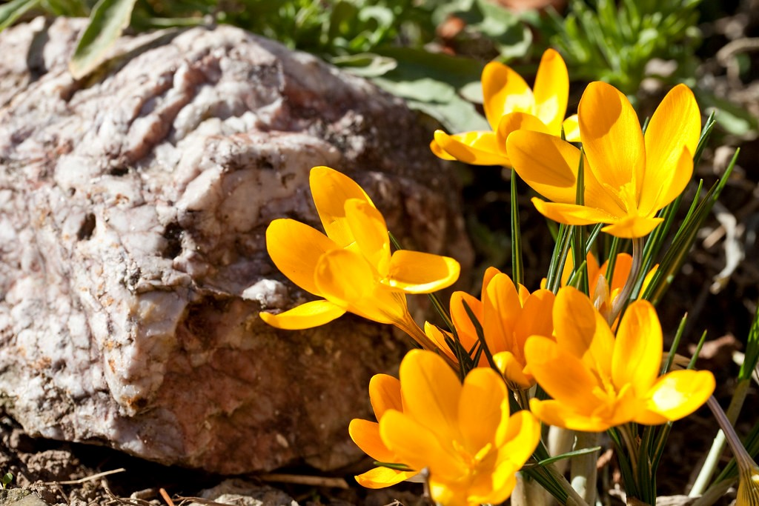
Creating an OER Strategic Plan, Generally Speaking….
Provides framework for support of OER policy and expanded OEP
Answers the “How” question
Acknowledges that “free” is not without cost
Notes:
Answers the “How?”
- Need support in terms of staffing as well as technology (not just $$)

Slide 7
Creating an OER Strategic Plan at SAIT
SAIT’s strat plan addresses:
Supporting the adoption of OER
Supporting integration of OER and OEP throughout institution
Providing training and support
Developing infrastructure
Collaborating with external partners
Supports in development:
Comprehensive training program
Integrate OER in current internal funding opportunities
Integrate OER into current curriculum practices
Create project workflow model
Notes:
On left: 5 Strategic goals, each with 3-5 action items
On right:
Funding: (CISCO, Cadmeus grants, scholarly support)
Curriculum: textbook selection, course development/design
Develop OER project workflow to highlight supports, checkpoints, and department & staff roles in process

Slide 8
Lessons Learned, Policy & Program Development
Establish an advisory committee (faculty, admin, and students)
Work within existing structure (grants, off loads, awards, tenure consideration)
Meet faculty were they are (roadshows and listening tours)
Starting tracking statistics early

Slide 9
Integration, Integration, Integration…
Have faculty senate endorse OER
Work with student association to recognize/thank OER faculty
Establish stipends/awards for development projects
Create an online guide for institutional information
Identify no-cost/low-cost/zed cred courses within your catalog
Info sessions for all roles (practitioners, admin, staff, students)
Boost any peer review or collaborative opportunities
Notes:
Integration = Sustainability
Alberta CoP - listserv and proposed yearly Summit

Slide 10
Promotion, Promotion, Promotion!
Notes:
Activities included: OER Petting Zoo (see a real live print OER!)
Buttons for students who signed petition
Food (cookies, snacks, coffee break info sessions)
Open Education Week celebrations
Open Access Week celebrations

Slide 11
What’s Happening at Your Institution?

Slide 12
Alberta Post-Secondary Collaborative Pressbooks Program
&
Notes:
Example of Collaboration
University of Alberta - Michelle Brailey, brailey@ualberta.ca
Macewan University - Robyn Hall, hallr27@macewan.ca
Mount Royal University - Cari Merkley, cmerkley@mtroyal.ca
SAIT Polytechnic - Jessica Norman, jessica.norman@sait.ca
University of Calgary - Christie Hurrell, achurrel@ucalgary.ca
University of Lethbridge - Joerdis Weilandt, joerdis.weilandt@uleth.ca
___________________________________________________________________________________
Also:
Robert Lawson, OER Alberta CoP Summit June 21st, NorQuest
Alberta CoP
Contact: Krysta McNutt
General info: albertaoer@googlegroups.com
Encourage non-library folk to join (faculty, Centre for Teaching and Learning, Education Technology, Instructional Designers, etc.)

Slide 13
More Opportunities to Collaborate
Alberta OER Community of Practice
Contact: Krysta McNutt
General info: albertaoer@googlegroups.com
https://groups.google.com/forum/#!forum/albertaoer/join
Canada OER Listserv
https://lists.bccampus.ca/mailman/listinfo/canadaoer

Slide 14
Resources
OER Policies
Green, C., Illowsky, B., Wiley, B., Ernst, D., Young, L., DeRosa, R., & Jhangiani, R. (2018, August 18). 7 things you should know about open education: policies. Retrieved from https://library.educause.edu/-/media/files/library/2018/8/eli7159.pdf
British Columbia Institute of Technology. BCIT’s open educational best practices and guidelines. Burnaby, BC: BCIT. Retrieved from https://open.bcit.ca/oer/islandora/object/oer%3A12/datastream/PDF/download/ citation.pdf. CC-BY-SA 4.0
Coolidge, A., & DeMarte, D. (2016, August). OER policy development tool. Retrieved from http://policy.lumenlearning.com/ CC-BY 4.0
Southern Alberta Institute of Technology. (2018, May 31). Open Educational Resources policy. AC.2.21.1 Calgary, AB: SAIT. Retrieved from https://www.sait.ca/Documents/About20SAIT/Administration/Policies and%20Procedures/AC.2.21.1%20Open%20Educational%20Resources.pdf. CC-BY-SA 4.0
Tidewater Community College. (2016, December 20). Tidewater Community College OER policy. No. 2108. Norfolk, VA: TCC. Retrieved from https://www.tcc.edu/uploads/pdf/policies/tcc-policy-2108.pdf.

Slide 15
Resources
Institutional OER Plans
Achieving the Dream. (n.d.) OER readiness assessment. Retrieved from https://drive.google.com/file/d/ 0B6cbgIt0rhk3VjBISkU1RlZhREk/view.
CCCOER. (n.d.). Eight steps to an institutional plan. Retrieved from https://www.cccoer.org/planning/institutional-planning/. CC-BY 4.0 International
DeFranco, T., McBride, M., Scalzo, K., Brown, A., & Pickett, A. (2016). OER success framework rubric. Albany, NY: SUNY OER Services & SUNY Textbooks. Retrieved from http://hdl.handle.net/1951/67895. CC-BY 3.0 US
Simmons, M. (2017, March 16). ISKME’s Open educational practice rubric. Half Moon Bay, CA: OER Commons. Retrieved from https://www.oercommons.org/authoring/20997-iskme-s-open-educational-practice-rubric/view. CC-BY-NC-SA 4.0 International.

Slide 16
Resources
OER Strategic Planning
Achieving the Dream. (n.d.) OER readiness assessment. Retrieved from https://drive.google.com/file/d/ 0B6cbgIt0rhk3VjBISkU1RlZhREk/view.
Huttner, N., Green, L., & Cowher, R. (2018, August 20). Seeking a sustainable OER ecosystem. New York: Redstone Strategy Group. Retrieved from https://www.redstonestrategy.com/wp-content/uploads/ 2018/08/Seeking-a-sustainable-OER-ecosystem.pdf. CC-BY 4.0
Jhangiani, R. KPU open education strategic plan 2018-2023. Surrey, BC: KPU. Retrieved from https://press books.bccampus.ca/kpuopeneducation/chapter/introduction/. CC-BY 4.0
Jhangiani, R. S., Pitt, R., Hendricks, C., Key, J., & Lalonde, C. (2016). Exploring faculty use of open educational resources at British Columbia post-­‐secondary institutions. BCcampus Research Report. Victoria, BC: BCcampus. Retrieved from https://bccampus.ca/files/2016/01/BCFacultyUseOfOER_final.pdf. CC-BY 3.0
Southern Alberta Institute of Technology. (2019, March). Strategic OER goals at SAIT. Retrieved from http://libguides.sait.ca/OER CC-BY 4.0.

Slide 17
Images
Cszmurlo. (2007, January 28) The Three Sisters Szmurlo. [image]. Retrieved from https://commons.wikimedia.org/wiki/File:The-Three-Sisters-Szmurlo.jpg. CC-BY-SA 2.5
e.backlund. (n.d.) Cat with Kittens. [image]. Retrieved from https://www.publicdomainpictures.net/en/view-image.php?image=285088&picture=cat-with-kittens. CC0 1.0
Huang, J. (2016, June 10). Spring at Lake Louise. [image]. Retrieved from https://www.flickr.com/photos/50663863@N02/27688654666. CC-BY 2.0 Generic
Myriam. (2018, February 5) Spring awakening crocus flower snow cover. [image]. Retrieved from https://pixabay.com/en/spring-awakening-crocus-flower-snow-3132112/. CC0 1.0

